Slide 1
Gamma-ray astronomy with Imaging Air Cherenkov Telescopes
Lecture 2
Christian Stegmann
International School of Cosmic Ray Astrophysics
Erice, July, 2022

Slide 2
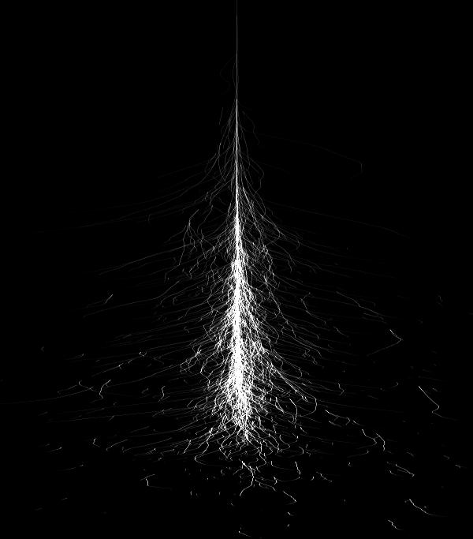
Summary lecture 1
What we know so far
Cherenkov telescopes (few 100 GeV)
  50 h, eff. area 50000 m²
  10⁻¹² ph/cm²s ~ 5.10⁻¹³ erg/cm²s
Gamma ray SED = Proton SED times cross section, convolved with p→gamma SED
Supernova remnants
  F(>1TeV) ≈ 3.5.10⁻¹¹ E₅₁ n/d²_{kpc}erg/cm²s,
  at 1…10 TeV
  We see them ☺
Photon

Slide 3
RX J1713-3946
The best studied SNR in VHE gamma-rays
Is this a proton or electron accelertor?

Slide 4

Radiation processes
involving electrons

Slide 5

This diagram describes …
… everything
e
+ ….
low energy
photon in
high energy
photon out
t

Slide 6
This diagram describes …
… Compton Scattering
e
+ ….
microwave background,
infrared, visible,
UV, X-ray photon
high energy
photon out
t

Slide 7

This diagram describes …
… Bremsstrahlung
e
+ ….
virtual photon
of nuclear
electric field
high energy
photon out
t

Slide 8
This diagram describes …
… Synchrotron Radiation
e
+ ….
⊗
virtual photon
of B field
high energy
photon out
t

Slide 9
This diagram describes …
… Pair production
fringe benefit:
photon absorption by
pair production
e
+ ….
microwave background,
infrared, visible,
UV, X-ray photon
high energy
photon out
t

Slide 10
Exact treatment & detailed discussion
THE reference:
Bremsstrahlung, Synchrotron Radiation, and Compton Scattering of High-Energy Electrons Traversing Dilute Gases
Blumenthal & Gould, Reviews of Modern Physics, vol. 42, pp. 237-271

Slide 11
Inverse Compton Scattering

Slide 12
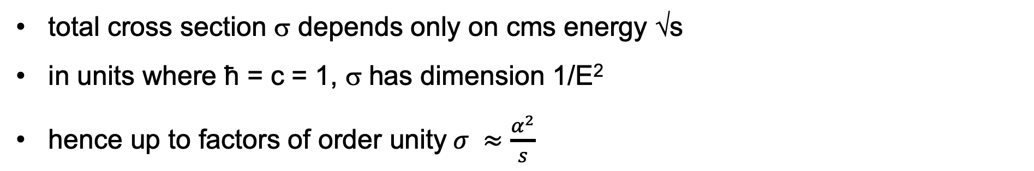
Cross section
e
α = 1/137
α
+ ….
microwave background,
infrared, visible,
UV, X-ray photon
high energy
photon out
t
total cross section σ depends only on cms energy √s
in units where ħ = c = 1, σ has dimension 1/E²
hence up to factors of order unity$σ ≈\frac{α^{2}}{s}$

Slide 13

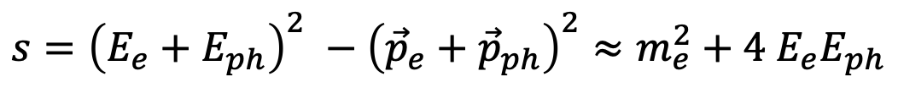
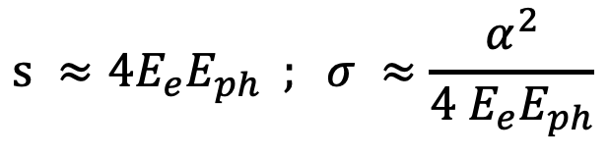

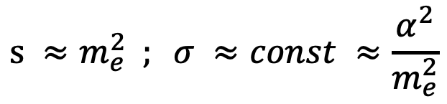

Cross section
for simplicity, consider head-on collision
Thomson limit
Klein-Nishina limit
$$s={\left(E_{e}+E_{ph}\right)}^{2} −{\left({\vec{p}}_{e}+{\vec{p}}_{ph}\right)}^{2}≈m_{e}^{2}+4 E_{e}E_{ph}$$
$$E_{e}≫m_{e}$$
$$4 E_{e}E_{ph}≪m_{e}^{2}$$
$$s ≈m_{e}^{2} ; σ ≈const ≈\frac{α^{2}}{m_{e}^{2}}$$
$$4 E_{e}E_{ph}≫m_{e}^{2}$$
$$s ≈4E_{e}E_{ph} ; σ ≈\frac{α^{2}}{4 E_{e}E_{ph}}$$

Slide 14
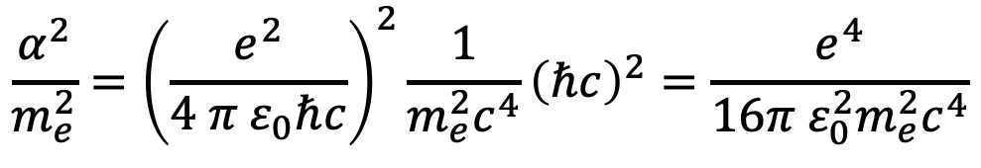


Cross section
In useful units
Correct answer is 16 → 6
“Thomson cross section” $6.6 ∙{10}^{−29} m^{2}$
$$\frac{α^{2}}{m_{e}^{2}}={\left(\frac{e^{2}}{4 π ε_{0}ℏc}\right)}^{2}\frac{1}{m_{e}^{2}c^{4}}{\left(ℏc\right)}^{2}=\frac{e^{4}}{16π ε_{0}^{2}m_{e}^{2}c^{4}}$$
$$ℏc ≈200 MeV fm$$

Slide 15



Kinematics
e
α = 1/137
α
+ ….
microwave background,
infrared, visible,
UV, X-ray photon
high energy
photon out
t
$$s=m^{∗2}≈m_{e}^{2}+4 E_{e}E_{ph}$$
$$E_{e}≫m_{e}$$
Thomson limit
$$4 E_{e}E_{ph}≪m_{e}^{2}$$

Slide 16

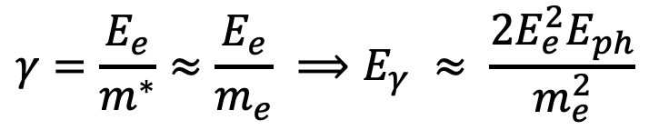
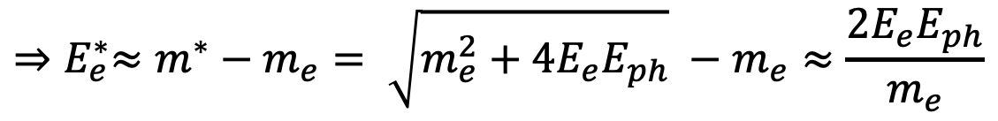
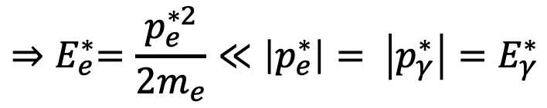

Kinematics
m*
CM frame
Thomson limit
all energy carried by gamma
Lab frame: boost by
$E_{γ}^{∗}= \left|p_{γ}^{∗}\right|$ = $\left|p_{e}^{∗}\right|$
$$p_{e}^{∗}≪m_{e}$$
$${⇒E}_{e}^{∗}=\frac{p_{e}^{∗2}}{2m_{e}}≪\left|p_{e}^{∗}\right|= \left|p_{γ}^{∗}\right|=E_{γ}^{∗}$$
$${⇒E}_{e}^{∗}≈m^{∗}−m_{e}= \sqrt{m_{e}^{2}+4E_{e}E_{ph}} −m_{e}≈\frac{2E_{e}E_{ph}}{m_{e}}$$
$$γ=\frac{E_{e}}{m^{∗}}≈\frac{E_{e}}{m_{e}} ⟹E_{γ} ≈ \frac{2E_{e}^{2}E_{ph}}{m_{e}^{2}}$$

Slide 17
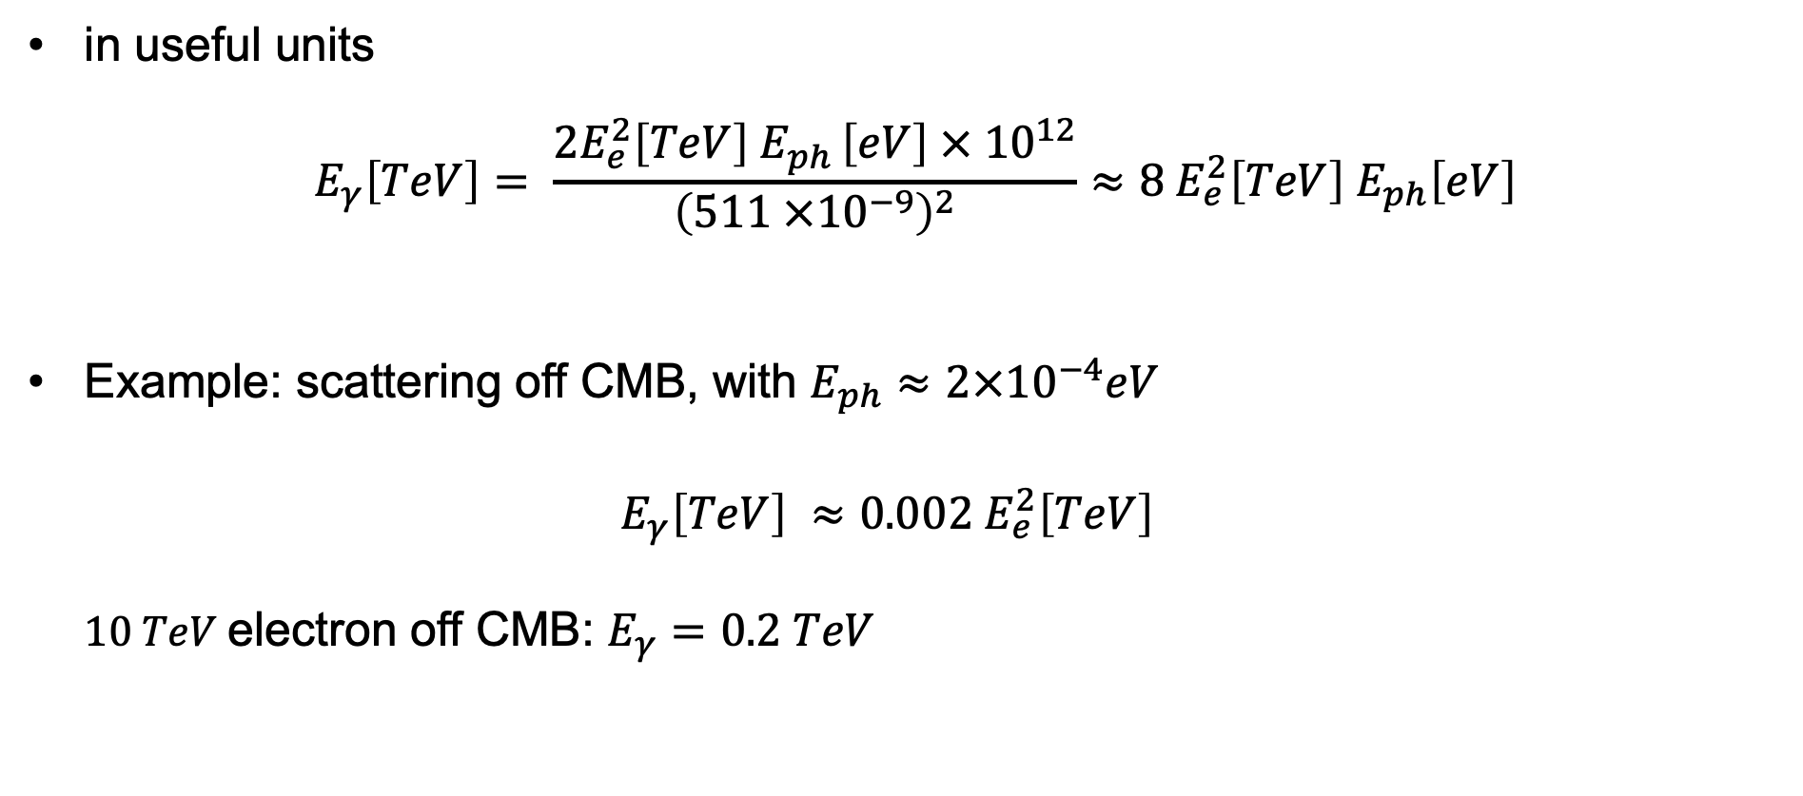
Kinematics
in useful units
$$E_{γ}\left[TeV\right]= \frac{2E_{e}^{2}\left[TeV\right] E_{ph }\left[eV\right] × {10}^{12}}{{\left(511 ×{10}^{−9}\right)}^{2}}≈8 E_{e}^{2}\left[TeV\right] E_{ph}\left[eV\right]$$
Example: scattering off CMB, with $E_{ph}≈2×{10}^{−4}eV$
$E_{γ}\left[TeV\right] ≈0.002 E_{e}^{2}\left[TeV\right]$
  $10 TeV$electron off CMB: $E_{γ}=0.2 TeV$
Notes:
What about energy conservation, E_gamma scales with E_e^2?

Slide 18
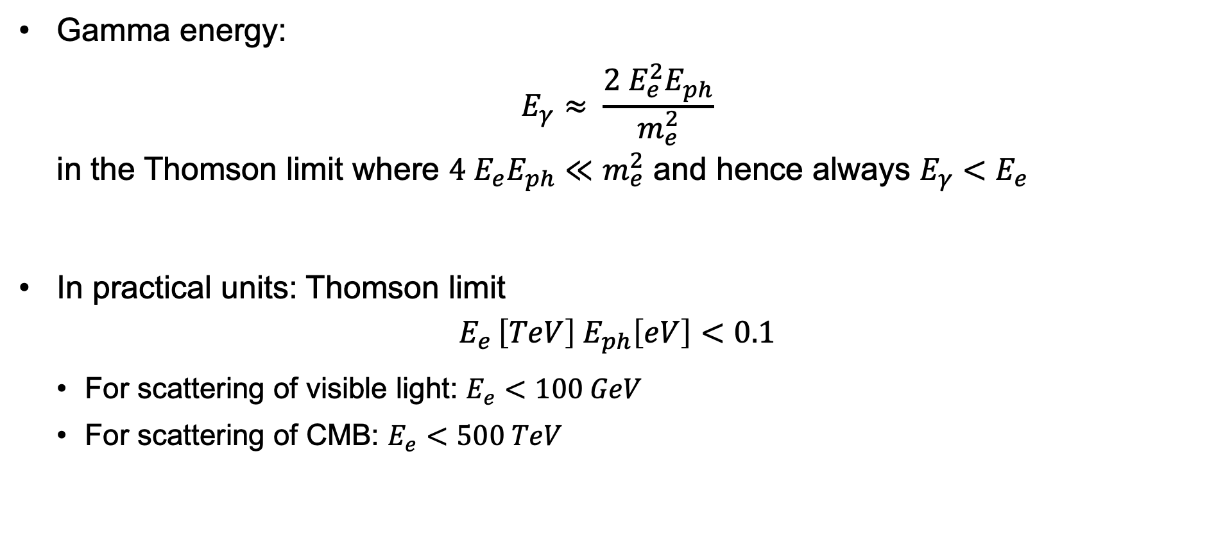
Kinematics
Gamma energy:
$E_{γ}≈ \frac{2 E_{e}^{2}E_{ph}}{m_{e}^{2}}$
in the Thomson limit where $4 E_{e}E_{ph}≪m_{e}^{2}$ and hence always $E_{γ}<E_{e}$
In practical units: Thomson limit
$E_{e }\left[TeV\right] E_{ph}\left[eV\right]<0.1$
  For scattering of visible light: $E_{e}<100 GeV$
  For scattering of CMB: $E_{e}<500 TeV$

Slide 19

Kinematics
Gamma energy:
$E_{γ}≈E_{e}^{2}E_{ph}$
Spectrum:
$\frac{dN}{dE_{γ}}=\frac{dN}{dE_{e}}\frac{dE_{e}}{dE_{γ}} \sim E_{e}^{−α}E_{γ}^{−\frac{1}{2}}$
${{\sim \left(E_{γ}^{−\frac{1}{2}}\right)}^{−α}E}_{γ}^{−\frac{1}{2}}=E_{γ}^{−\left(α+1\right)/2}$
→ Gamma spectral index is $(α+1)/2$

Slide 20
Gamma SED
Electron SED

Slide 21
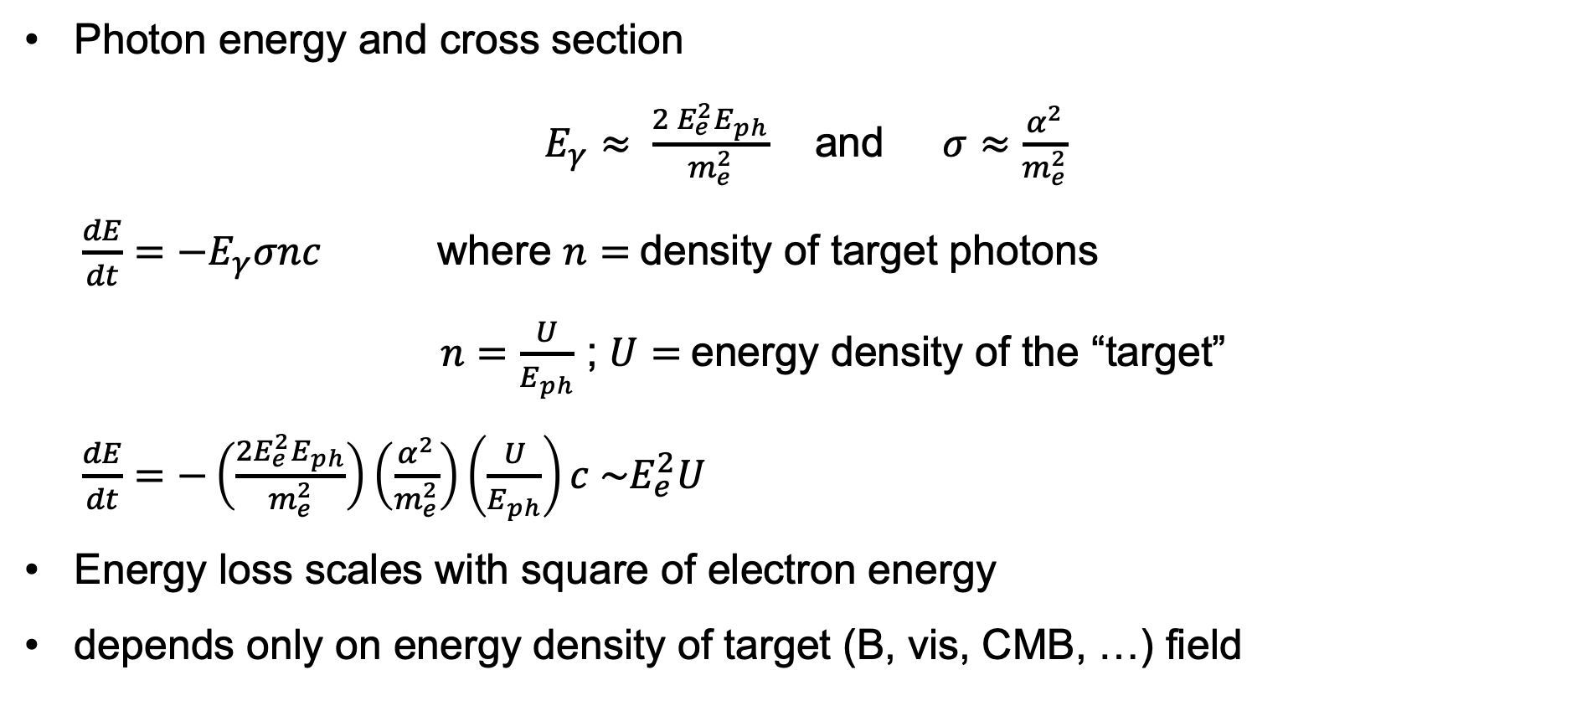
Energy loss rate
Photon energy and cross section
$E_{γ}≈ \frac{2 E_{e}^{2}E_{ph}}{m_{e}^{2}}$ and $σ≈\frac{α^{2}}{m_{e}^{2}}$
$\frac{dE}{dt}=−E_{γ}σnc$ where $n=$density of target photons
$n=\frac{U}{E_{ph}}$ ; $U=$energy density of the “target”
$\frac{dE}{dt}=−\left(\frac{2E_{e}^{2}E_{ph}}{m_{e}^{2}}\right)\left(\frac{α^{2}}{m_{e}^{2}}\right)\left(\frac{U}{E_{ph}}\right)c \sim E_{e}^{2}U$
Energy loss scales with square of electron energy
depends only on energy density of target (B, vis, CMB, …) field

Slide 22
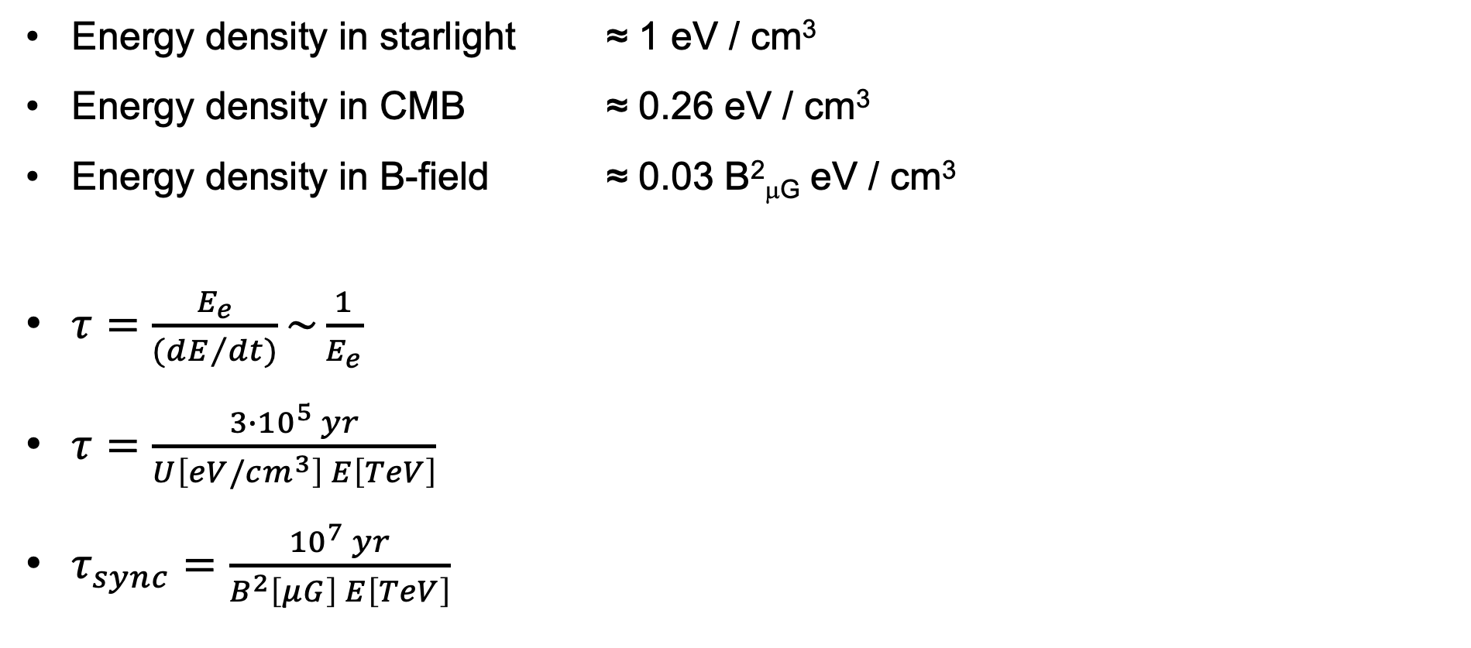
Energy loss rate
Energy density in starlight ≈ 1 eV / cm³
Energy density in CMB ≈ 0.26 eV / cm³
Energy density in B-field ≈ 0.03 B²_{μG} eV / cm³
$τ=\frac{E_{e}}{({dE}/{dt})}\sim \frac{1}{E_{e}}$
$τ=\frac{3∙{10}^{5} yr}{U\left[eV/cm^{3}\right] E\left[TeV\right]}$
$τ_{sync}=\frac{{10}^{7} yr}{B^{2}\left[μG\right] E\left[TeV\right]}$
Energy density in
3 μG field ≈ CMB
for typical eV energy densities in target fields and multi-TeV electrons, loss time O(10⁵) y

Slide 23
IC scattering loss history
Blumenthal & Gould, RMP 42

Slide 24
Synchrotron radiation

Slide 25
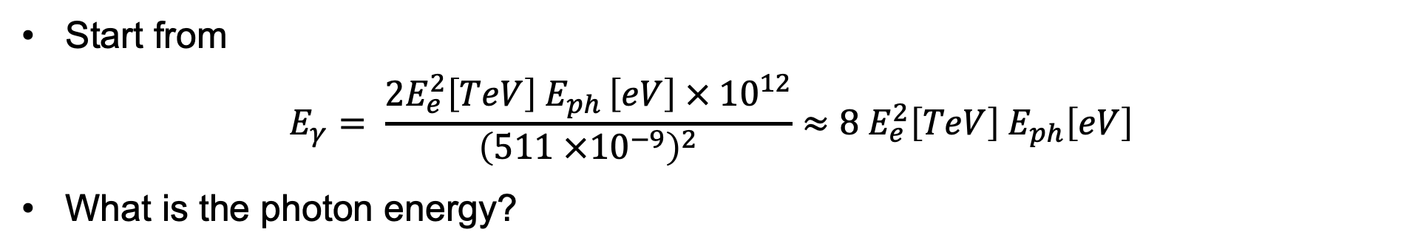

This diagram describes …
… Synchrotron Radiation
e
+ ….
$$E_{ph}$$
⊗
Start from
$E_{γ}= \frac{2E_{e}^{2}\left[TeV\right] E_{ph }\left[eV\right] × {10}^{12}}{{\left(511 ×{10}^{−9}\right)}^{2}}≈8 E_{e}^{2}\left[TeV\right] E_{ph}\left[eV\right]$
What is the photon energy?

Slide 26
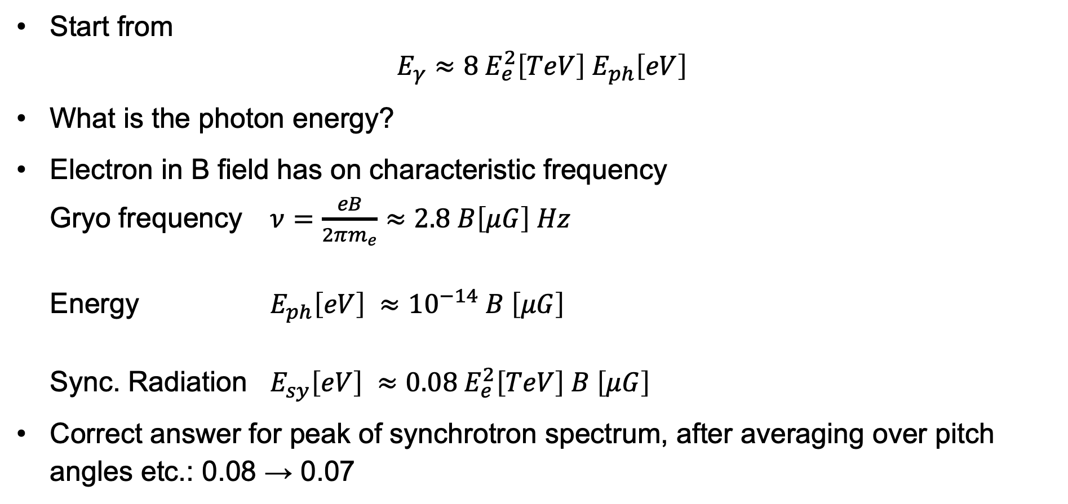
Synchrotron radiation energy
Start from
$E_{γ}≈8 E_{e}^{2}\left[TeV\right] E_{ph}\left[eV\right]$
What is the photon energy?
Electron in B field has on characteristic frequency
Gryo frequency $ν=\frac{eB}{2πm_{e}}≈2.8 B\left[μG\right] Hz$
Energy $E_{ph}\left[eV\right] ≈{10}^{−14} B \left[μG\right]$
Sync. Radiation $E_{sy}\left[eV\right] ≈0.08 E_{e}^{2}\left[TeV\right] B \left[μG\right]$
Correct answer for peak of synchrotron spectrum, after averaging over pitch angles etc.: 0.08 → 0.07

Slide 27
Examples: the full
radiation panorama

Slide 28
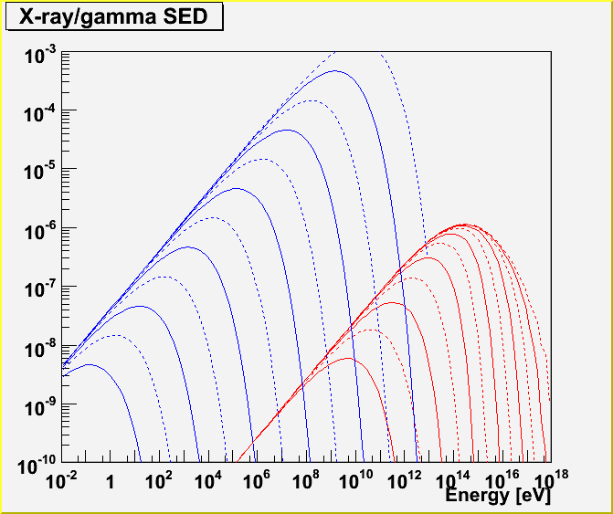
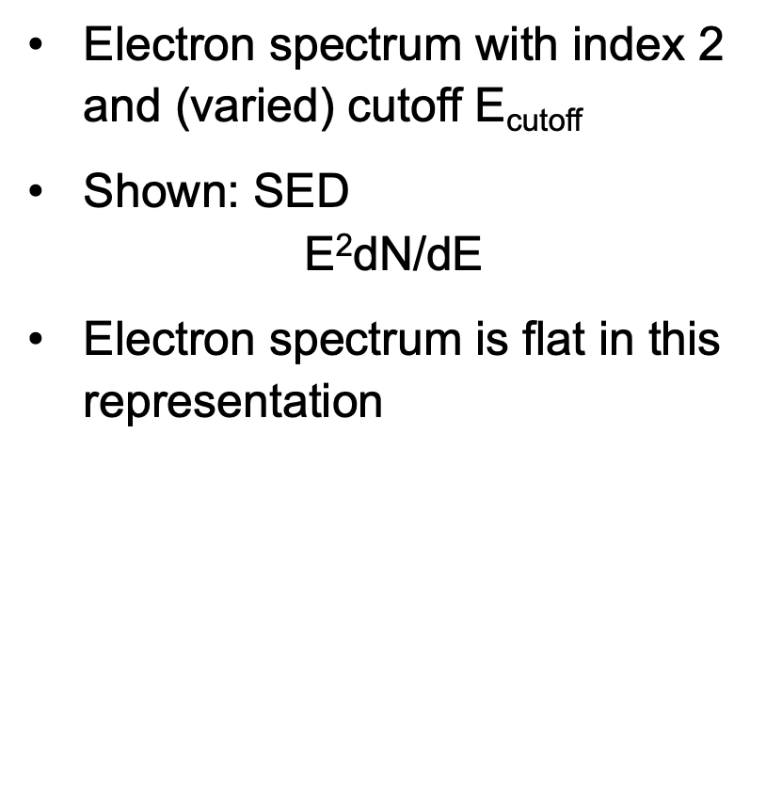

From electrons to gamma rays
Werner Hofmann
Electron spectrum with index 2 and (varied) cutoff E_{cutoff}
Shown: SED
$\text{E}\text{2}\text{dN}\text{/}\text{dE}$
Electron spectrum is flat in this representation
$$\text{E}\text{2}\text{dN}\text{/}\text{dE}$$
Sync.
3μG
IC on CMB
100 TeV
10 TeV
1 TeV
Numerical integration of
exact expressions incl. CMB spectrum

Slide 29
From electrons to gamma rays
Werner Hofmann
Electron spectrum with index 2 and (varied) cutoff E_{cutoff}
Synchr. (and IC) photon index
  α = (α_{e}+1)/2 = 1.5 for α_{e}=2
$$\text{E}\text{2}\text{dN}\text{/}\text{dE}$$
Sync.
3μG
IC on CMB
100 TeV
10 TeV
1 TeV

Slide 30
From electrons to gamma rays
Werner Hofmann
Electron spectrum with index 2 and (varied) cutoff E_{cutoff}
Peak sync. energy
E_{eV} ~ 0.01 E_{cutoff,TeV}² B_{μg}
Peak sync. Intensity ~ E_{cutoff} B²
$$\text{E}\text{2}\text{dN}\text{/}\text{dE}$$
Sync.
3μG
IC on CMB
(differs somewhat from coefficient 0.07 for monoenergetic electrons due to convolution with power law spectrum)
100 TeV
10 TeV
1 TeV

Slide 31
From electrons to gamma rays
Werner Hofmann
Electron spectrum with index 2 and (varied) cutoff E_{cutoff}
For typical conditions
W_{B} ~ W_{CMB}
hence I_{sync} ~ I_{IC}
$$\text{E}\text{2}\text{dN}\text{/}\text{dE}$$
Sync.
3μG
IC on CMB
100 TeV
10 TeV
1 TeV

Slide 32
From electrons to gamma rays
Werner Hofmann
Electron spectrum with index 2 and (varied) cutoff E_{cutoff}
IC on CMB:
E_{γ,TeV} ~ 0.003 E_{e,TeV}²
$$\text{E}\text{2}\text{dN}\text{/}\text{dE}$$
Sync.
3μG
IC on CMB
100 TeV
had estimated 0.002
as coefficient
10 TeV
1 TeV

Slide 33
From electrons to gamma rays
Werner Hofmann
Electron spectrum with index 2 and (varied) cutoff E_{cutoff}
IC strongly reduced in Klein-Nishina regime
4 ε γ_{e}/m > 1
$$\text{E}\text{2}\text{dN}\text{/}\text{dE}$$
Sync.
3μG
IC on CMB
100 TeV
10 TeV
1 TeV

Slide 34
Radiation cooling

Slide 35
Spectra & radiation cooling
Cooling modifies particle spectra
dE/dt = const (Ionization losses)
➜ relative losses stronger for low-energy particles
➜ spectra become harder
dE/dt ~ E (Bremsstrahlung, IC in KN regime)
➜ relative losses same for all particles
➜ (power-law) spectra keep their shape
dE/dt ~ E² (Synchrotron, IC)
➜ relative losses stronger for high-energy particles
➜ spectra become steeper

Slide 36
Spectral energy distribution of RX J1713.7-3946
RX J1713.7-3946
Berezkho & Völk
astro/ph-0602177
Synchrotron
~B²
d = 1 kpc
E = 1.8.10⁵¹ erg
M = 3.5 M_{Sun}
ρ(r)= 0.01 … 10 /cm³
B = 126 μG
e/p= 10⁻⁴
~10 μG
Elektron IC

Slide 37
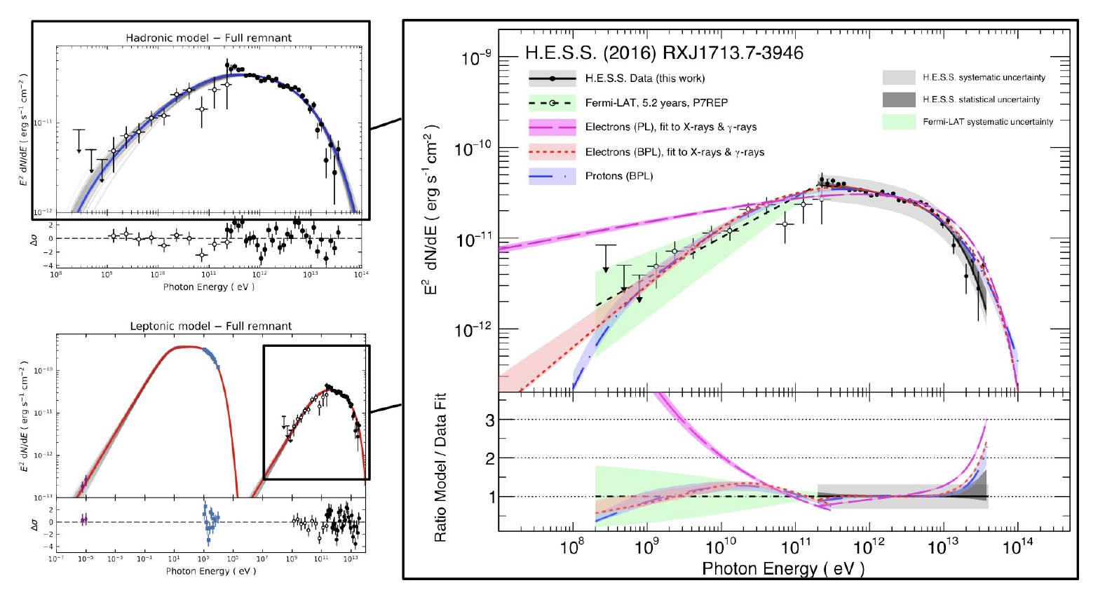
Precision Measurements: RX J1713.7-3946
Leptonic vs hadronic models
A&A 612 (2018), A6

Slide 38
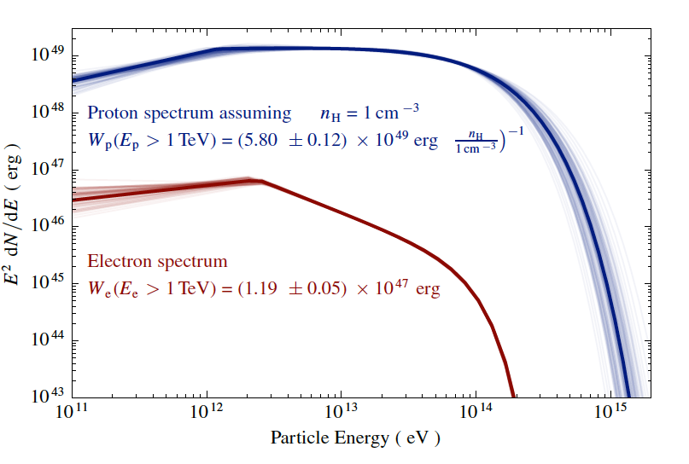
Precision Measurements: RX J1713.7-3946
Parent energy distributions
A&A 612 (2018), A6

Slide 39
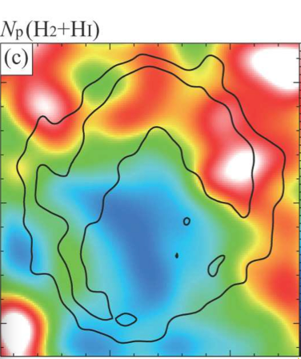
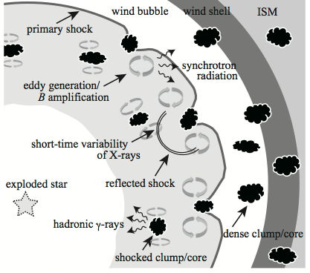
Targets in the vicinity of RX J1713.7-3946
Penetration depth into dense clouds ~E^{0.5}
→ Target mass ~E^{0.5}
→ Spectra ~E^{-2.0+0.5}
Distribution of Hydrogen:
Clouds
Fukui et al. arXiv:1107.0508
Inoue et al. arXiv:1106.3080

Slide 40
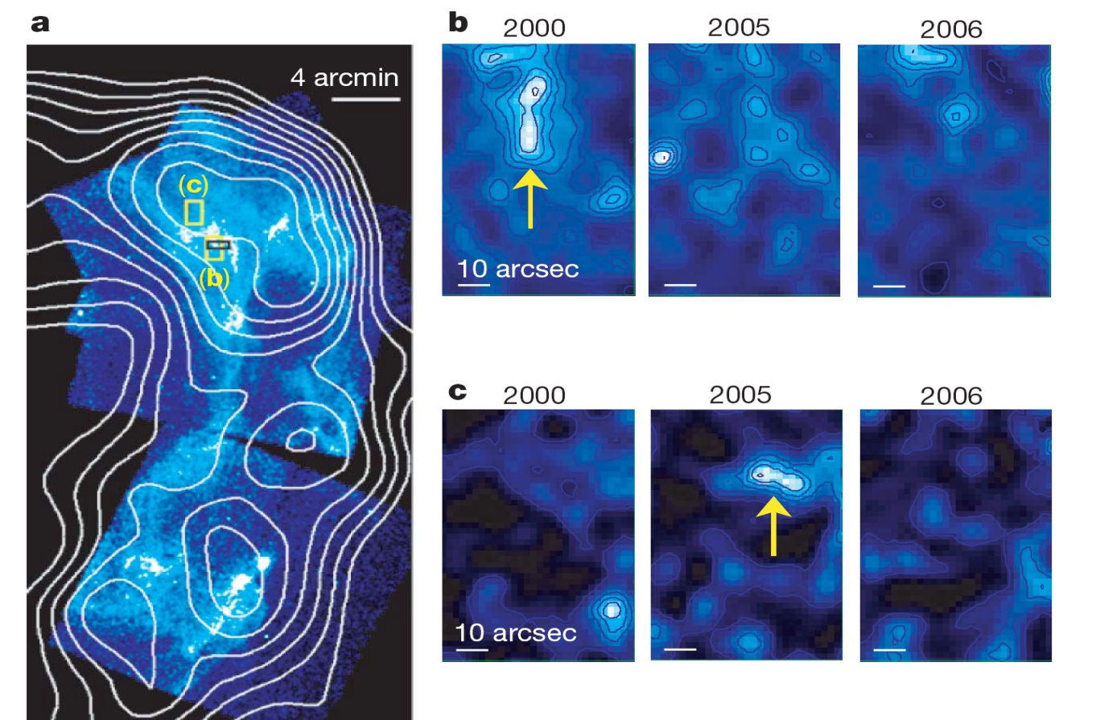
Magnetic fields in SNR RX1713-3946
Röntgen ,Chandra
Uchiyama et al. 2007
→ Magnetic fields 0.1 – 1 mG

Slide 41
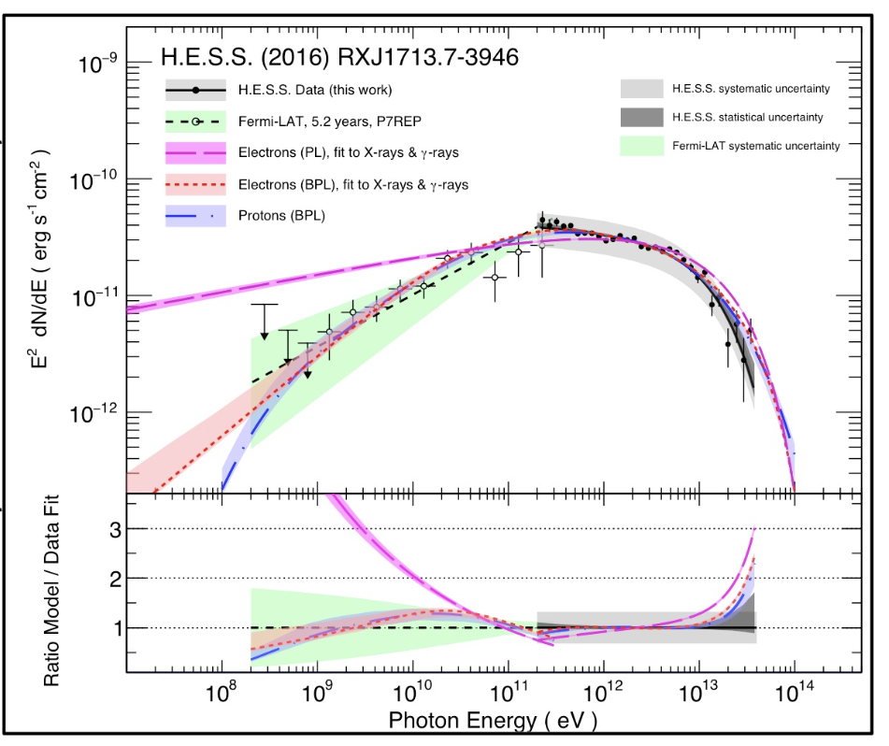
Precision Measurements: RX J1713.7-3946
Leptonic vs hadronic models
Spectrum best described by broken power-law +
exponential cutoff
Hadronic model
  Break results from higher energy CRs diffusing faster into cold, dense MC clumps (e.g. Gabici & Aharonian 2014)
  E_{break} depends on SNR age and density profile; E_{c} ~100 TeV
Leptonic model
  B ~ 10 – 15 μG, E_{break} ~2 TeV
  Break requires 2nd electron population, or additional seed photon field
  Detailed hydro-CR codes can reproduce observed emission
→ No clear case for either leptonic or hadronic accelerator
→ Improved 20 – 100 TeV coverage required

Slide 42
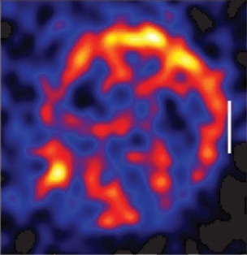
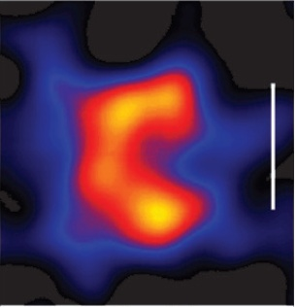
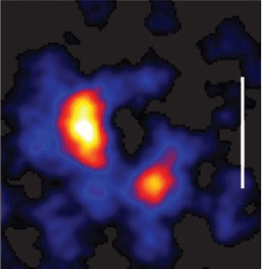
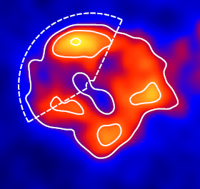
Shell-type supernova remnants in TeV gamma-rays
RX J0852.0-4622
RCW 86
SN1006
H.E.S.S.
H.E.S.S.
H.E.S.S.
RX J1713.7-3946
The sample is increasing
HESS J1731-347
H.E.S.S.
H.E.S.S.

Slide 43
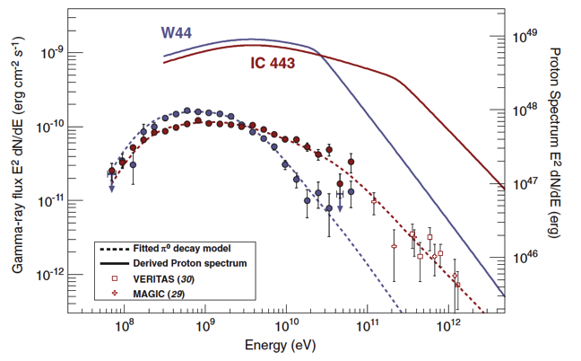
FERMI sees the Pion bump
Science 339, 2013

Slide 44
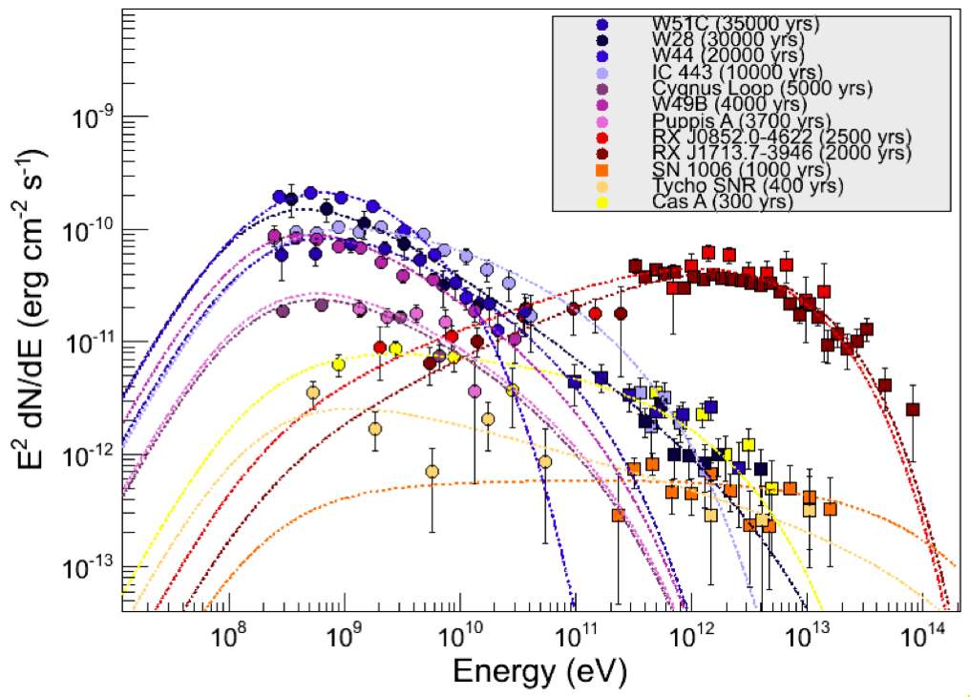
GeV-TeV spectra of supernova remnants
from S. Funk
TeVPA 2011

Slide 45
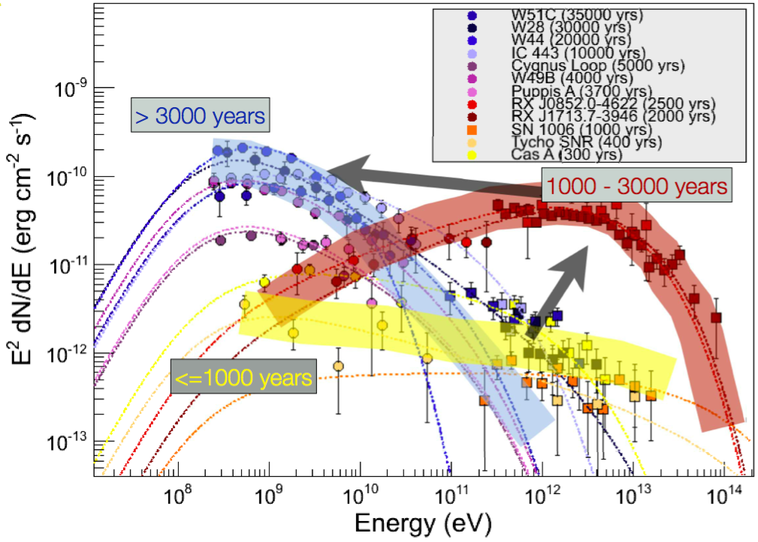
GeV-TeV spectra of supernova remnants
from S. Funk
TeVPA 2011

Slide 46
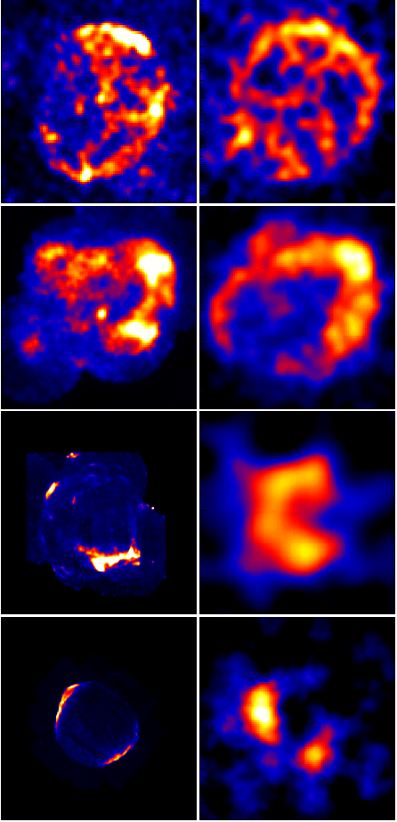
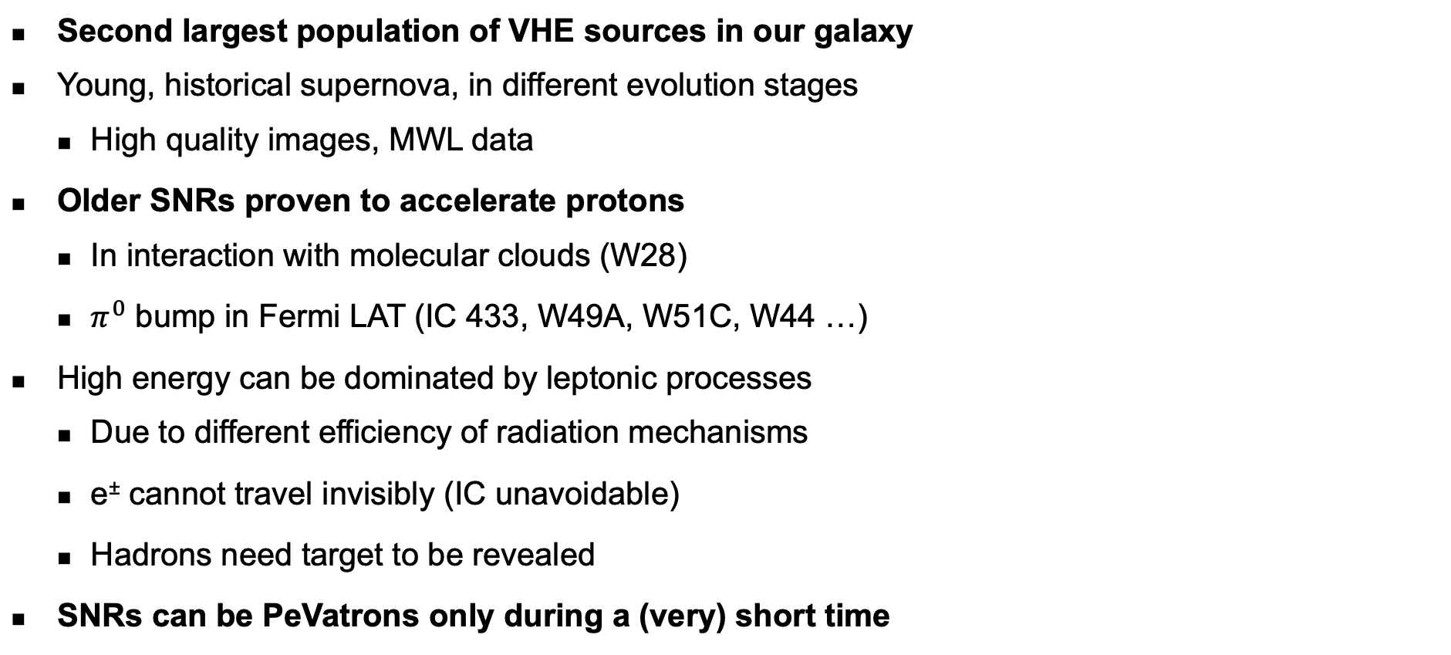
Supernova Remnants
Second largest population of VHE sources in our galaxy
Young, historical supernova, in different evolution stages
  High quality images, MWL data
Older SNRs proven to accelerate protons
  In interaction with molecular clouds (W28)
  $π^{0}$ bump in Fermi LAT (IC 433, W49A, W51C, W44 …)
High energy can be dominated by leptonic processes
  Due to different efficiency of radiation mechanisms
  e± cannot travel invisibly (IC unavoidable)
  Hadrons need target to be revealed
SNRs can be PeVatrons only during a (very) short time
X rays
γ rays

Slide 47
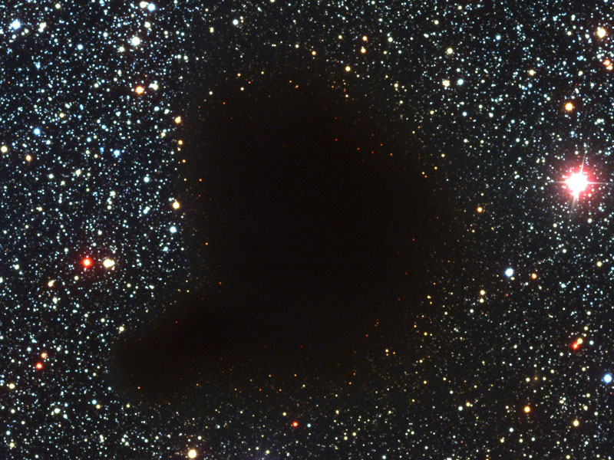

Seeing molecular clouds in gamma rays

Slide 48
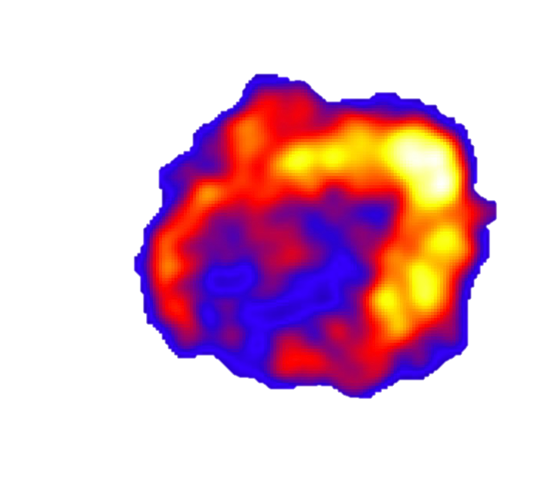
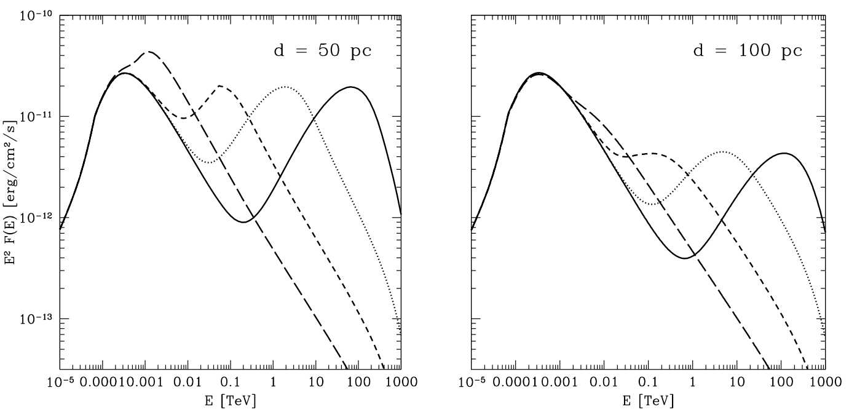
Beam meets target: Supernova remnants & Clouds
500
yr
2000
yr
8000
yr
32000
yr
Gabici et al, arXiv:0901.4549

Slide 49
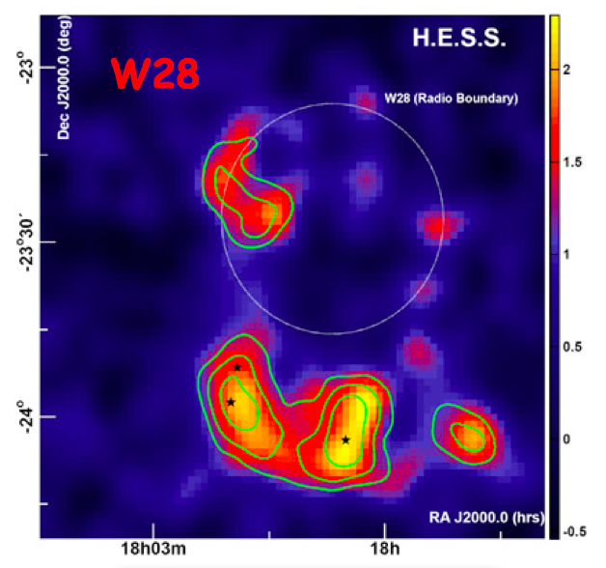
The SNR W28
HESS:
Aharonian et al., arXiv:0801.3555
Fermi:
Abdo et al., ApJ 718 (2010) 348
AGILE
Giuliani et al., arXiv:1005.0784
Models:
Gabici et al., arXiv:1009.5291
Li & Chen, arXiv:1009.0894
Ohira et al., arXiv:1007.4869
CRs escaping from
35-150 kyr old SNR
interacting with clouds?

Slide 50
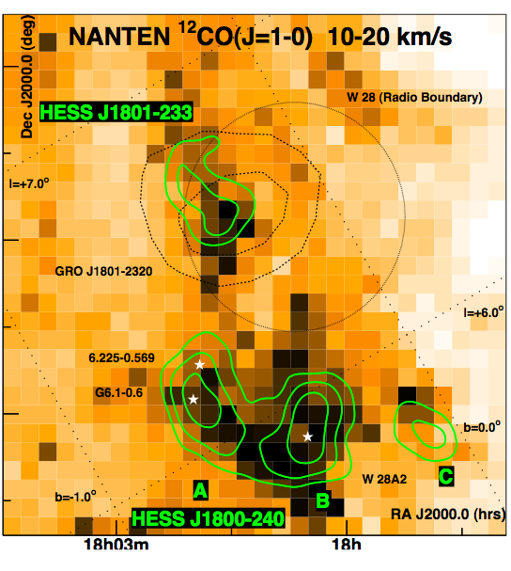
The SNR W28 & clouds seen in CO

Slide 51
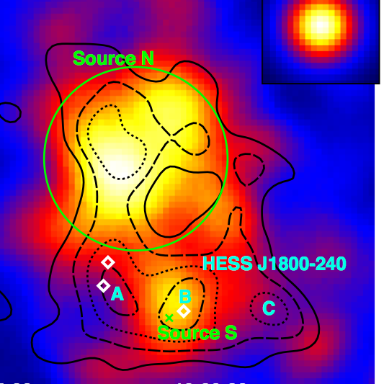
The SNR W28 @ TeV and GeV
Fermi
Notes:
One interpretation: CRs diffuse faster @ TeV energies
GeV CRs have not yet reached all clouds

Slide 52
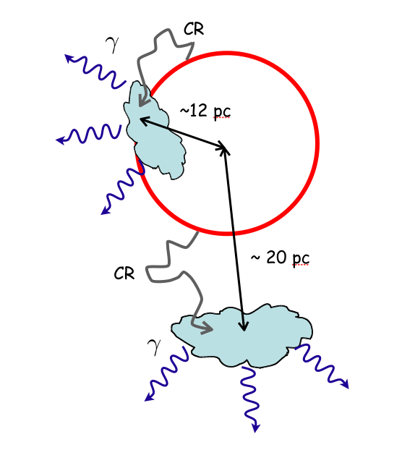
from
S. Gabici

Slide 53

from
S. Gabici
GeV &
TeV γ
GeV CR
diffusion
radius
TeV γ
only
GeV &
TeV γ
TeV γ
only
TeV CR
diffusion
radius

Slide 54
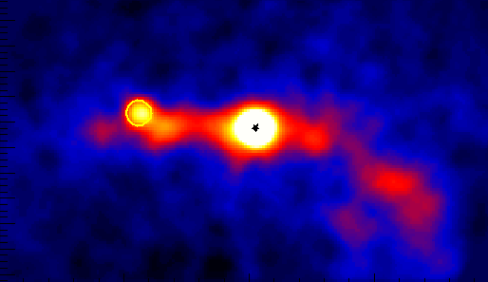
The Galactic Center

Slide 55
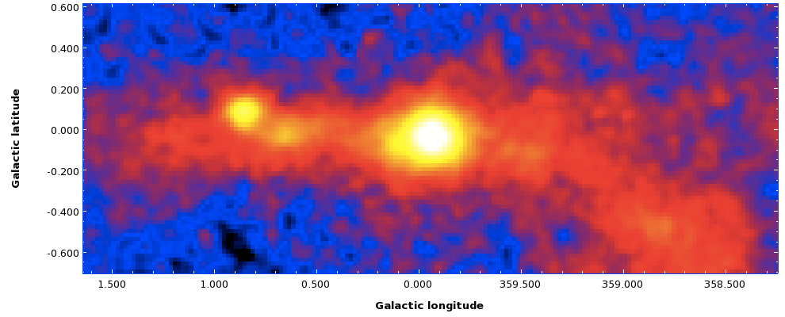
High Precision Measurement of the Galactic Center
H.E.S.S.
Full dataset: 2004 – 2012 (220 hours)

Slide 56
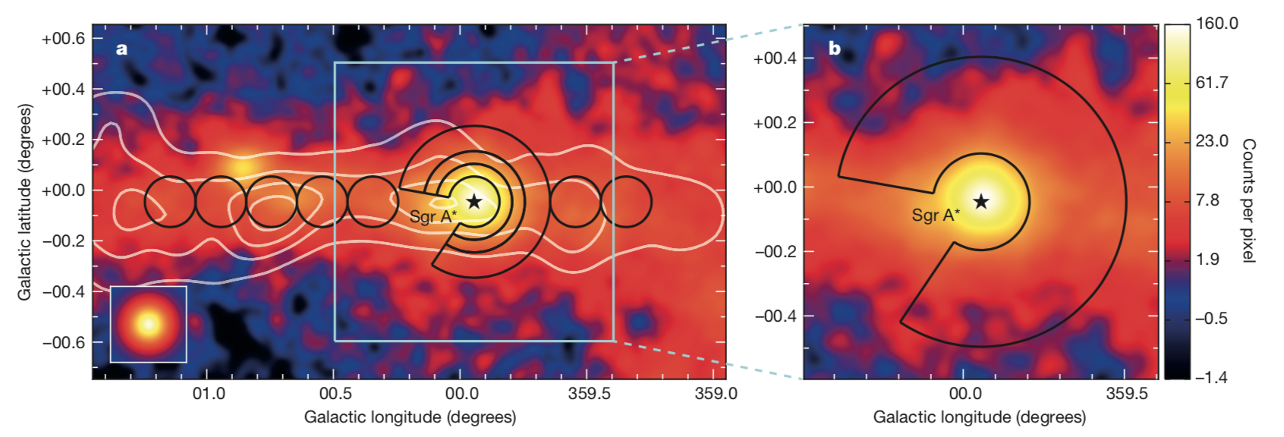
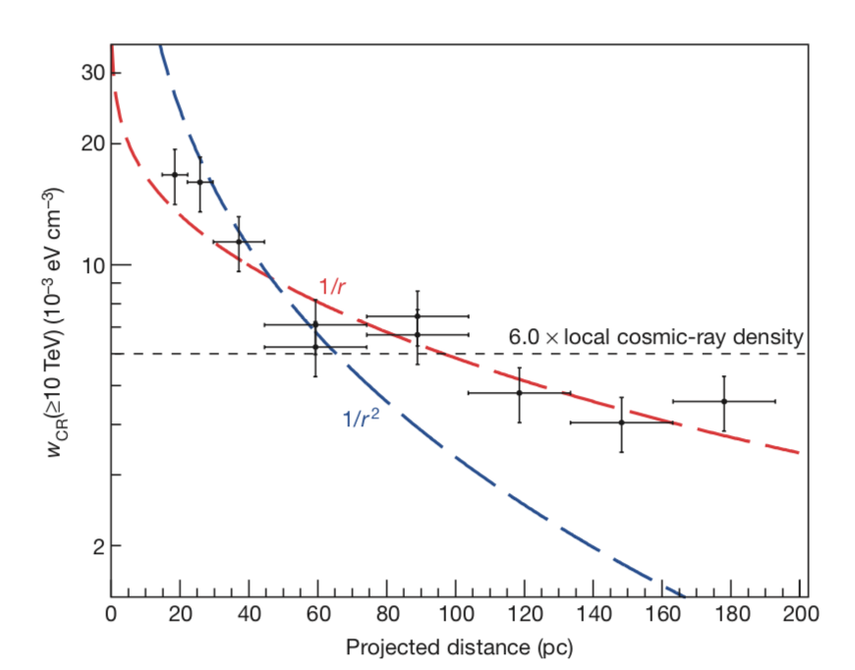
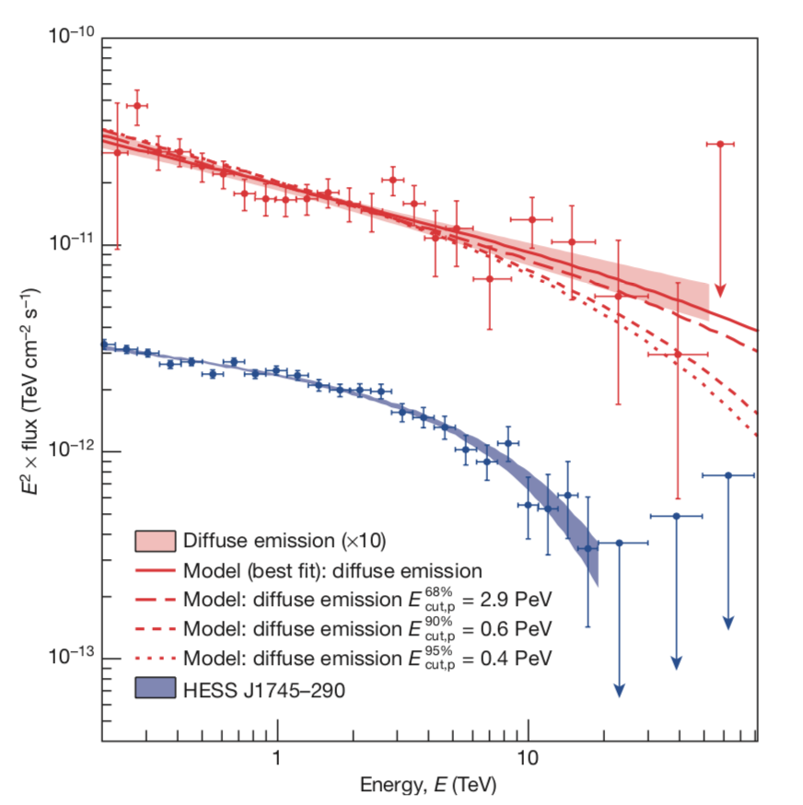
High Precision Measurement of the Galactic Center
Radial distribution of cosmic rays
Energy spectra
Nature 531 (2016) 476

Slide 57
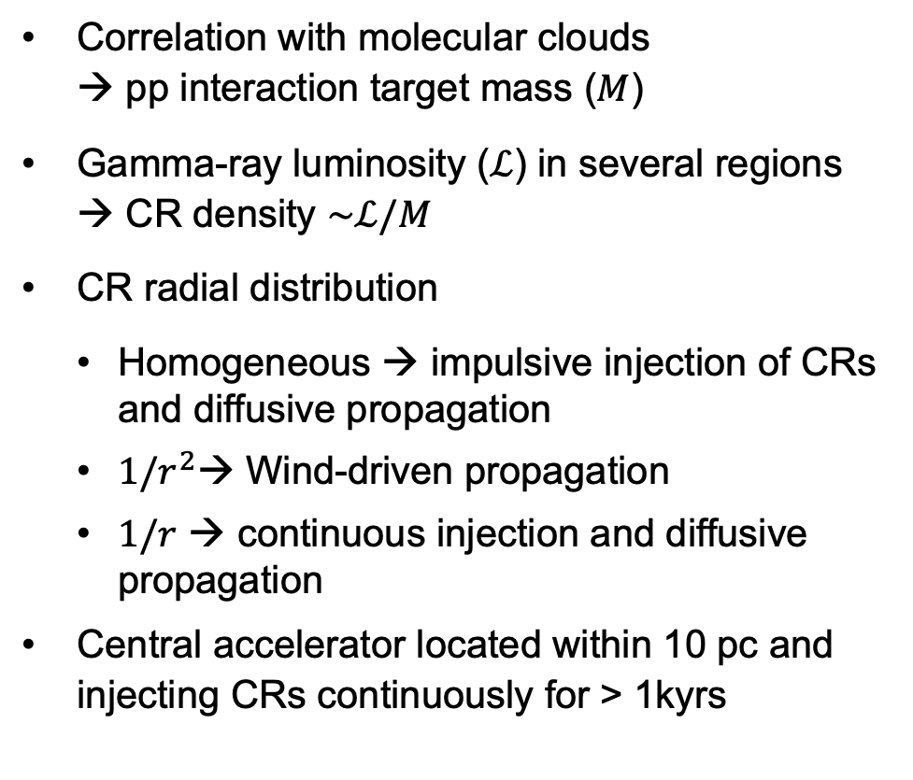


Cosmic-ray Density Distribution
Correlation with molecular clouds
→ pp interaction target mass ($M$)
Gamma-ray luminosity ($ℒ$) in several regions
→ CR density $\sim ℒ/M$
CR radial distribution
  Homogeneous → impulsive injection of CRs and diffusive propagation
  $1/r^{2}$→ Wind-driven propagation
  $1/r$ → continuous injection and diffusive propagation
Central accelerator located within 10 pc and injecting CRs continuously for > 1kyrs
Diffusion regime,
continuous injection $\sim 1/r$
Wind advection regime ~ $1/r^{2}$

Slide 58
Diffuse Emission and Injection Spectra
Diffuse gamma-ray spectrum
  E^{-2.3} up to 50 TeV w/o cutoff
Assume central source of protons
  fit resulting gamma-ray spectrum to HESS data
Proton injection spectrum:
  E^{-2.2} power law from GeV to few PeV
  Cut-off
  0.6 PeV at 90% CL
  2.9 PeV at 68% CL
A cosmic PeVatron!
Nature 531 (2016) 476
H.E.S.S.
Notes:
quasi continuous injection lasting 10⁴ years
total CR power injected at the GC ~10³⁸ erg/s
Kelner, S., Aharonian, F. & Bugayov, V. Energy spectra of gamma-rays, electrons and neutrinos produced at proton-proton interactions in the very high energy regime. Phys. Rev. D 74, 034018 (2006); erratum 79, 039901 (2009).

Slide 59
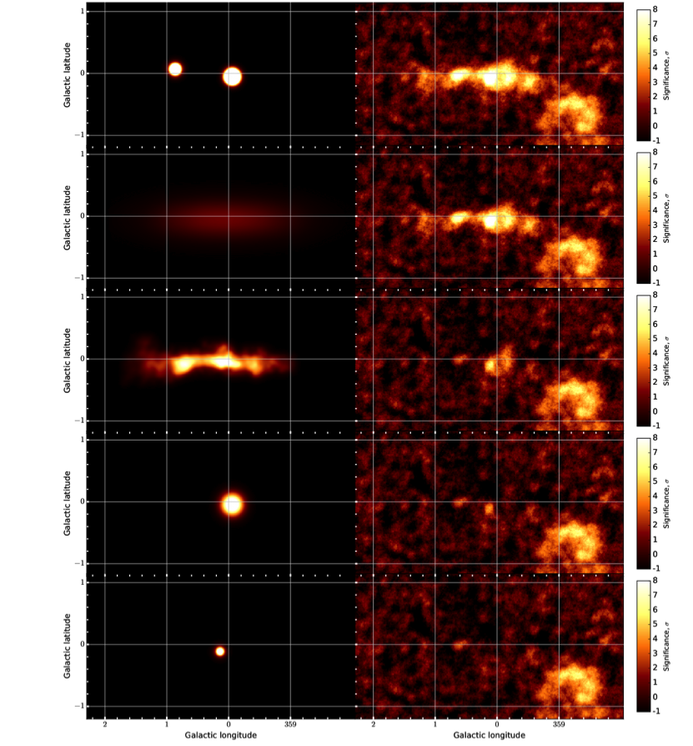
The Galactic Centre region
A busy region
Point sources + galactic emission
Iterative fitting of different components
Confirms central PeVatron
CRs fill the entire CMZ
  ~50% following dense has tracers
  + Large scale component (dark gas? unresolved sources?)
Additional central component of 0.1° (or 14pc extension)
  CRs accelerated at the GC pervading the CMZ?
Arc source HESS J1746-285
  Non thermal filaments in the Radio Arc with high B field (>50μG)
  Nearby molecular clouds
Large scale component
Dense gas component
Central component
HESS J1746-285
A&A 612 (2018)

Slide 60
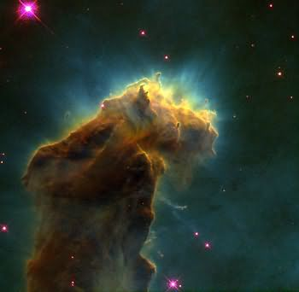
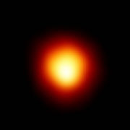

The sources of cosmic rays
molecular cloud
massive star
no acceleration
until ...
SNR shell
RX J1713
Jim Hinton

Slide 61






The sources of cosmic rays
molecular cloud
nearby accelerator
yes
active cloud
massive star
in cluster?
Sagittarius B
yes
no
collective wind
interaction
no acceleration
until ...
binary system
no
Neutronenstern?
Westerlund 2
yes
compact companion
no
yes
SNR shell
Composite SNR
neutron star
PWN
yes
no
binary-PWN
radio-Jet
RX J1713
G 21.5-0.9
HESS J1825
PSR B1259-63
LS 5039?
Jim Hinton

Slide 62

The Milky Way

Slide 63

The Milky Way in VHE gamma-rays

Slide 64

H.E.S.S. Galactic Plane Survey
2673 hours of high-quality data, taken in the years 2004 to 2013.
  Longitude l = 250 to 70 degrees, latitude |b| < 5 degrees
  Sensitivity for the detection of point-like sources is at the level of 2% Crab or better

Slide 65


Slide 66

H.E.S.S. galactic plane survey
Source extraction with automatic pipeline
67 VHE sources + 11 complex sources (e.g. shell SNR) excluded from pipeline
Systematic association of HGPS sources with nearby PSR, SNR, PWN, GeV sources (3FGL and 1FHL)
Notes:
Not a population study

Slide 67


Associations and Identifications

Slide 68
End lecture 2

