Slide 1
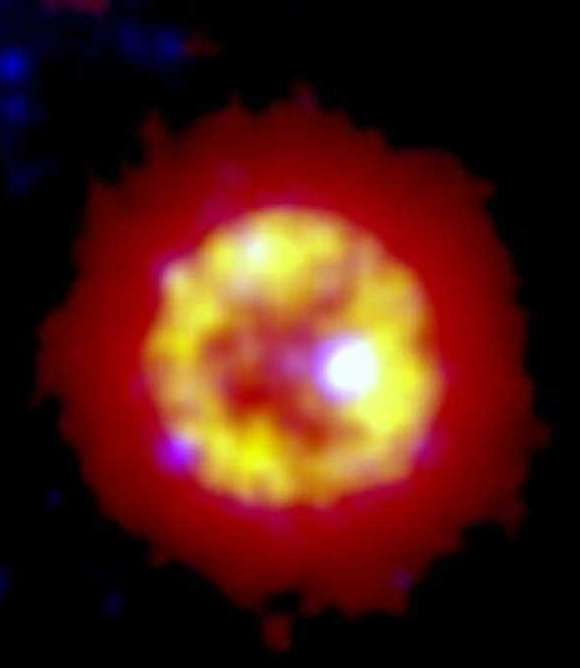



Study on the magnetized wind from white dwarfs
Yici ZHONG
With Kazumi Kashiyama, Shinsuke Takasao and Toshikazu Shigeyama
The University of Tokyo
ISCRA, Aug. 02, 2022
© nebula IRAS 00500+6713

Slide 2
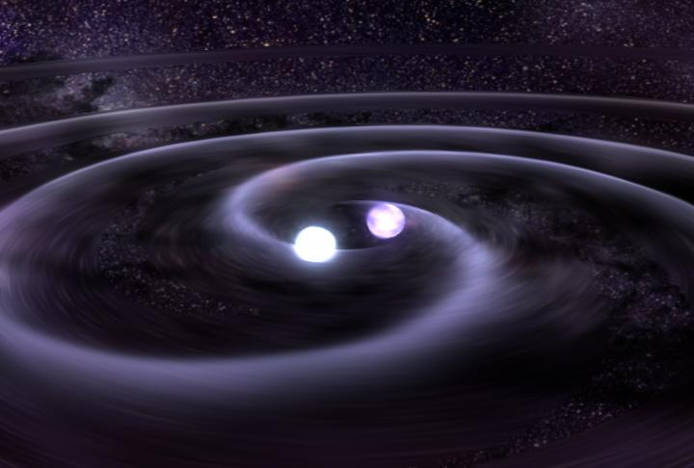
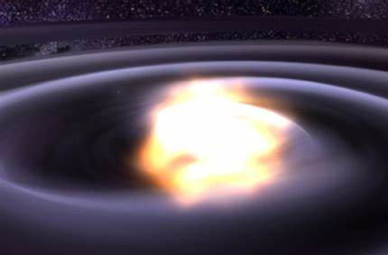
Highly magnetized and fast spinning White dwarf (WD)
Collapse into
neutron star?
WD: most common outcome of stellar evolution, ~ 10¹⁰ in MW
Type Ia
supernova?
GRB? FRB?
~ 2% total population
Highly magnetized
massive white dwarf?
WD merger remnant: Depending on M_{tot}, the physical properties of the wind, consequence of the mass loss…
Heavy: M ~ Chandrasekhar mass
Highly magnetized: B ~ 10⁶-10⁸ G
Rapidly rotating: P ~ 10-100 s

Slide 3
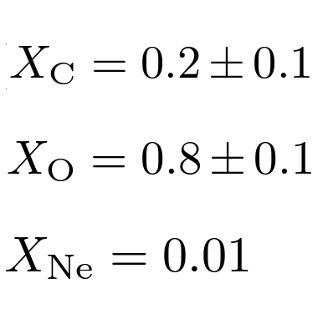
e.g., IRAS 00500+6713
WISE 22µm
WISE 22µm
WD J005311: A pale blue dot in a mid-infra nebula WS35 (assoc. Cassiopeia):
Different intensity scale
(HR diagram)
C-O with Ne enriched wind
(spectral fitting)
WISE 12µm
IPHAS Hα
(Spectral Line width & line height)
Gvaramadze et al.19
Notes:
IRAS 00500+6713: WD merger product
WS35: nebula, there are also following X-ray observations and spectroscopic investigation
J005311: central object
Figure 1 WS35: a new mid-infrared nebula in Cassiopeia. Upper panels: WISE 22 μm image of the nebula at two intensity scales, highlighting details of its structure. The position of the central star is indicated by a circle. Bottom panels, from left to right: WISE 12 μm and IPHAS Hα images of the nebula and its central star. At the distance of WS35 of ≈ 3 kpc, 1 arcmin corresponds to ≈0.86 pc. The coordinates are in units of RA (J2000) and Dec. (J2000) on the horizontal and vertical scales, respectively.

Slide 4
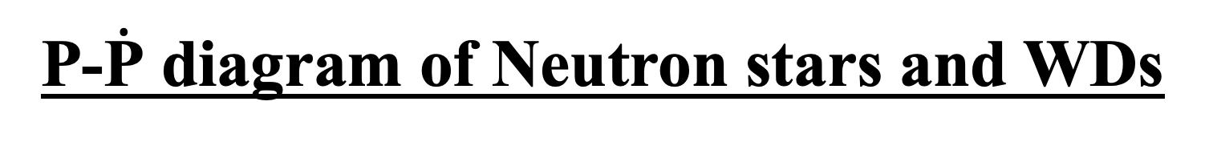
P-$\dot{\text{P}}$ diagram of Neutron stars and WDs
Factories for GeV cosmic rays
Highly magnetized WDs
(also with fast spin)
WD pulsar or not? Physical properties of the wind and the consequence of the mass loss shall be clarified
Kashiyama et al. in prep

Slide 5

Wind property <= Magnetosphere condition
The gas density close to the J005311 surface:
Force-free magnetosphere, particles are accelarated by magnetic pressure. Similar to pulsar!
=> NOT in the force-free regime.
Very hadronic wind. Heavy mass loading. Acceleration mechanism?
How does it spin down? Will it eventually become force-free?
…
Spin-down evolution of the system
Notes:
With mass loss proceeds, $\dot{M}$ (also $ω$?) decreases, its magnetosphere gradually becomes force-free (where its spin evolution can be described as dipole spin down).

Slide 6
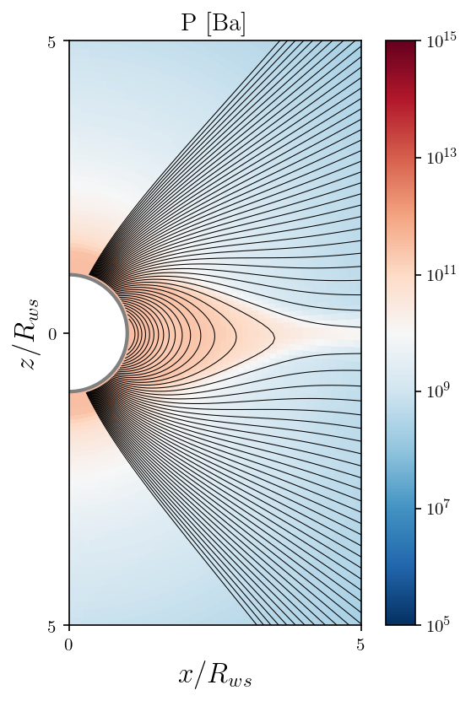
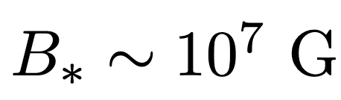
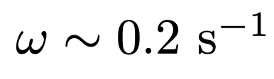
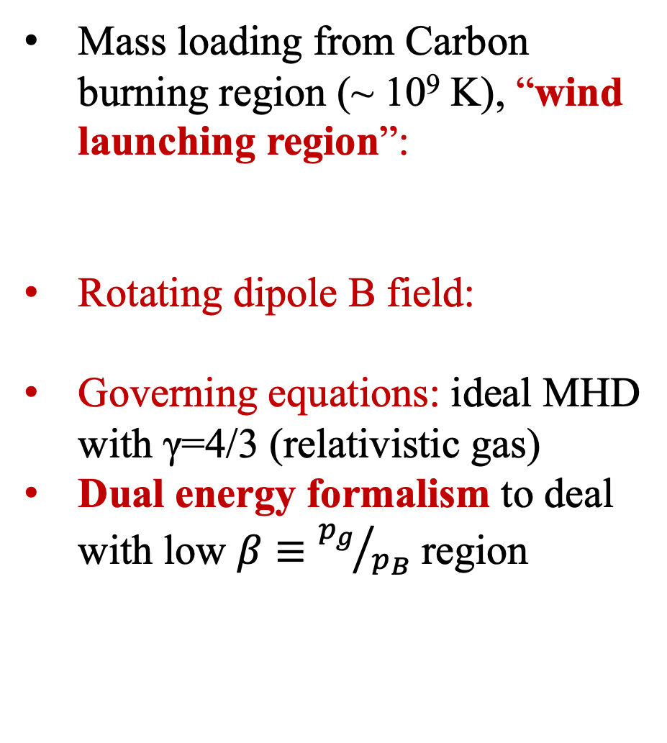
Physical Picture
J005311-like object
Mass loading from Carbon burning region (~ 10⁹ K), “wind launching region”:
Rotating dipole B field:
Governing equations: ideal MHD with $\text{γ}\text{=4/3}$ (relativistic gas)
Dual energy formalism to deal with low $β≡{p_{g}}/{p_{B}}$ region
O-Ne
WD

Slide 7
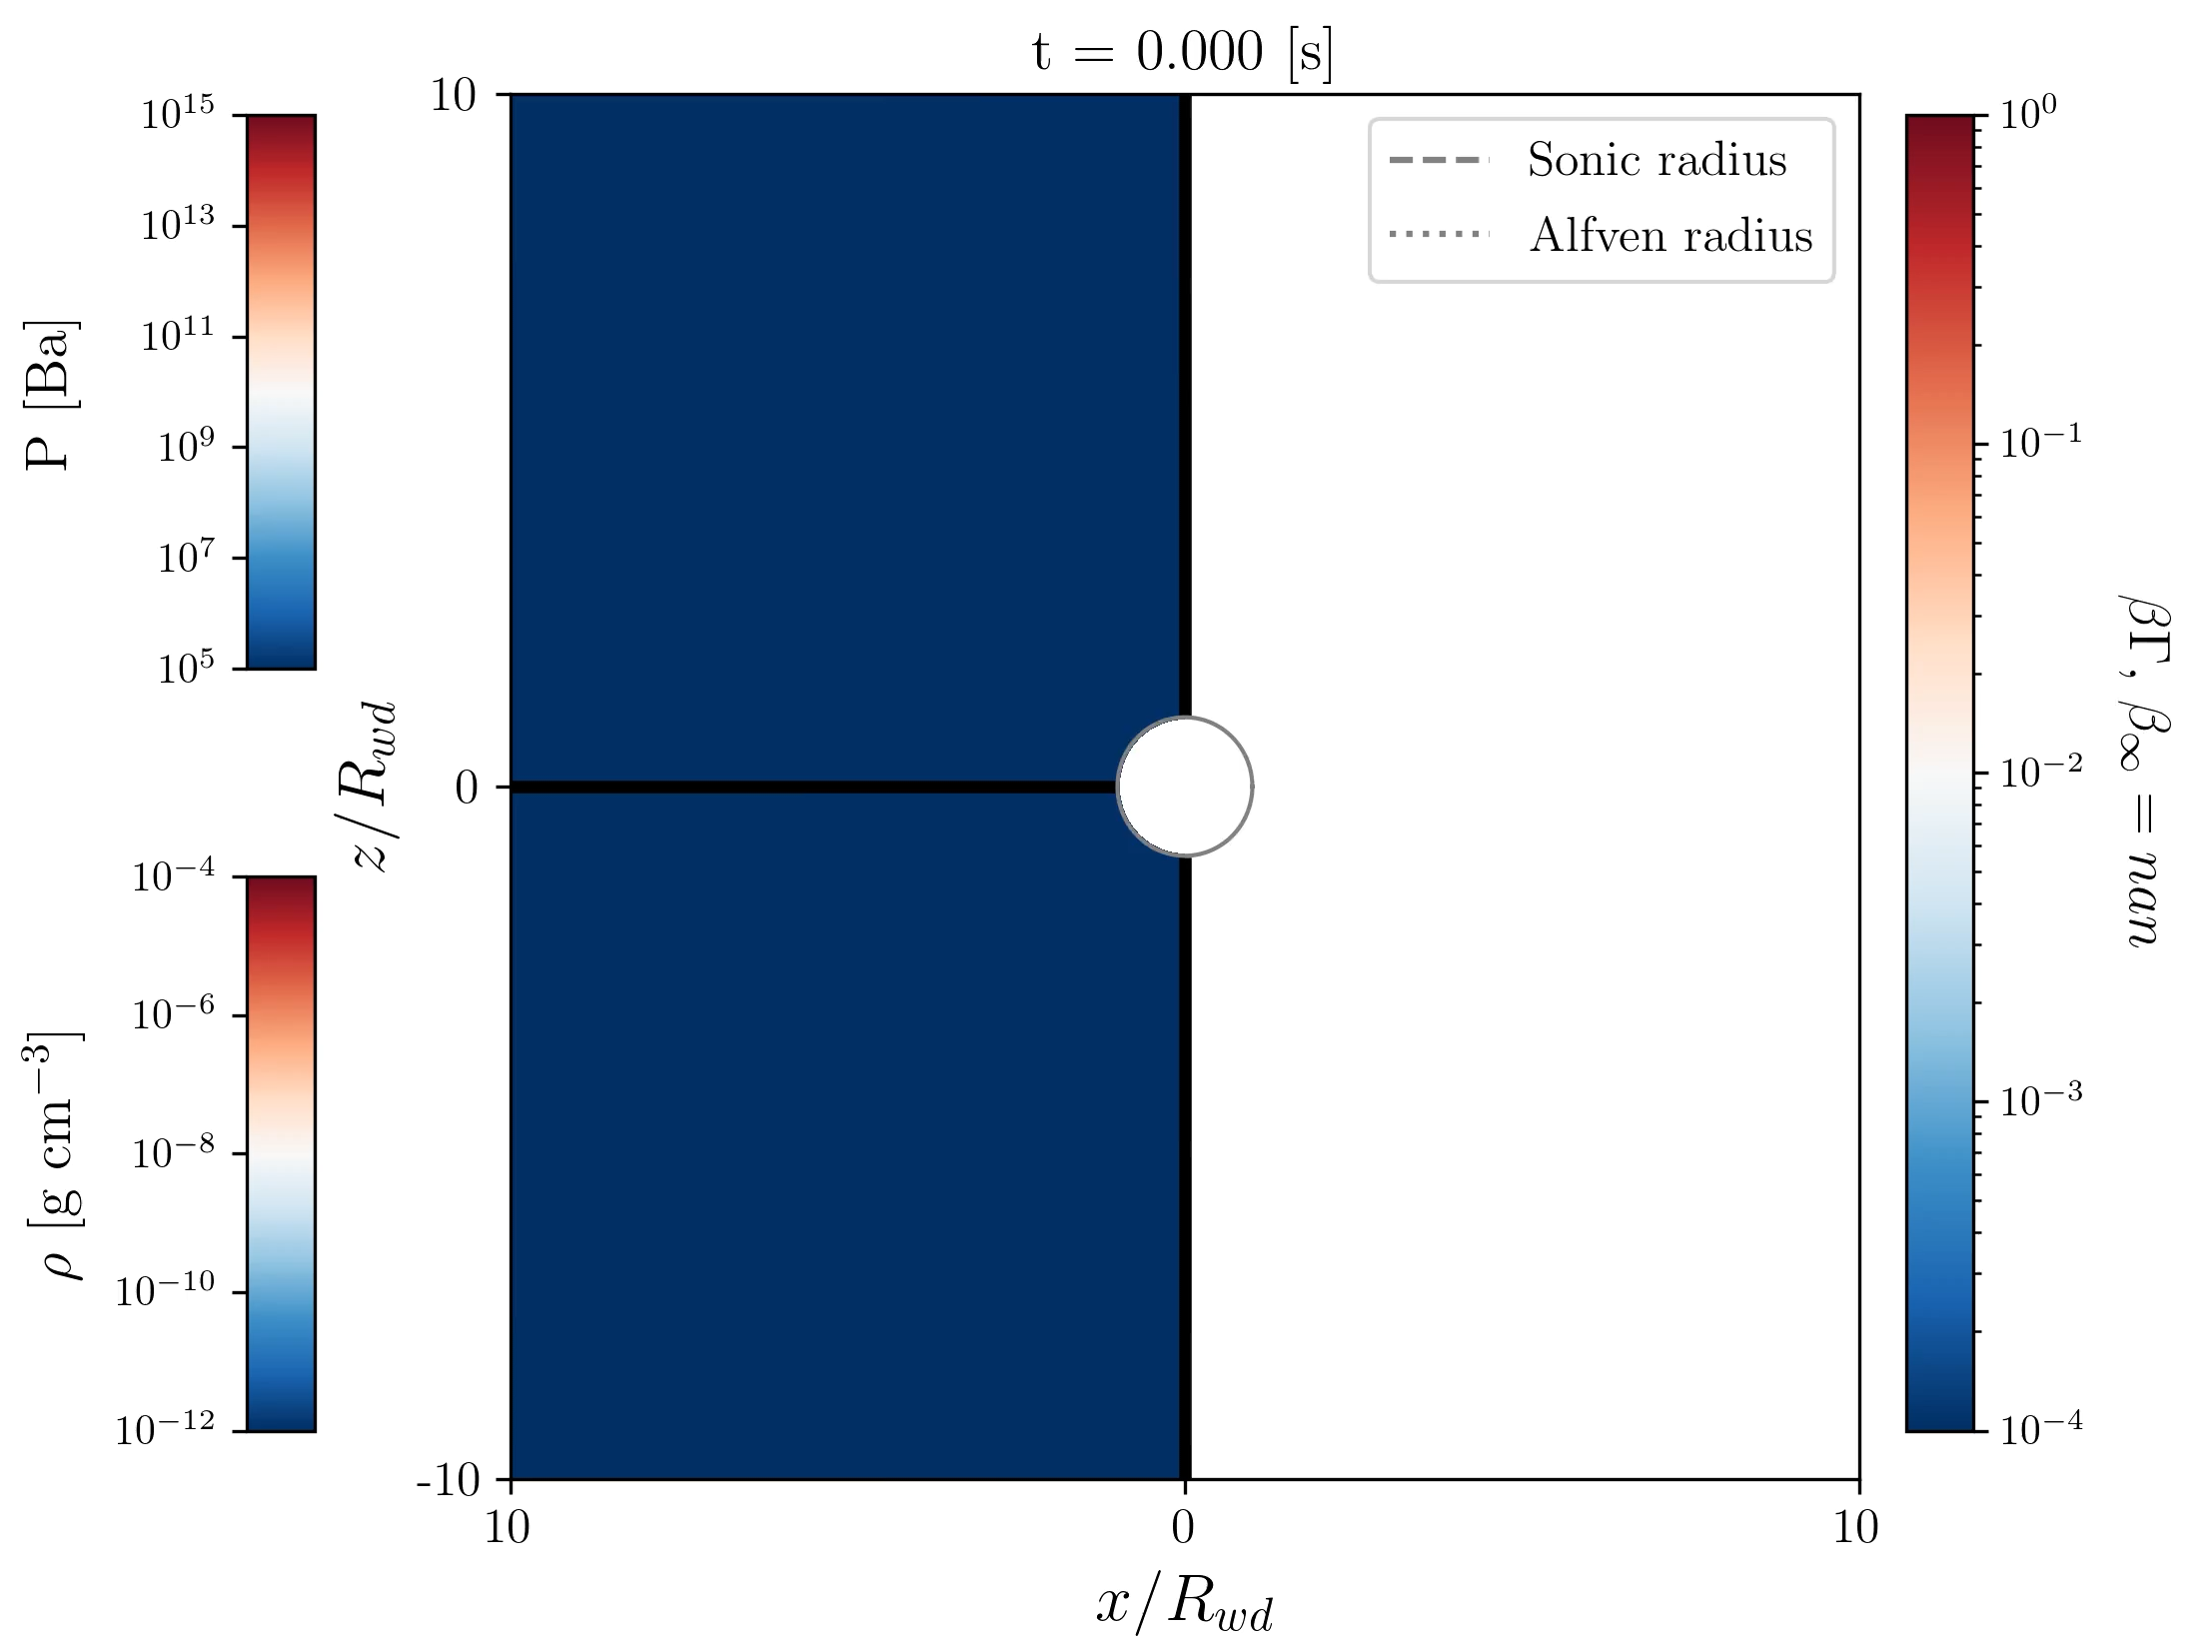
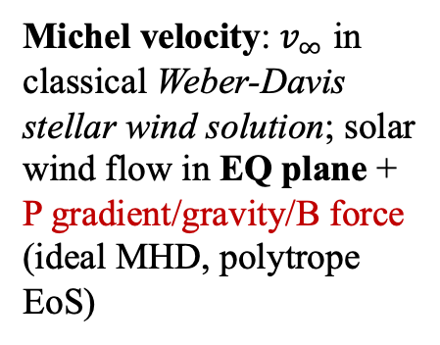
Results: Quasi-stationary wind solution
Michel velocity: $v_{∞}$ in classical Weber-Davis stellar wind solution; solar wind flow in EQ plane + P gradient/gravity/B force (ideal MHD, polytrope EoS)

Slide 8
Wind Terminal Velocity
Weber-Davis stellar wind solution
Time variability at equatorial plane: magnetic reconnection; centrifugal force VS magnetic tension => field line open/close
Order of magnitude: ~ 4 x 10⁸ cm/s . Quite fast! (slightly lower than observation; but our outer boundary is quite small)
Overall isotropic: nearly spherical nebula shape?
[c]
Polar region: ~ Parker wind solution (steady state solution of ideal MHD Eqs. without considering effect of B
[s]

Slide 9
T_{sp}
Energy flux at outer boundary (after integrated over solid angle) ~ 10³⁹ erg/s
Mass flux at outer boundary (after integrated over solid angle)
~ 3 x 10⁻⁶ M_{sun}/yr
Time variability: similar to the so-called “slingshot prominence” in the context of solar MHD study. => imprints on associated nebula
Notes:
Diffusivity shall be added to stabilize this feature

Slide 10
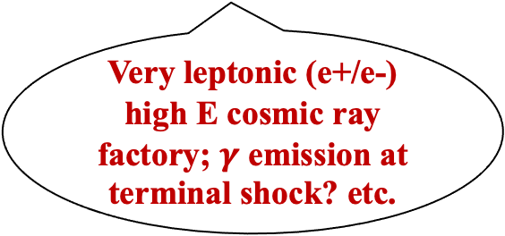
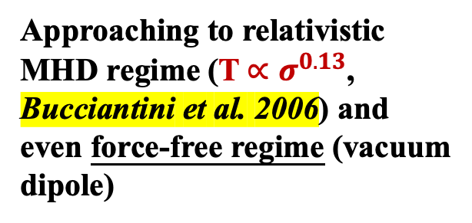
Spin down formula fitting in trans-relativistic MHD regime
Approaching to relativistic MHD regime (T$∝σ^{0.13}$, Bucciantini et al. 2006) and even force-free regime (vacuum dipole)
Very leptonic (e+/e-) high E cosmic ray factory; $γ$ emission at terminal shock? etc.
trans-relativistic => relativistic => force-free
Dimensionless parameter taken account in WD spin, magnetization and mass loss from the system.
Notes:
Spin-down history + chemical composition (depending on carbon burning etc.) => justify it as a source of CR

Slide 11
Take-out message
Maybe too massive! Exploding to NS
Results are encouraging.
Now and to come:
Detailed parameter survey
A more “grand unified” fitting of Torque
Smoothly connecting to relativistic regime, making the evolution track a “whole”
…
Highly magnetized
massive white dwarf?
Spinning
down
WD pulsar (GeV e+/e- CR factory)
Conventional
WD
Heavy: M ~ Chandrasekhar mass
Highly magnetized: B ~ 10⁶-10⁸ G
Rapidly rotating: P ~ 10-100 s
Maybe spinning down too fast

Slide 12
Backup slides

Slide 13
As the source of cosmic ray?
Cowsik & Price 1971, Ostriker 1970: rotating magnetic WDs can be main source of cosmic rays in MW galaxy:
  Total energy by magnetic braking of WDs: large enough to maintain the cosmic ray energy density in the galaxy
  Easier to produce GeV-range particles that contributes the most to cosmic ray energy density (e.g., comparing to pulsar)
  Large density of WDs: high degree of isotropy for cosmic rays
BUT! Schonfelder & Trumper 1972:this picture is incompatible with observations of normal WDs B fields and its decay theory (in case of effective cosmic ray production). Only a fraction of them with high B field can contribute to cosmic ray production. Recent studies like Kashiyama et al 2011, Lobato et al 2017, Kamae et al 2018 also points out the correlation between highly magnetized WDs and GeV cosmic ray.

Slide 14
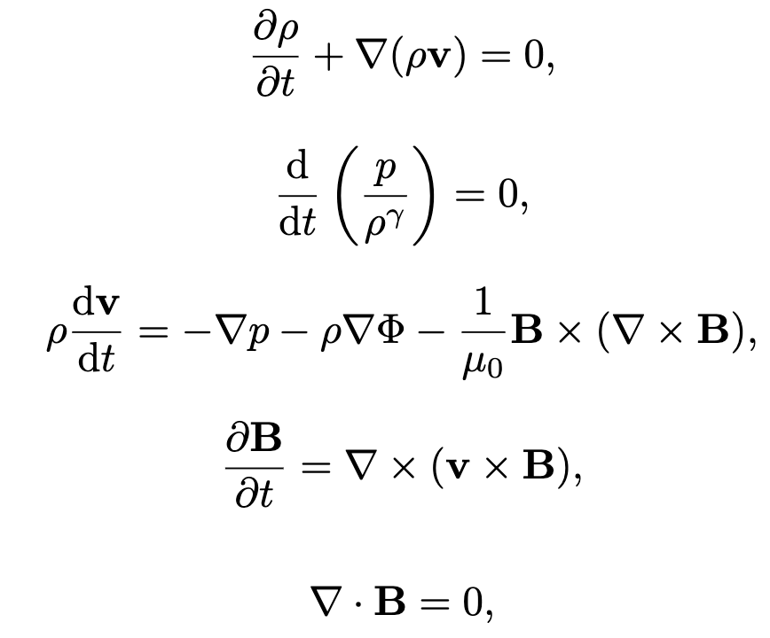
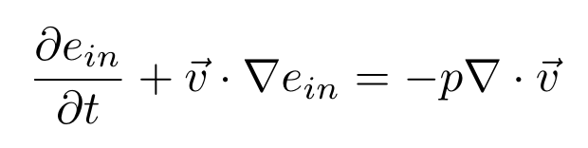

Numerical Setting
Governing Equations:
ideal MHD
Riemann solver: hlld (lhlld introduces unnecessary asymmetry at polar region)
Reconstruction method: PLM
Source term (wind launching region) is implemented implicitly
Dual energy formalism is employed: we solve the internal energy equation separately to deal with B-dominated region:

