Slide 1
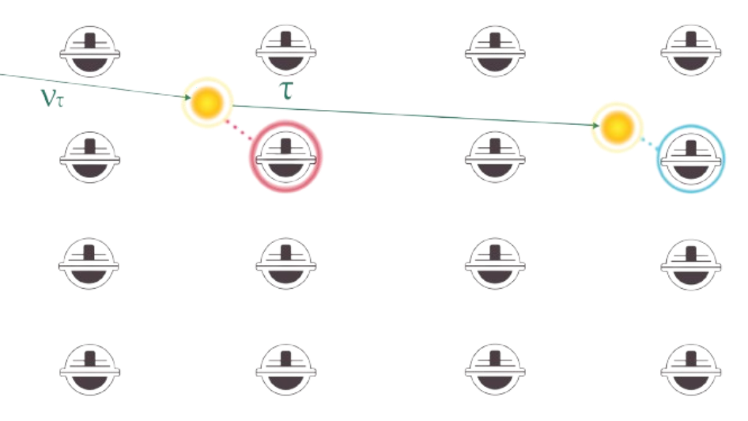


High-energy neutrino reconstruction in IceCube with bright and DeepCore DOMs
Christopher Eldridge for the IceCube Collaboration
ISCRA 2026

Slide 2
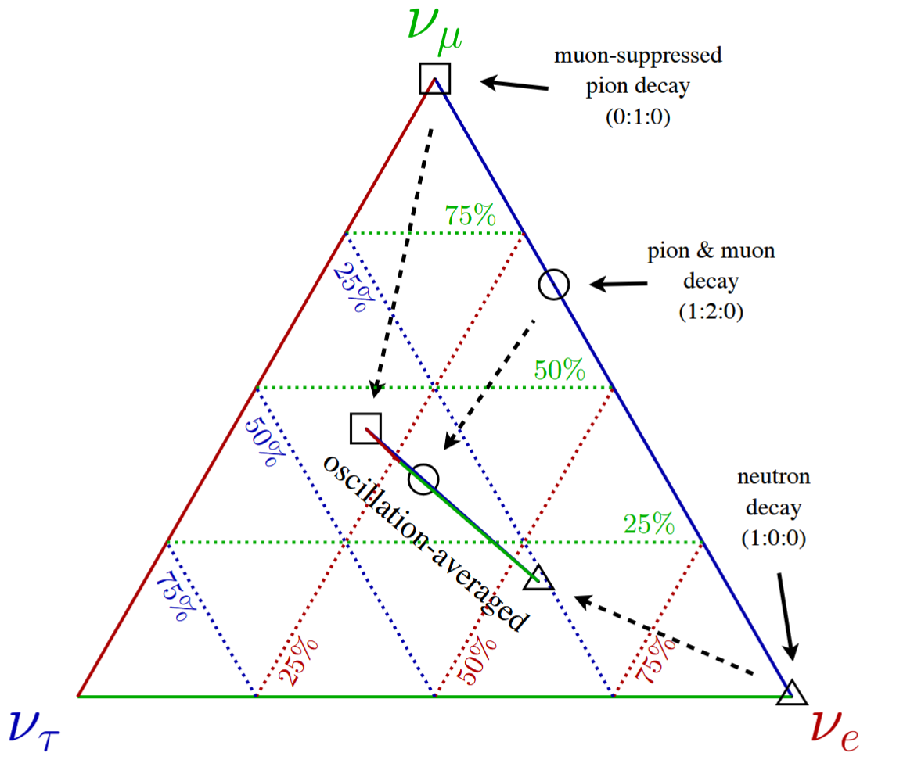
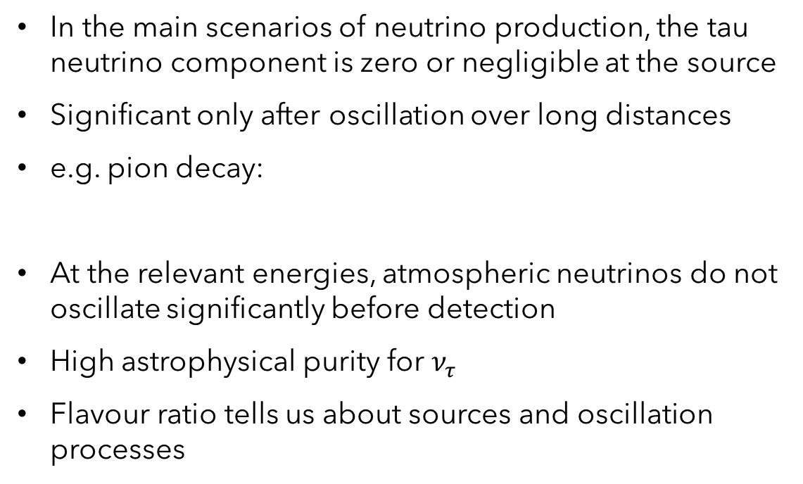
Motivation
In the main scenarios of neutrino production, the tau neutrino component is zero or negligible at the source
Significant only after oscillation over long distances
e.g. pion decay:
At the relevant energies, atmospheric neutrinos do not oscillate significantly before detection
High astrophysical purity for $ν_{τ}$
Flavour ratio tells us about sources and oscillation processes
Image: IceCube Collaboration (2014),
“IceCube-Gen2: A Vision for the Future of Neutrino Astronomy in Antarctica”
1
ISCRA 2026
Christopher Eldridge

Slide 3
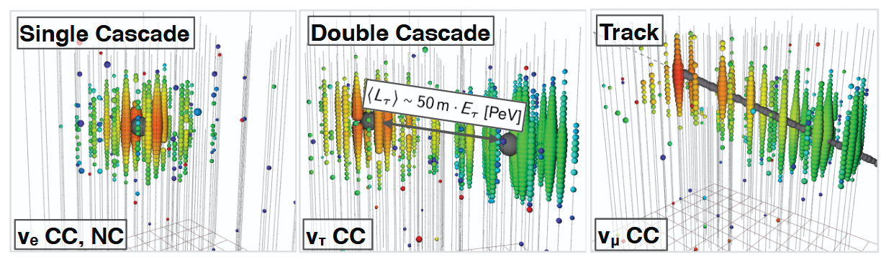
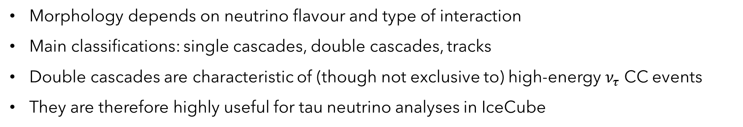
Neutrino interactions in IceCube
Morphology depends on neutrino flavour and type of interaction
Main classifications: single cascades, double cascades, tracks
Double cascades are characteristic of (though not exclusive to) high-energy $ν_{τ}$ CC events
They are therefore highly useful for tau neutrino analyses in IceCube
Images: J. Stachurska, PhD thesis (2020), ”Astrophysical Tau Neutrinos in IceCube”
2
ISCRA 2026
Christopher Eldridge

Slide 4

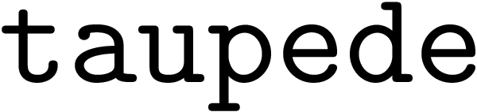
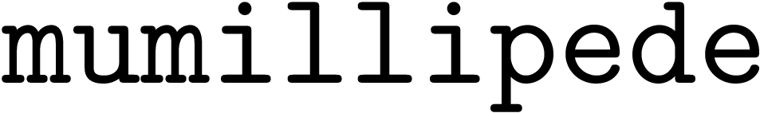
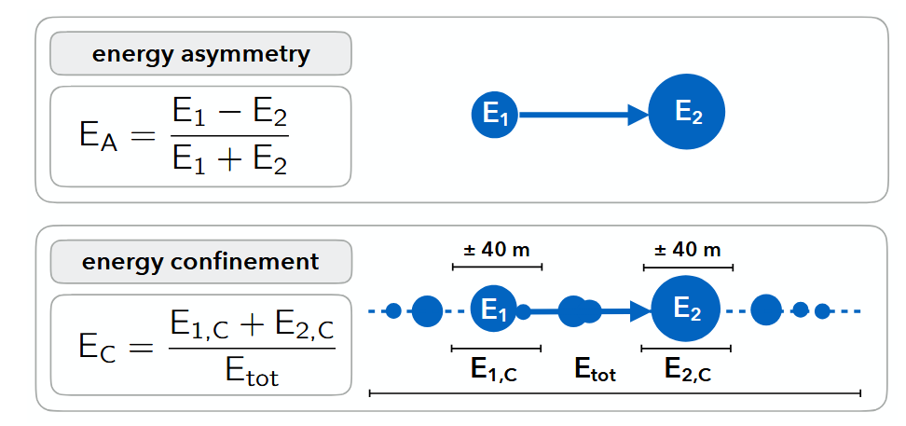
Event reconstruction
We reconstruct events using the likelihood-based framework
Source model depends on the event hypothesis:
  Single cascade
  Track
  Double cascade
Other parameters of interest: energy asymmetry and energy confinement, from . and .
Images: M. Usner, PhD thesis (2018), “Search for Astrophysical Tau-Neutrinos in Six Years of High-Energy Starting Events in the IceCube Detector“
3
ISCRA 2026
Christopher Eldridge

Slide 5
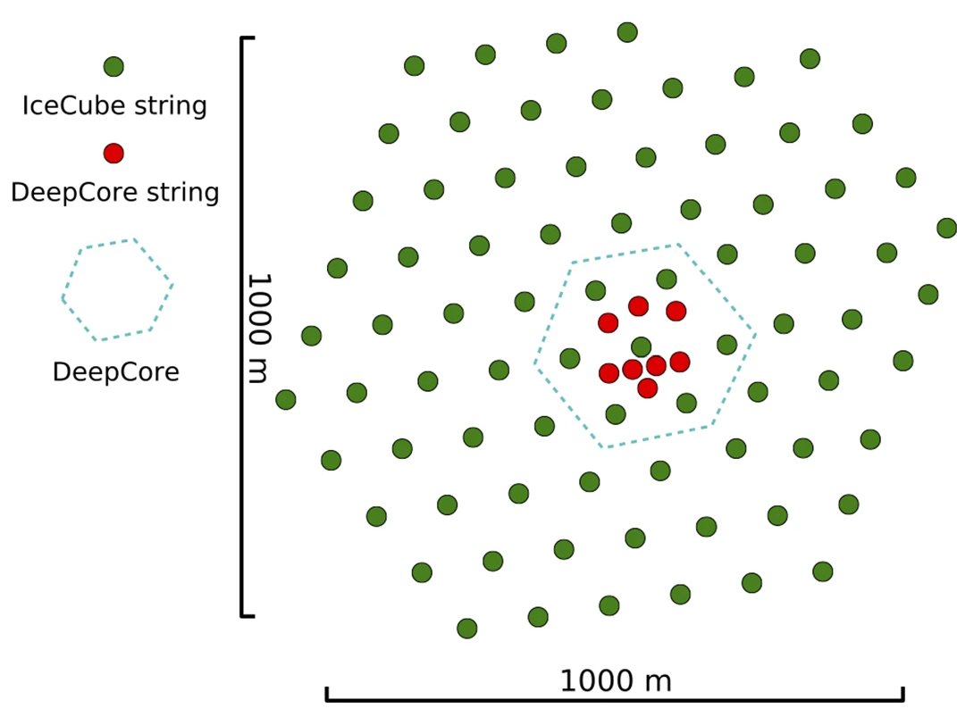
Bright and DeepCore DOMs
A DOM is bright if the amount of light it collects exceeds the average by a threshold factor
Excluded from previous analyses
Concerns include potential reconstruction bias due to high weight
and DeepCore is a subarray within IceCube
Denser instrumentation, higher quantum efficiency
8 strings, 480 DOMs
Excluded for homogeneity reasons
Image: IceCube Collaboration (2018),
“Search for nonstandard neutrino interactions with IceCube DeepCore“
4
ISCRA 2026
Christopher Eldridge

Slide 6
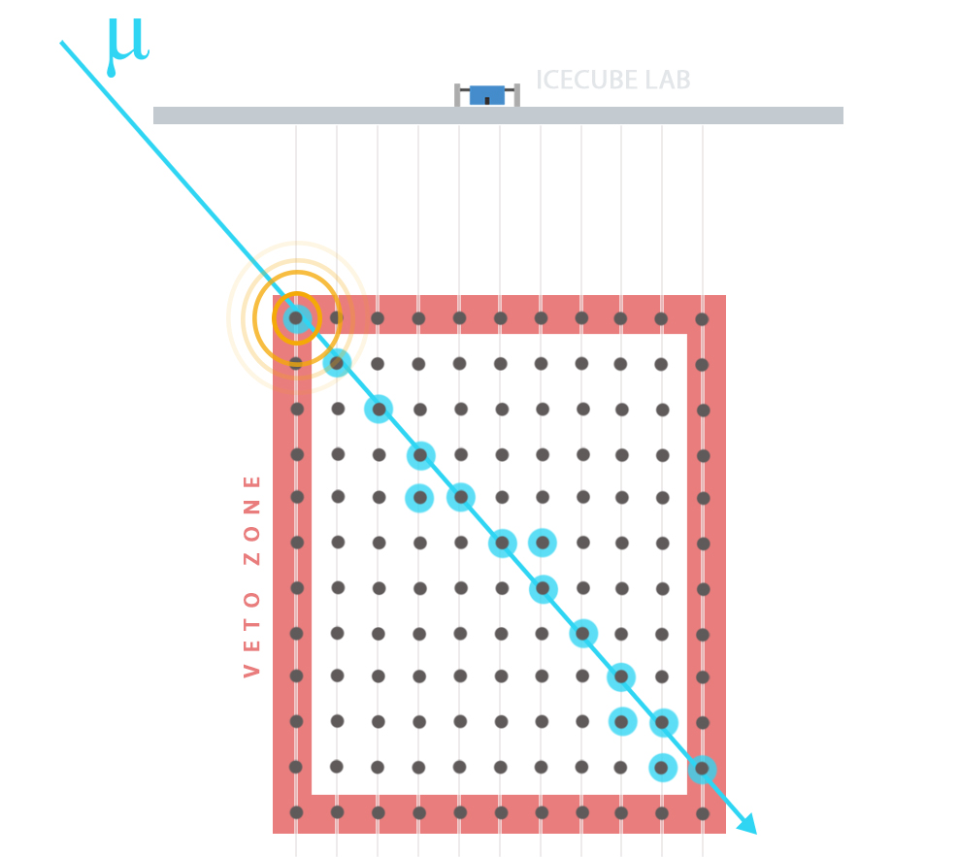
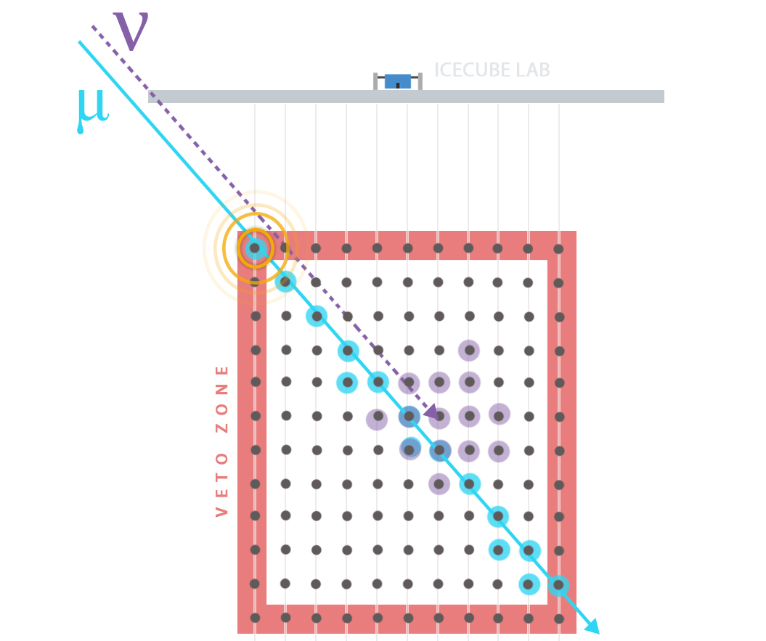
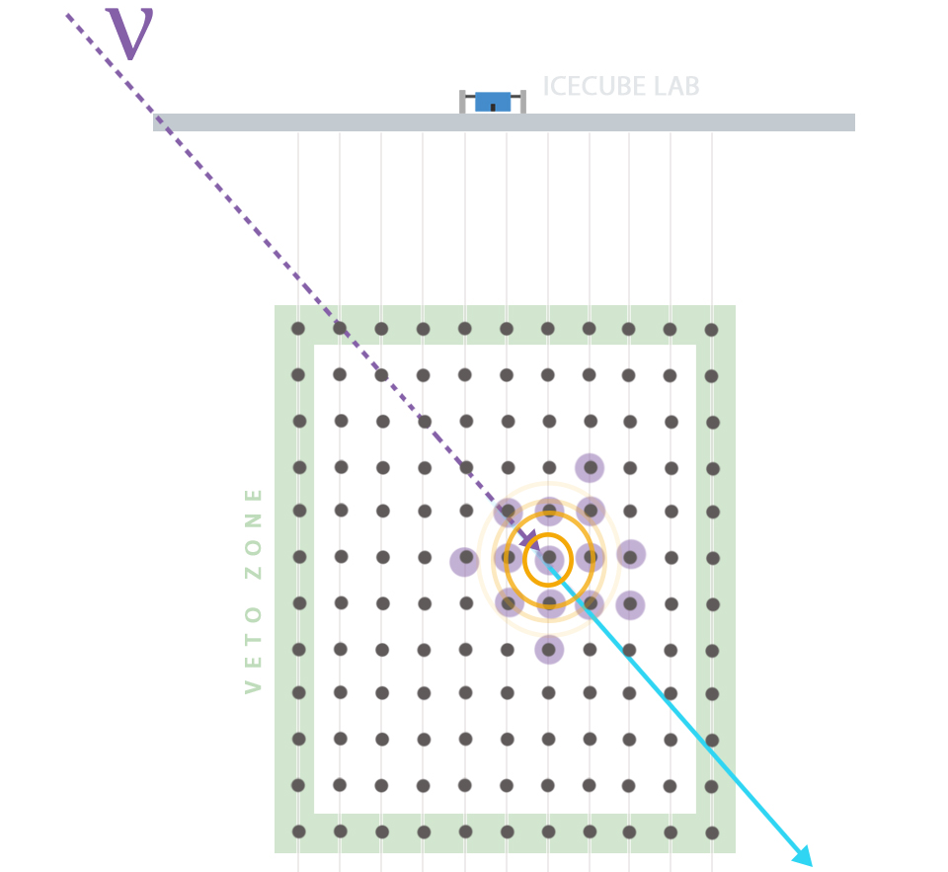
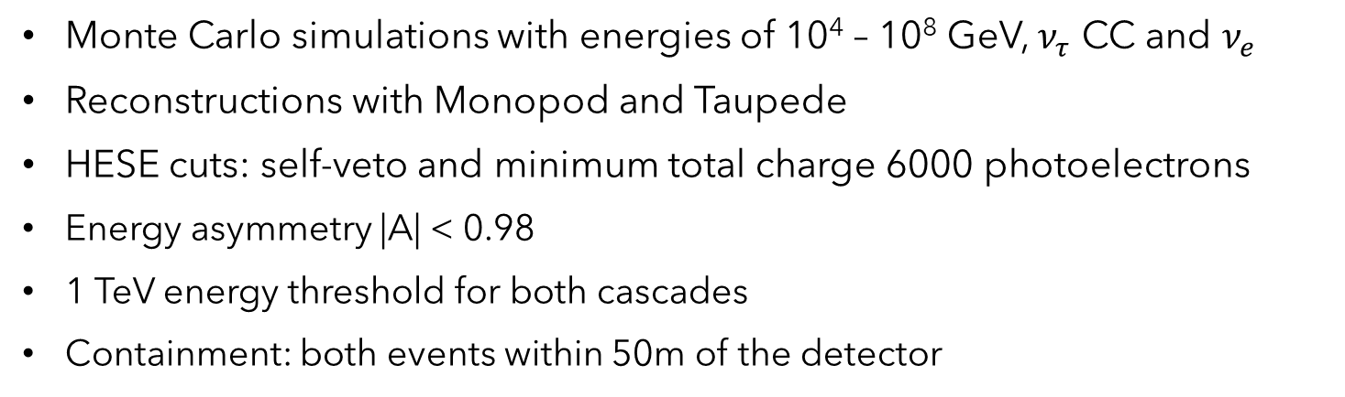
Simulations, reconstructions and event selection
Monte Carlo simulations with energies of 10⁴ – 10⁸ GeV, $ν_{τ}$ CC and $ν_{e}$
Reconstructions with Monopod and Taupede
HESE cuts: self-veto and minimum total charge 6000 photoelectrons
Energy asymmetry |A| < 0.98
1 TeV energy threshold for both cascades
Containment: both events within 50m of the detector
Images:
IceCube gallery
5
ISCRA 2026
Christopher Eldridge

Slide 7
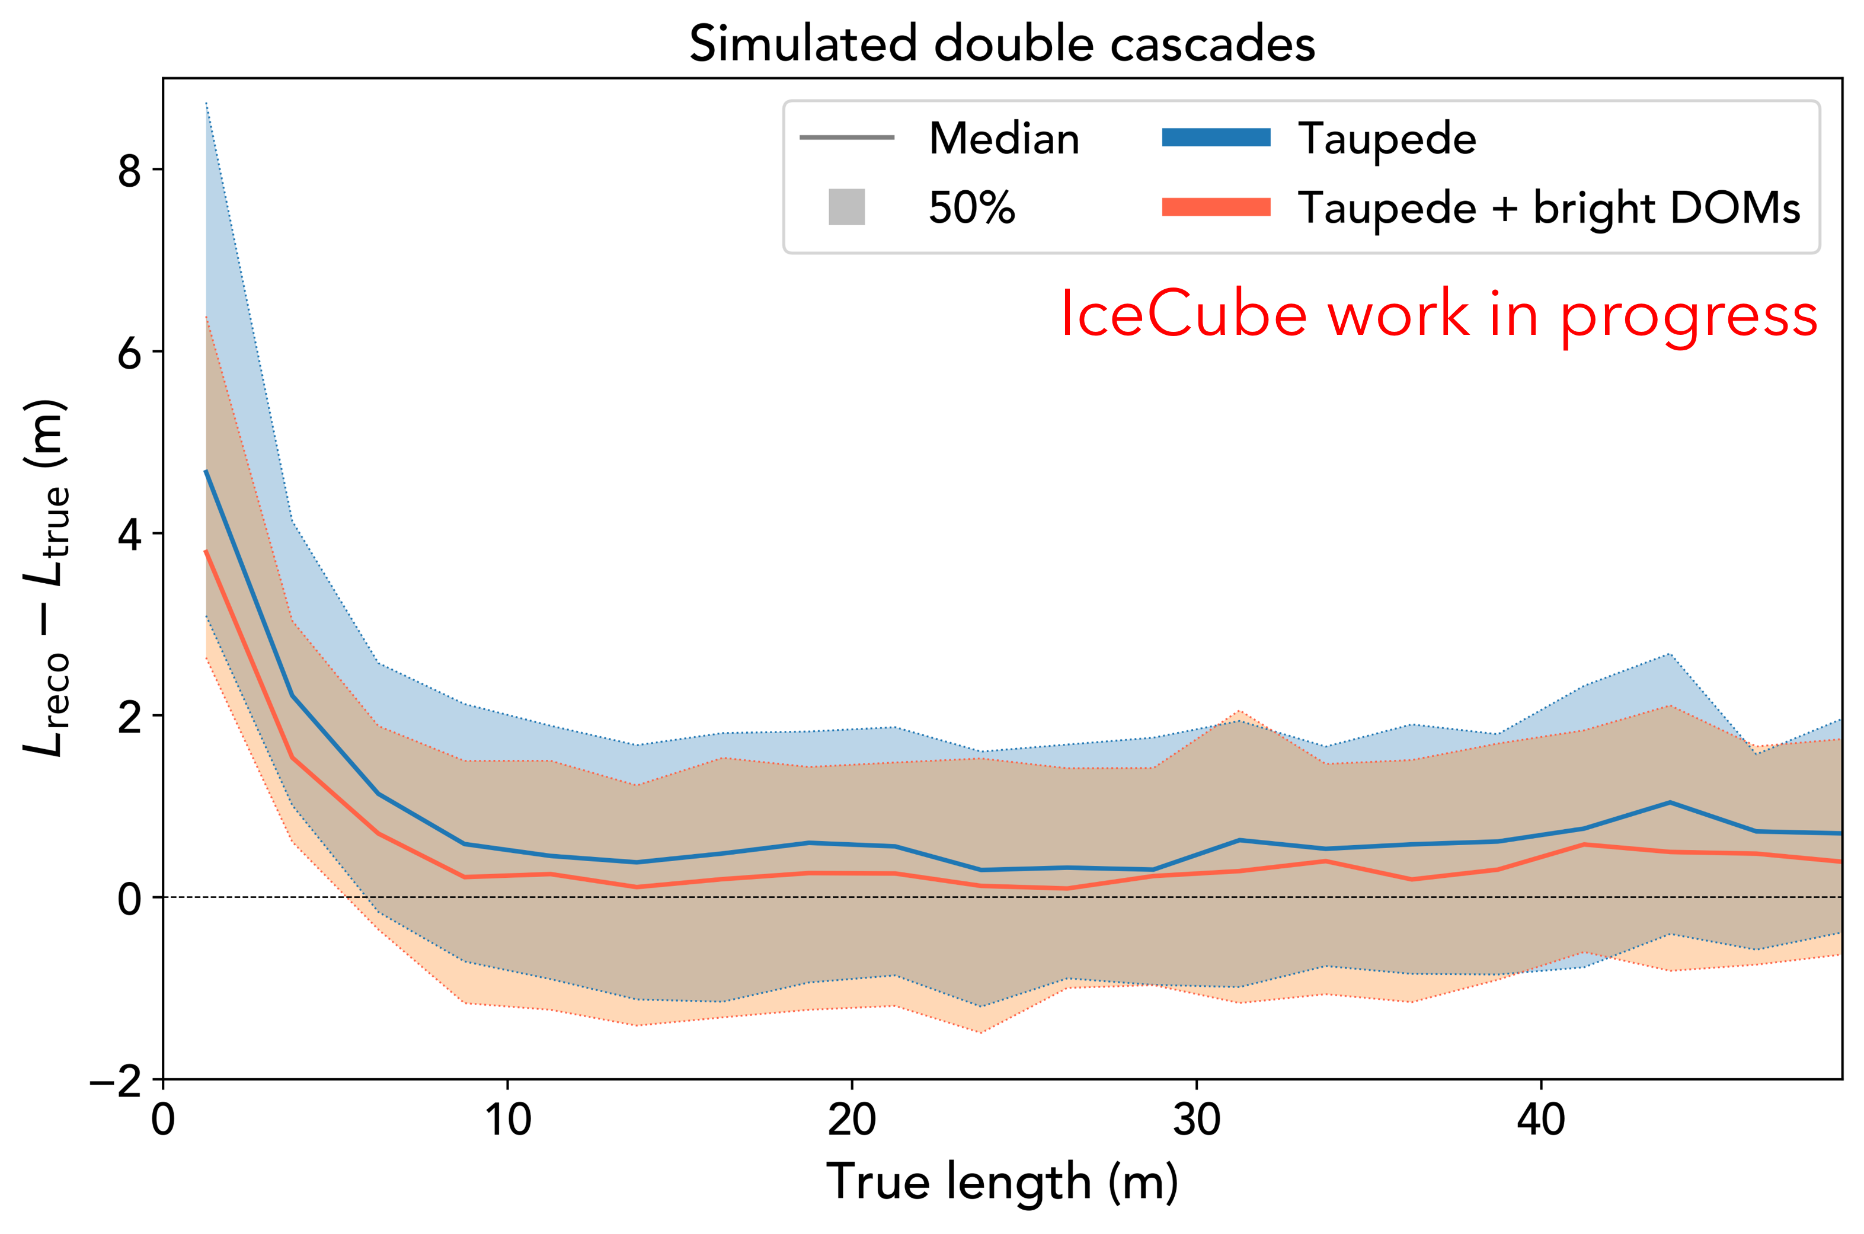
Bright DOMs
Neutral to positive effects for all parameters
Improvement in Taupede length reconstruction for both single and double cascades
6
ISCRA 2026
Christopher Eldridge

Slide 8
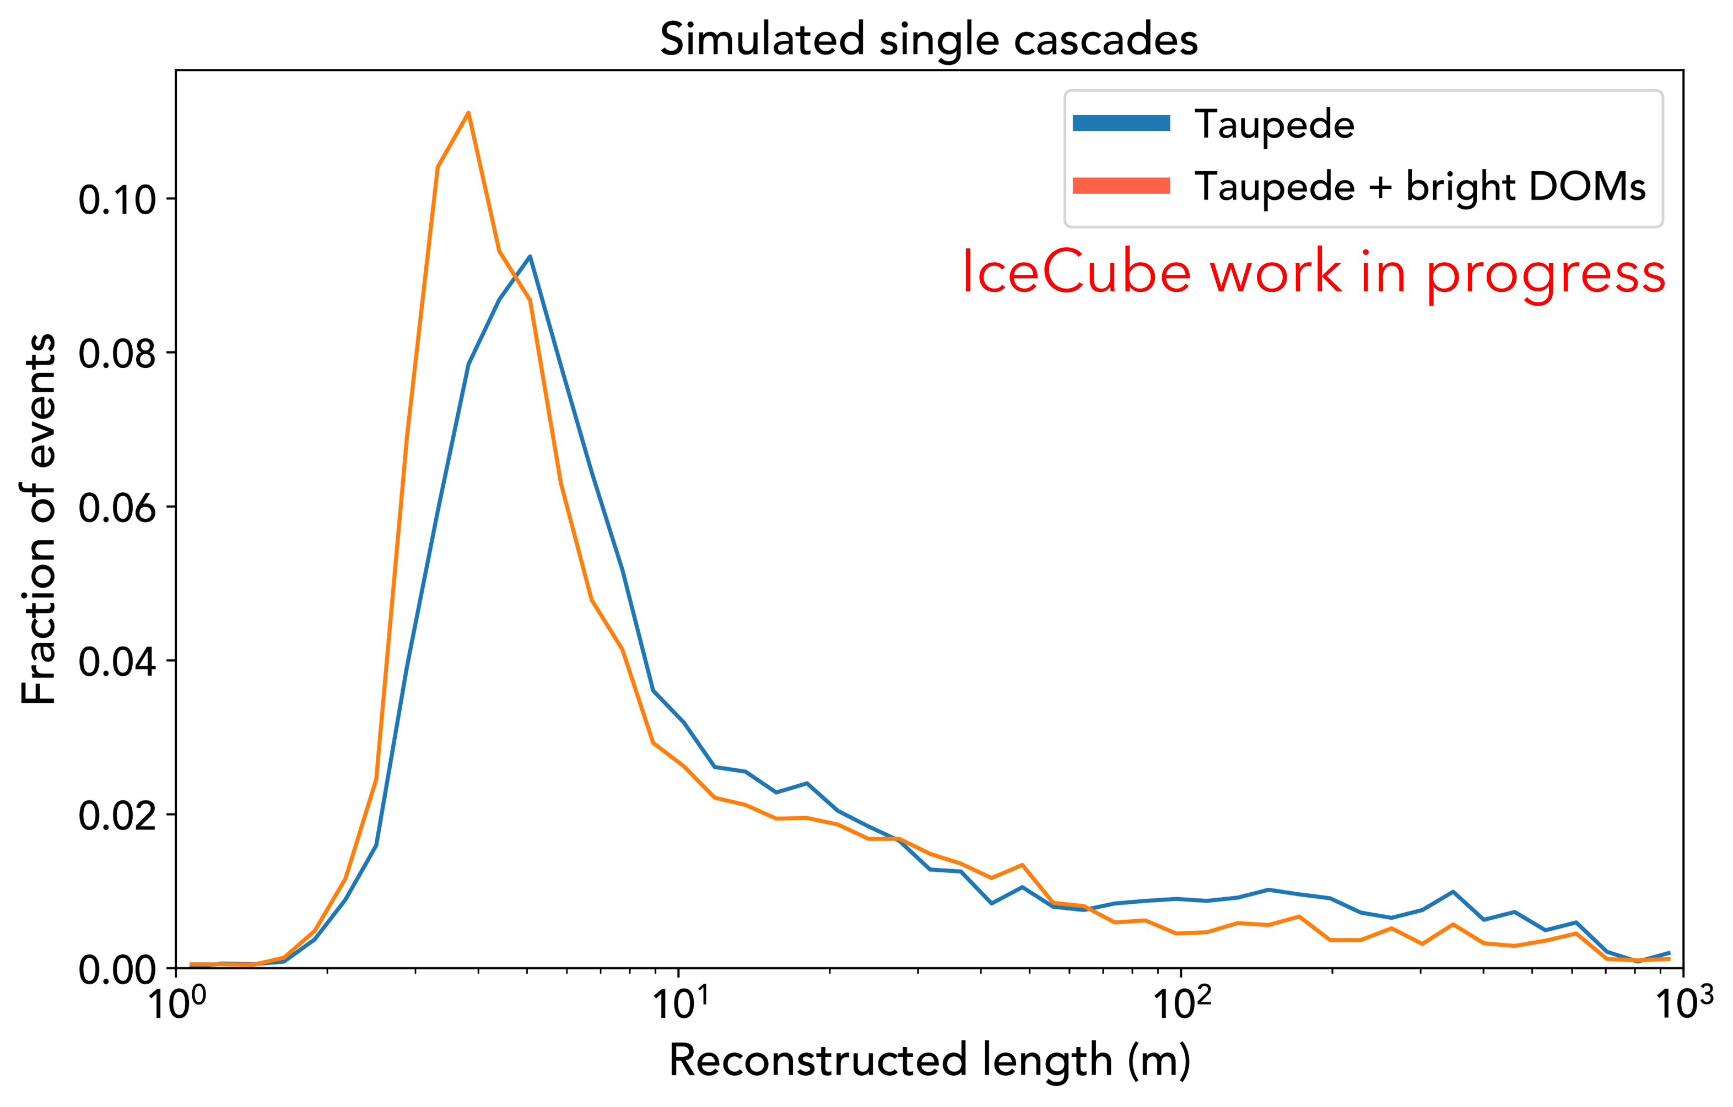
Bright DOMs
Neutral to positive effects for all parameters
Improvement in Taupede length reconstruction for both single and double cascades
6
ISCRA 2026
Christopher Eldridge

Slide 9
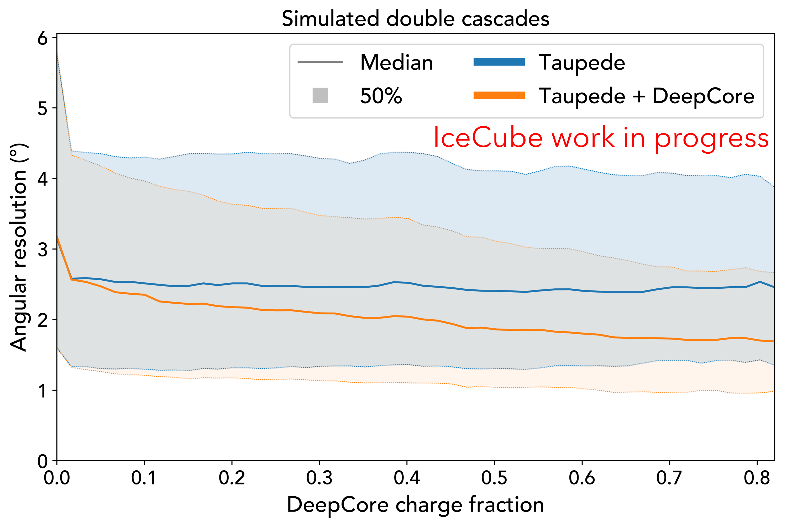
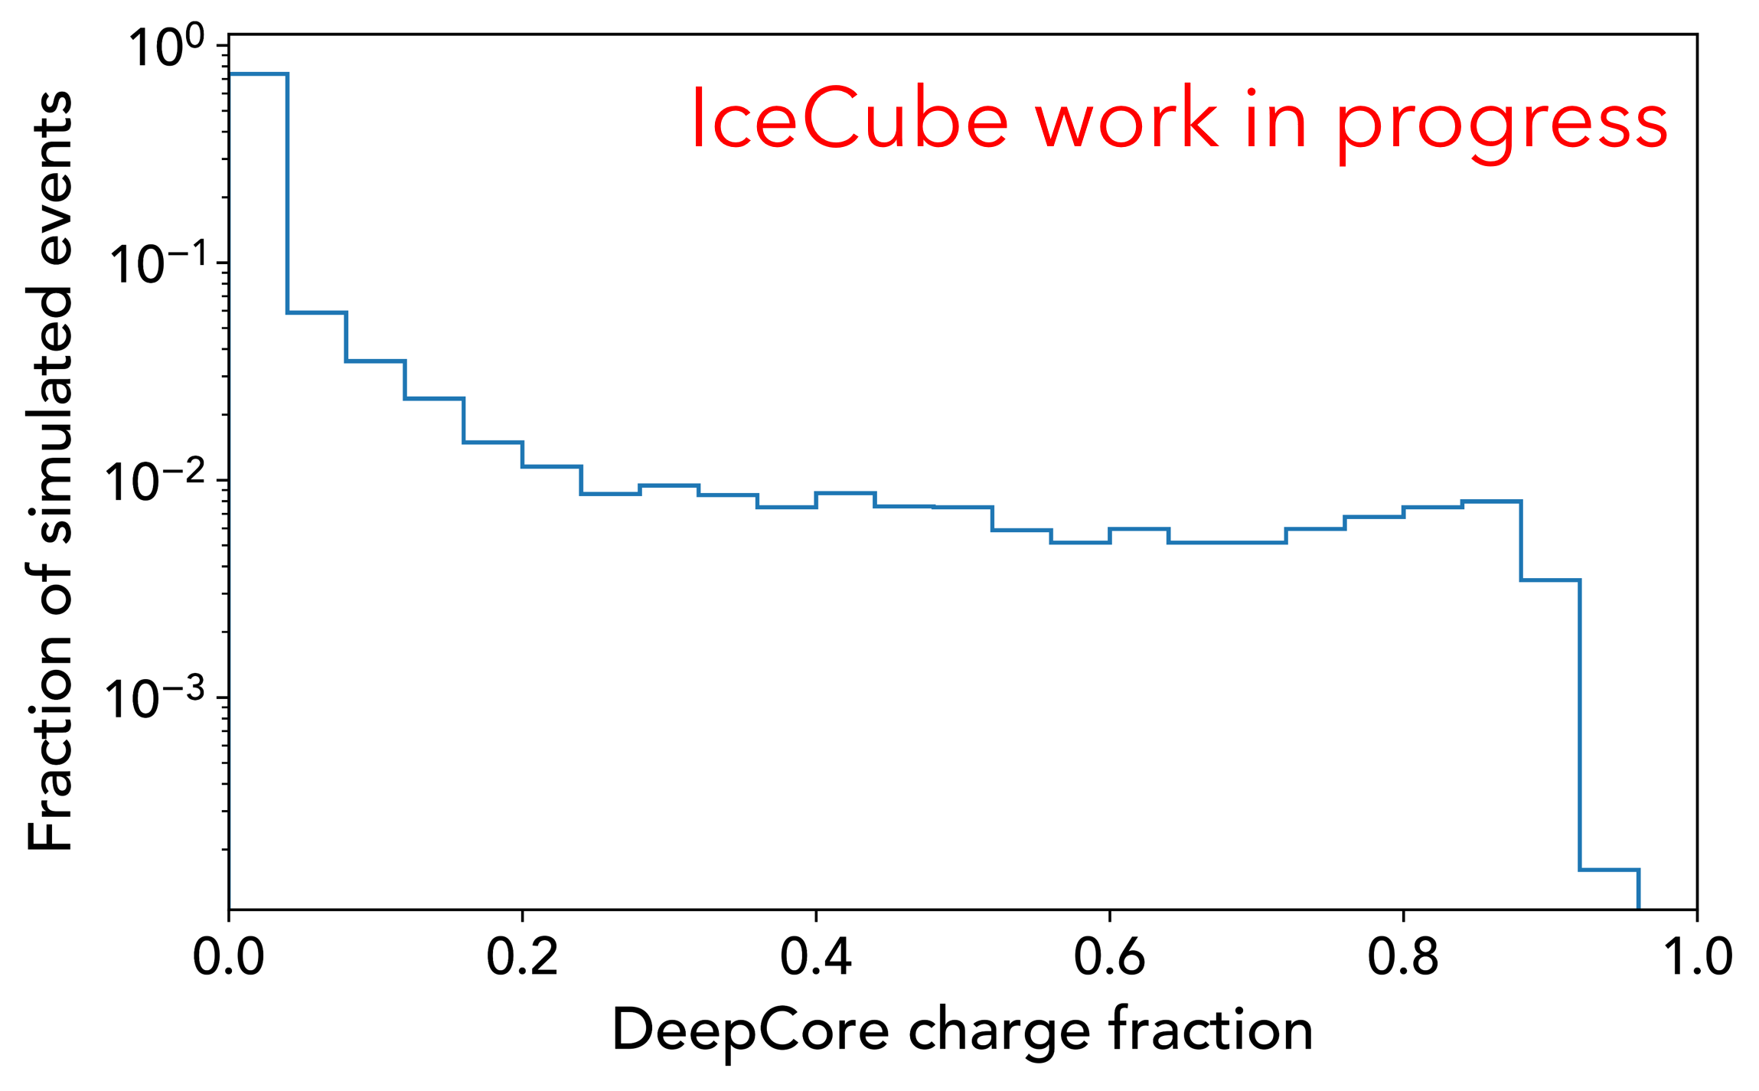
DeepCore
The fraction of signal on DeepCore DOMs is very small for most events (median 0.27%)
For all parameters except energy, reconstruction improved for DeepCore-heavy events
7
ISCRA 2026
Christopher Eldridge

Slide 10
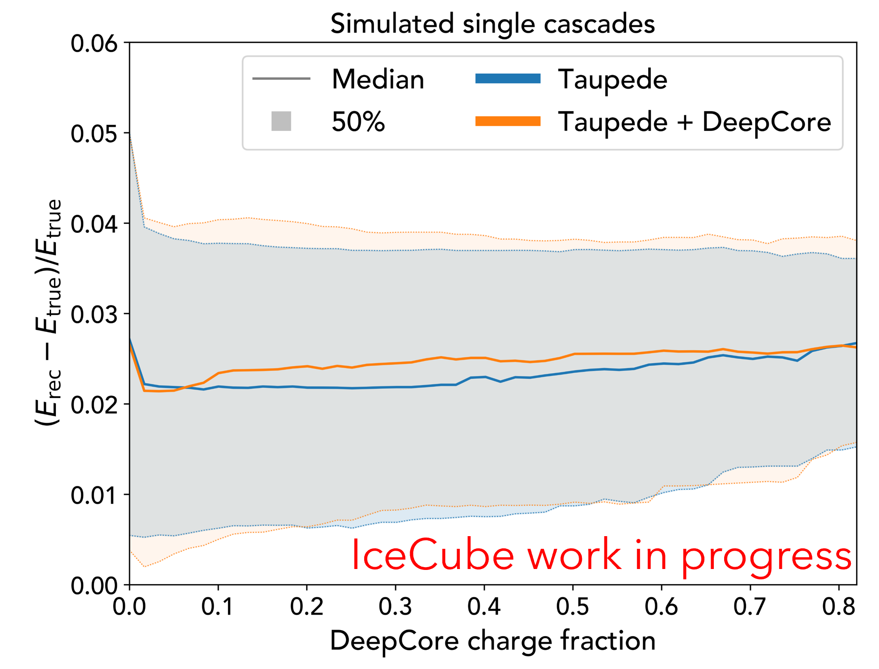
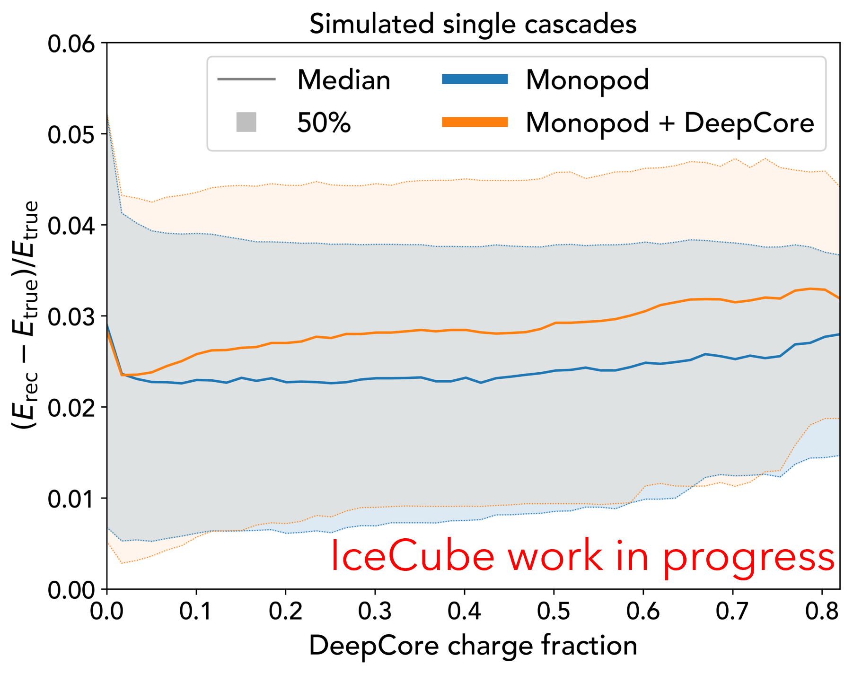
DeepCore
Energy reconstruction worsened slightly for Taupede, more severely for Monopod
8
ISCRA 2026
Christopher Eldridge

Slide 11
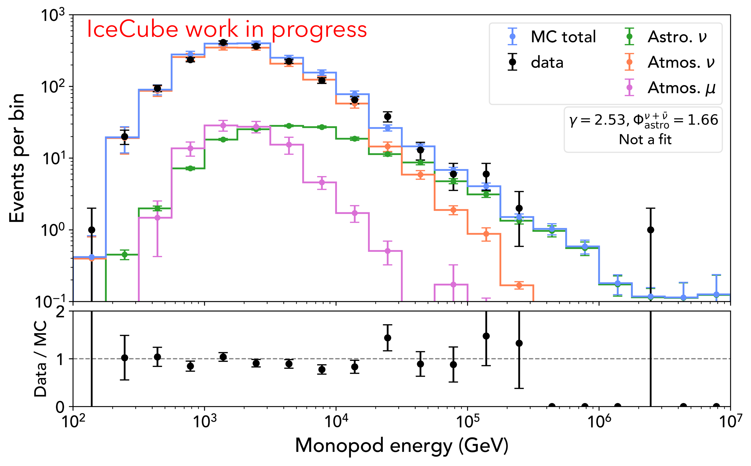
Data-Monte Carlo agreement
Stony Brook level 6 selection
Burn sample: 10% of events (livetime ~1.2 years)
1604 events
Best-fit spectrum from 2020 Stony Brook cascade analysis
Good agreement when including bright & DC DOMs
Promising outlook for high-energy analysis
9
ISCRA 2026
Christopher Eldridge

Slide 12
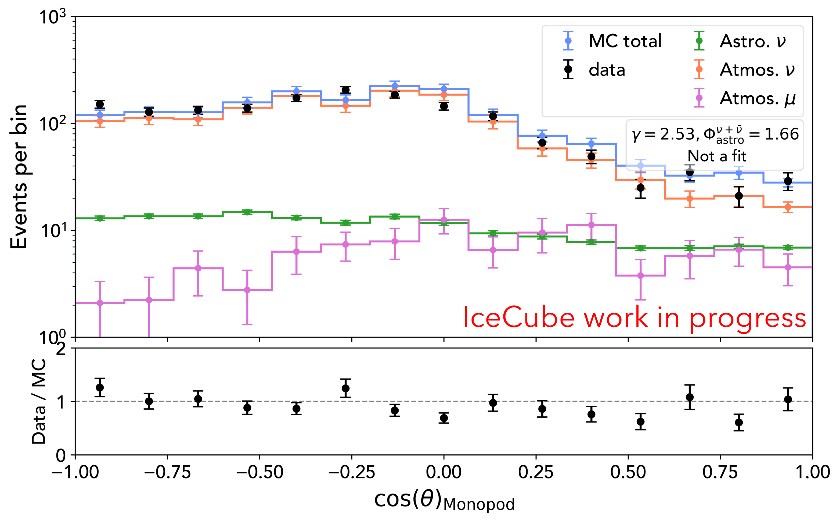
Data-Monte Carlo agreement
Stony Brook level 6 selection
Burn sample: 10% of events (livetime ~1.2 years)
1604 events
Best-fit spectrum from 2020 Stony Brook cascade analysis
Good agreement when including bright & DC DOMs
Promising outlook for high-energy analysis
9
ISCRA 2026
Christopher Eldridge

Slide 13
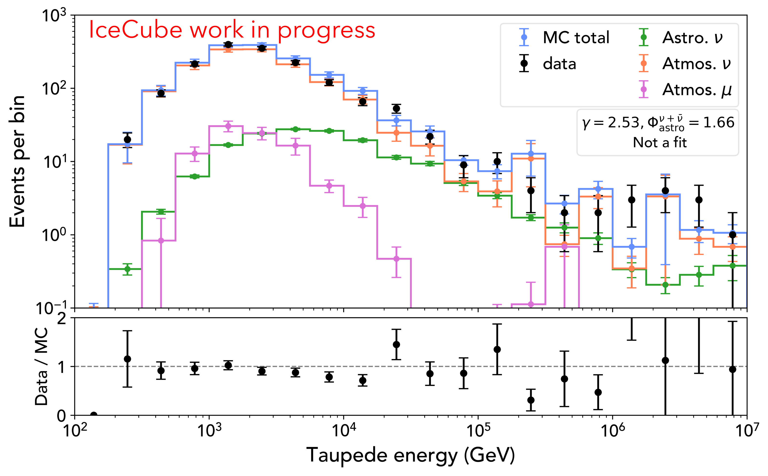
Data-Monte Carlo agreement
Stony Brook level 6 selection
Burn sample: 10% of events (livetime ~1.2 years)
1604 events
Best-fit spectrum from 2020 Stony Brook cascade analysis
Good agreement when including bright & DC DOMs
Promising outlook for high-energy analysis
9
ISCRA 2026
Christopher Eldridge

Slide 14
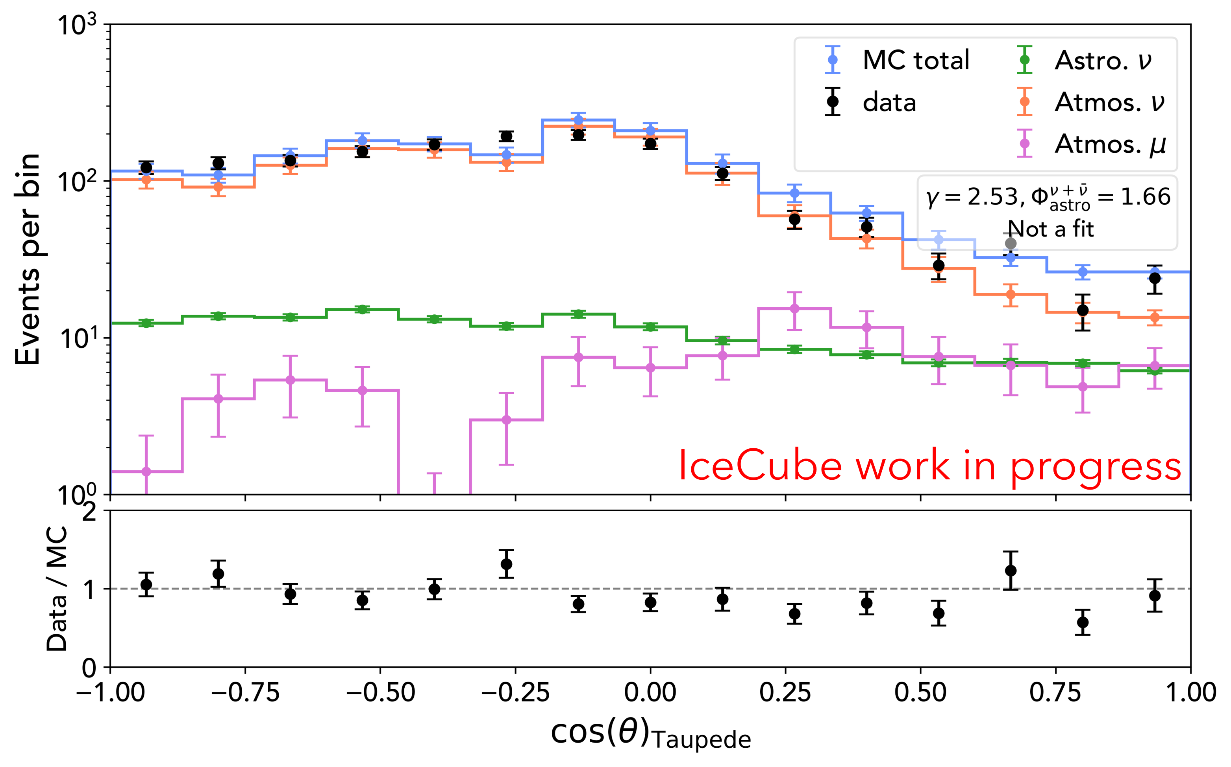
Data-Monte Carlo agreement
Stony Brook level 6 selection
Burn sample: 10% of events (livetime ~1.2 years)
1604 events
Best-fit spectrum from 2020 Stony Brook cascade analysis
Good agreement when including bright & DC DOMs
Promising outlook for high-energy analysis
9
ISCRA 2026
Christopher Eldridge

Slide 15
Summary and next steps
The inclusion of bright DOMs improves Taupede length reconstruction
The inclusion of DeepCore DOMs improves the reconstruction for most parameters; for energy it worsens
Good data/MC agreement with the Stony Brook cascade selection for both Monopod and Taupede with and without bright/DC DOMs.
Test statistics: rlogl-based and waveform-based
Long-term: analysis!
Inclusive tau search and flavour composition measurement
10
Bochum 2026 diffuse session
ISCRA 2026
Christopher Eldridge

Slide 16
Backup

Slide 17
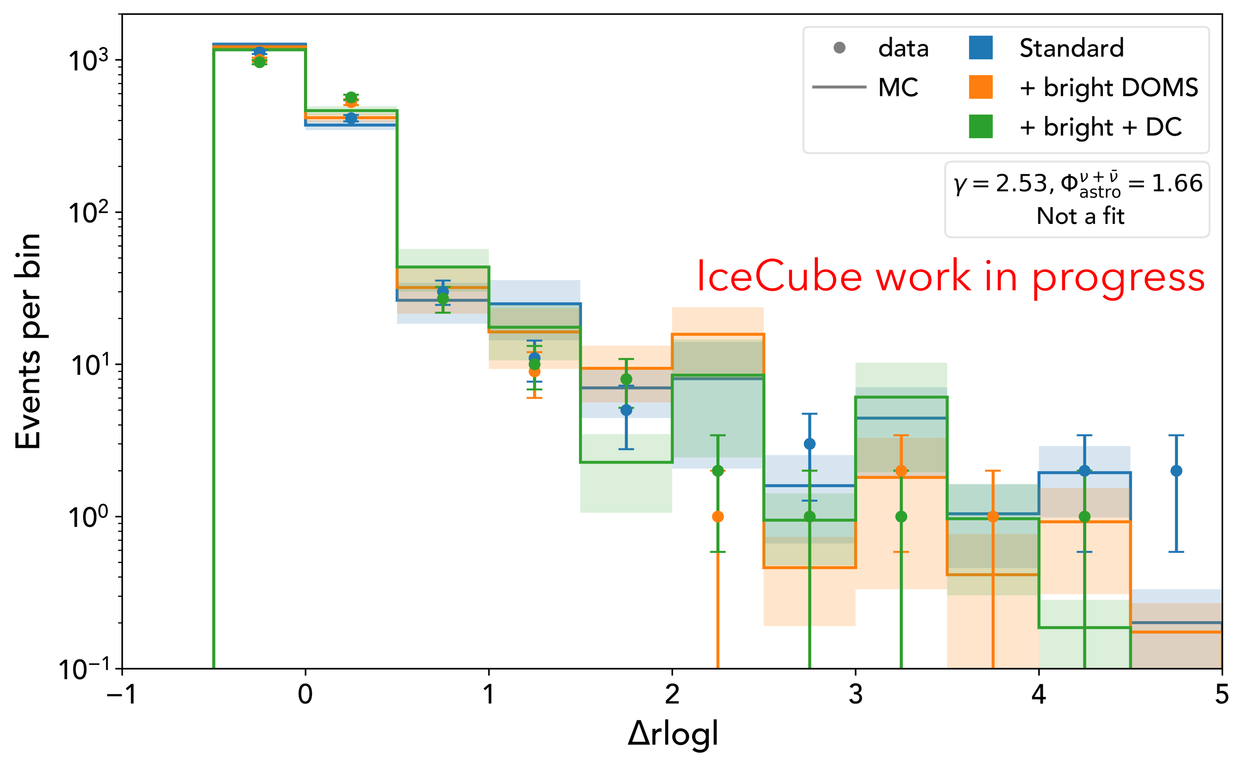
Data-Monte Carlo agreement
The difference in reduced log-likelihood between Monopod and Taupede is a key quantity for event classification
Data-MC agreement continues to hold when bright/DC DOMs are included
11
ISCRA 2026
Christopher Eldridge

