Slide 1














The Low Frequency (LF) instrument of the Payload for Ultrahigh Energy Observation (PUEO)
Yuchieh Ku
ISCRA 2026
Erice, Italy

Slide 2
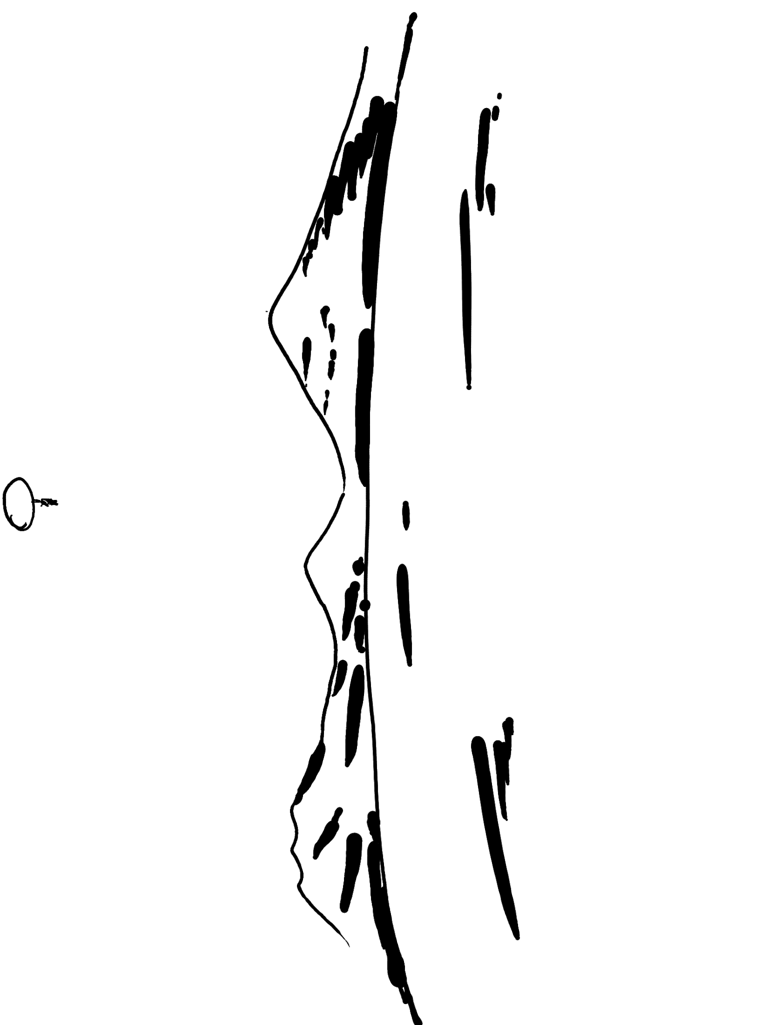
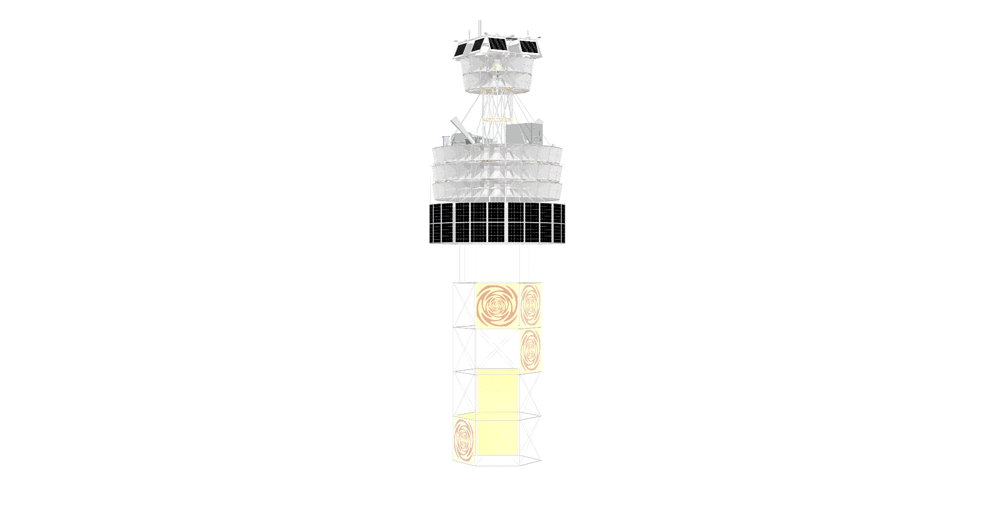


PUEO
35 km
PUEO is a NASA balloon-borne radio detector looking for UHE neutrinos using Antarctic ice
O(Mkm²) of ice

Slide 3
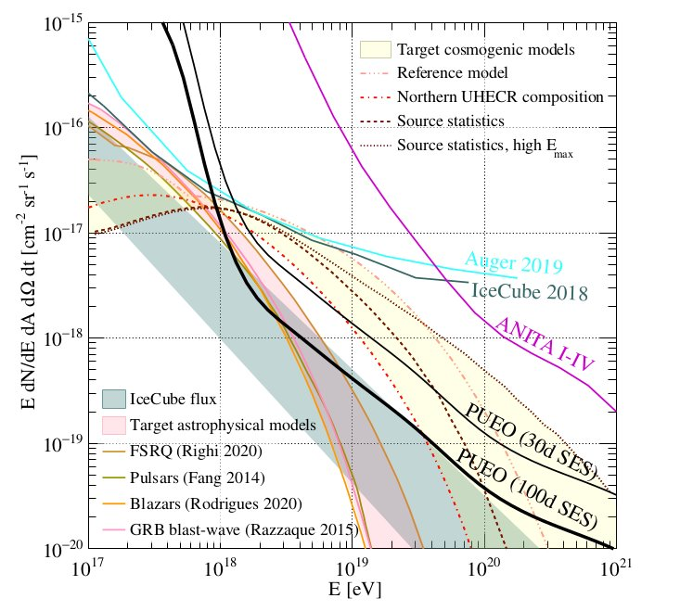
PUEO
35 km
PUEO is a NASA balloon-borne radio detector looking for UHE neutrinos using Antarctic ice
O(Mkm²) of ice

Slide 4
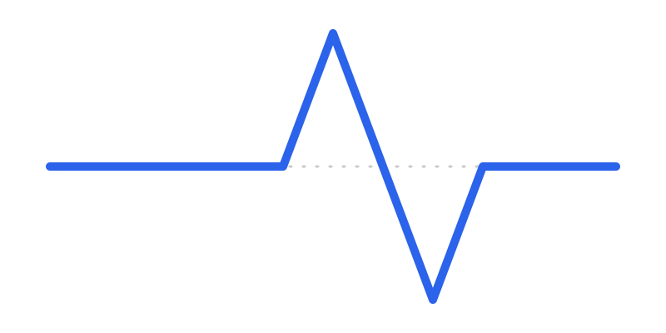

PUEO’s science channel - Askaryan
θ=56°

Slide 5
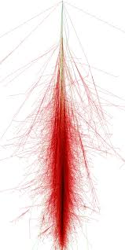

PUEO’s science channel - Extensive air shower
CR
θ=1.4°
CR

Slide 6
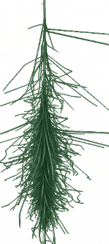
PUEO/ANITA’s science channel - EAS
CR
CR
decay
𝝉
CC interaction
𝝂_{𝝉}

Slide 7
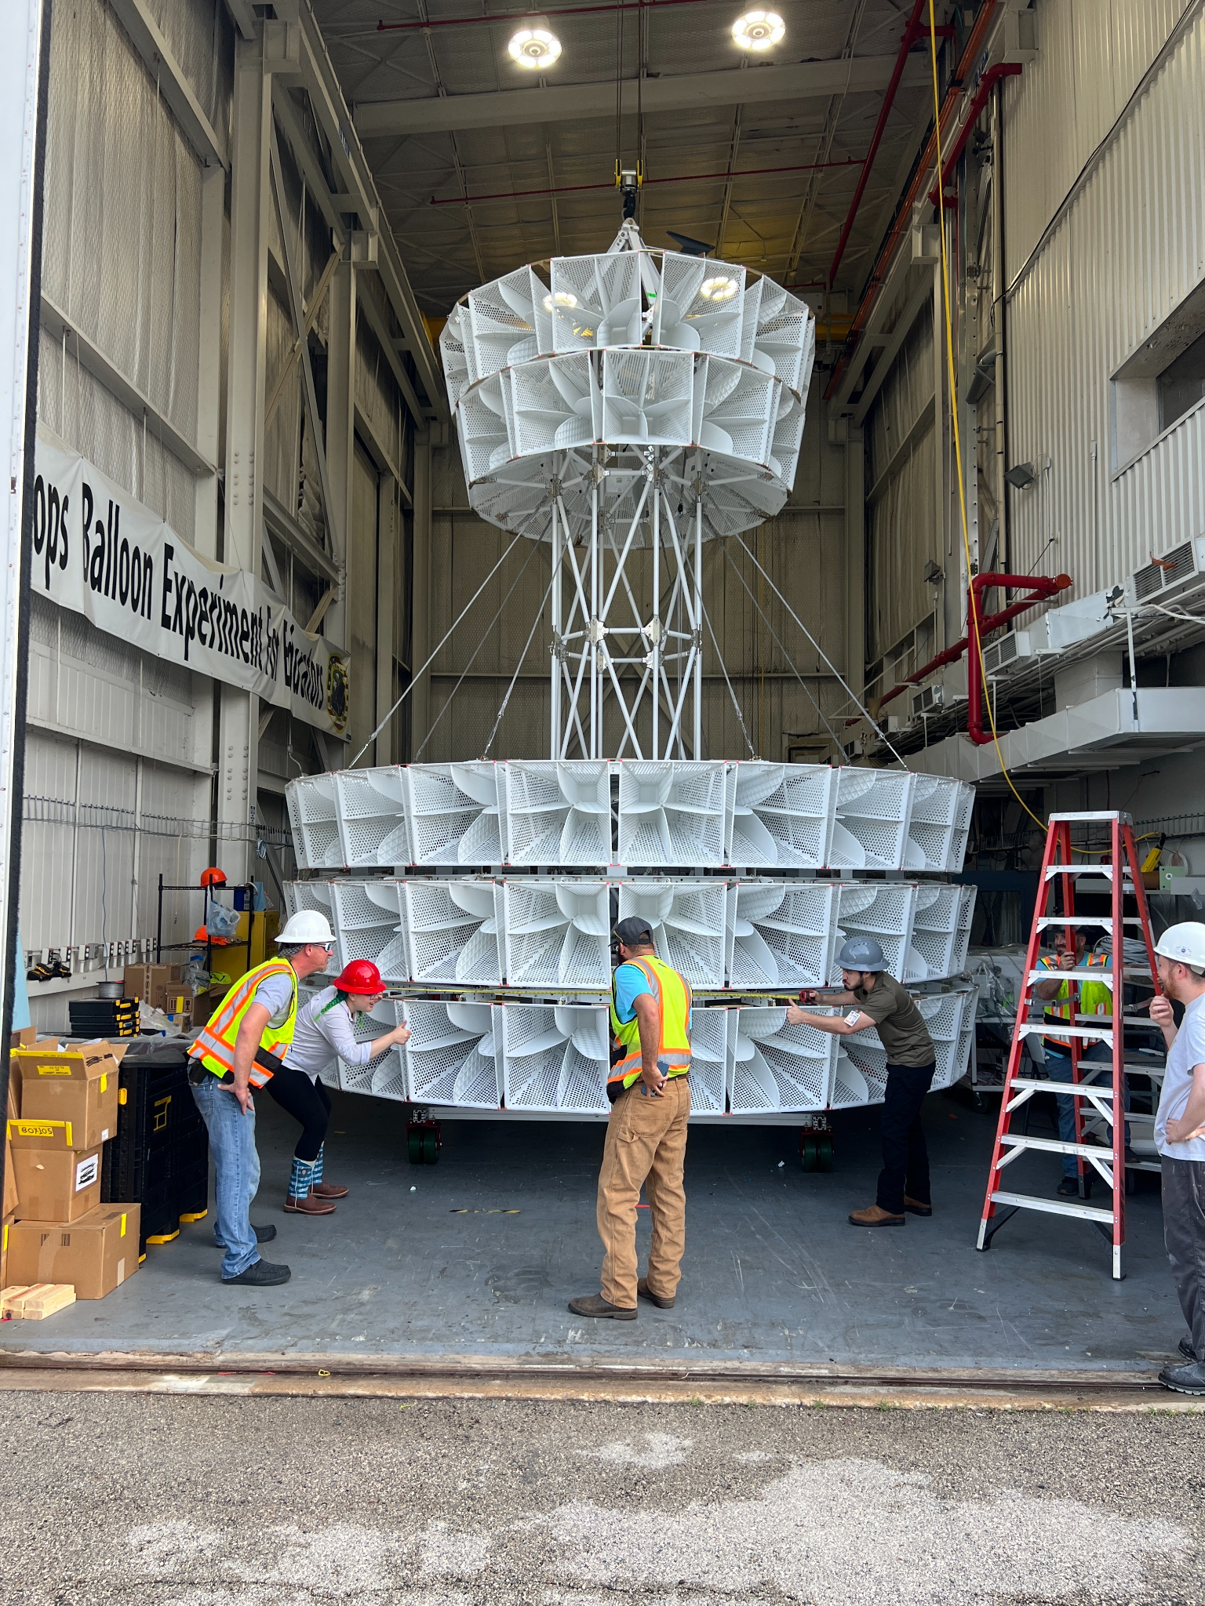
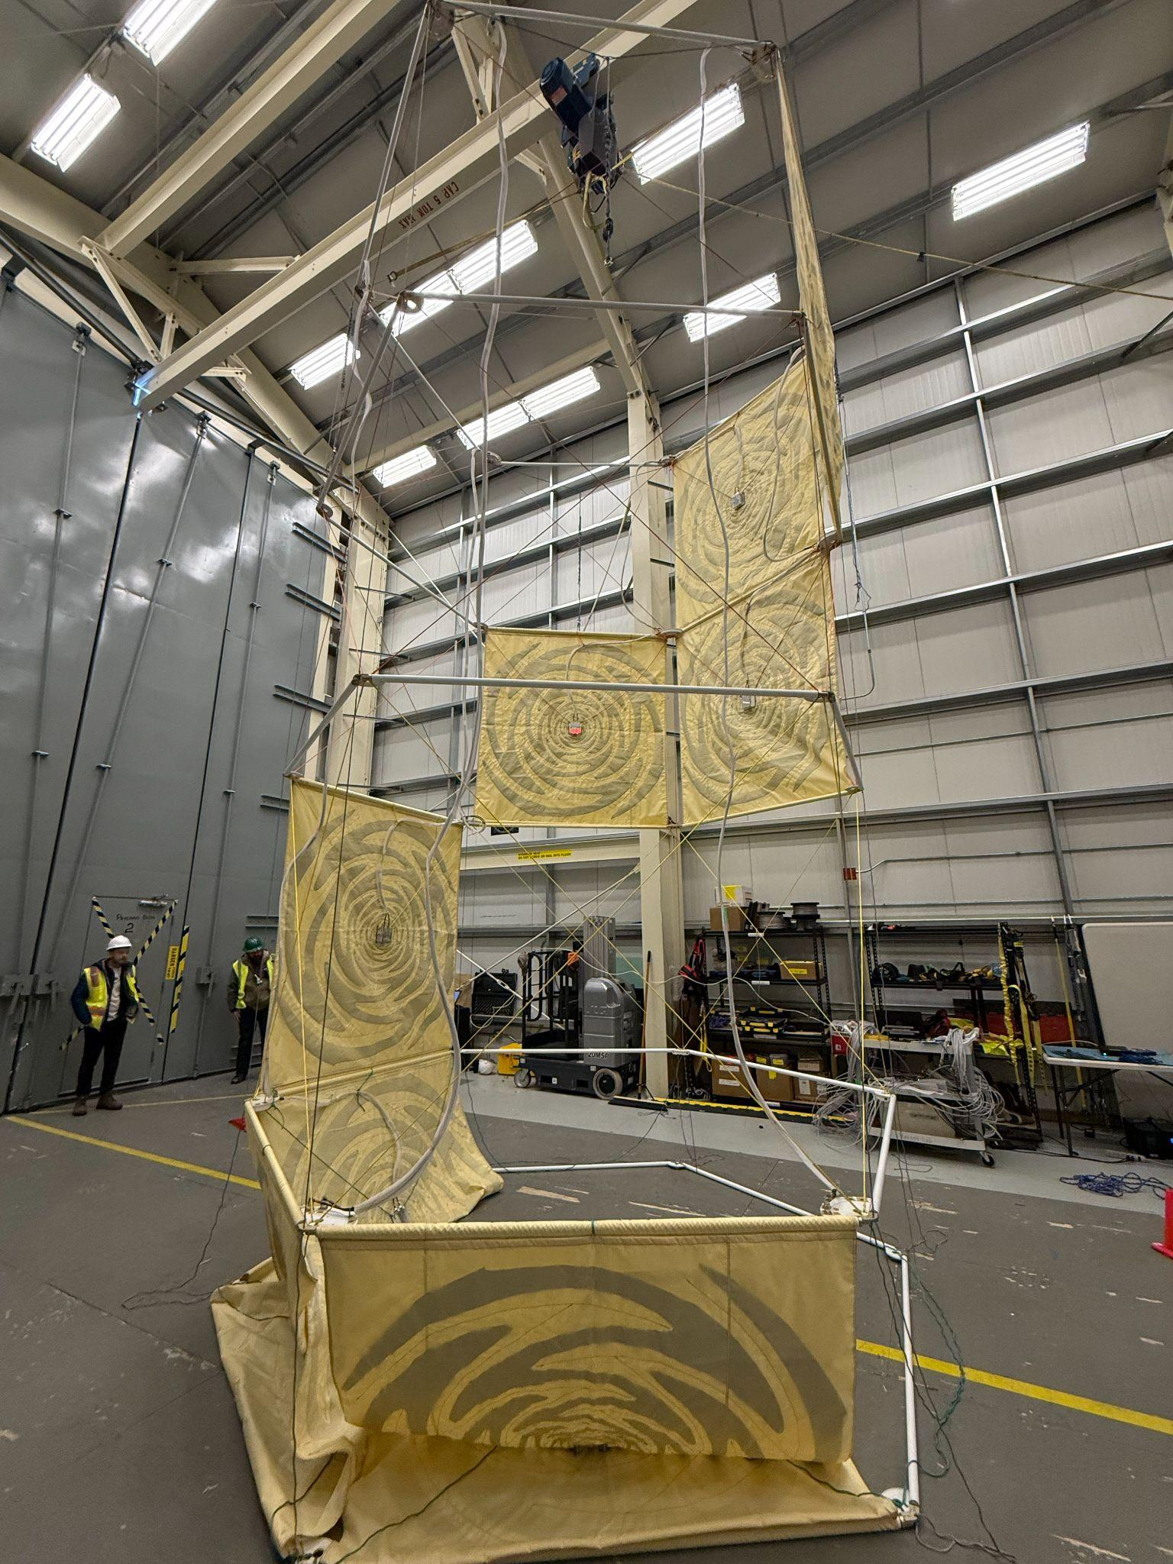
Payload for Ultrahigh Energy Observation
MI
LF
Main Instrument (MI): 96 Horn antennas operating at 300-1200 MHz
LowFreq Instrument (LF) : 8 sinuous antennas operating at 50-500 MHz

Slide 8
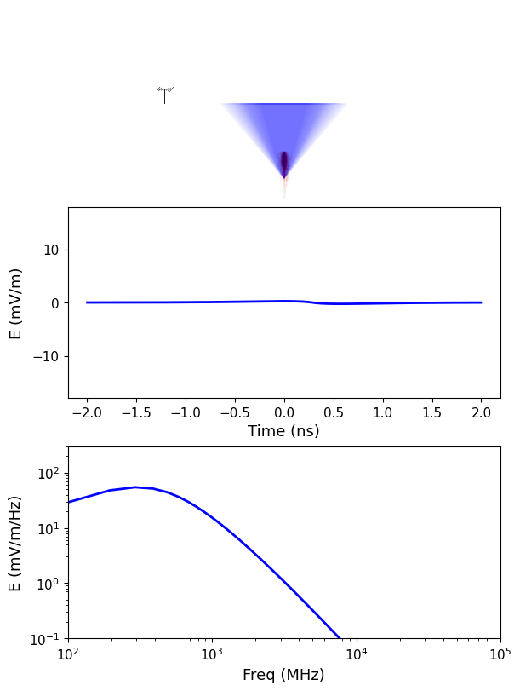
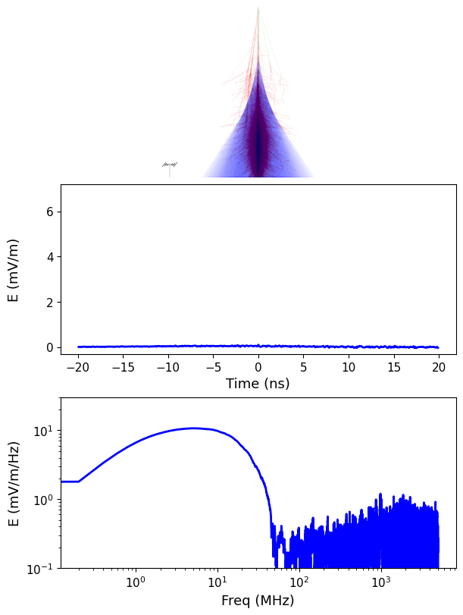
Why LF?
Cross validation/extend spectra for Askaryan channel
Air shower channel is LowFreq dominant
Independently measure
1.Polarization
2.Polarity (+/-)
3.Direction
LF
MI
LF
MI
A. Cummings
Notes:
Maybe add another slide about Tau channel

Slide 9
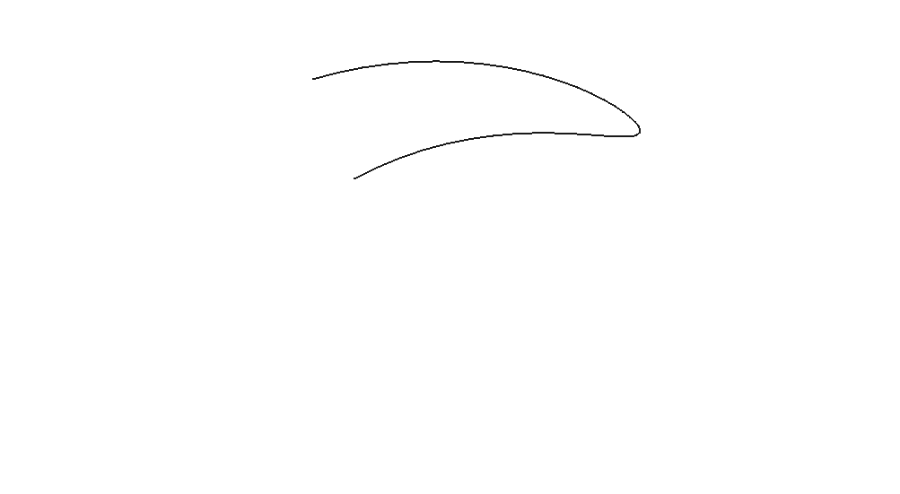
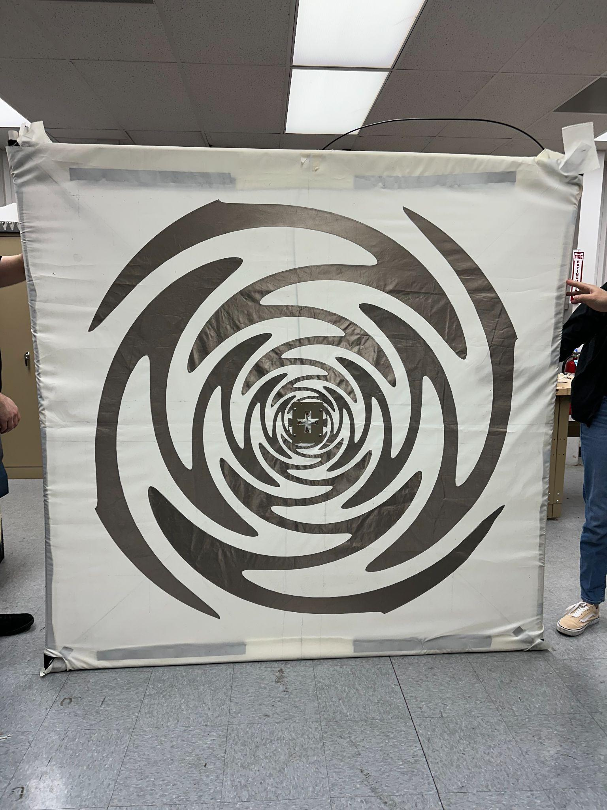
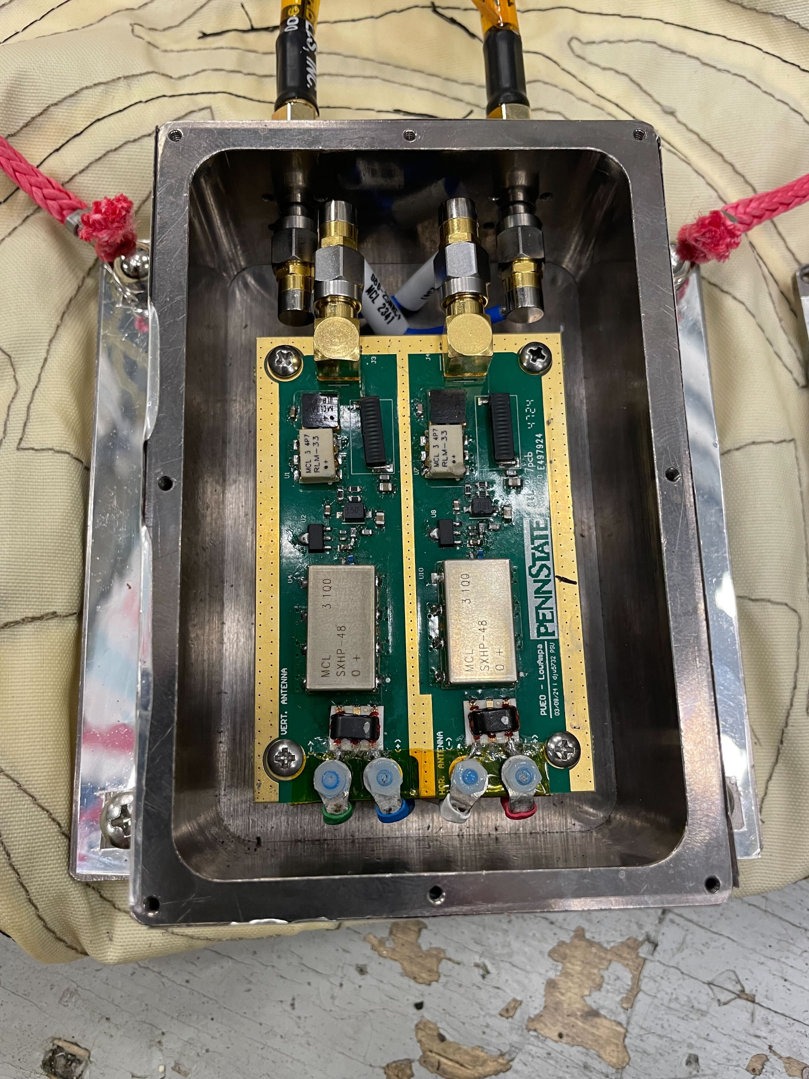
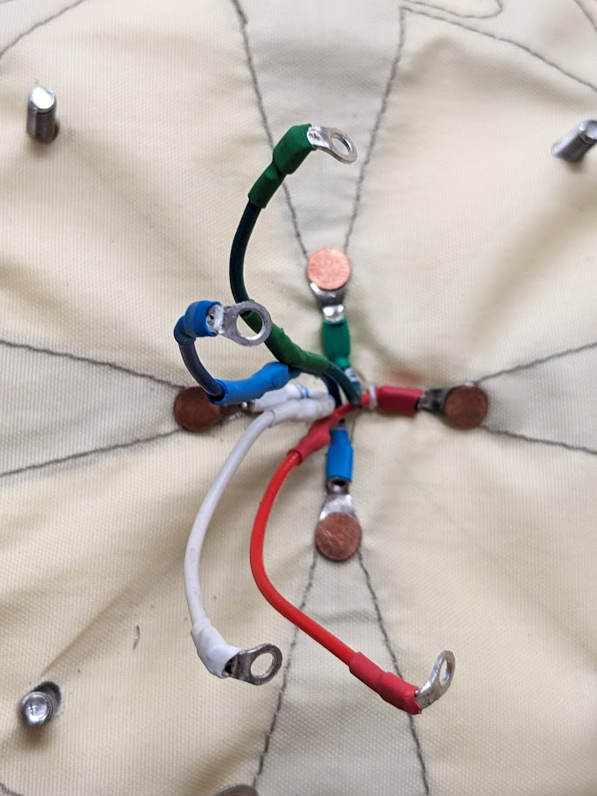
LF Sinuous Antenna
Log-periodic "Sinuous" antenna operates at 50-500 MHz.
Rp
Dual polarized, independent Horizontal/Vertical polarization
Nickel-Copper-Silver fabric sewn on polyester
Rp
H port
V port
V port
H port

Slide 10
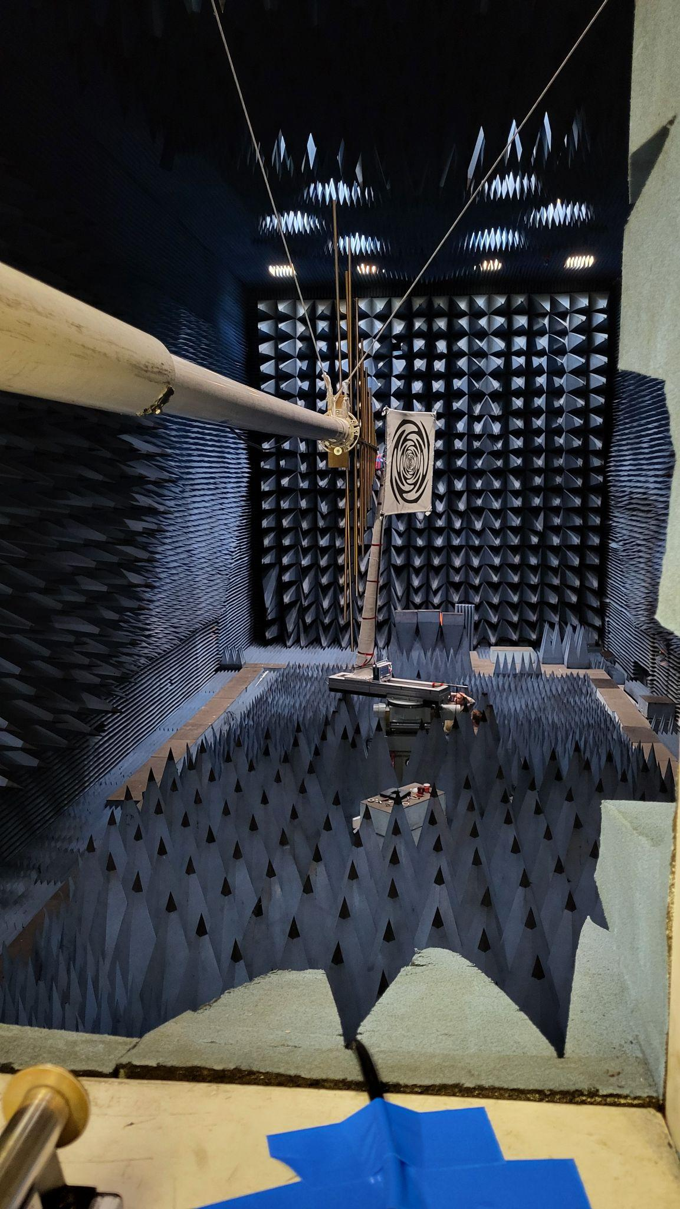
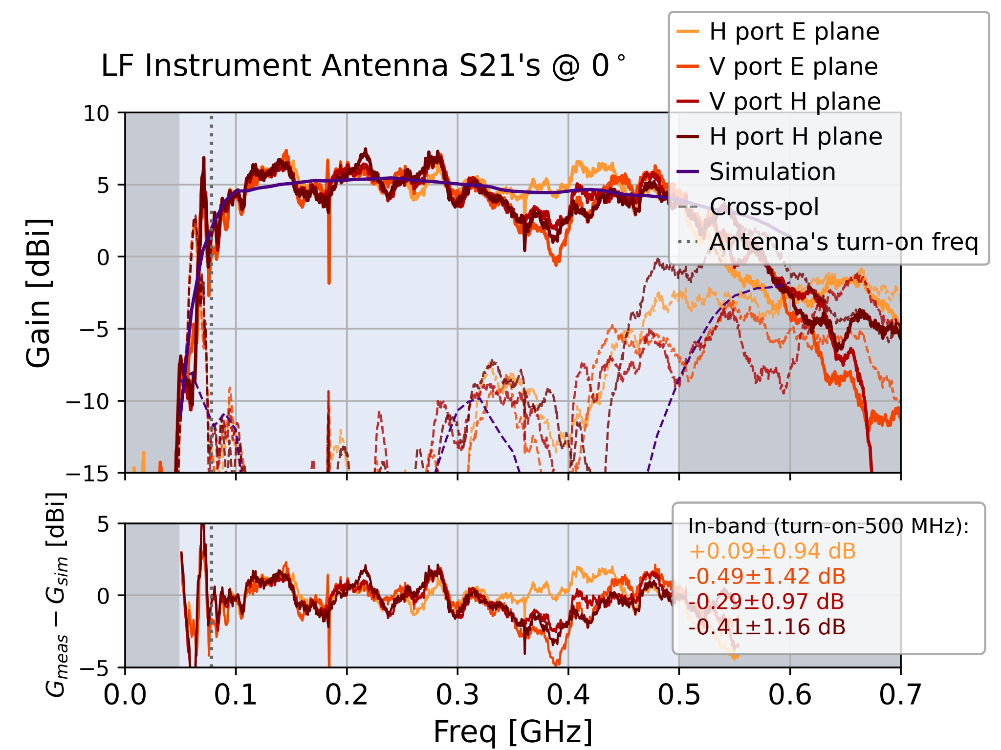
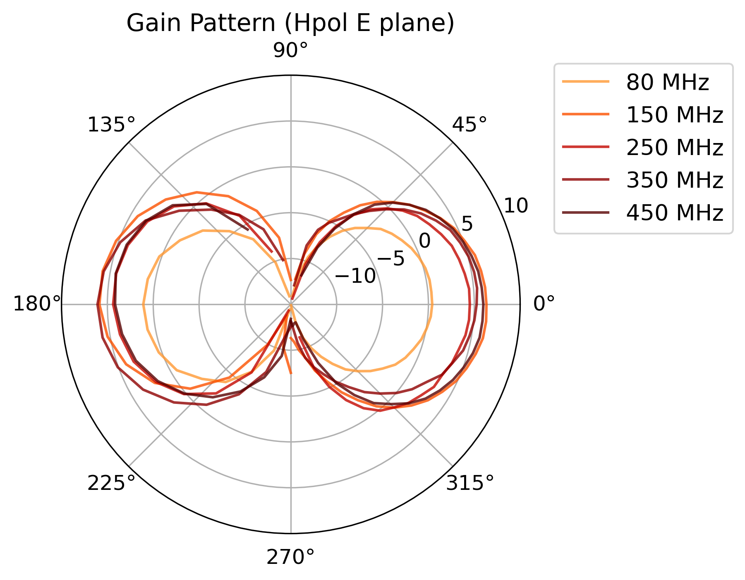
LF Antenna Design and Measurements
Identical back and front lobes.
4-6 dBi gain at boresight.
60°+ 60° antenna beam width.
Top view
back
front
Applied Research lab anechoic chamber at Warminster, PA

Slide 11
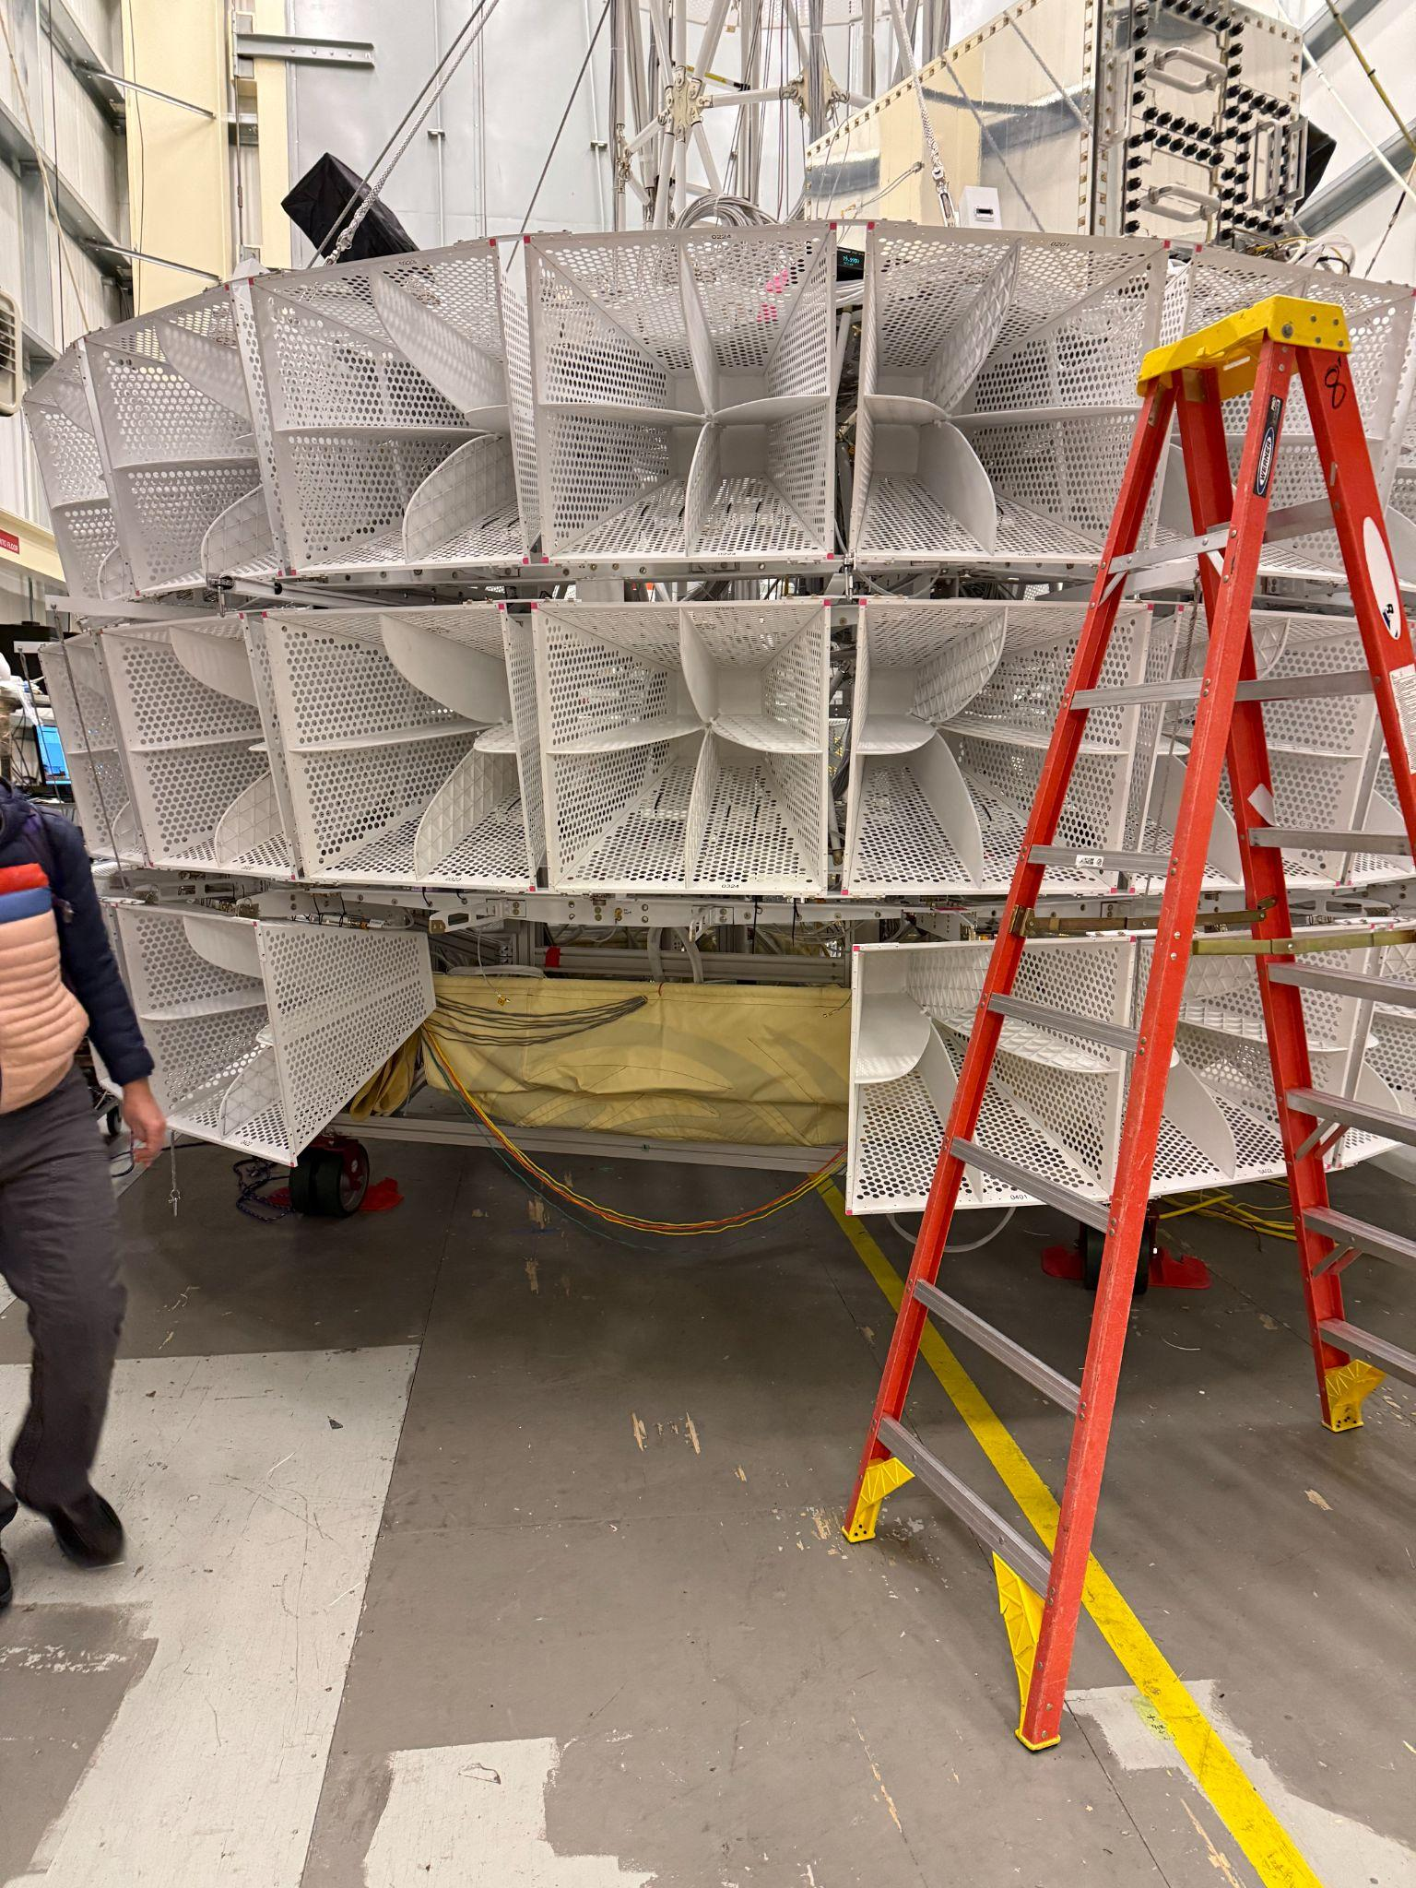
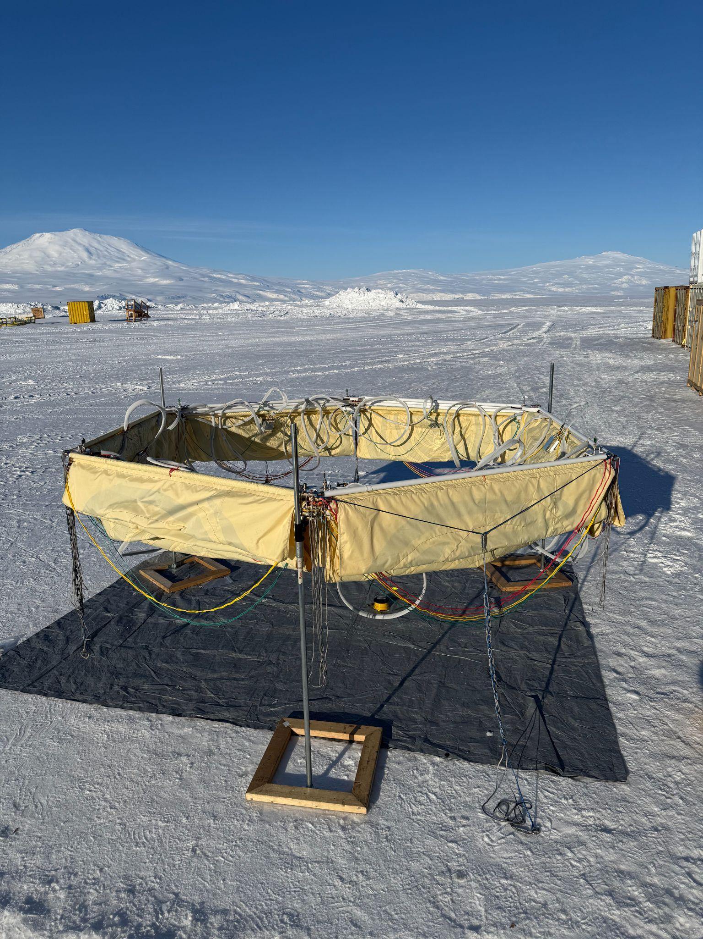
Deployment
backup

Slide 12
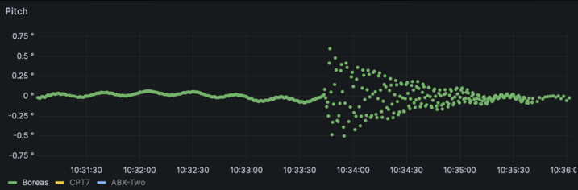
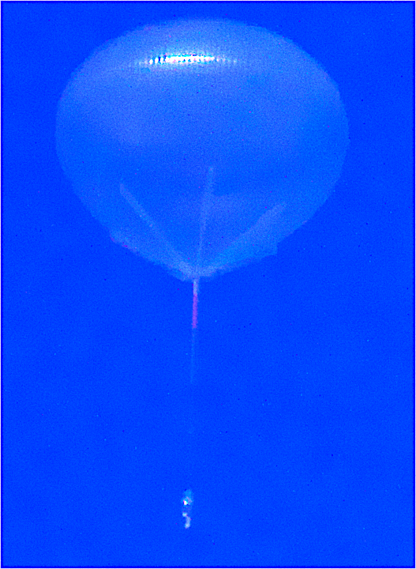
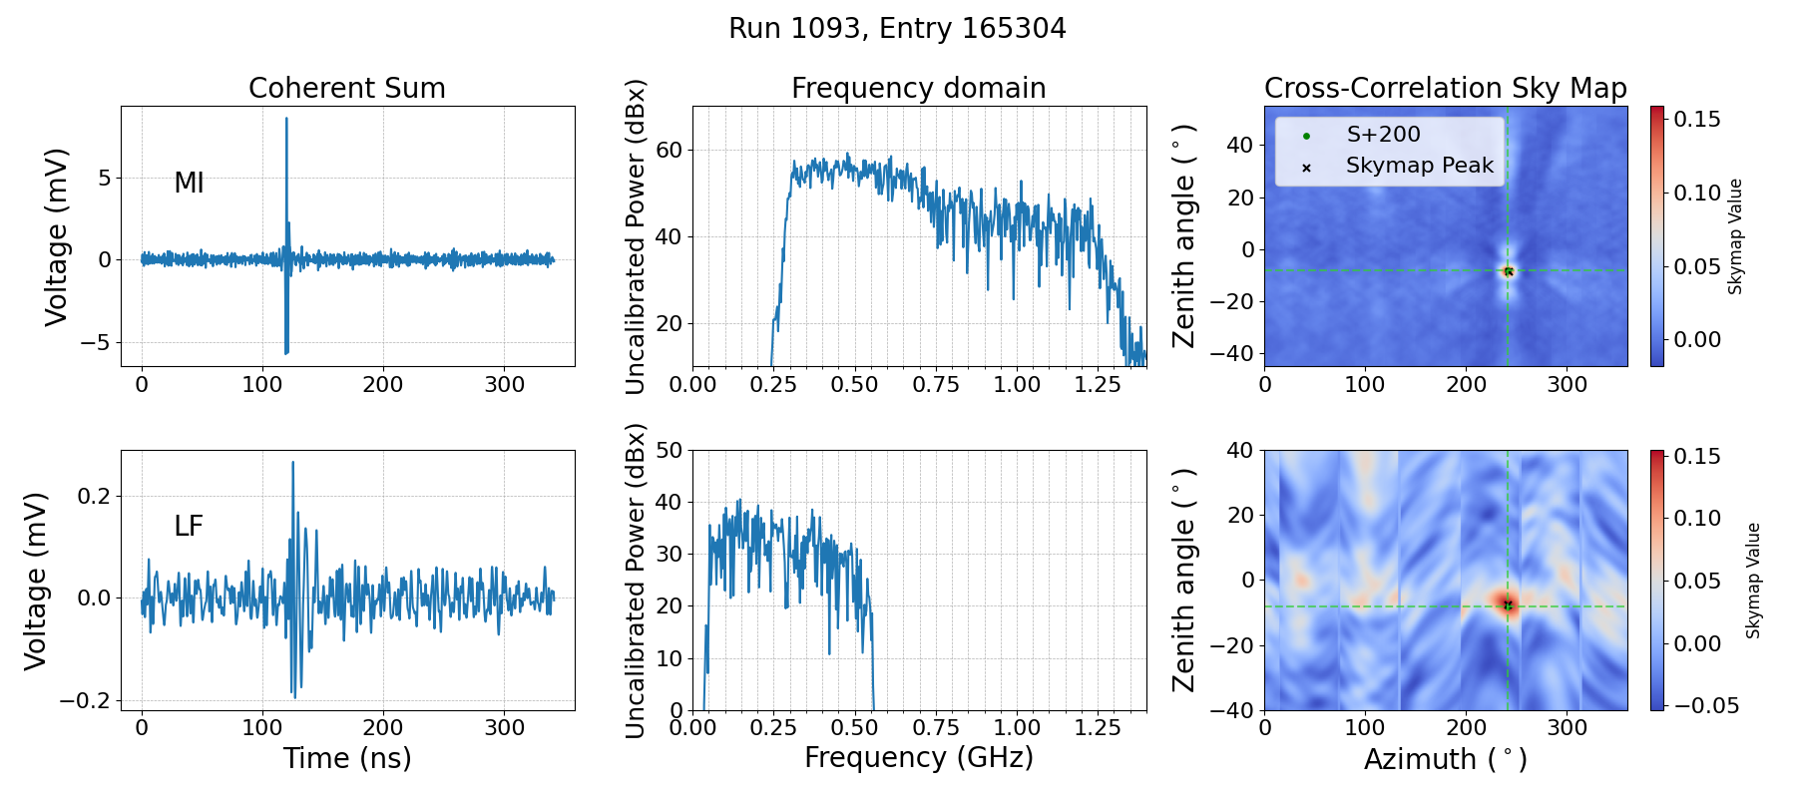

Deployment & performance of LF
Jolt seen in Nav system
Ground Calibration pulser event seen in both MI and LF
Notes:
Explain MI and LF rows better
map

Slide 13
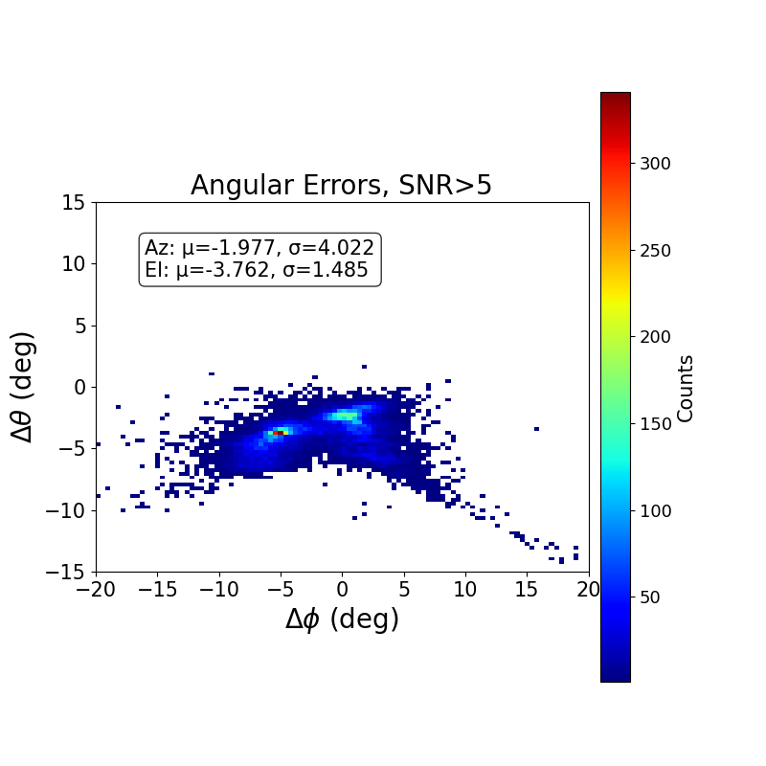
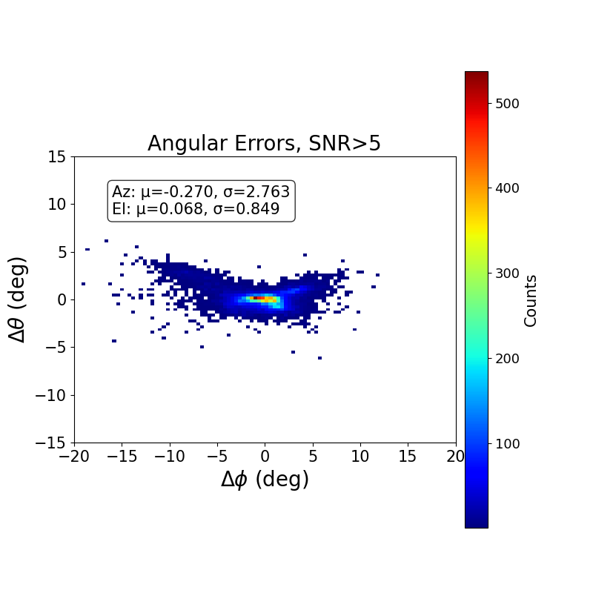
LF pointing resolution
Uncalibrated
After Position Calibration
Preliminary
0.8° resolution in elevation
2.8 °resolution in azimuth

Slide 14
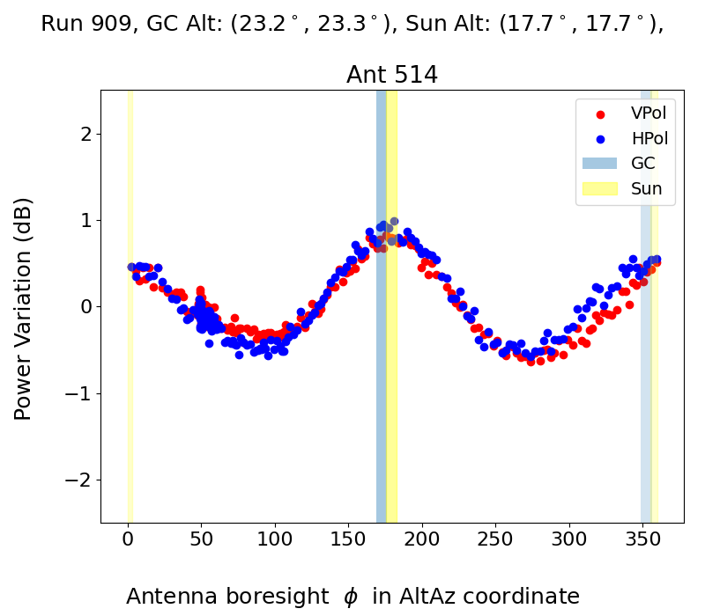

Galactic noise in LF
Payload spinning
(θ_{GC},ɸ_{GC})
Ant boresight (θ_{Ant},ɸ_{Ant})
Noise power is correlated with antenna orientation relative to the Galactic center (GC).
During the flight, the Sun remained within ~10° of the Galactic Center, making the two contributions difficult to separate. However, during the quiet sun periods (no solar burst) galactic emission is expected to be 1-2 orders of magnitude brighter.
Galactic noise provides a stable reference and will be used to calibrate the LF instrument.
*Band pass to 50-300 MHz
Notes:
Sun vs galaxy. stacked map

Slide 15
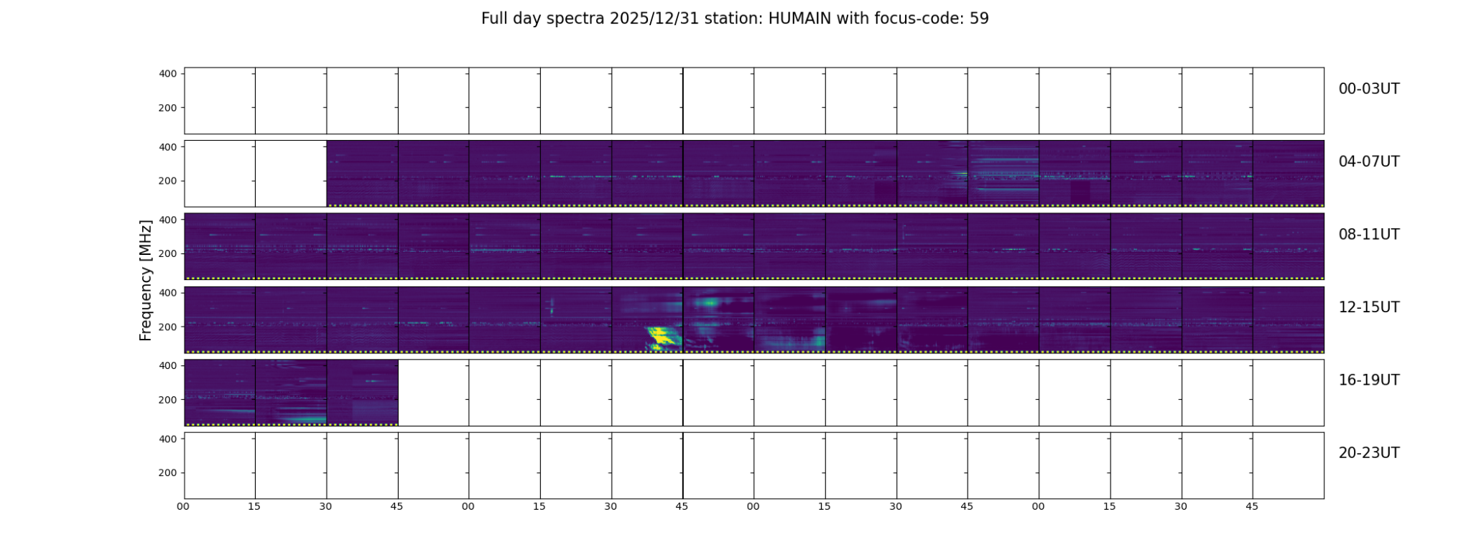
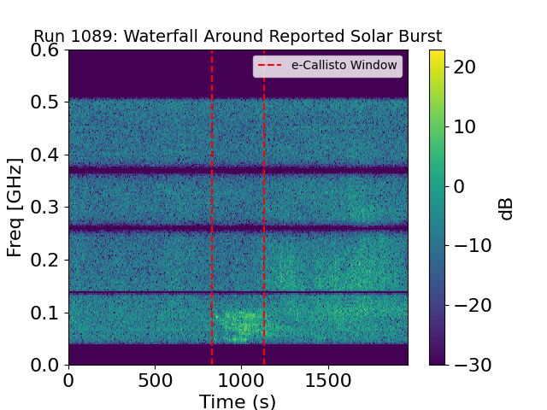
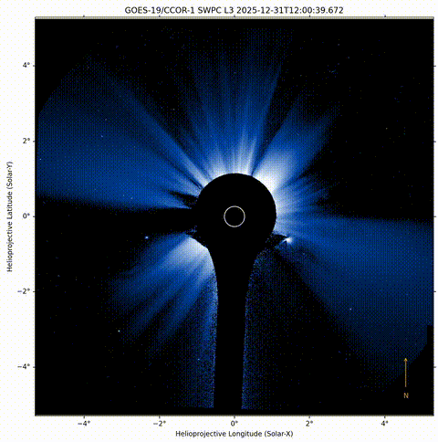
Solar radio bursts in LF
e-Callisto International Network reported ~130 solar radio bursts coincident with PUEO’s flight.
O(10,000) unbiased events (triggered on GPS second) in PUEO’s LF are associated with solar bursts and reconstruct back to sun location
HUMAIN observatory
LF spectrogram

Slide 16
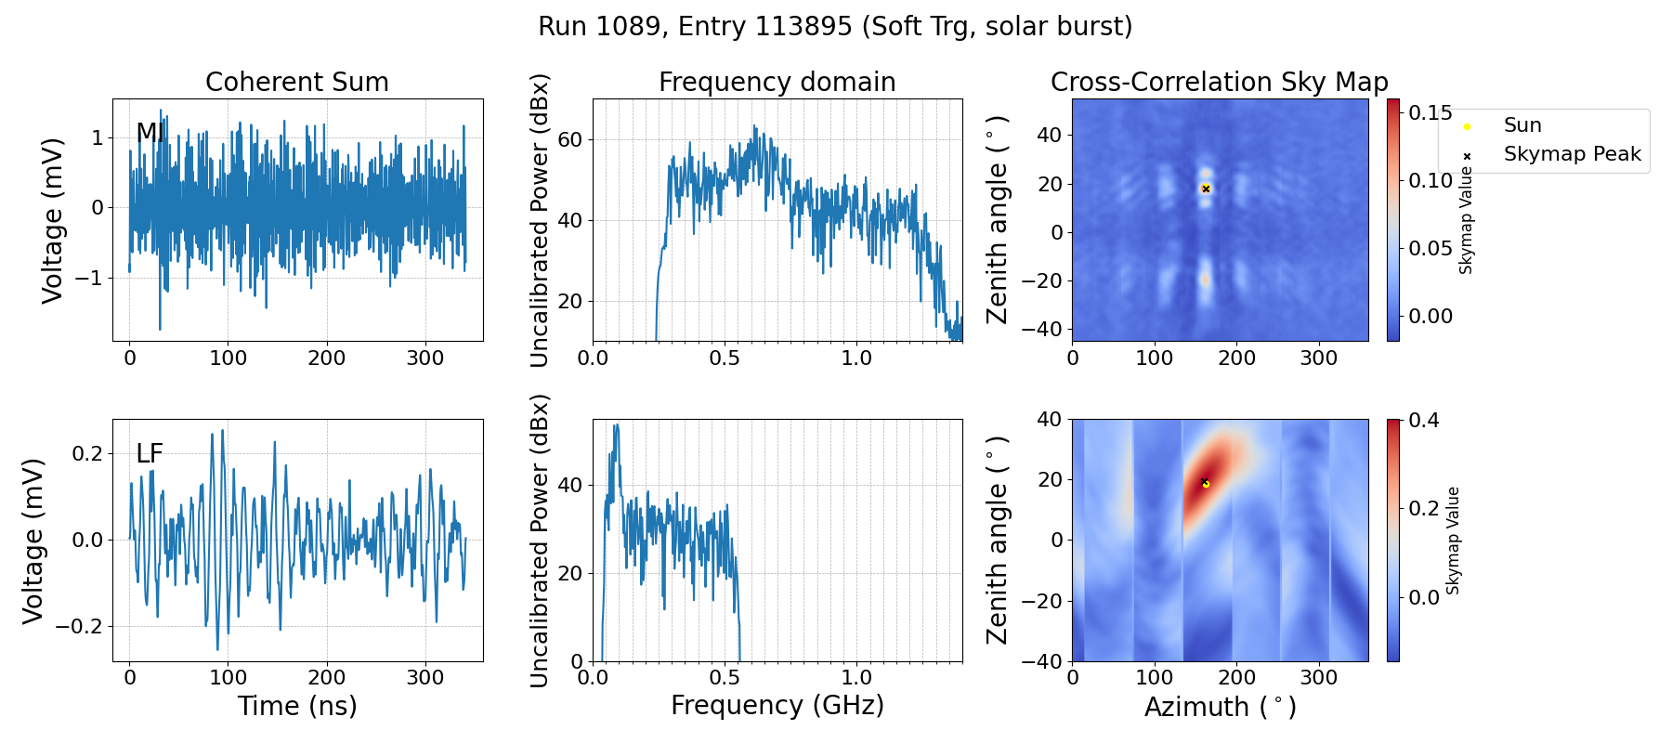
Solar radio bursts in LF

Slide 17
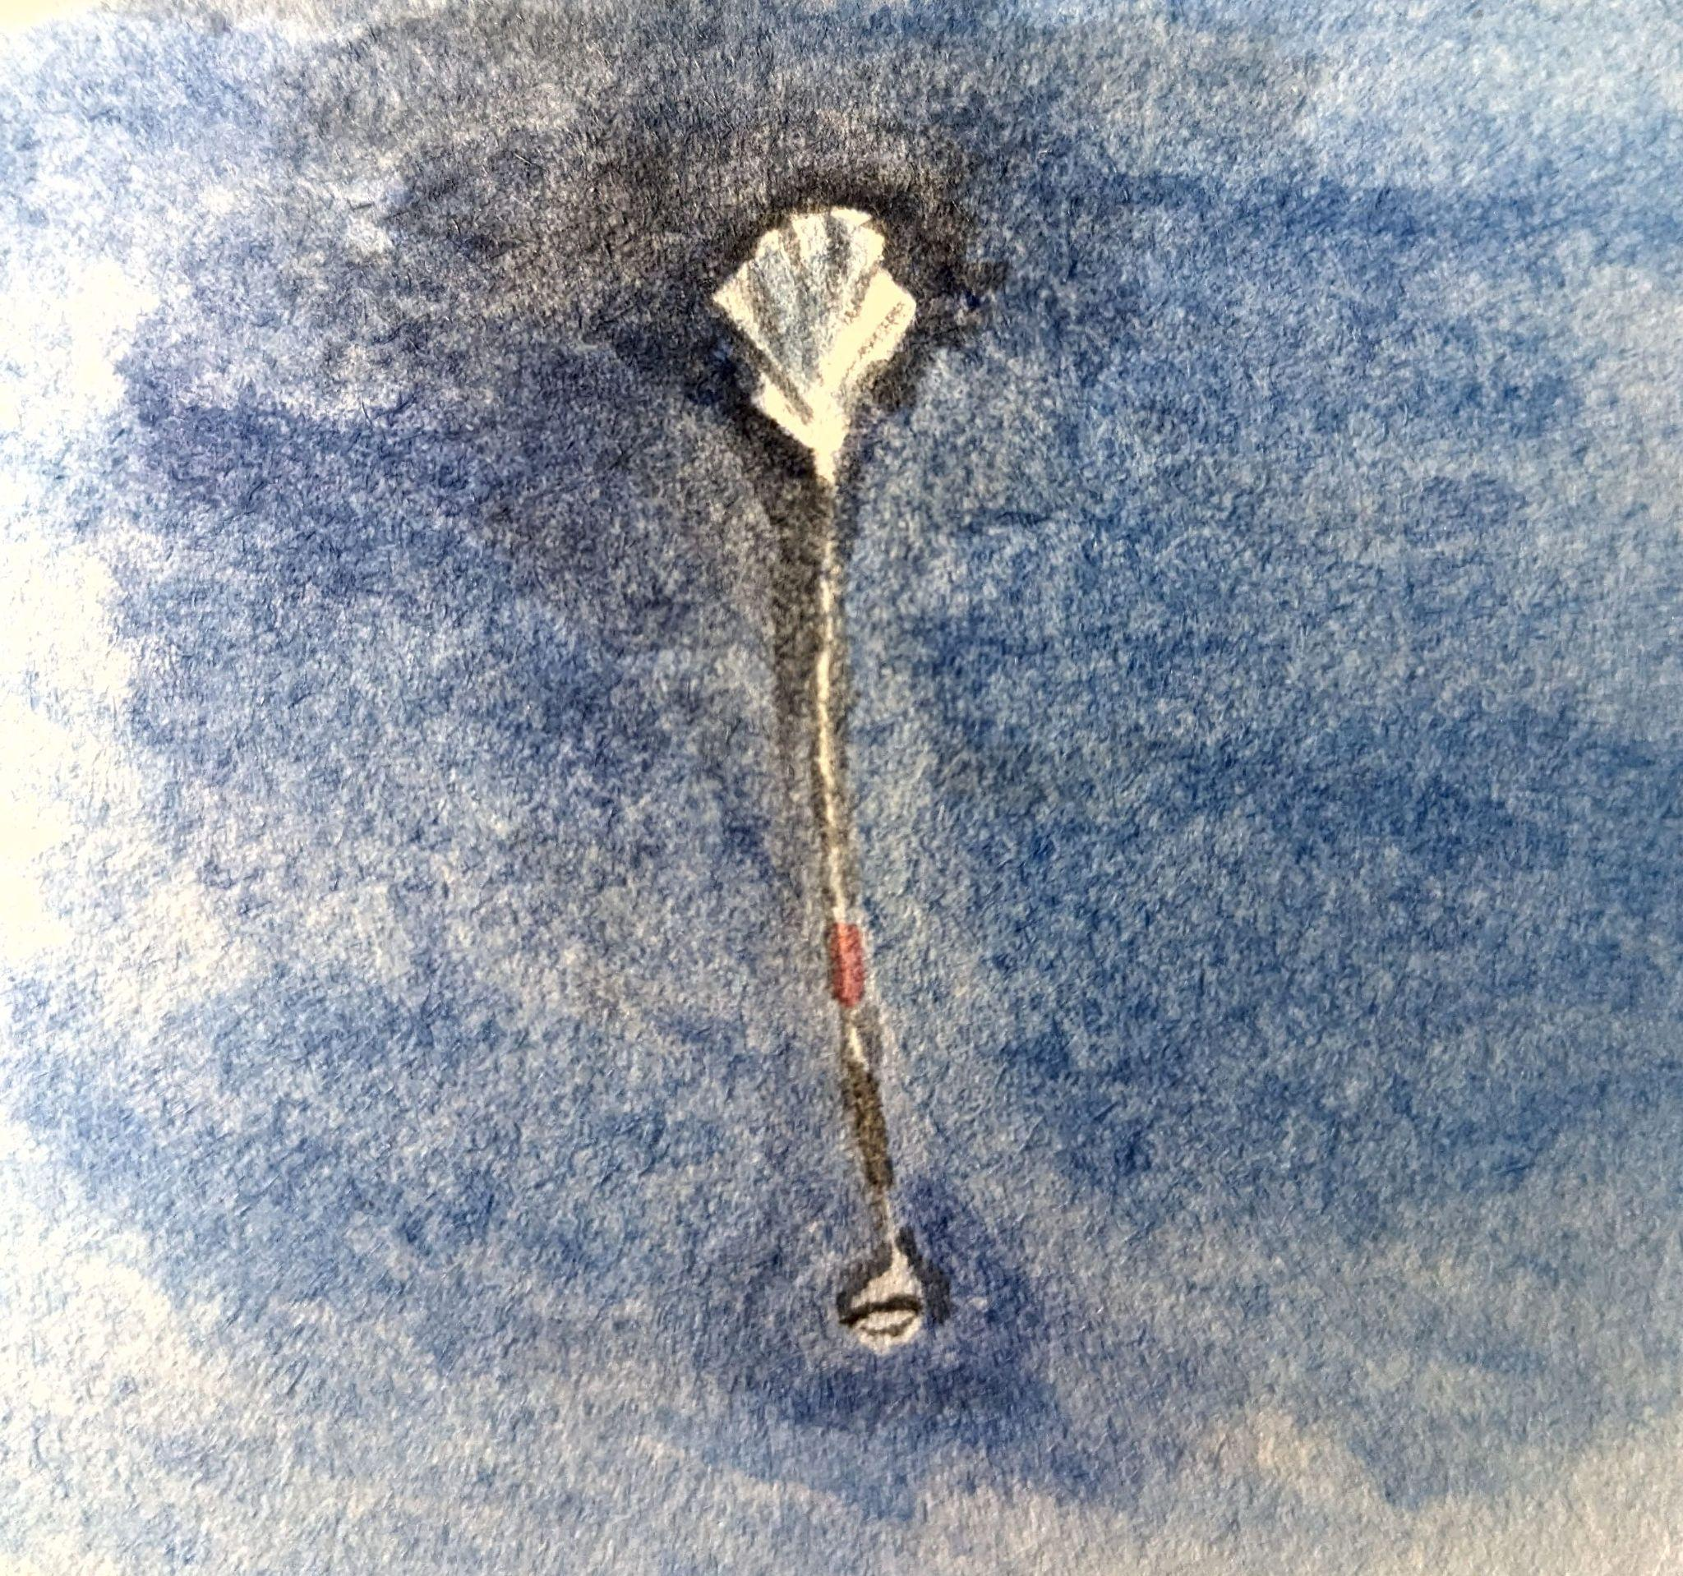
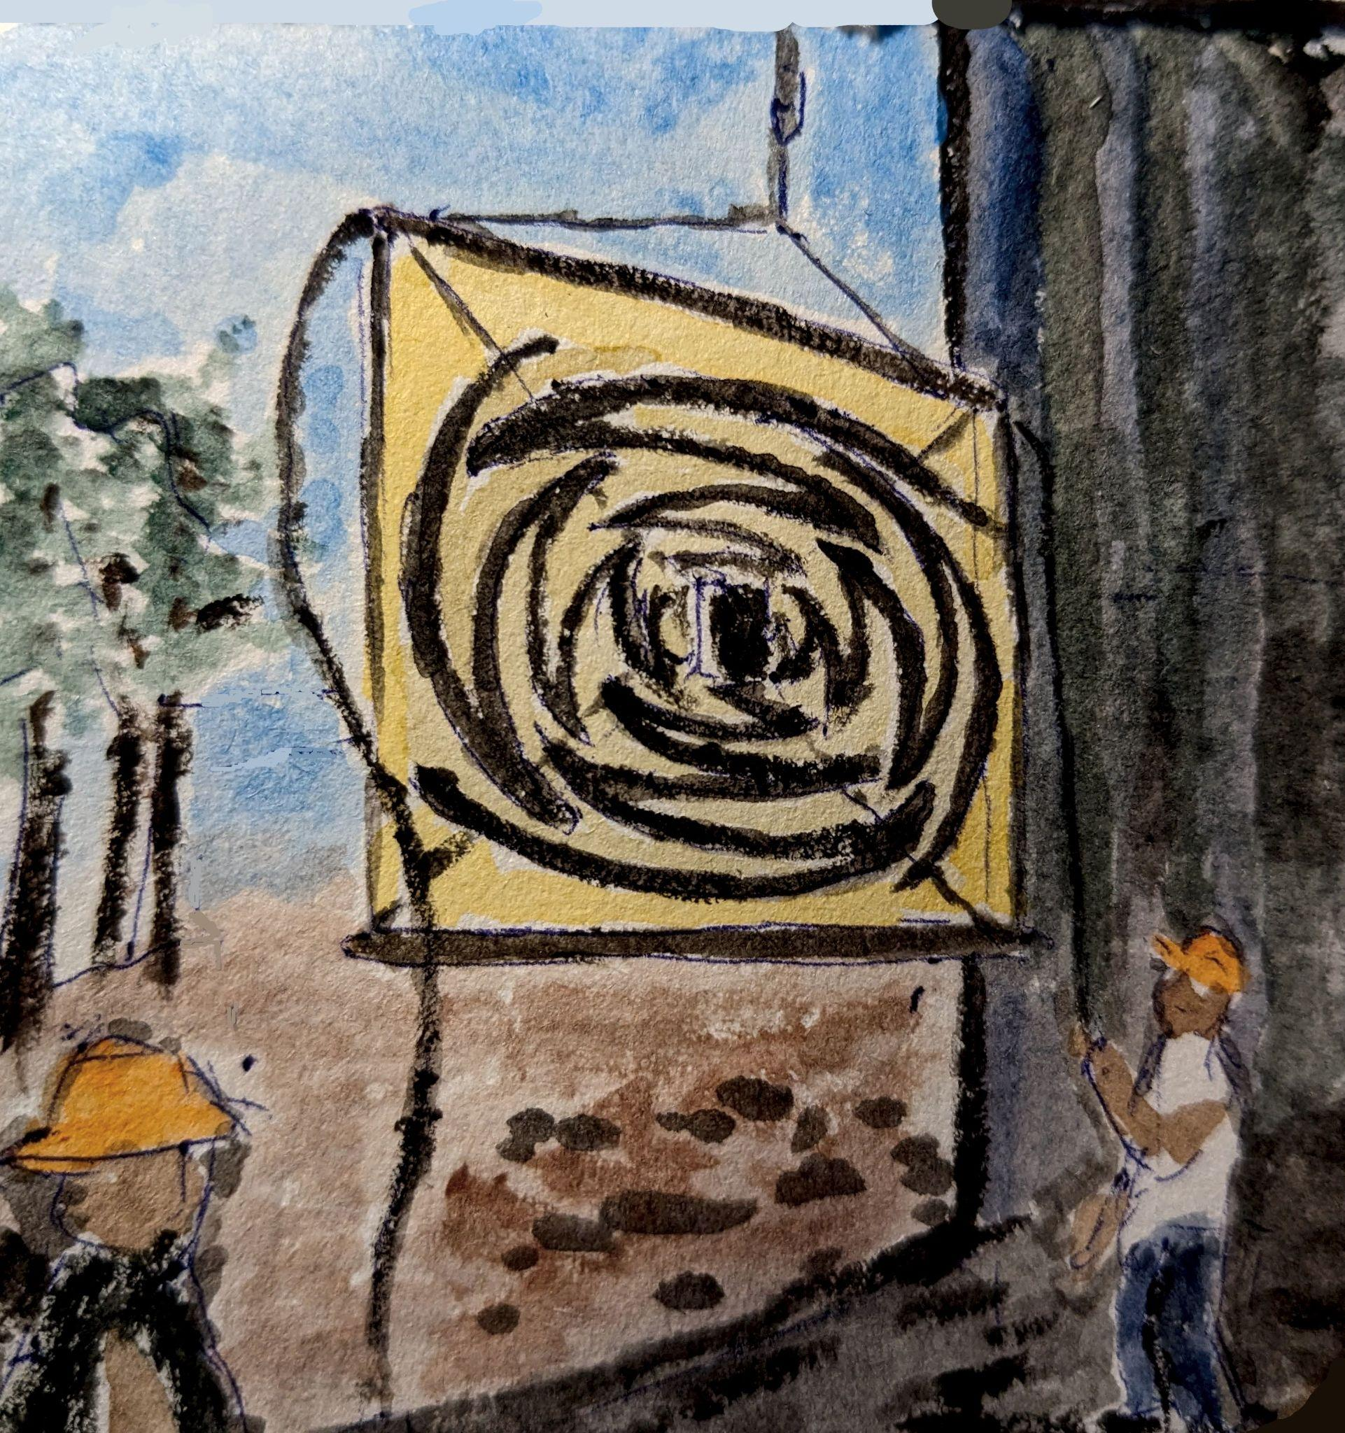
Summary
LF completed a successful 23 day 10 hour flight with PUEO!
LF will independently quantify signal properties, aiding PUEO in categorizing backgrounds for neutrino searches.
LF is in particular sensitive to EAS signals.
Position calibration of the LF antennas has been performed.
LF noise is dominated by galactic emission < 200 MHz, providing a calibration source.
LF observes events consistent with solar radio bursts, demonstrating how LF expands the science reach of PUEO.

Slide 18
Back ups

Slide 19
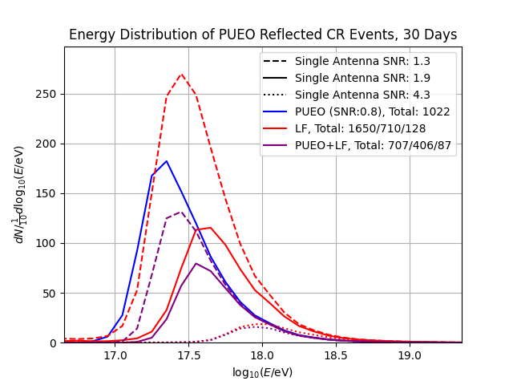
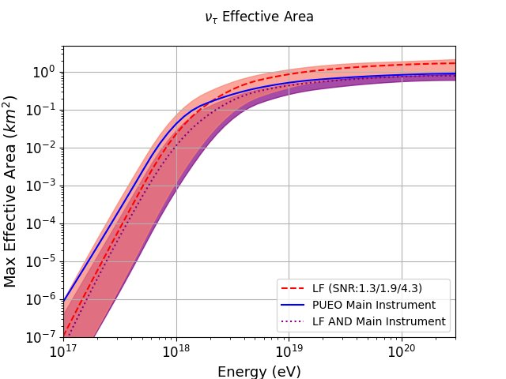
Science of LF: taus & reflected-CRs
*Blue curve is what we flew in PUEO, red are with the LF trg (PUEO II)
Preliminary
Preliminary
A. Cummings
LF increases PUEO’s effective area to the CRs and taus.
A thousand reflected CR events are expected in PUEO’s flight. With information from both MI and the LF.

Slide 20
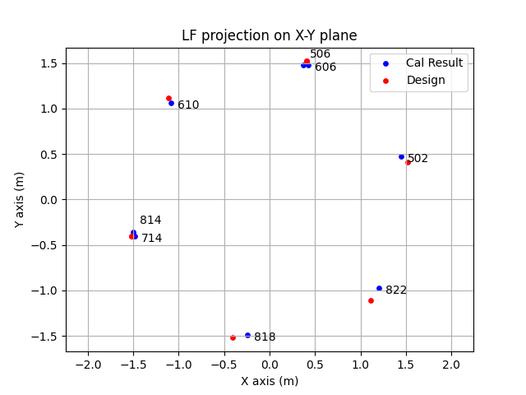
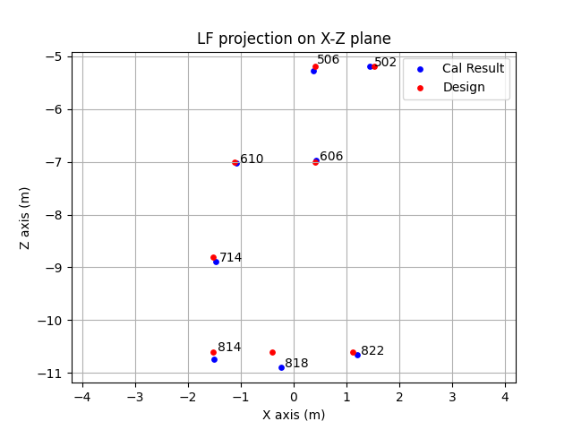
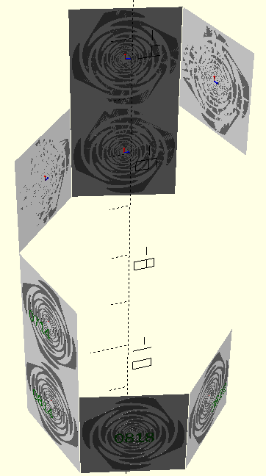
LF Antenna position calibration
Calibration performed by varying antenna positions to minimize the difference between expected and measured time delays for antenna pairs.
~22,000 ground calibration events from Taylor Dome VPol were used over a 5–6 hour period.
Preliminary
Preliminary
Design geometry
Calibration uncertainties from MC study: r ~ 1 cm, ϕ ~ 0.5 °, z ~ 5 cm
For comparison purpose, a translation on X-Y plane is applied to center the LF.
*X,Y,Z directions are align with payload coor, but origin is not
 | 502 | 506 | 606 | 610 | 714 | 814 | 818 | 822
Δr (cm) | -4.8 | -4.7 | -3.4 | -5.3 | -3.7 | -2.7 | -6.5 | -2.6
Δφ(°) | 3.09 | 0.86 | -0.94 | 0.55 | 0.22 | -1.76 | 5.77 | 6.05
Δz(cm) | 0 | -8.5 | 2.1 | -2.8 | -8.2 | -13.7 | -29.8 | -5.7
ΔCable delay (ns) | 0 | 0.05 | 0.43 | -0.04 | -0.09 | 1.03 | 1.10 | 1.05
Notes:
Error bar

Slide 21
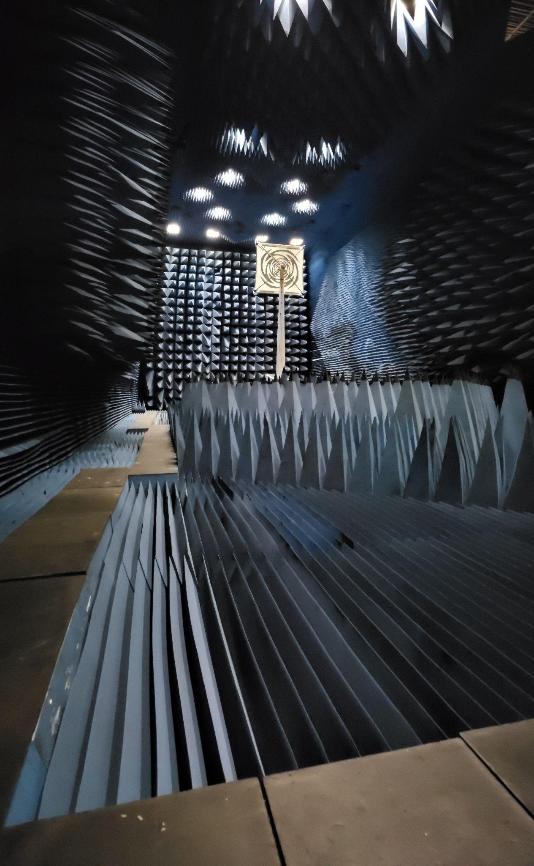
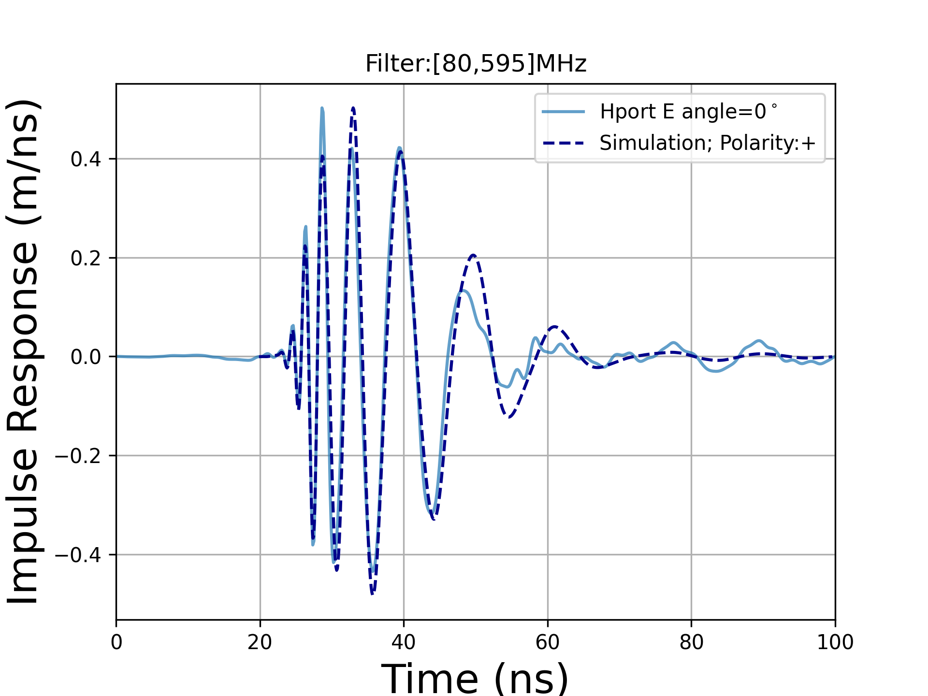
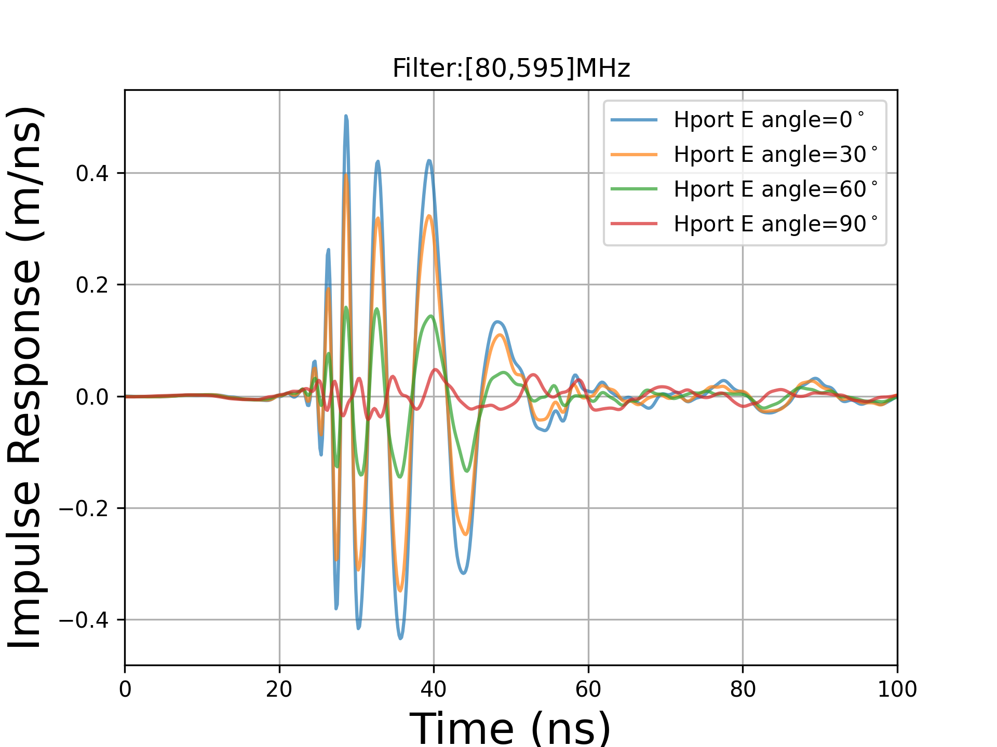
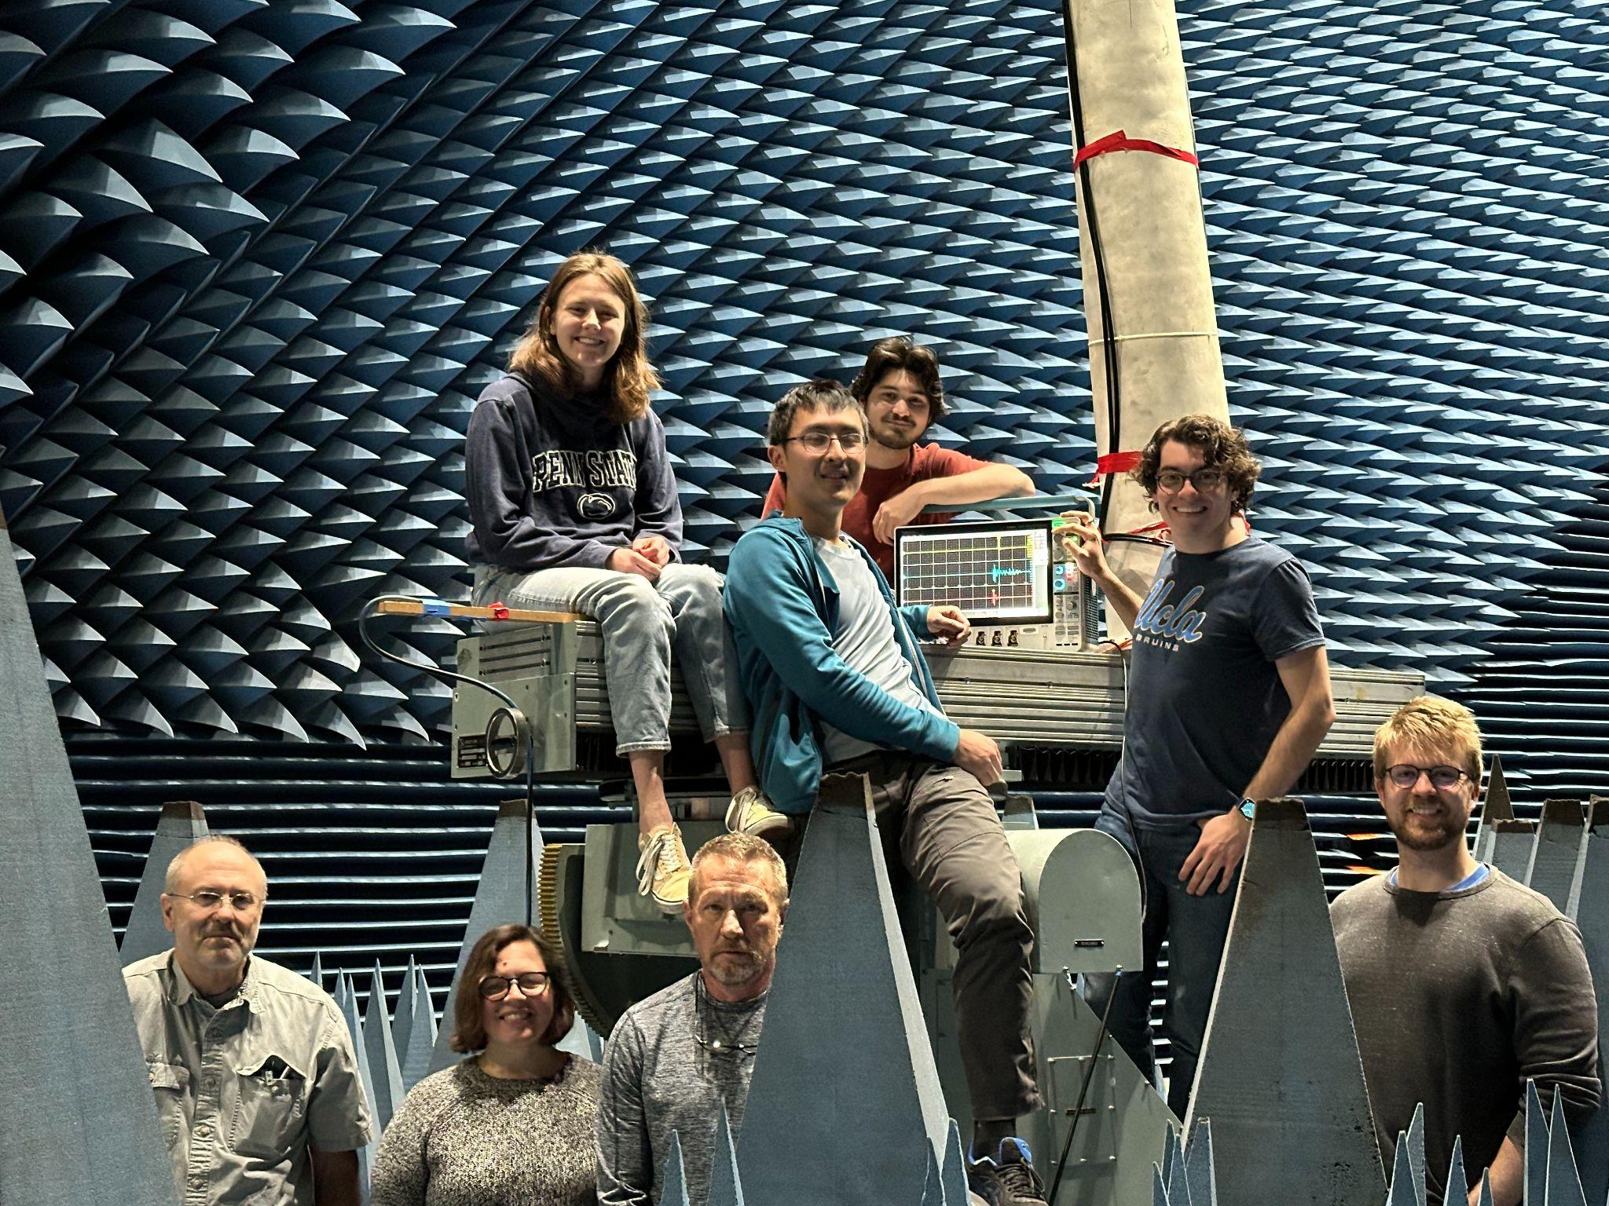
LF Antenna Design and Measurements
Impulse response measurements match well with simulations.
Angular responses have consistent phase response, making the coherent sum over antenna pointing at different directions feasible.

Slide 22
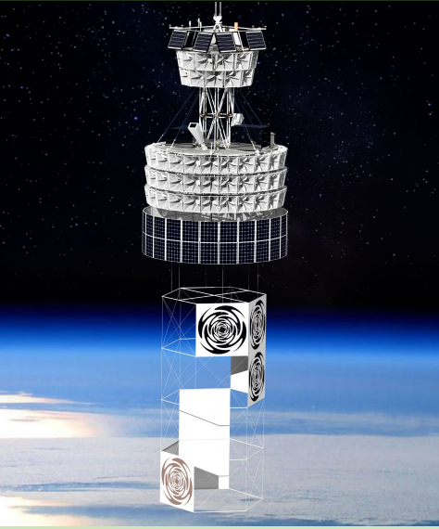
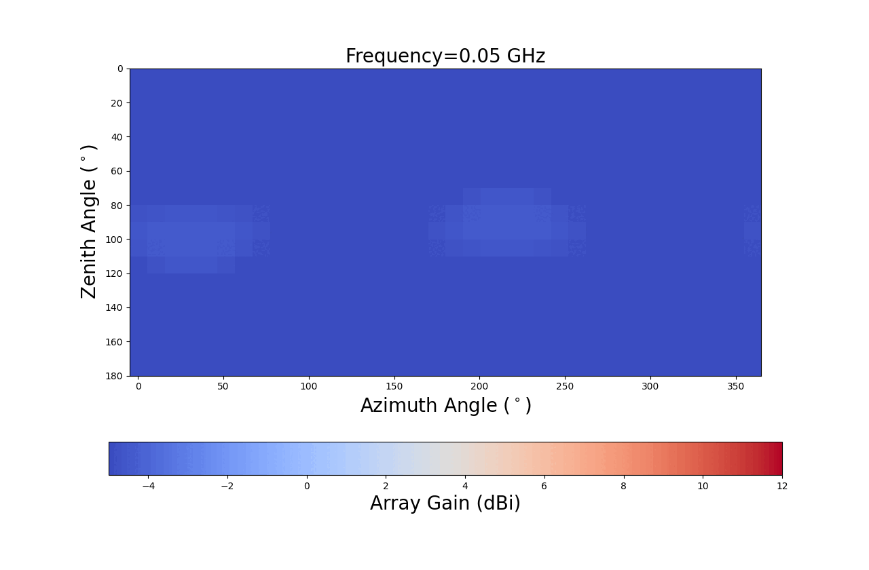
From 1 to 8: LF array Layout
4 layers of hexagon ring provide vertical and horizontal baselines for interferometry.
Keep antennas from blocking each other.
Sub-deg angular resolution with SNR>5

Slide 23
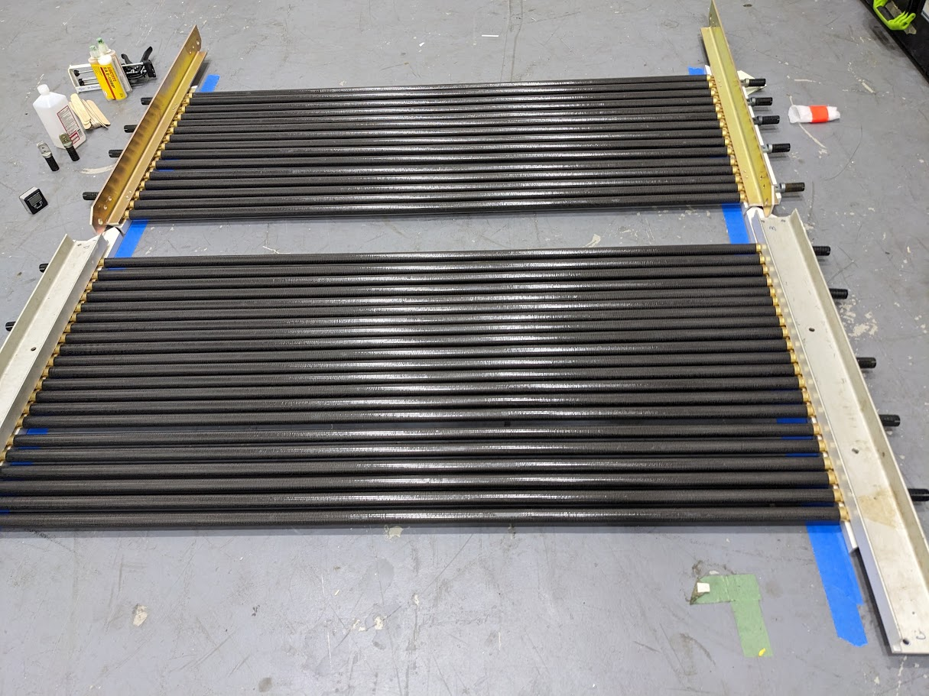
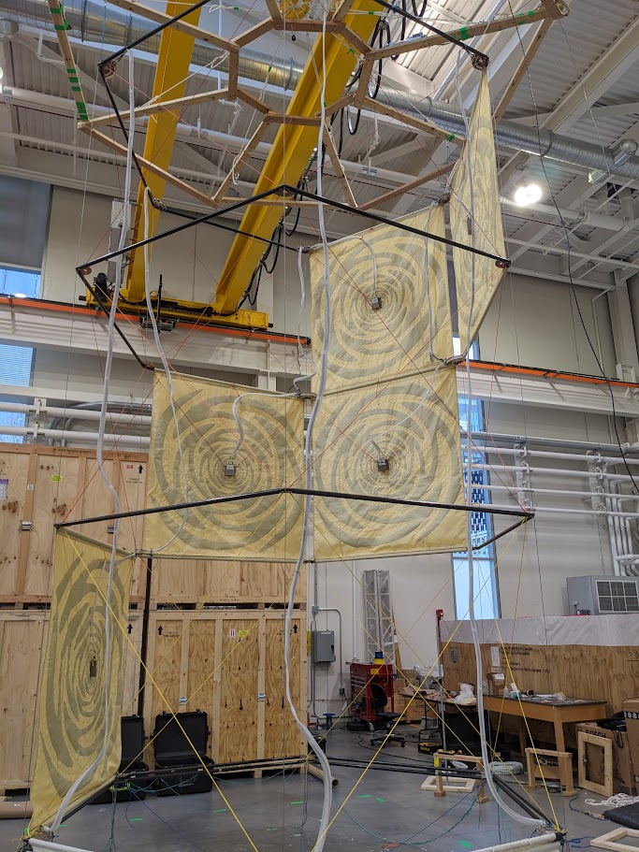
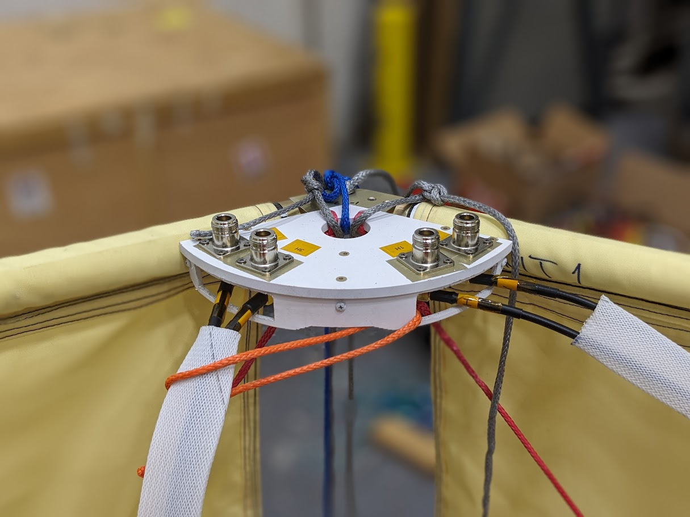
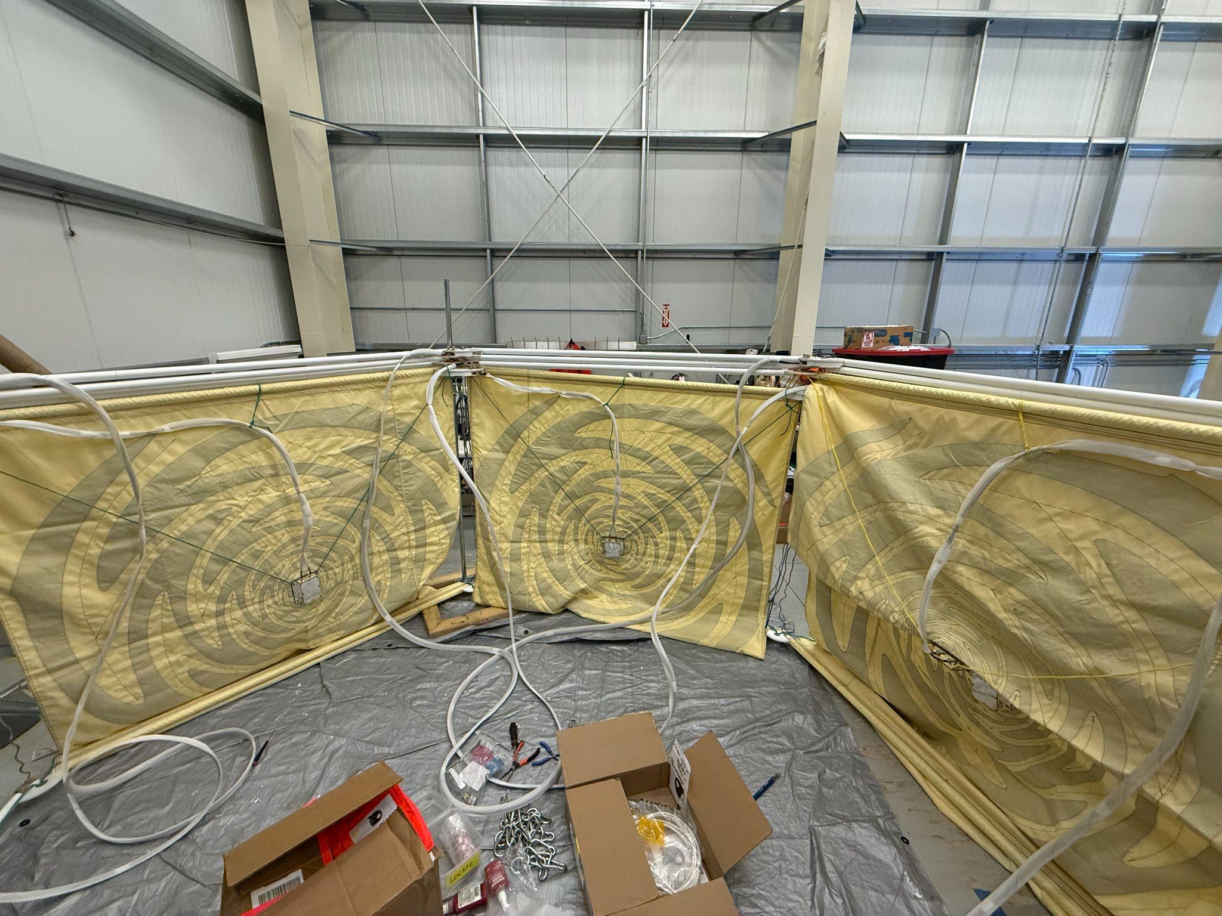
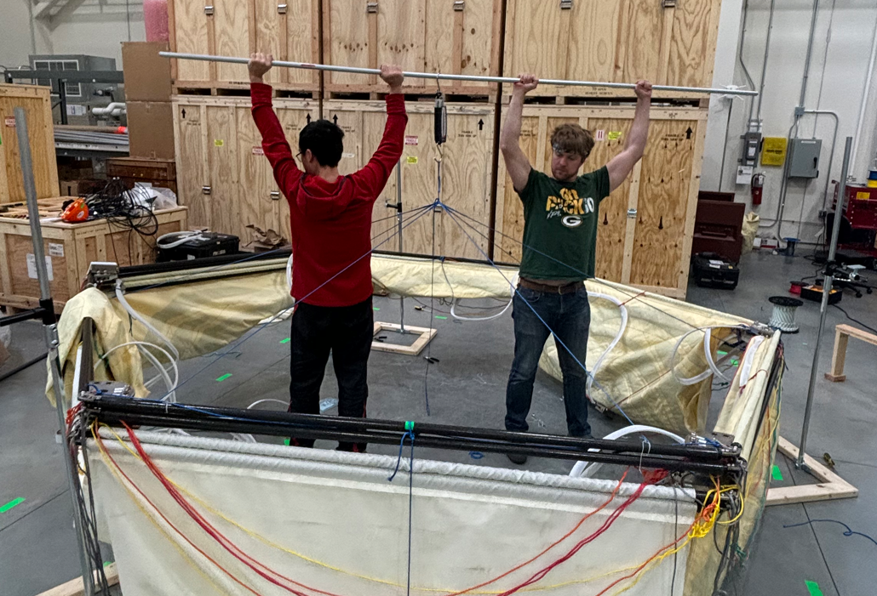
LF gondola
Carbon fiber tubes
Connectors station
24 ft tall, 12 ft wide
100 lbs in total

Slide 24
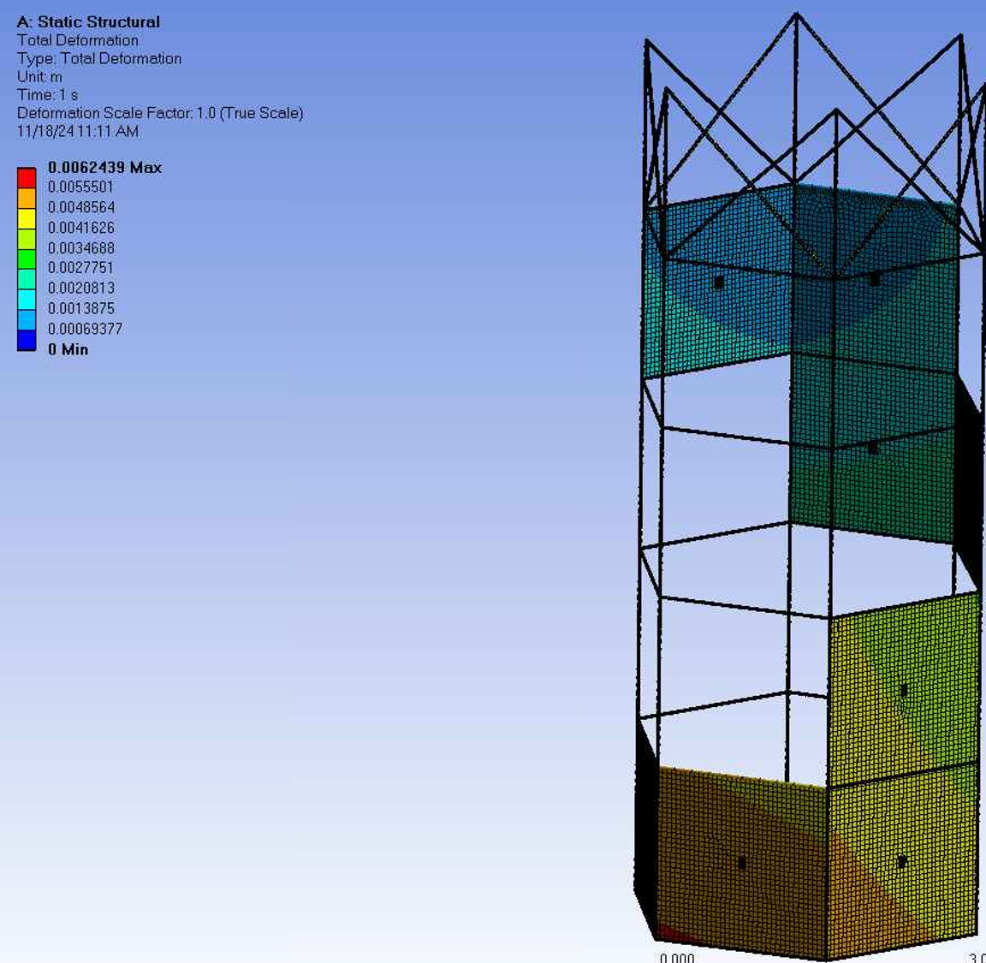
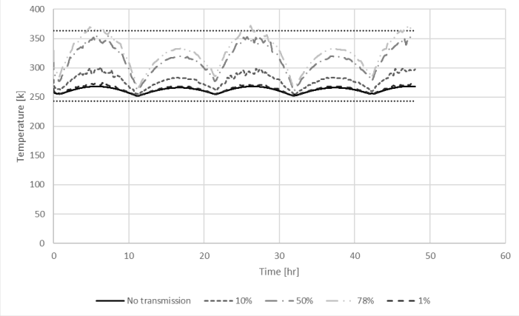
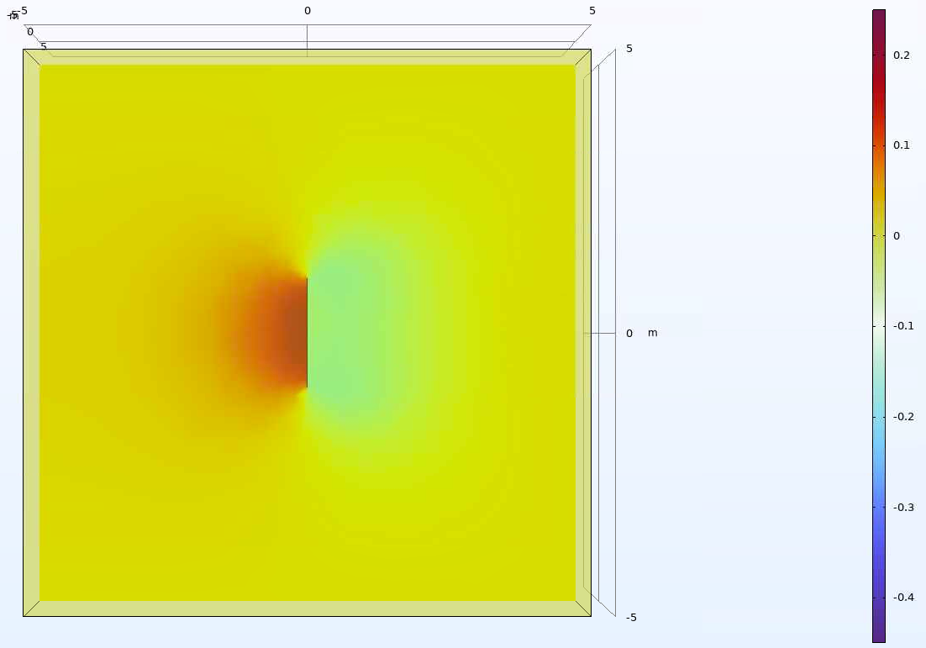

Antenna Wind Loading / Thermal
Thermal study suggests that a >0.1 mm polyester heat shield is necessary.
Wind study suggests that maximum deflection ~6 mm
Pressure at center of panel w/out holes
Pressure at center of panel w/ holes
U = 20m/s
Pmax ~ 0.2 Pa in both cases

Slide 25


Antenna position calibration
Measurement path:
Δt_{measure} through correlate the measured waveforms
Geometry path: Δt_{expect} (Δ⍴, Δz, Δφ, ΔCabledelay) through known pulser loc, payload loc, and assumed antenna position.
ΔT = Δt_{measure} - Δt_{expect} (Δr, Δz, Δφ, ΔCabledelay)
Minimize

Slide 26




Calibration uncertainty in MC
CableDelay~0.03ns ⍴~0.9cm φ ~ 0.4 deg z ~ 4.5cm
SNR10
SNR5

Slide 27







In each LF phi sector
To investigate:
Azimuthal (ɸ) has an opposite-signed offset at ɸ and ɸ+180 deg
LF Φ I
LF Φ II
LF Φ III
LF Φ I
LF Φ II
LF Φ III
Azimuth in payload coordinate (deg)

Slide 28


Pointing vs SNR

Slide 29

Galactic noise in LF
Payload spinning
(θ_{GC},ɸ_{GC})
Ant boresight (θ_{Ant},ɸ_{Ant})
Noise power strongly depends on the antennas orientation relative to the GC
Sun is always close (~10 deg) to the GC during the flight, so it’s hard to decouple the effects. However, during the quiet sun periods (no solar burst) galaxy is expected to be 1-2 orders of magnitude brighter.

Slide 30




Galactic noise in simulation
100 MHz
Antenna model
Haslam sky model
x
Antenna Temperature
“Power at antennas’ feed”

Slide 31

How to deploy the LF ?

Slide 32

How to deploy the LF ?

Slide 33

How to deploy the LF ?

Slide 34

How to deploy the LF ?

Slide 35

How to deploy the LF ?

Slide 36

How to deploy the LF ?

Slide 37

How to deploy the LF ?

Slide 38

How to deploy the LF ?

Slide 39

How to deploy the LF ?

Slide 40

How to deploy the LF ?
back

