Slide 1
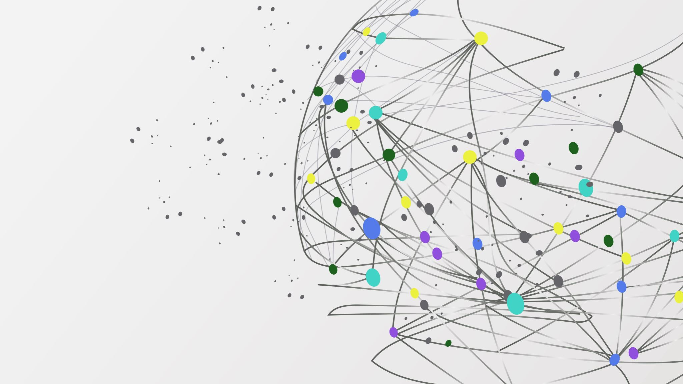





Velocity and Track Reconstruction using HELIX RICH
Duncan Fuehne, University of Chicago
International School of Cosmic Ray Astrophysics
4 August, 2026
Erice, Sicily

Slide 2

Cosmic Ray Transport Measurements
Galactic cosmic rays (CRs) inform us about the intergalactic medium

Slide 3

Cosmic Ray Transport Measurements
Galactic cosmic rays (CRs) inform us about the intergalactic medium
Measuring ratio of Primaries to Secondaries probes grammage traversed in galaxy [mass/${length}^{2}]$

Slide 4

Cosmic Ray Transport Measurements
Galactic cosmic rays (CRs) inform us about the intergalactic medium
Measuring ratio of Primaries to Secondaries probes grammage traversed in galaxy [mass/${length}^{2}]$
Measuring ratio of “clock” isotopes probes confinement time in galaxy

Slide 5
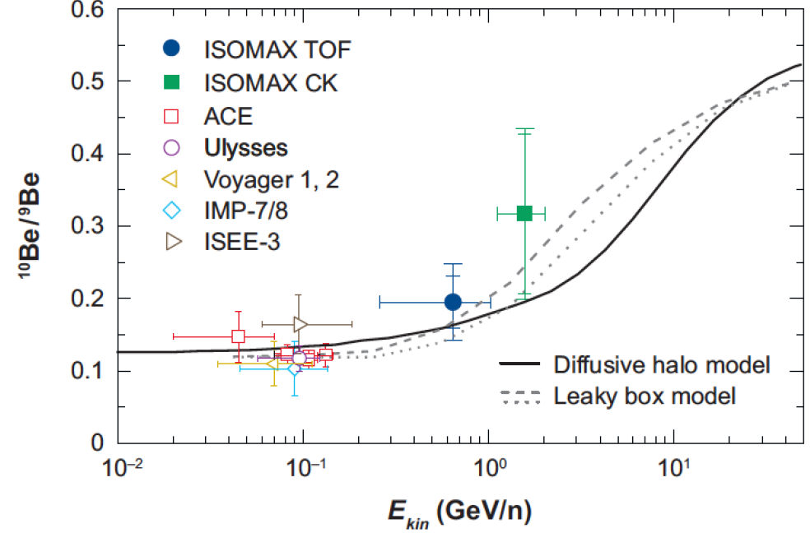
Be-10 “Clock Isotope”
Higher energies probe larger region of galaxy
  Relativistic effects
I. Moskalenko - “AMS02 Days”
*Only mass resolved measurements shown

Slide 6
Be-10 “Clock Isotope”
Higher energies probe larger region of galaxy
  Relativistic effects
HELIX: measure Be-10/Be-9 precisely up to 10 GeV/n
I. Moskalenko - “AMS02 Days”
*Only mass resolved measurements shown

Slide 7
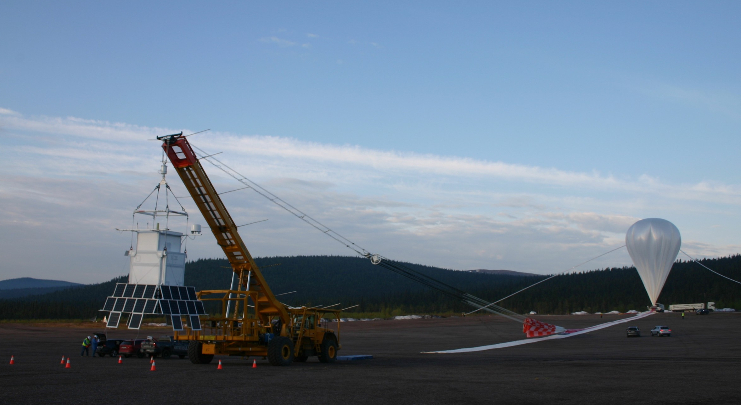
HELIX Overview
Balloon program designed to measure cosmic ray isotopes
1 Engineering flight so far
  Launched 28, 2024 in Kiruna, Sweden
  6 flight
  Successful recovery
  120 million triggers

Slide 8
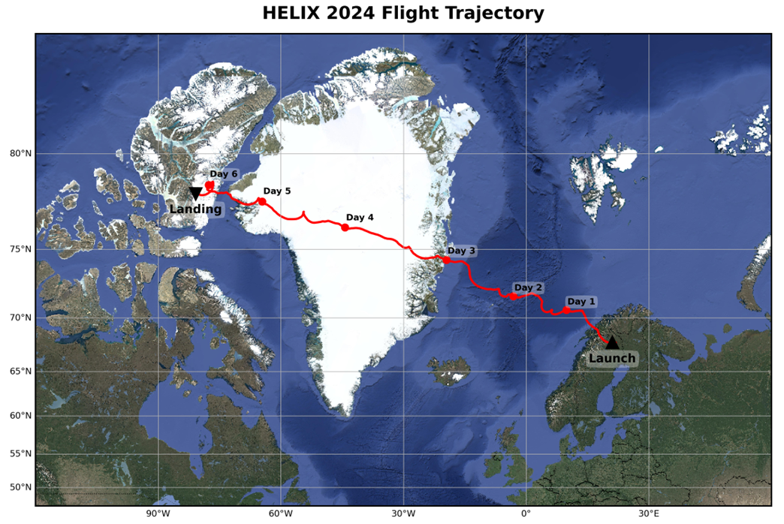
HELIX Overview
Balloon program designed to measure cosmic ray isotopes
1 Engineering flight so far
  Launched 28 May, 2024 in Kiruna, Sweden
  6 day flight
  120 million triggers
  Successful recover triggers

Slide 9
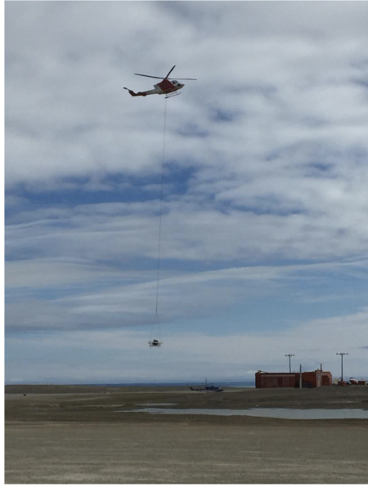
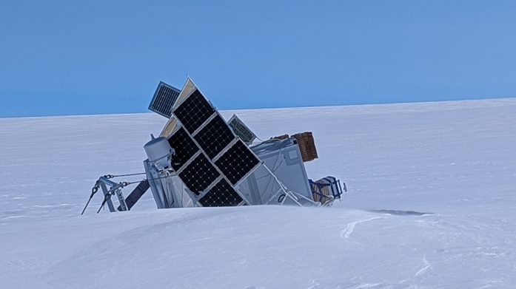
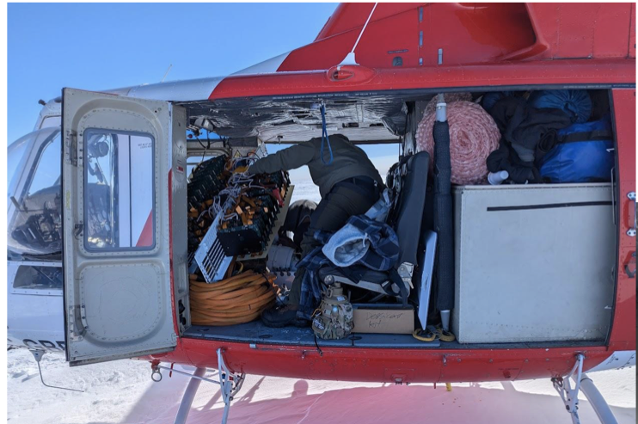
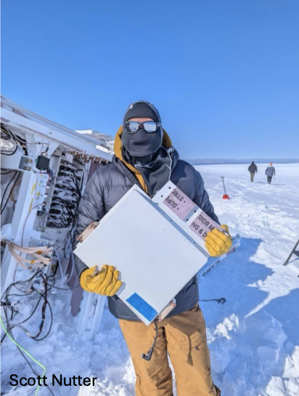
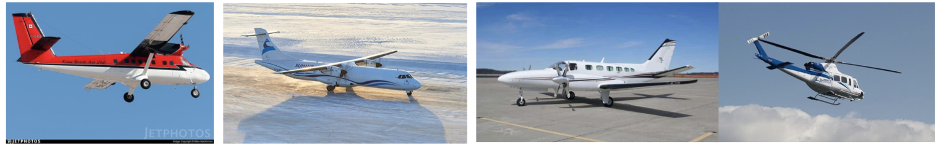
HELIX Overview
Balloon program designed to measure cosmic ray isotopes
1 Engineering flight so far
  Launched 28 May, 2024 in Kiruna, Sweden
  6 day flight
  120 million triggers
  Successful recovery

Slide 10
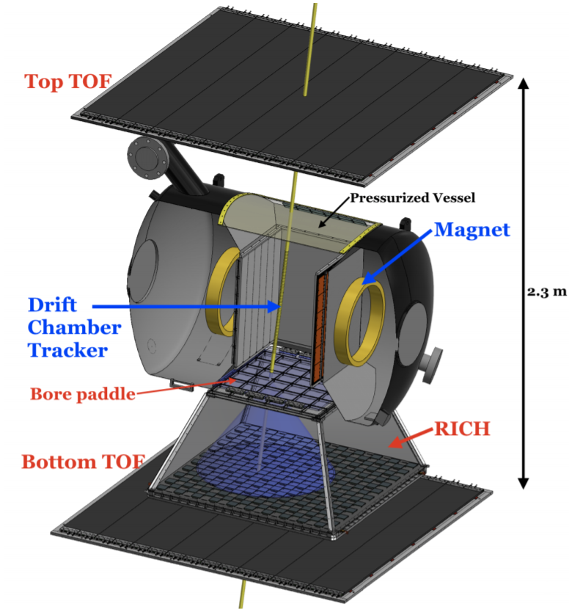
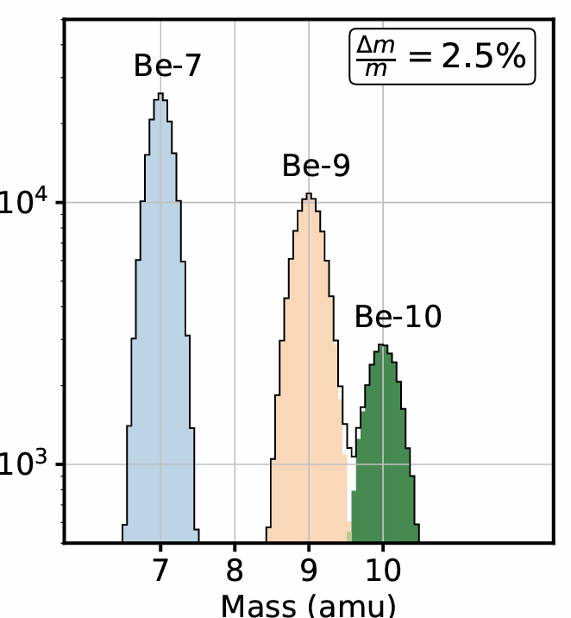
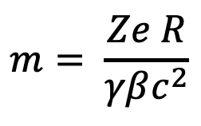
HELIX Overview
1st Helix flight payload:
  Built for a mass resolution < 2.5% for Be nuclei < 3 GeV/n
3 Instruments:
  DCT
  TOF
  RICH
$$m= \frac{Ze R}{γβc^{2}}$$
Monte Carlo

Slide 11

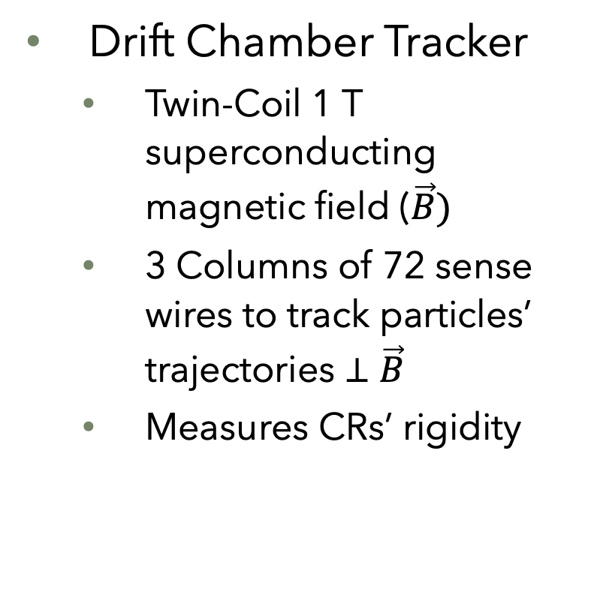

HELIX Overview
Drift Chamber Tracker
  Twin-Coil 1 T superconducting magnetic field ($\vec{B})$
  3 Columns of 72 sense wires to track particles’ trajectories $⊥$ $\vec{B}$
  Measures CRs’ rigidity
$$m= \frac{Ze R}{γβc^{2}}$$
Be Candidate
$$←\overset{⃑}{B}$$
$$⊗\overset{⃑}{B}$$

Slide 12
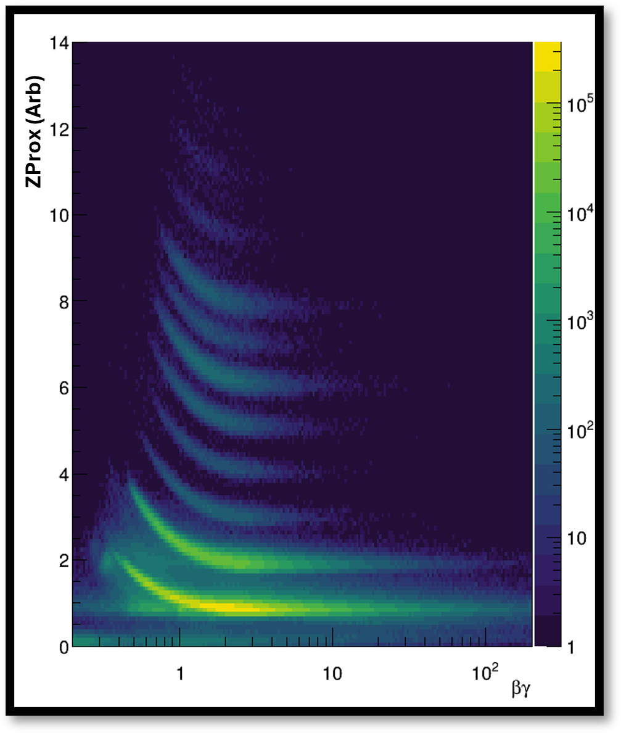
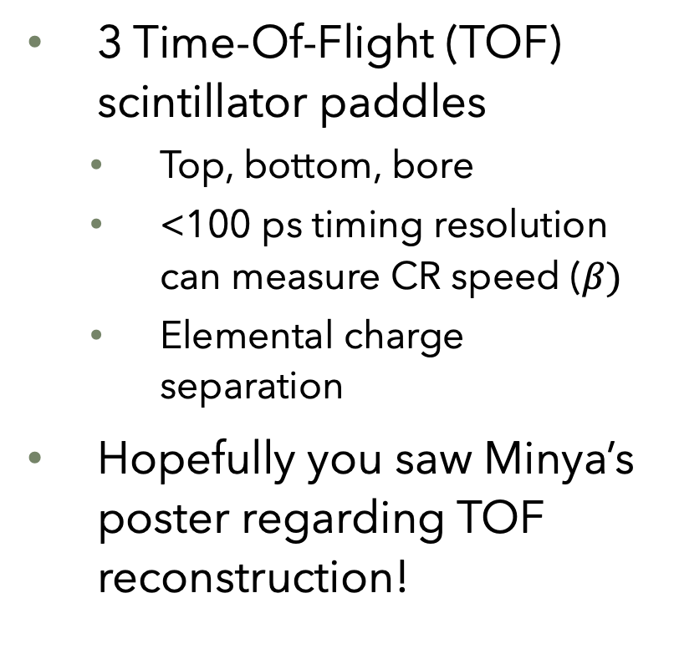
Helix Overview
3 Time-Of-Flight (TOF) scintillator paddles
  Top, bottom, bore
  <100 ps timing resolution can measure CR speed ($β)$
  Elemental charge separation
Hopefully you saw Minya’s poster regarding TOF reconstruction!
$$m= \frac{Ze R}{γβc^{2}}$$
Prelim. Flight TOF Data

Slide 13
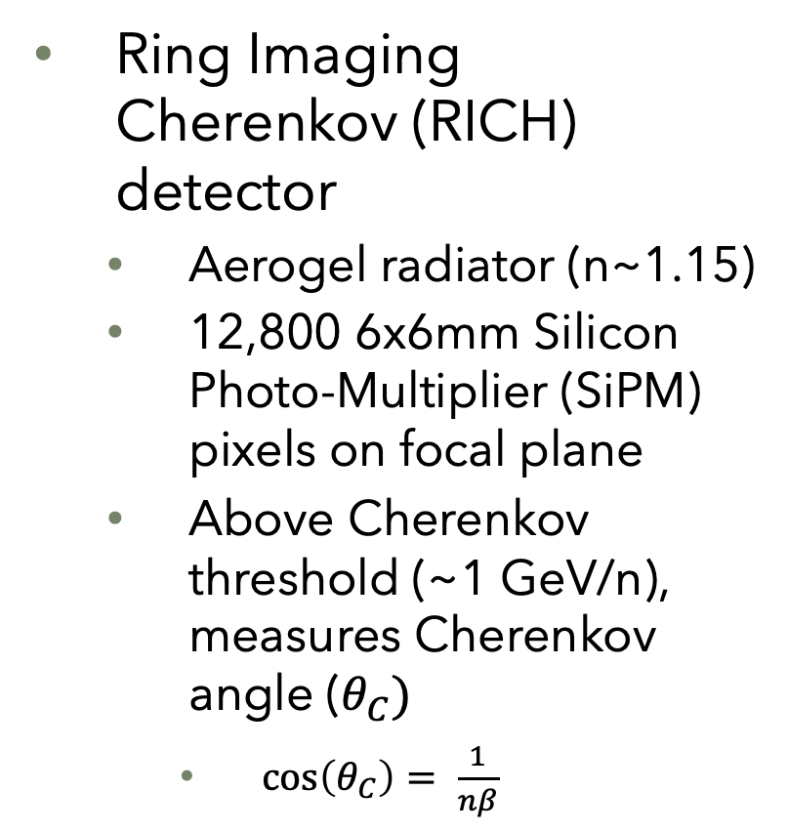
HELIX Overview
Ring Imaging Cherenkov (RICH) detector
  Aerogel radiator (n~1.15)
  12,800 6x6mm Silicon Photo-Multiplier (SiPM) pixels on focal plane
  Above Cherenkov threshold (~1 GeV/n), measures Cherenkov angle ($θ_{C})$
    $\cos\left(θ_{C}\right)= \frac{1}{nβ}$
$$m= \frac{Ze R}{γβc^{2}}$$
Be Candidate after kernel density filtering

Slide 14


RICH Reconstruction
RICH Focal Plane Consists of SiPM hits: ${(x}_{i}, y_{i}, w_{i})$
$${(x}_{i}, y_{i}, w_{i})$$

Slide 15


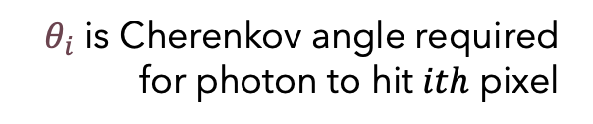

RICH Reconstruction
Ypsilantis, Thomas, and Jacques Séguinot. "Theory of ring imaging Cherenkov counters." Nuclear Instruments and Methods in Physics Research Section A: Accelerators, Spectrometers, Detectors and Associated Equipment 343.1 (1994): 30-51.
RICH Focal Plane Consists of SiPM hits: ${(x}_{i}, y_{i}, w_{i})$
Convert ${(x}_{i}, y_{i}) →\left(θ_{i},φ_{i}\right)$ using
Ypsilantis-Seguinot
$$θ_{i}$$
$$φ_{i}$$
$${(x}_{i}, y_{i}, w_{i})$$
$θ_{i}$ is Cherenkov angle required for photon to hit $ith$ pixel

Slide 16
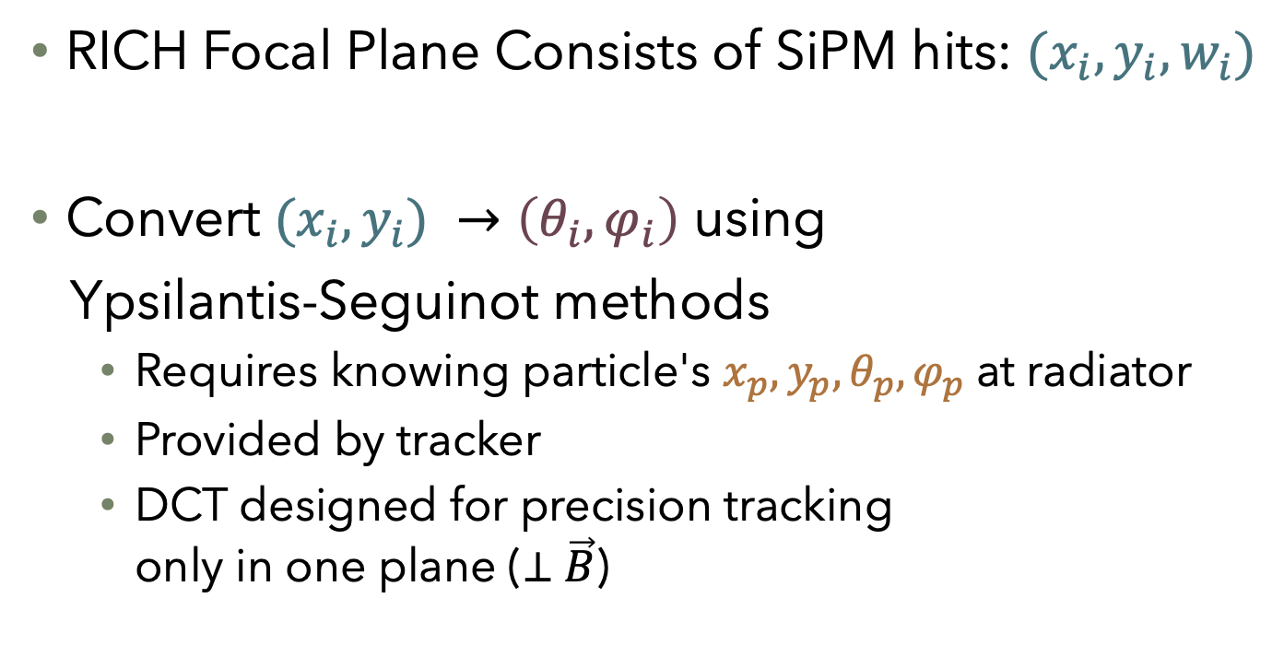

RICH Reconstruction
Ypsilantis, Thomas, and Jacques Séguinot. "Theory of ring imaging Cherenkov counters." Nuclear Instruments and Methods in Physics Research Section A: Accelerators, Spectrometers, Detectors and Associated Equipment 343.1 (1994): 30-51.
RICH Focal Plane Consists of SiPM hits: ${(x}_{i}, y_{i}, w_{i})$
Convert ${(x}_{i}, y_{i}) →\left(θ_{i},φ_{i}\right)$ using
Ypsilantis-Seguinot methods
  Requires knowing particle's $x_{p},y_{p}, θ_{p},φ_{p}$at radiator
  Provided by tracker
  DCT designed for precision tracking only in one plane ($⊥$ $\vec{B}$)
$$(x_{p},y_{p}, θ_{p}, φ_{p})$$
$$θ_{i}$$
$$φ_{i}$$
$${(x}_{i}, y_{i}, w_{i})$$
$θ_{i}$ is Cherenkov angle required for photon to hit $ith$ pixel

Slide 17
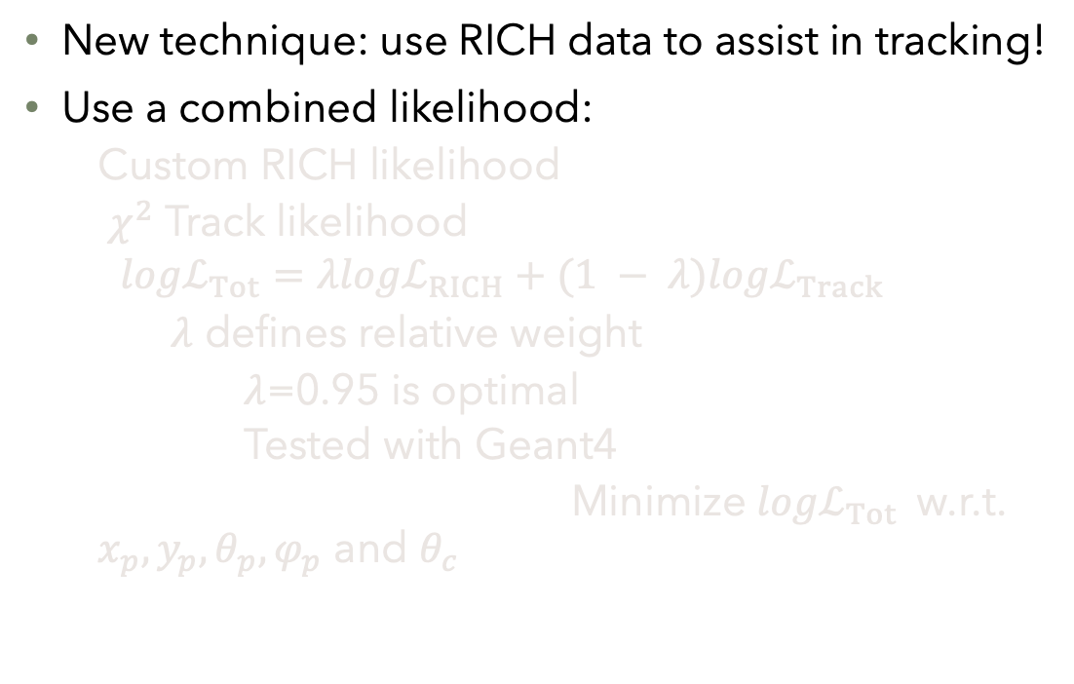
RICH as a Tracker
New technique: use RICH data to assist in tracking!
Use a combined likelihood:
  Custom RICH likelihood
  $χ^{2}$ Track likelihood
  $${logℒ}_{Tot}=λ{logℒ}_{RICH}+(1 − λ){logℒ}_{Track}$$
    $λ$ defines relative weight
      $λ$=0.95 is optimal
      Tested with Geant4
  Minimize ${logℒ}_{Tot}$w.r.t. $x_{p},y_{p}, θ_{p},φ_{p}$ and $θ_{c}$

Slide 18
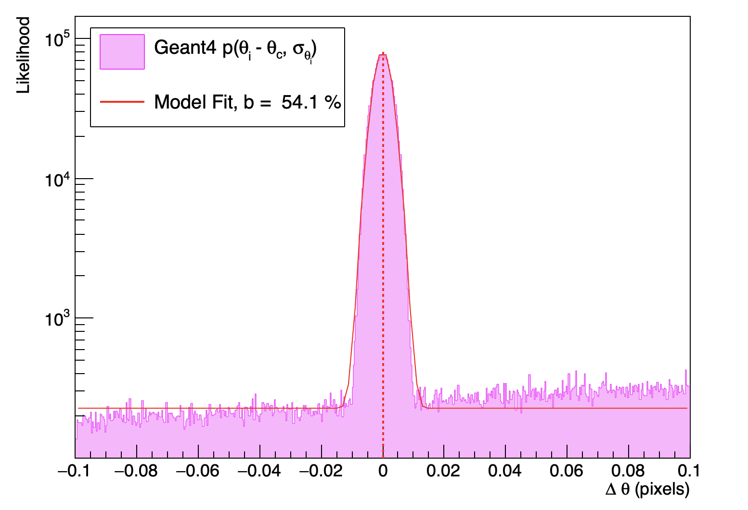
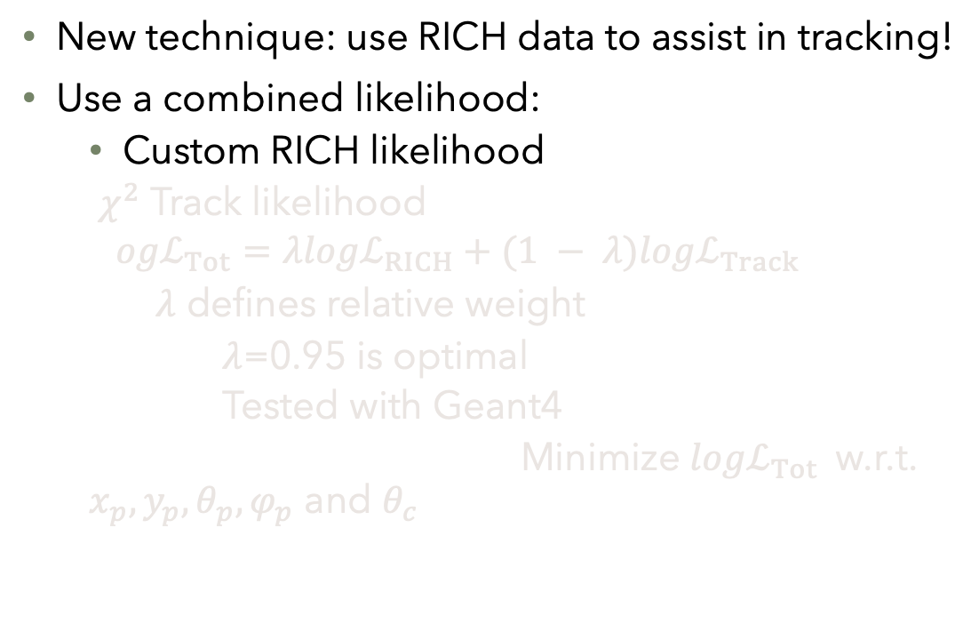
RICH as a Tracker
Be Likelihood from Geant4
Gaus + background
New technique: use RICH data to assist in tracking!
Use a combined likelihood:
  Custom RICH likelihood
  $χ^{2}$ Track likelihood
  $${ogℒ}_{Tot}=λ{logℒ}_{RICH}+(1 − λ){logℒ}_{Track}$$
    $λ$ defines relative weight
      $λ$=0.95 is optimal
      Tested with Geant4
  Minimize ${logℒ}_{Tot}$w.r.t. $x_{p},y_{p}, θ_{p},φ_{p}$ and $θ_{c}$

Slide 19
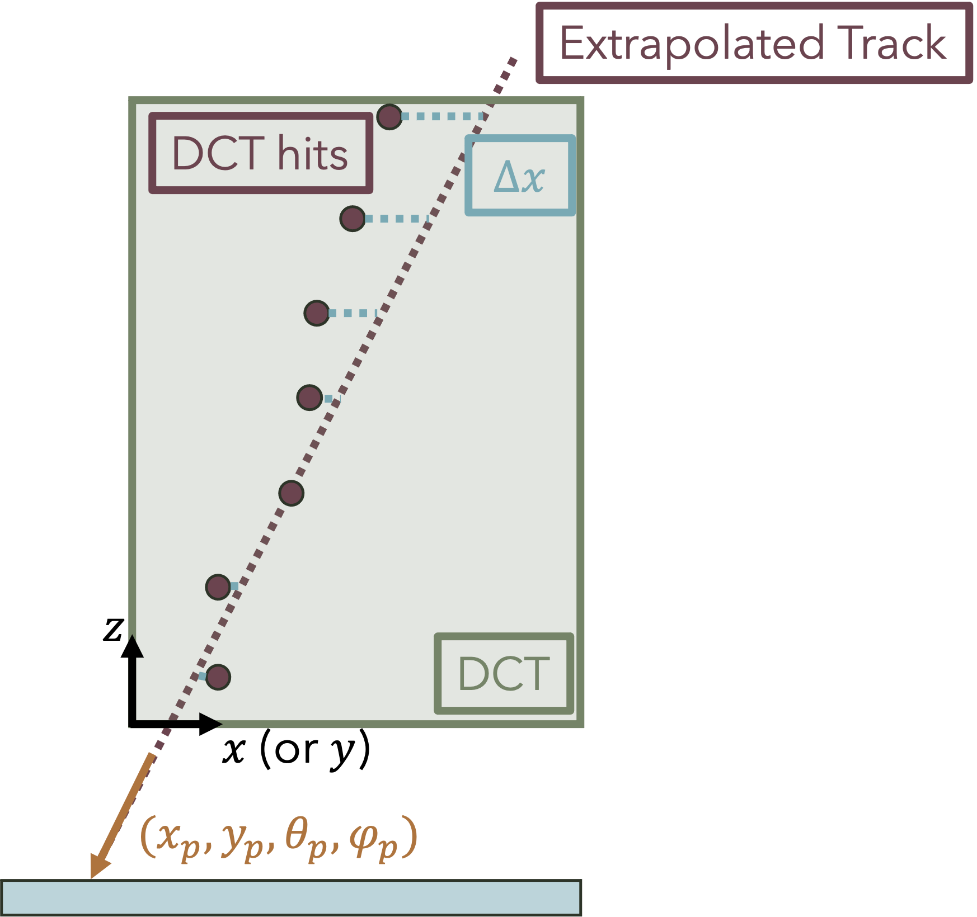
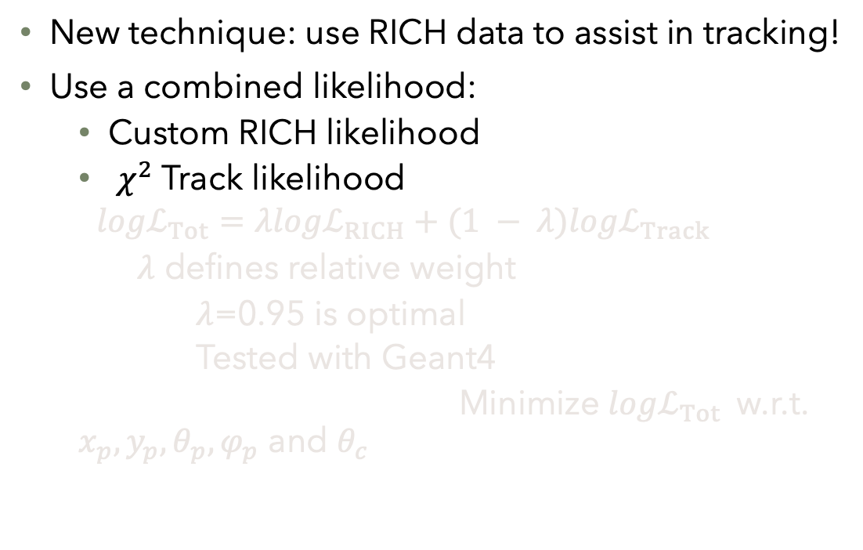
RICH as a Tracker
Be Likelihood from Geant4
Gaus + background
New technique: use RICH data to assist in tracking!
Use a combined likelihood:
  Custom RICH likelihood
  $χ^{2}$ Track likelihood
  $${logℒ}_{Tot}=λ{logℒ}_{RICH}+(1 − λ){logℒ}_{Track}$$
    $λ$ defines relative weight
      $λ$=0.95 is optimal
      Tested with Geant4
  Minimize ${logℒ}_{Tot}$w.r.t. $x_{p},y_{p}, θ_{p},φ_{p}$ and $θ_{c}$

Slide 20
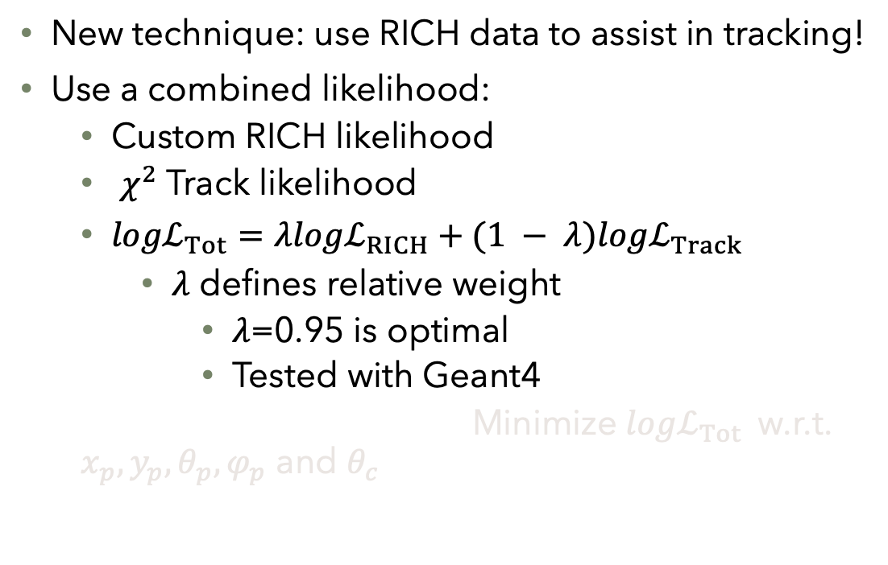
RICH as a Tracker
Be Likelihood from Geant4
Gaus + background
New technique: use RICH data to assist in tracking!
Use a combined likelihood:
  Custom RICH likelihood
  $χ^{2}$ Track likelihood
  ${logℒ}_{Tot}=λ{logℒ}_{RICH}+(1 − λ){logℒ}_{Track}$
    $λ$ defines relative weight
      $λ$=0.95 is optimal
      Tested with Geant4
  Minimize ${logℒ}_{Tot}$w.r.t. $x_{p},y_{p}, θ_{p},φ_{p}$ and $θ_{c}$

Slide 21
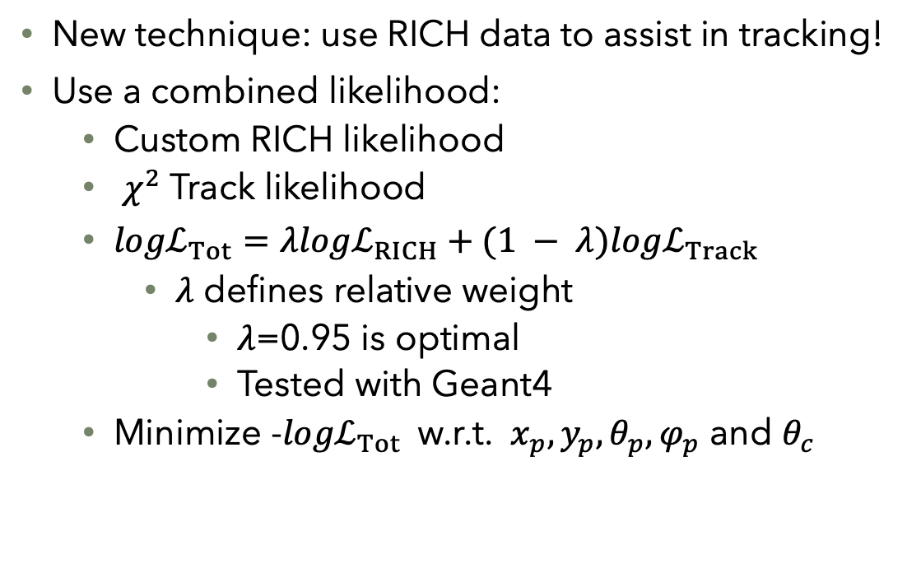
RICH as a Tracker
Be Likelihood from Geant4
Gaus + background
New technique: use RICH data to assist in tracking!
Use a combined likelihood:
  Custom RICH likelihood
  $χ^{2}$ Track likelihood
  ${logℒ}_{Tot}=λ{logℒ}_{RICH}+(1 − λ){logℒ}_{Track}$
    $λ$ defines relative weight
      $λ$=0.95 is optimal
      Tested with Geant4
  Minimize -${logℒ}_{Tot}$w.r.t. $x_{p},y_{p}, θ_{p},φ_{p}$ and $θ_{c}$

Slide 22
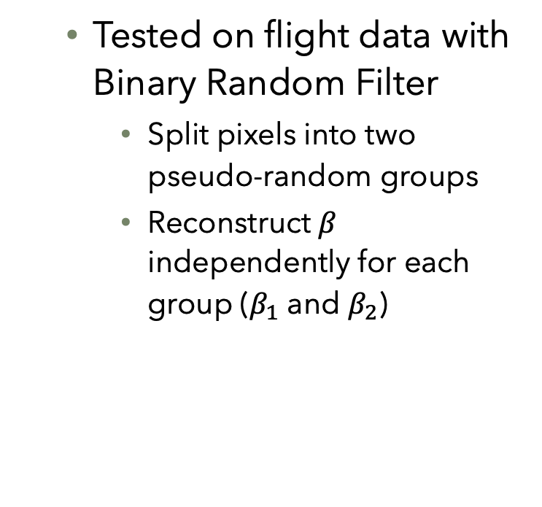
Track-RICH Minimization (TRM) Performance
w/o TRM
w/o TRM
  Tested on flight data with Binary Random Filter
    Split pixels into two pseudo-random groups
    Reconstruct $β$ independently for each group ($β_{1}$ and $β_{2}$)
w/ TRM
w/ TRM

Slide 23
Track-RICH Minimization (TRM) Performance
w/o TRM
w/o TRM
  Use residuals from direct ionization hits in Focal Plane to compare tracking performance
  All Z > 3
Non-bending
Bending
w/ TRM
w/ TRM
Non-bending
Bending

Slide 24
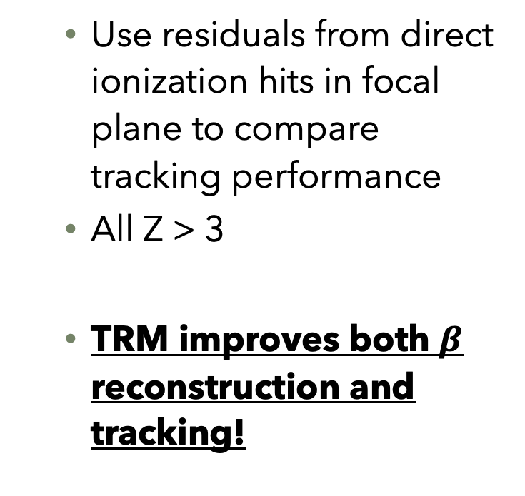
Track-RICH Minimization (TRM) Performance
w/o TRM
w/o TRM
  Use residuals from direct ionization hits in focal plane to compare tracking performance
  All Z > 3
  TRM improves both $β$ reconstruction and tracking!
Non-bending
Bending
w/ TRM
w/ TRM
Non-bending
Bending

Slide 25
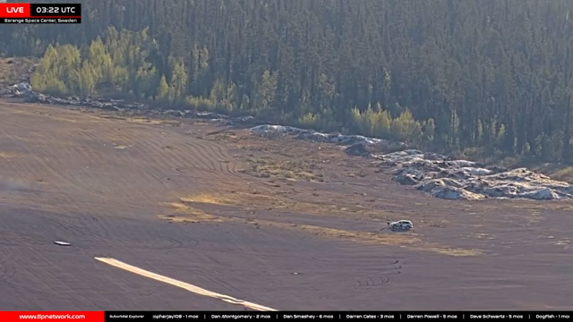
Launch Video

Slide 26
Extras

Slide 27
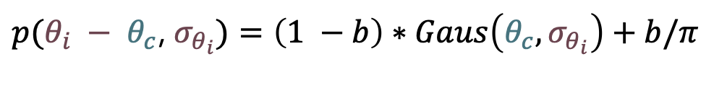
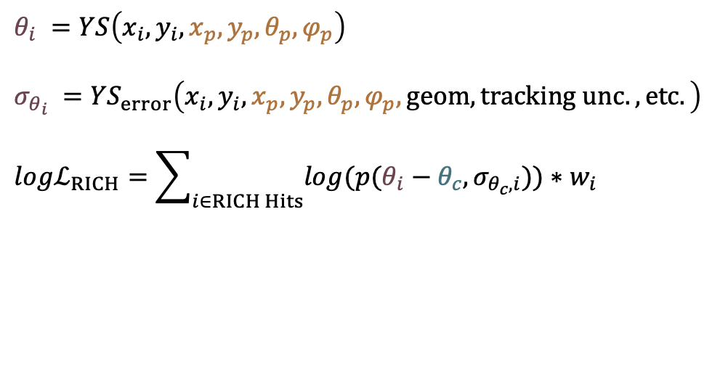
RICH as a Tracker
Be Likelihood from Geant4
New technique: use RICH data to assist in tracking!
Use a combined likelihood:
  Custom RICH likelihood
RICH Likelihood is a function of $x_{p},y_{p}, θ_{p},φ_{p}$ and $θ_{c}$
$p(θ_{i} − θ_{c}$, $σ_{θ_{i}})=\left(1 −b\right)∗Gaus\left(θ_{c},σ_{θ_{i}}\right)+b/π$
$$θ_{i} =YS\left(x_{i}, y_{i},x_{p},y_{p}, θ_{p},φ_{p}\right)$$
$$σ_{θ_{i}} ={YS}_{error}\left(x_{i}, y_{i},x_{p},y_{p}, θ_{p},φ_{p}, geom, tracking unc., etc.\right)$$
$${logℒ}_{RICH}=\sum_{i∈RICH Hits}{log(p(θ_{i}}−θ_{c},σ_{θ_{c}, i}))∗w_{i}$$

Slide 28
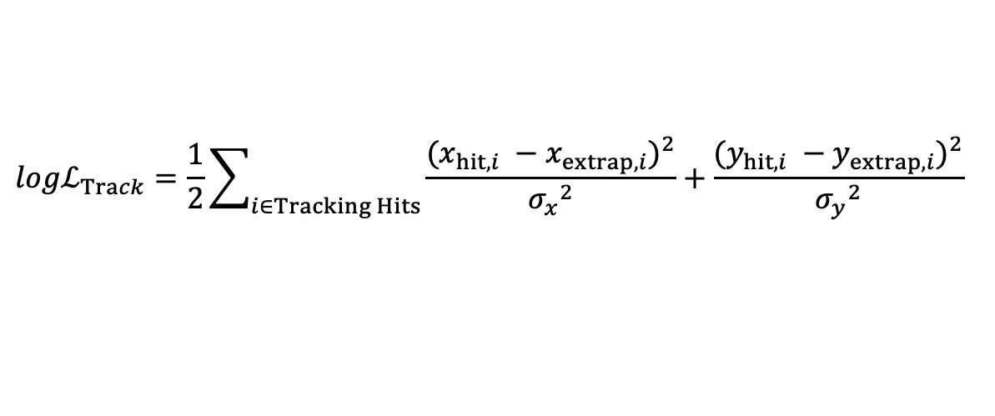





RICH as a Tracker
Extrapolated Track
DCT hits
$$Δx$$
  $χ^{2}$ Track likelihood
$$z$$
DCT
$x$ (or $y$)
$$(x_{p},y_{p}, θ_{p}, φ_{p})$$
$${logℒ}_{Track}=\frac{1}{2}\sum_{i∈Tracking Hits}{\frac{{(x_{hit, i} −x_{extrap, i})}^{2}}{{σ_{x}}^{2}}+\frac{{(y_{hit, i} −y_{extrap, i})}^{2}}{{σ_{y}}^{2}}}$$

Slide 29
Kernel Density Filtering

Slide 30
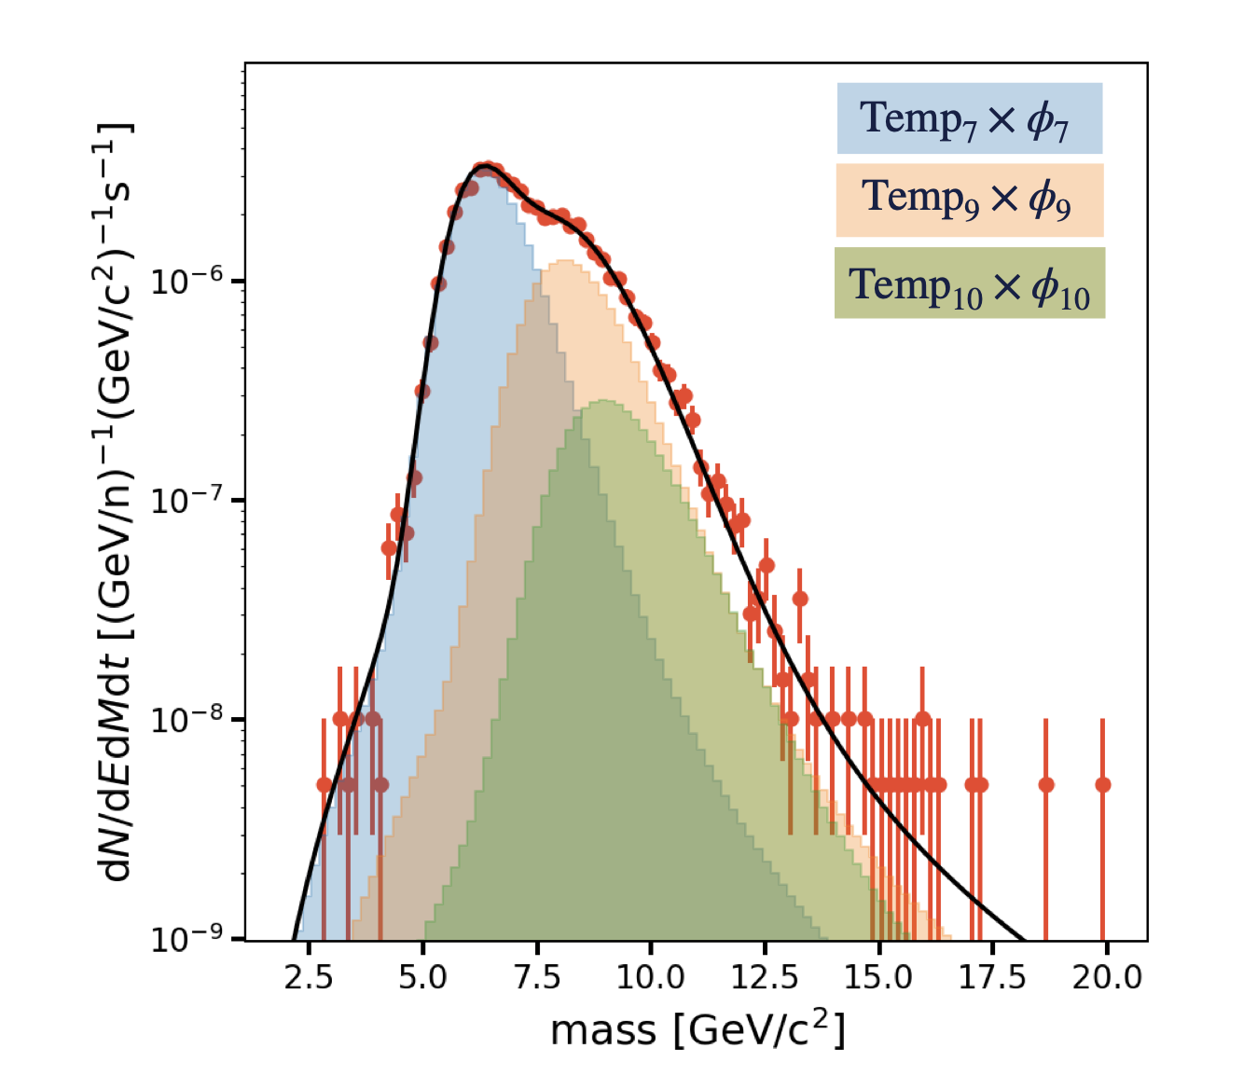
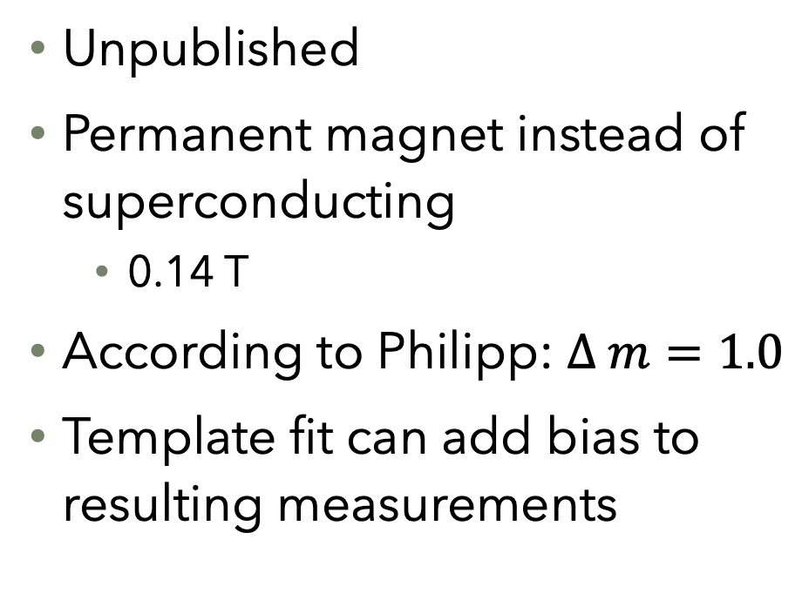
AMS-02 Be Distribution
Unpublished
Permanent magnet instead of superconducting
  0.14 T
According to Philipp: $∆ m=1.0$
Template fit can add bias to resulting measurements
Derome et al., PoS (ICRC2021) 119

