Slide 1




Gravitational Waves II
Notable GWs
Simone Mastrogiovanni
INFN Rome
ISCRA - Erice, Italy 2026

Slide 2
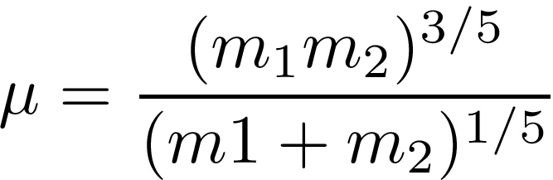
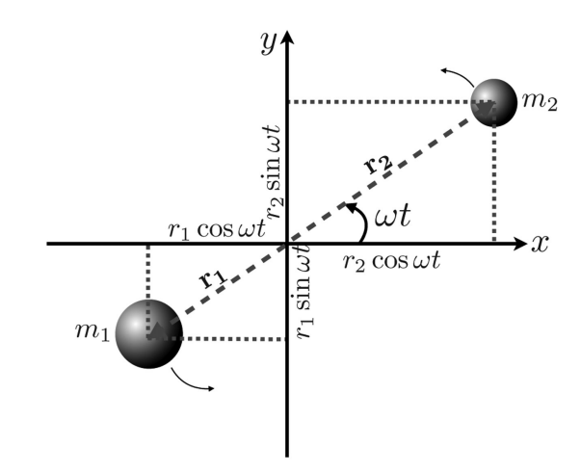
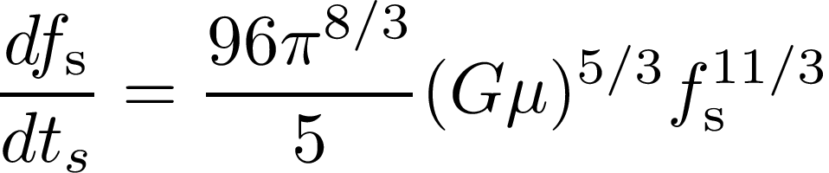
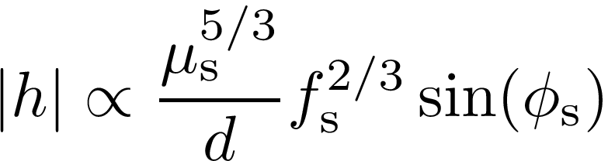
Autopsy of a compact binary
The GW frequency is emitted at twice the orbital frequency of the binary.
Chirp mass
GW frequency evolution at source
Amplitude at the source
S. Mastrogiovanni - ISCRA 2026

Slide 3
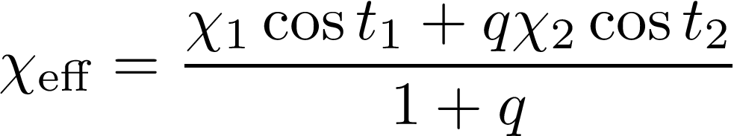



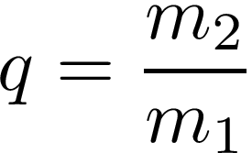


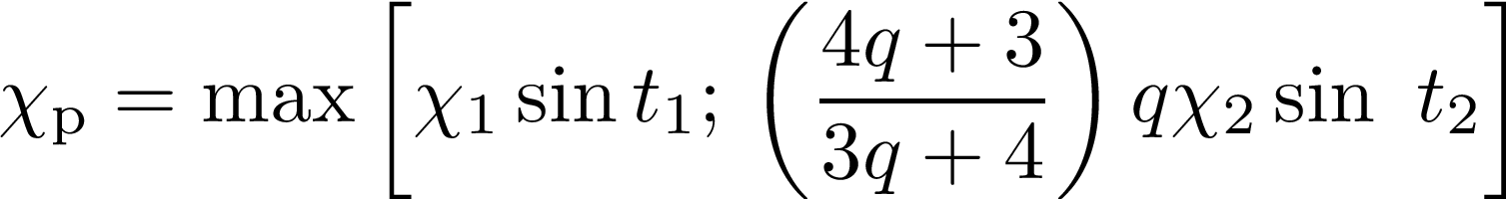

Autopsy of a compact binary
Orbital angular momentum
Effective spin parameter
Mass ratio
Precessing spin parameter
S. Mastrogiovanni - ISCRA 2026

Slide 4





Autopsy of a compact binary
Sky position
Luminosity Distance
S. Mastrogiovanni - ISCRA 2026

Slide 5
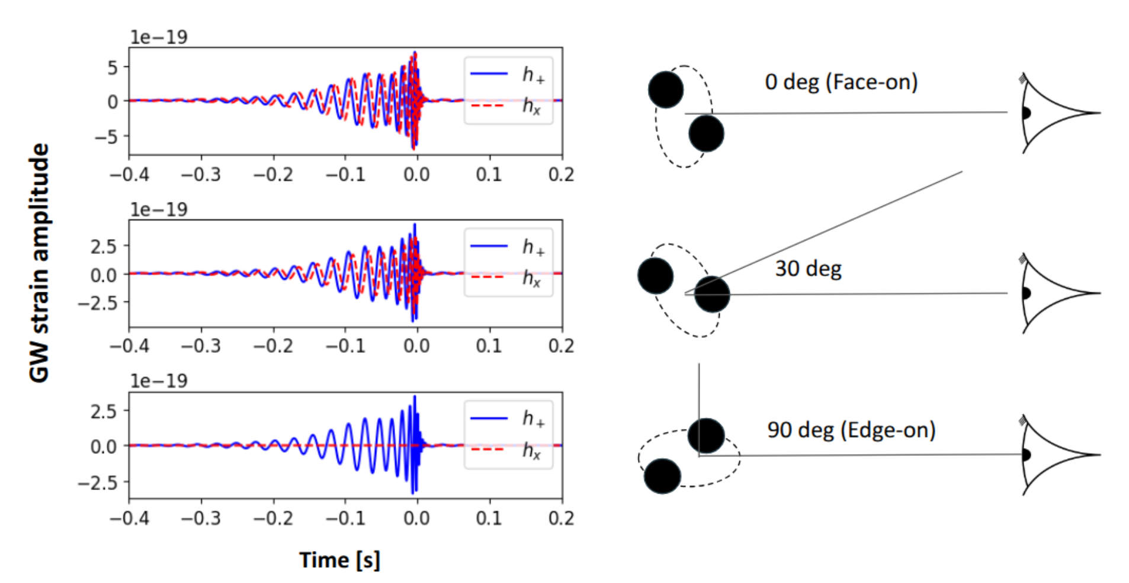
Autopsy of a compact binary
Luminosity distance of the source is typically not well measured.
S. Mastrogiovanni - ISCRA 2026

Slide 6
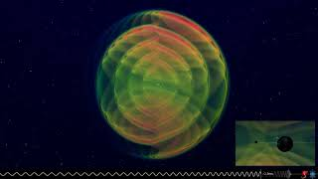
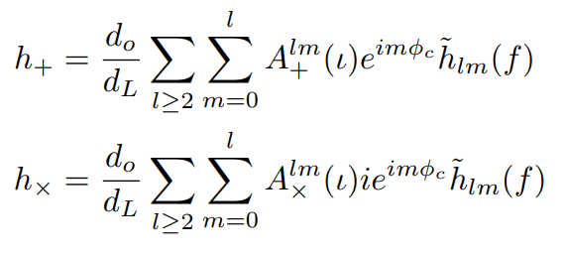
(l,m,n): Higher order modes
S. Mastrogiovanni - ISCRA 2026

Slide 7
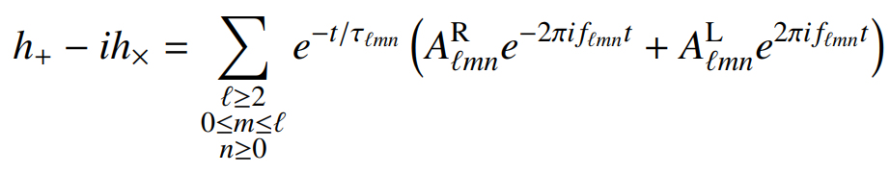
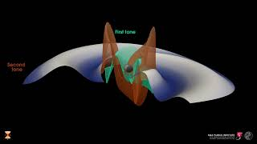
(l,m,n): Overtones
S. Mastrogiovanni - ISCRA 2026

Slide 8
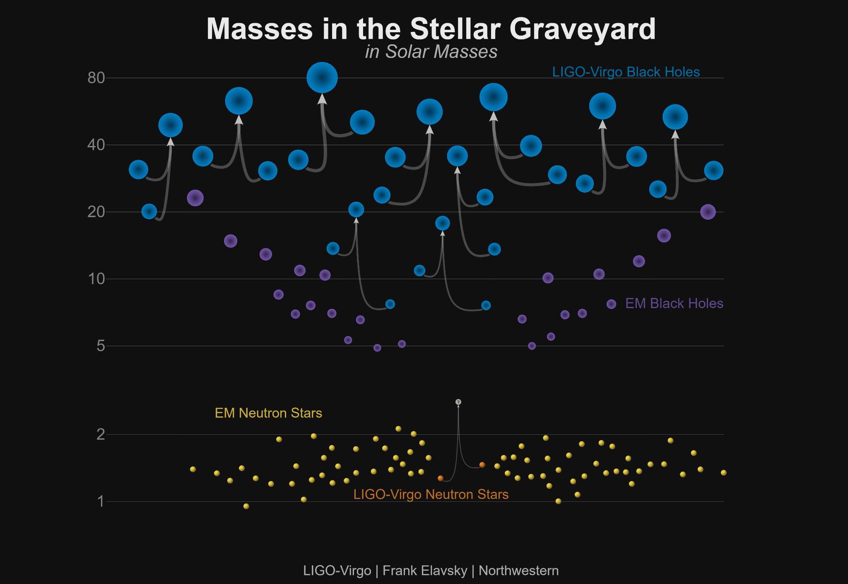
GWTC-1.0
S. Mastrogiovanni - ISCRA 2026

Slide 9
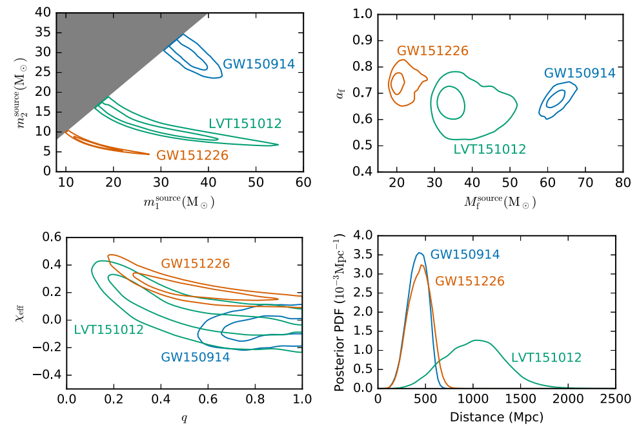
The first three GW detections
Vanilla Black holes
The source-frame masses does not excess what we expected for Stellar-mass origin black holes.
The two BHs have similar masses.
No sign of precession.
We extensively tested the waveform systematics, deviations from waveform prescriptions etc.
S. Mastrogiovanni - ISCRA 2026

Slide 10
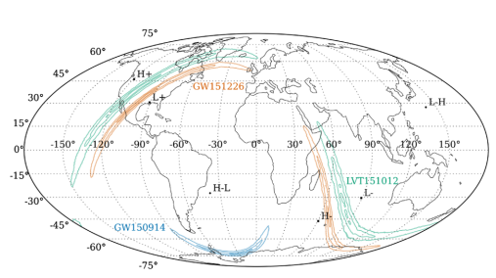
The first three GW detections
The Sky localization for these events is huge 230 deg2, 850deg2 and 1600deg2 for GW150914, GW151226 and GW151012.
There was no electromagnetic counterpart observed for these events.
S. Mastrogiovanni - ISCRA 2026

Slide 11
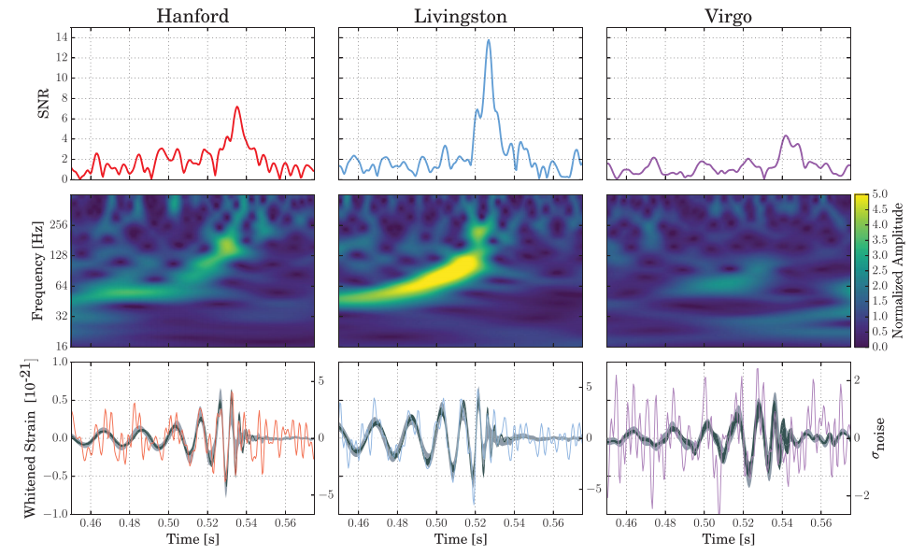
GW170814: The first triple detection
The event was detected with a False Alarm rate of 1/27000 years.
The network SNR for this signal was 18
The signal is barely visible in Virgo, where it has a small SNR.
S. Mastrogiovanni - ISCRA 2026

Slide 12
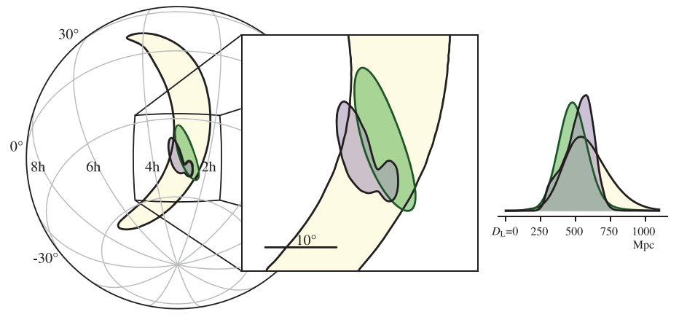
GW170814: The first triple detection
credible area on the sky is 1160 deg2 and shrinks to 100 deg2 when including Virgo data
When including Virgo, the 90% localization volume goes from 71 × 10⁶ Mpc³, to 2.1 × 10⁶ Mpc³
This is very important for cosmology.
S. Mastrogiovanni - ISCRA 2026

Slide 13
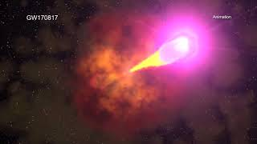
GW170817: The first MM event
At 12:41:04 UTC a GW from the merger of two Neutron star is detected
+2 seconds later Integral and Fermi detect a GRB.
~10 hrs later a kilonova emission from NGC4993 is observed.
With GW170817 we have been provided:
Luminosity distance from GW170817.
Redshift identification of the host galaxy from NGC4993.
Peculiar motion of NGC4993.
S. Mastrogiovanni - ISCRA 2026

Slide 14
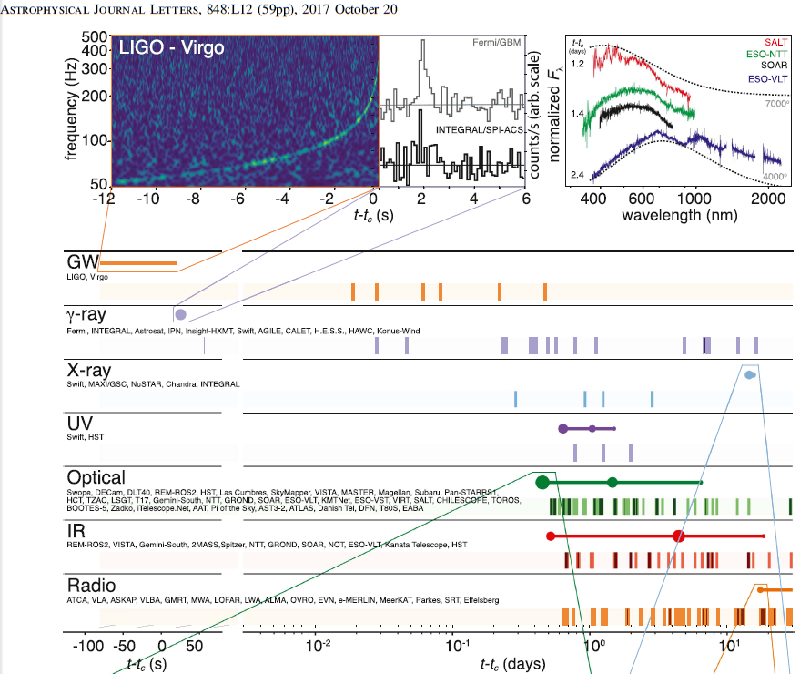
GW170817: The first MM event
At 12:41:04 UTC a GW from the merger of two Neutron star is detected
+2 seconds later Integral and Fermi detect a GRB.
~10 hrs later a kilonova emission from NGC4993 is observed.
With GW170817 we have been provided:
Luminosity distance from GW170817.
Redshift identification of the host galaxy from NGC4993.
Peculiar motion of NGC4993.
S. Mastrogiovanni - ISCRA 2026

Slide 15
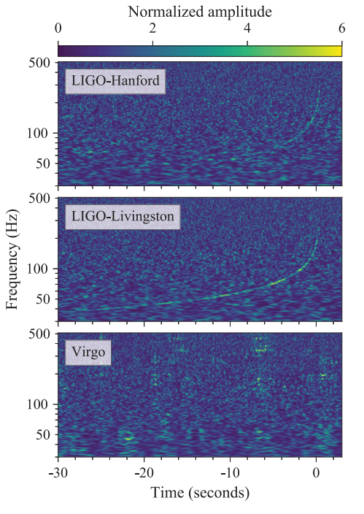
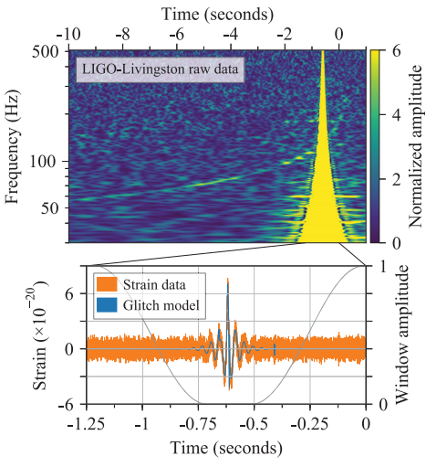
GW170817: The first MM event
Curiosity: The event was not detected initially in LIGO L, since there was a glitch
Cleaning your data
S. Mastrogiovanni - ISCRA 2026

Slide 16


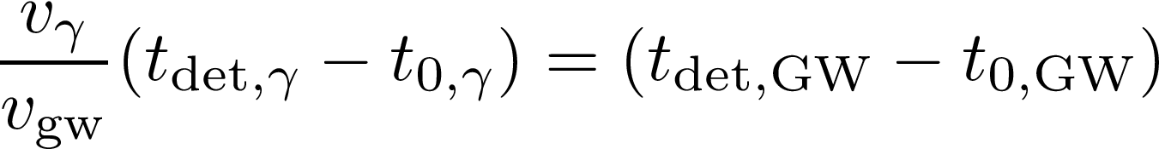
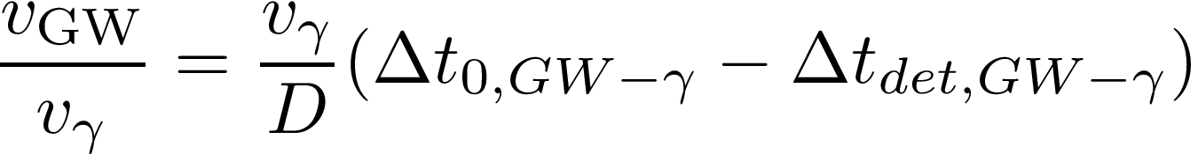

GW170817: The first MM event
From GW170817 we measured the distance = 26 Mpc, and the time of arrival of the GRB (The GRB arrived 1.74s) later. Can we measure the speed of gravity?
By equating the two and expanding to the first order...
If we feed the numbers and consider that the EM counterpart can be emitted upt to +/- 10 s...
Or mass of the graviton <1e-22 eV/c2
S. Mastrogiovanni - ISCRA 2026

Slide 17
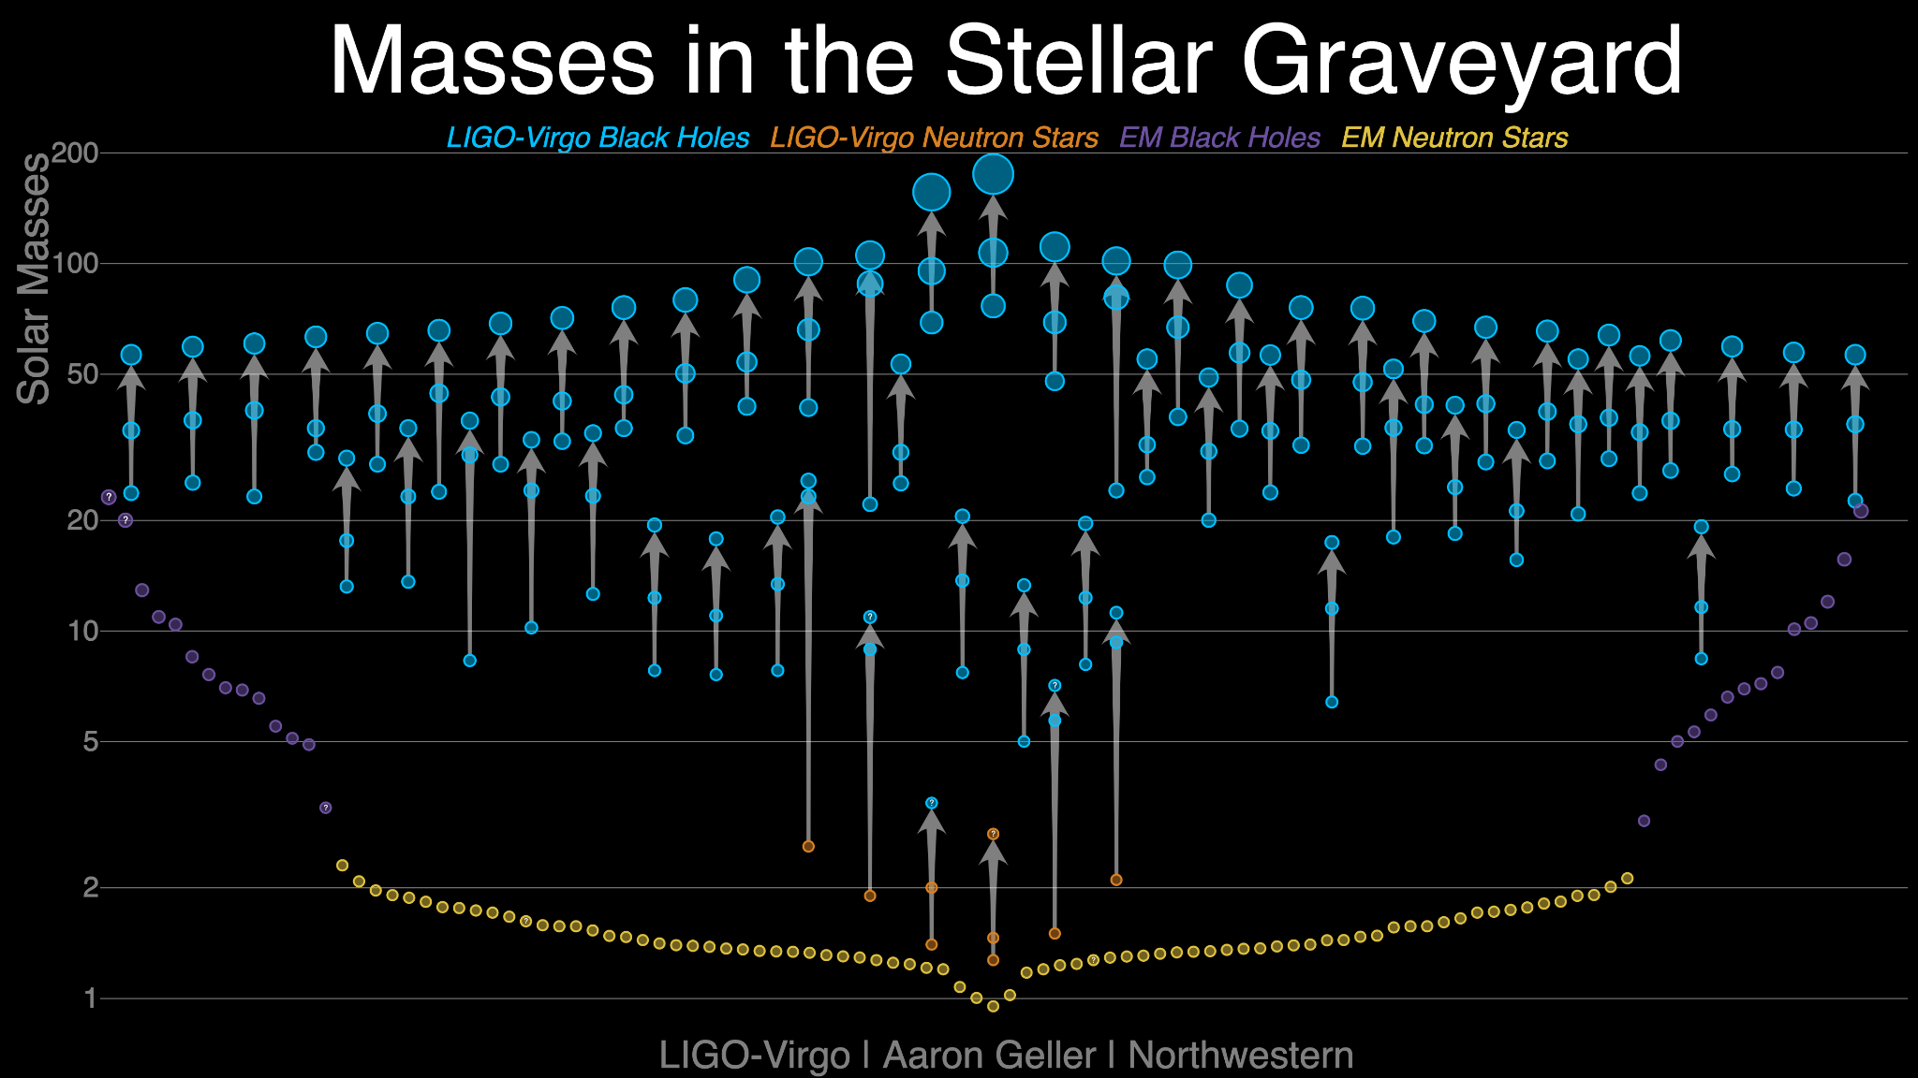
GWTC-2.0

Slide 18
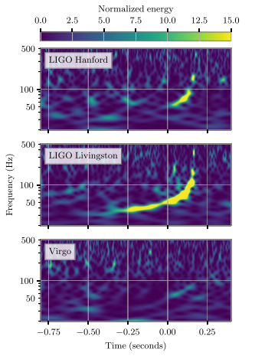
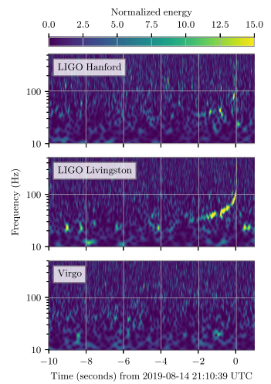
GW190412 and GW190814
GW190412
This event had a network SNR of 19.
GW190814
This event had a network SNR of 24.
S. Mastrogiovanni - ISCRA 2026

Slide 19
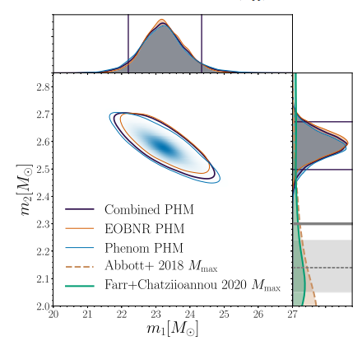
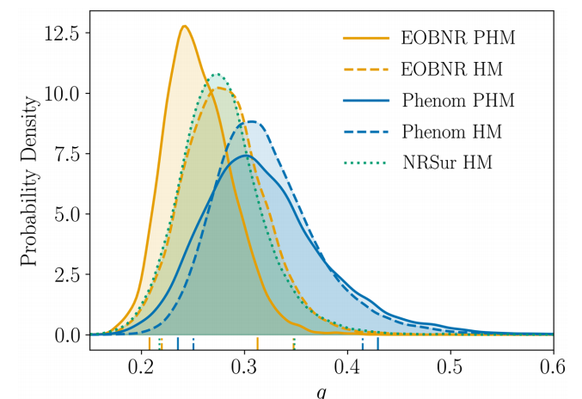
GW190412 and GW190814
These are the first events that shows a mass ratio which is clearly not one. These are asymmetric mass events.
GW190814
GW190412
S. Mastrogiovanni - ISCRA 2026

Slide 20
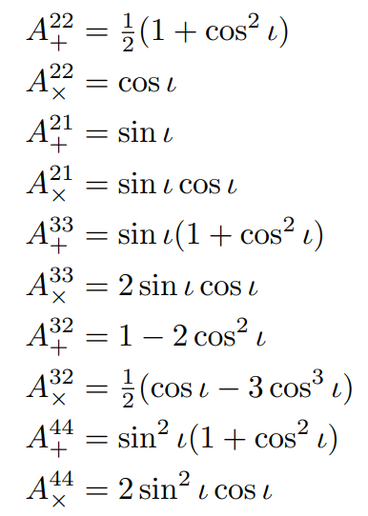


GW190412 and GW190814
Strong mass-asymmetric binaries could allow us to detect GWs higher modes (beyond the quadrupole formula.)
Different projection factors!
Different frequencies!
During inspiral
During ringdown
S. Mastrogiovanni - ISCRA 2026

Slide 21
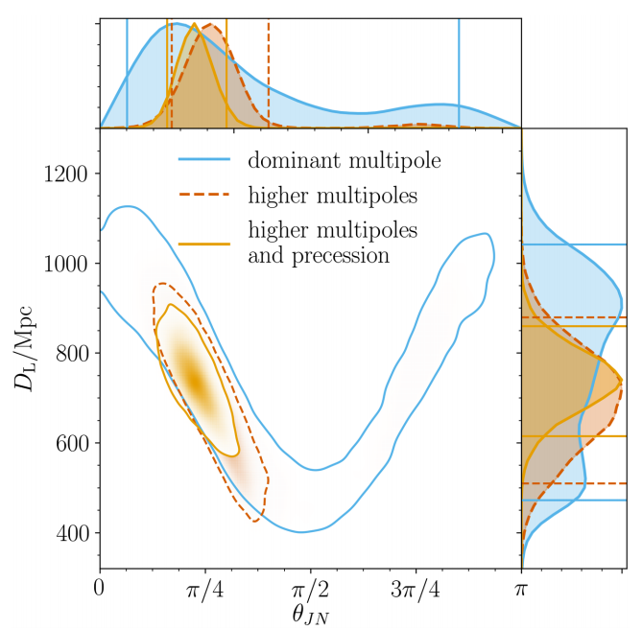
GW190412 and GW190814
Detecting higher modes breaks the degeneracy between the luminosity distance.
The presence of higher modes improves the luminosity distance estimation of the events.
GW190412
S. Mastrogiovanni - ISCRA 2026

Slide 22
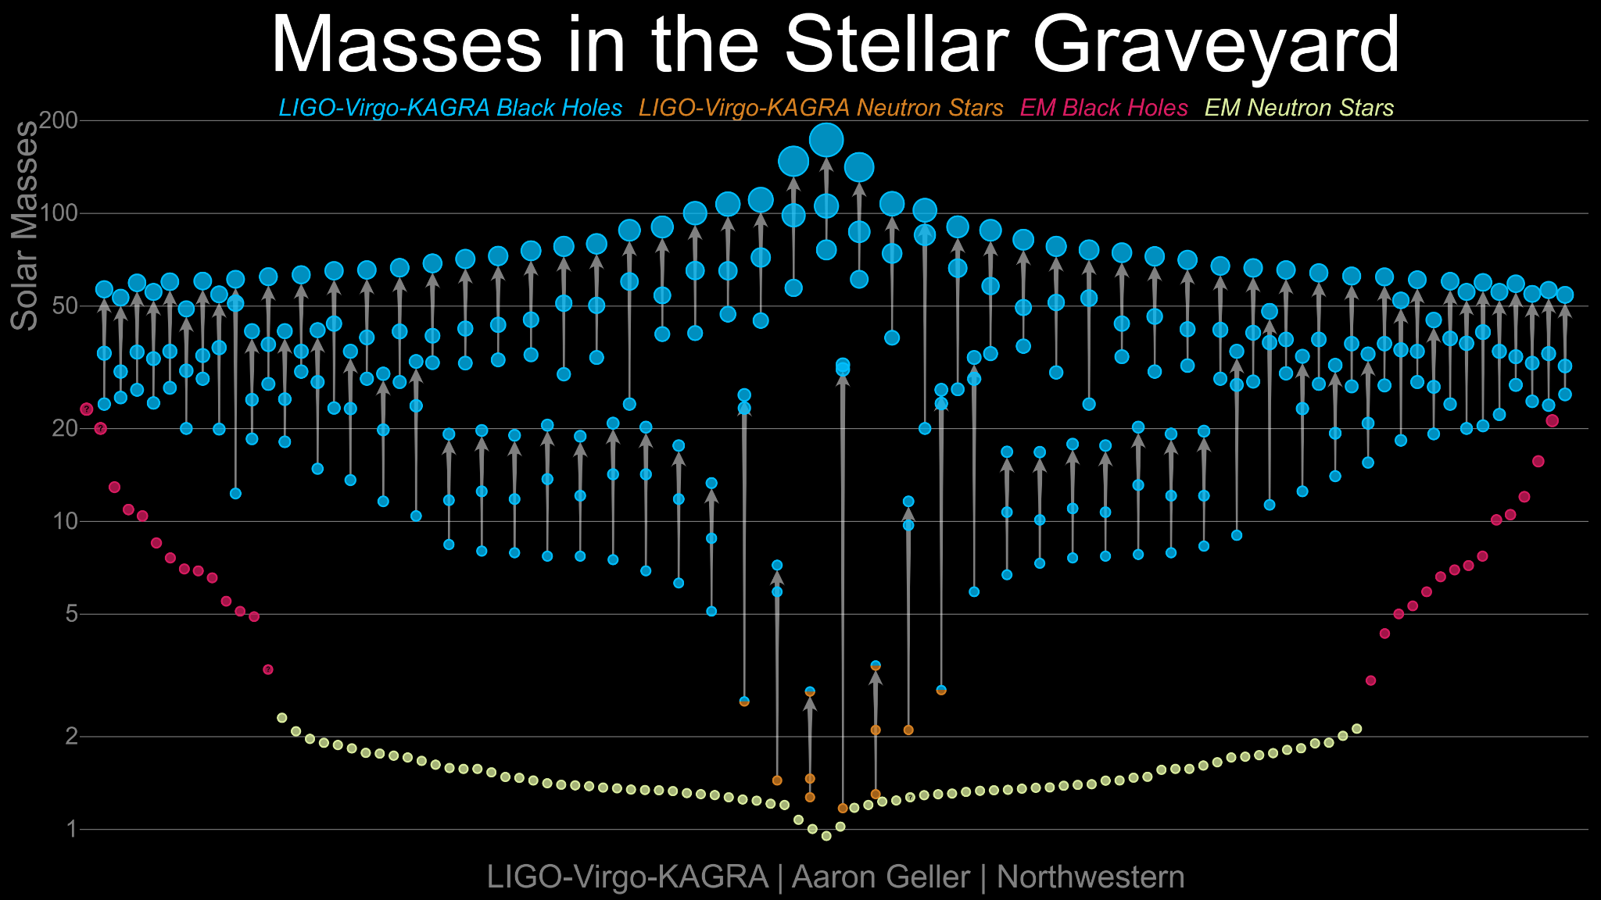
GWTC-3.0

Slide 23
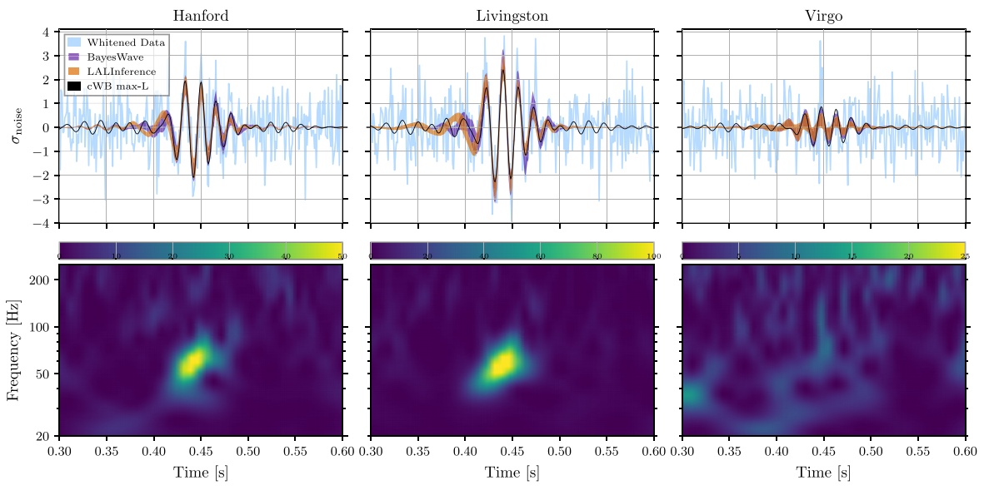
GW190521: A very massive events
GW190521, with a three-detector network signal-to-noise ratio of 14.7, and an estimated false-alarm rate of 1 in 4900 yr
S. Mastrogiovanni - ISCRA 2026

Slide 24
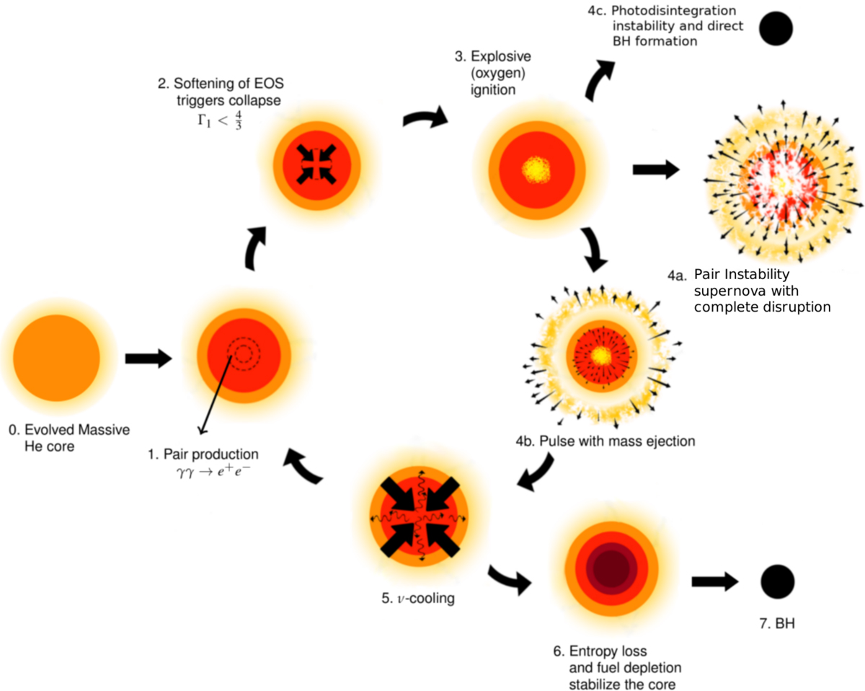
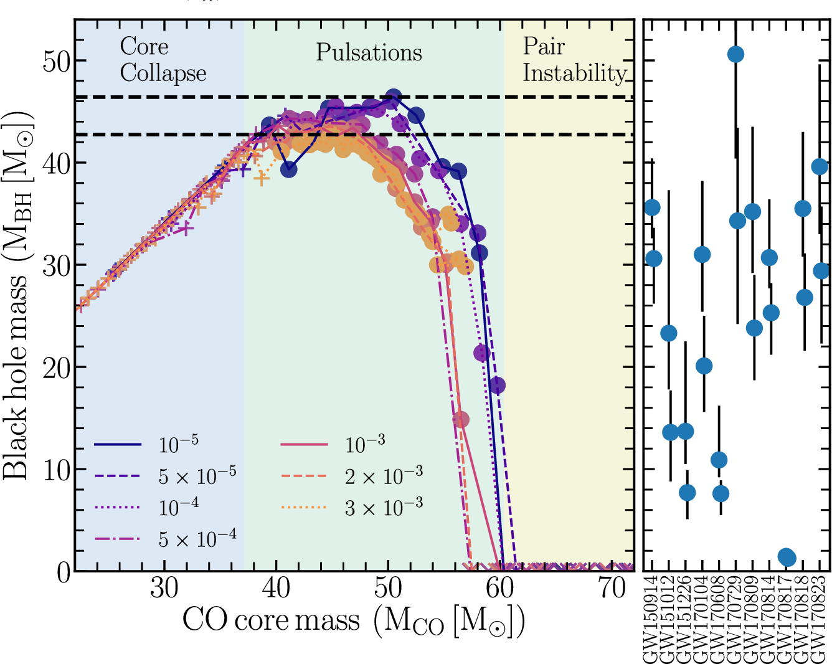
The PISN
S. Mastrogiovanni - ISCRA 2026

Slide 25
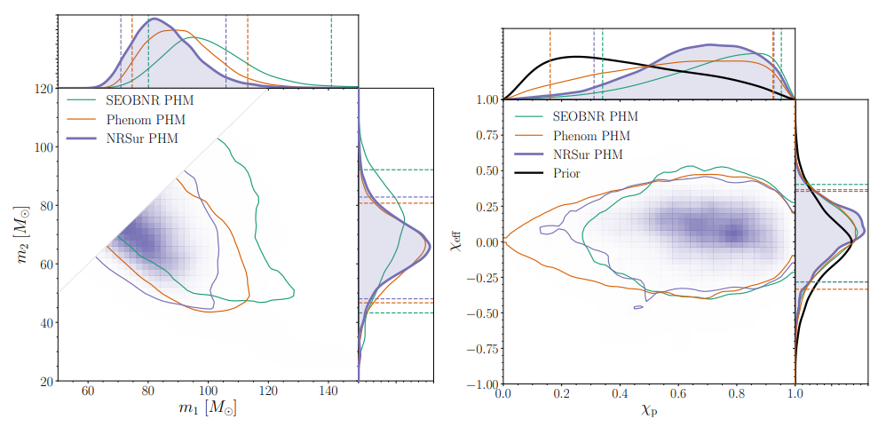
GW190521: A very massive events
The primary mass has only a 0.32% probability of being below 65. This challenge our knowledge of BH formation [Pair (and pulsational) instability Supernova process].
There was a small evidence for precession.
S. Mastrogiovanni - ISCRA 2026

Slide 26
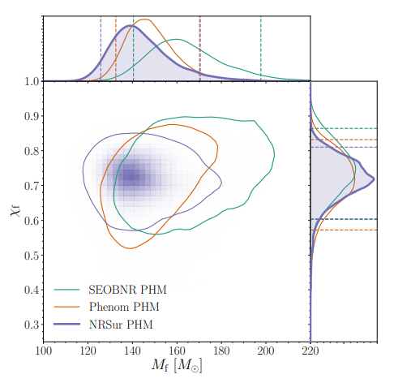
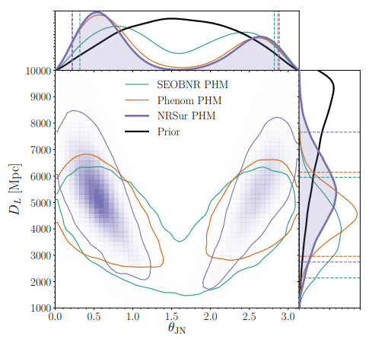
GW190521: A very massive events
We calculate the mass of the remnant to be 142, which can be considered an intermediate mass black hole (IMBH)
S. Mastrogiovanni - ISCRA 2026

Slide 27
GW190521: A very massive events
Second generation of mergers?
BBH formed in a dense astrophysical environment such as globular clusters
BBH formed from two merged stars
BBH formed in an AGN dense environment
Alternative models
Possible, but really unlikely. You need either a triple star system (5% prob of producing excetring BBHs) or very dense environments (1% prob)
Strong lensing: The lensing needed to transform BBH merger of 50-65 solar masses in this kind of signal is too high.
Primordial black holes?: We do not know given the large uncertainties on the models. There are some studies.
Cosmic string? The signal is very inconsistent with the template.
S. Mastrogiovanni - ISCRA 2026

Slide 28
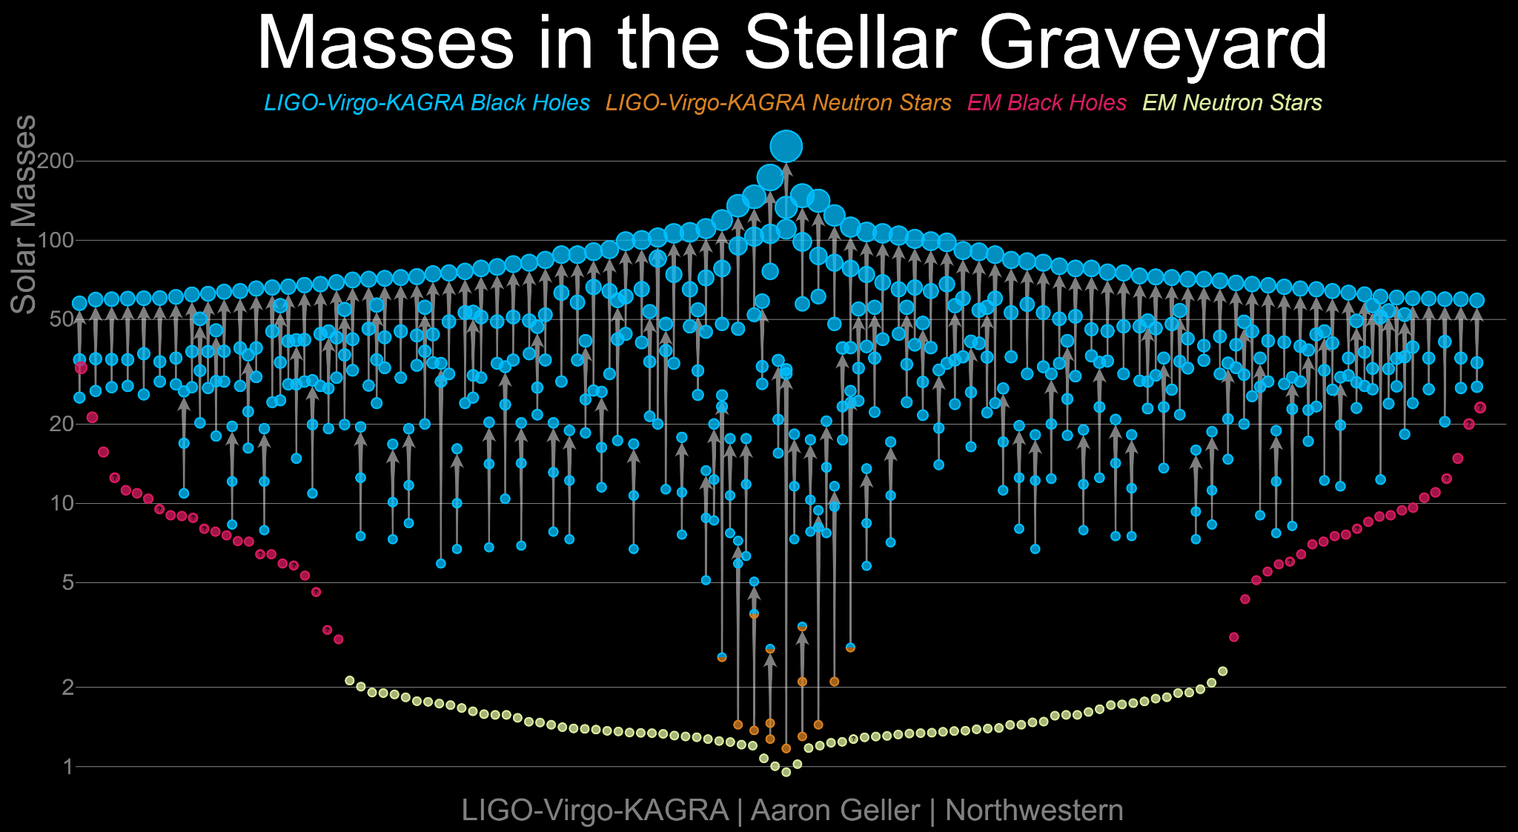
GWTC-4.0

Slide 29
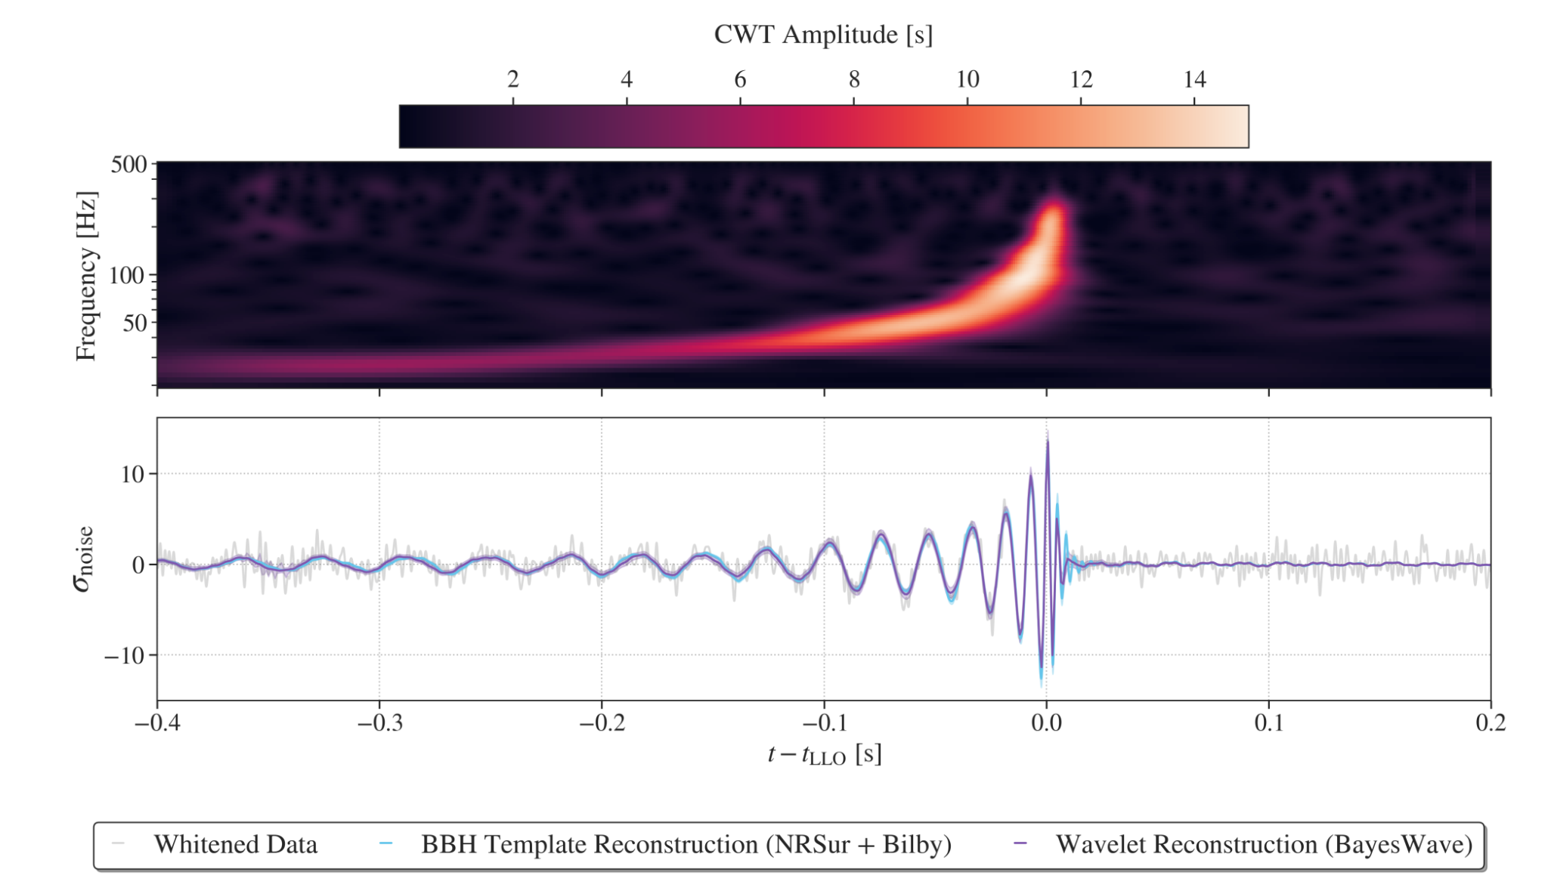
The answer is 42: GW230814
Astrophys.J.Lett. 1004 (2026) 2, L23
S. Mastrogiovanni - ISCRA 2026

Slide 30
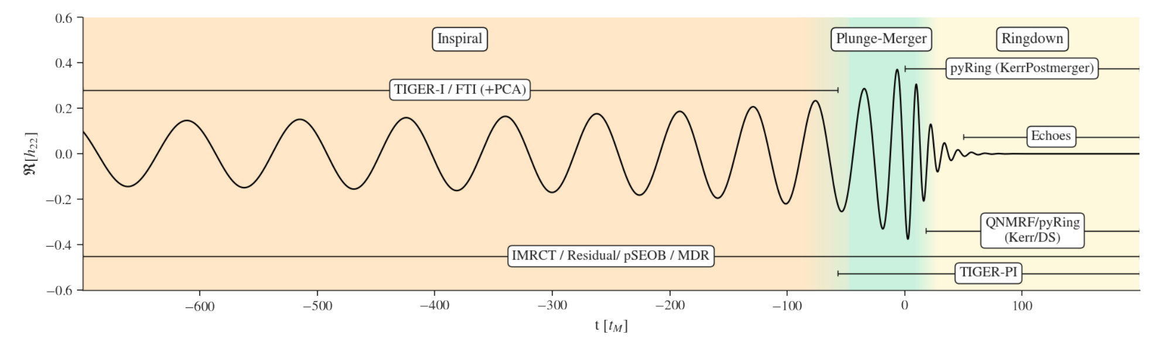
The answer is 42: GW230814
Astrophys.J.Lett. 1004 (2026) 2, L23
S. Mastrogiovanni - ISCRA 2026

Slide 31
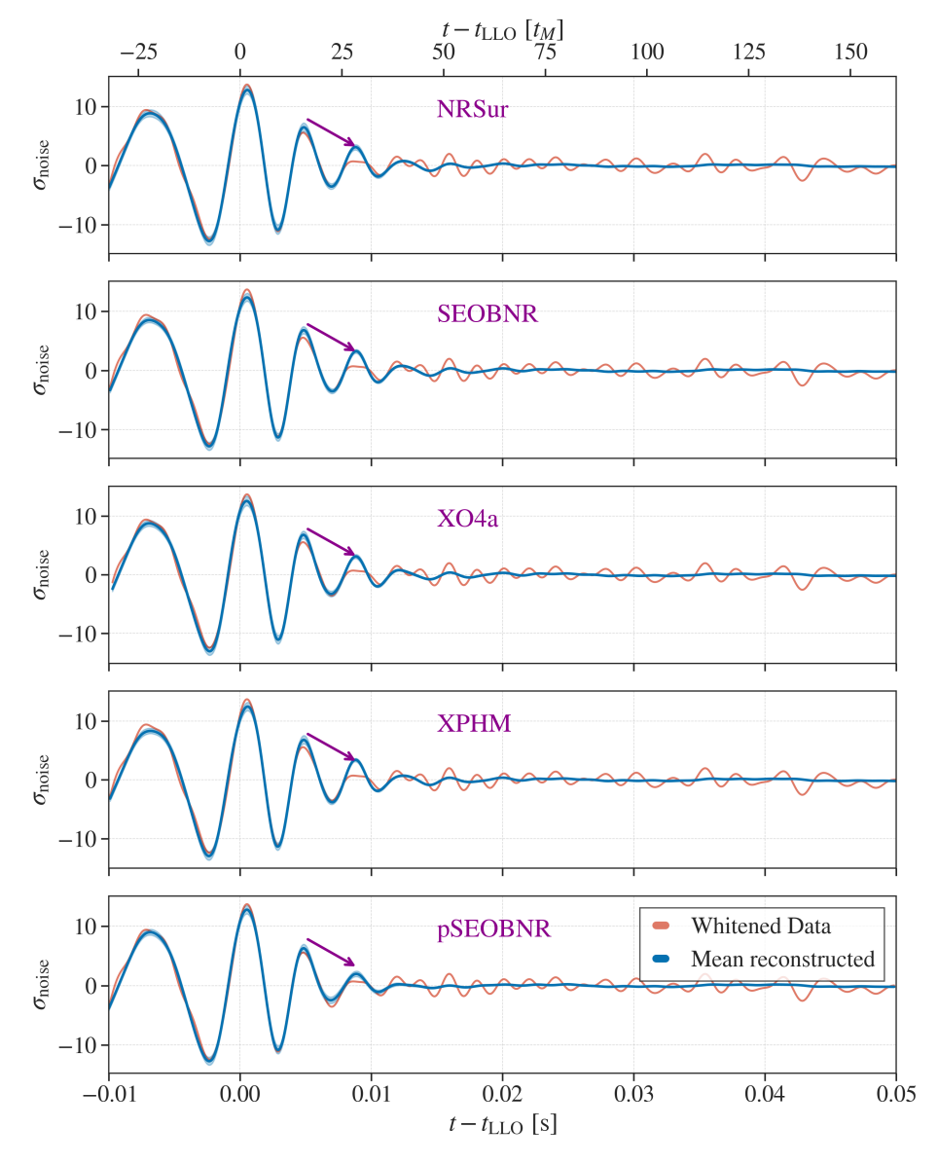
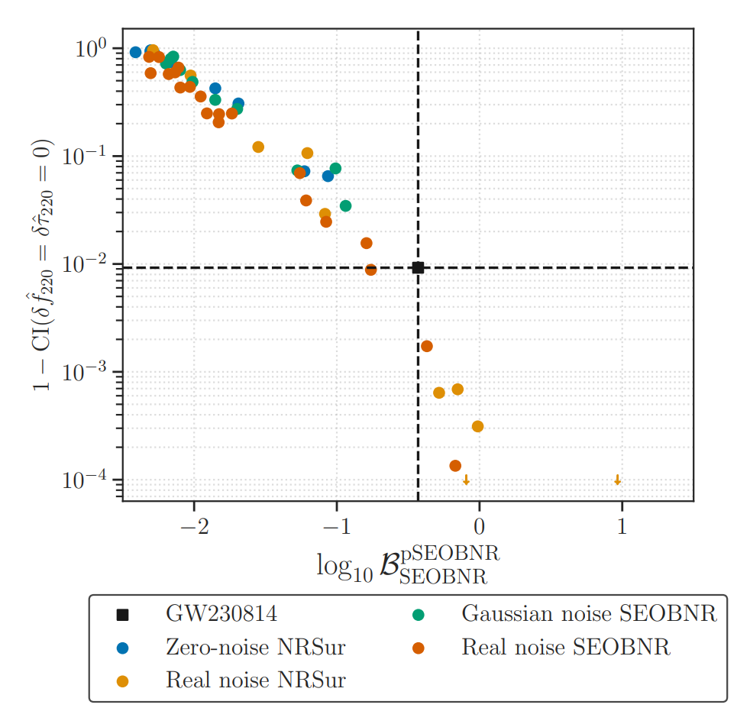
The answer is 42: GW230814
S. Mastrogiovanni - ISCRA 2026
Astrophys.J.Lett. 1004 (2026) 2, L23

Slide 32
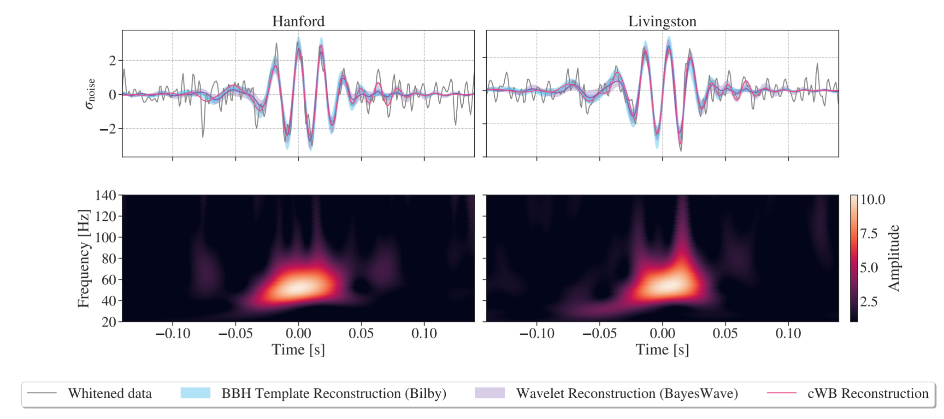
Breaking the limits: GW231123
ApJL 993 L25 (2025)
S. Mastrogiovanni - ISCRA 2026

Slide 33
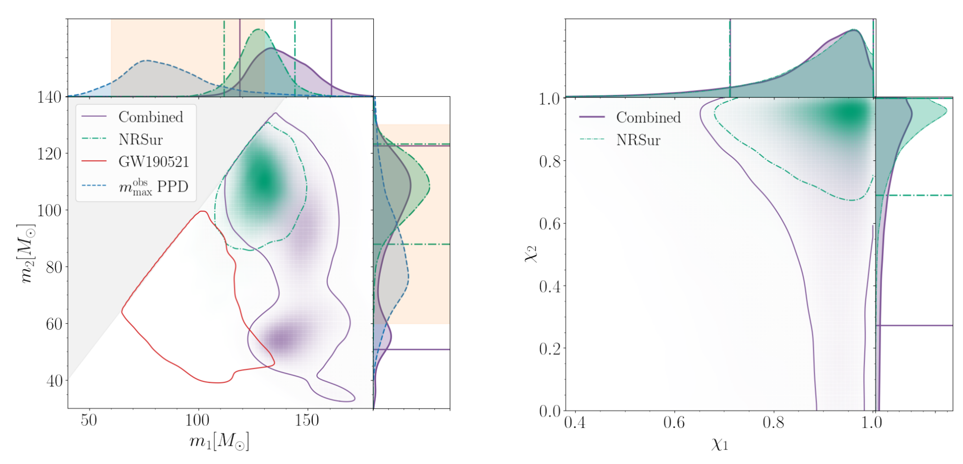
Breaking the limits: GW231123
ApJL 993 L25 (2025)
S. Mastrogiovanni - ISCRA 2026

Slide 34
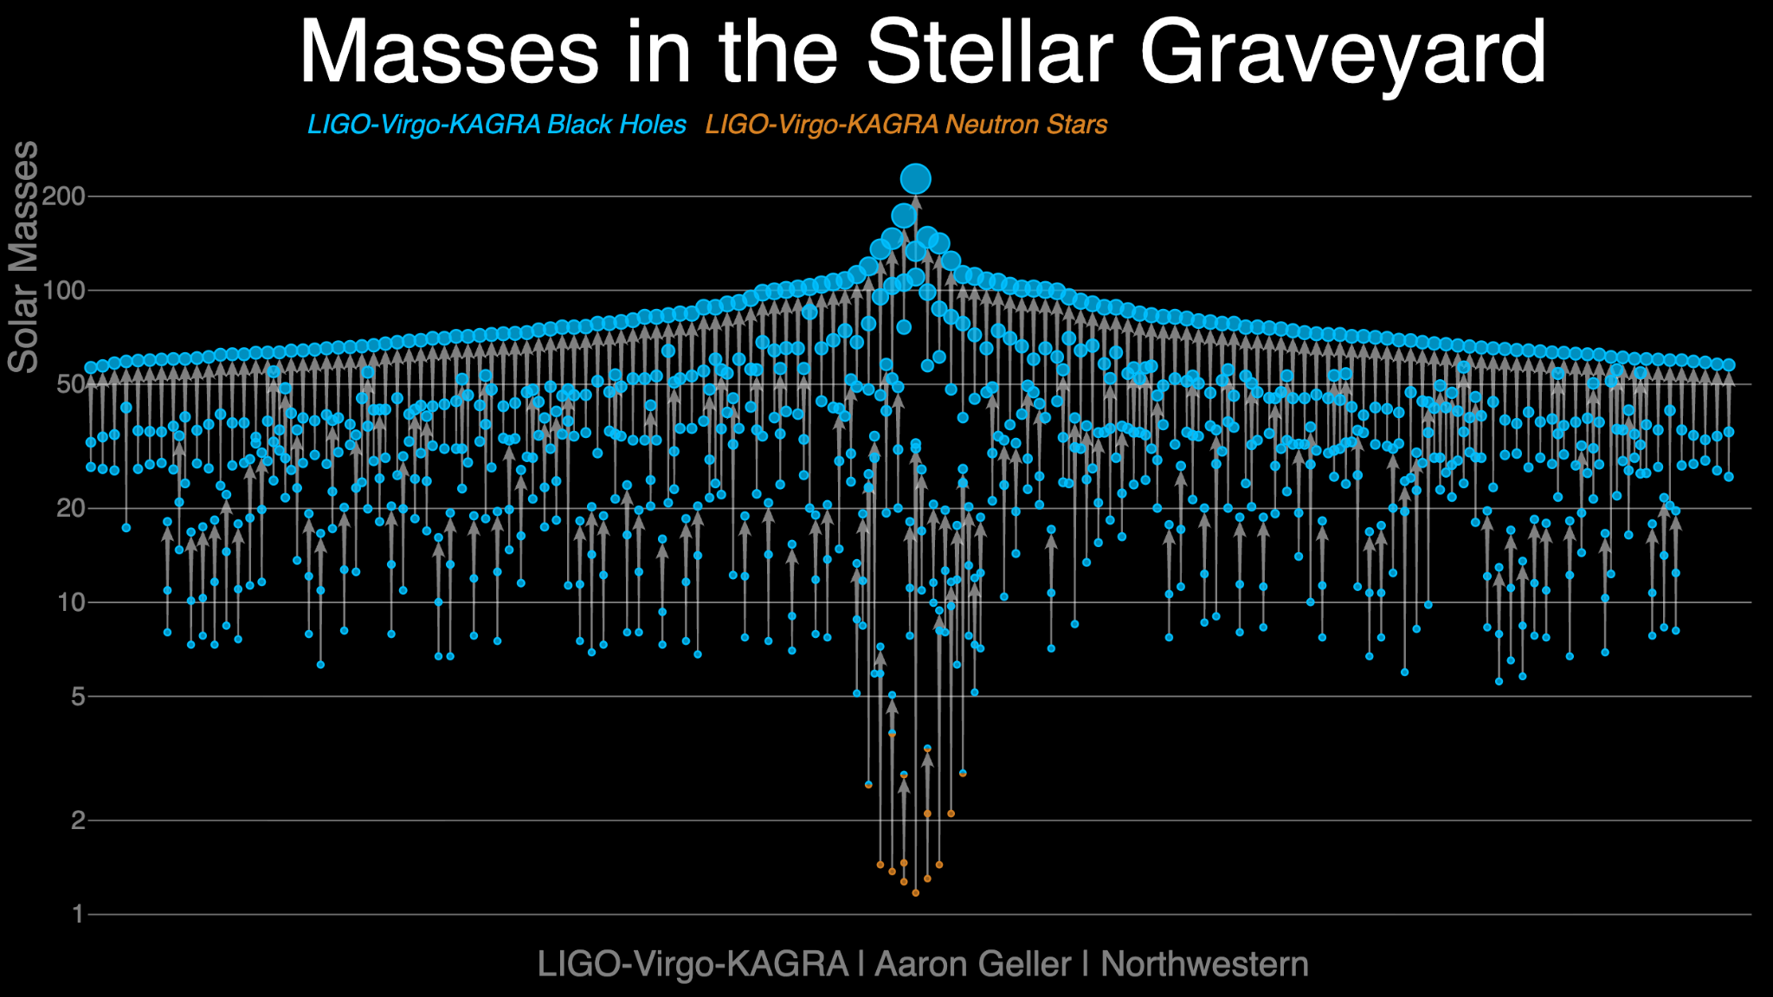
GWTC-5.0

Slide 35
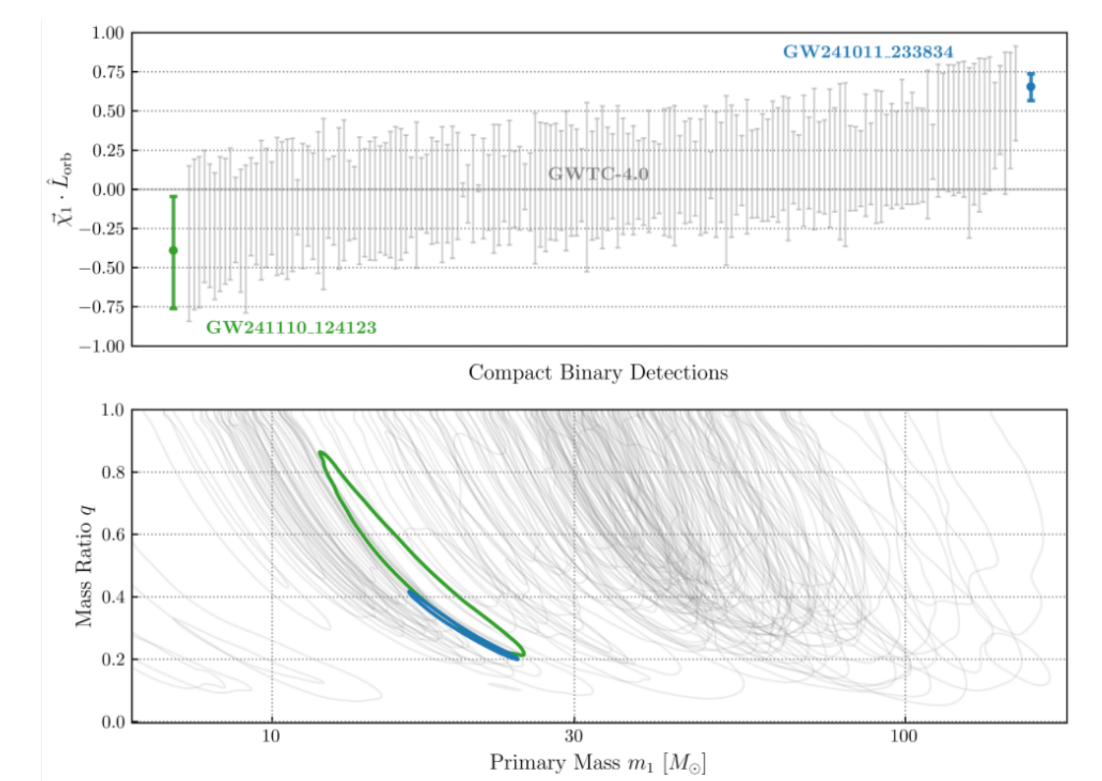
The twins: GW241011 and GW241110
ApJL, 993:L21 (45pp), 2025
S. Mastrogiovanni - ISCRA 2026

Slide 36
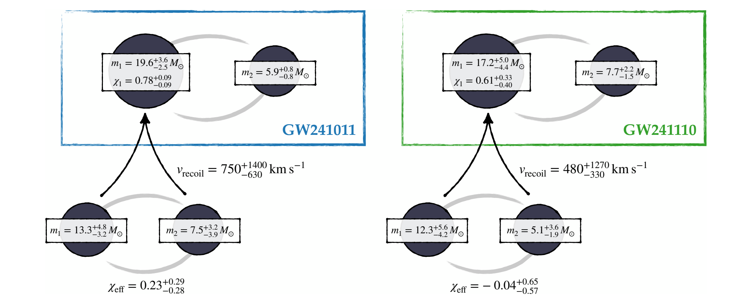
The twins: GW241011 and GW241110
ApJL, 993:L21 (45pp), 2025
S. Mastrogiovanni - ISCRA 2026

Slide 37
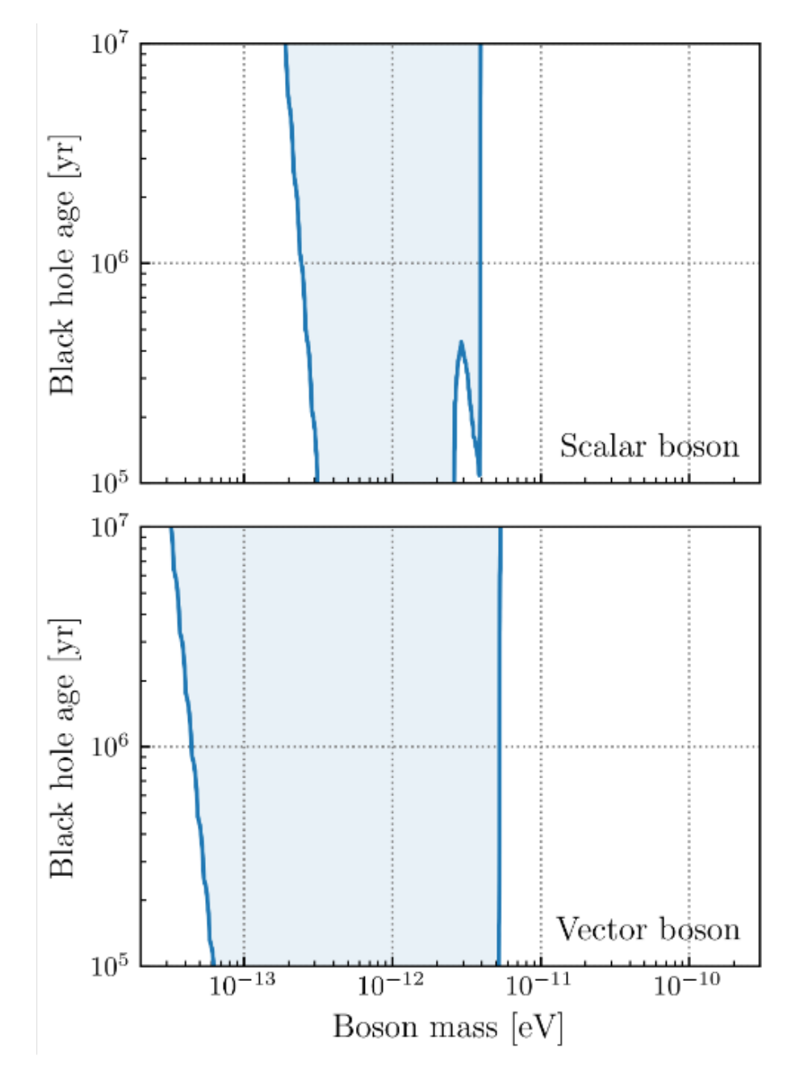
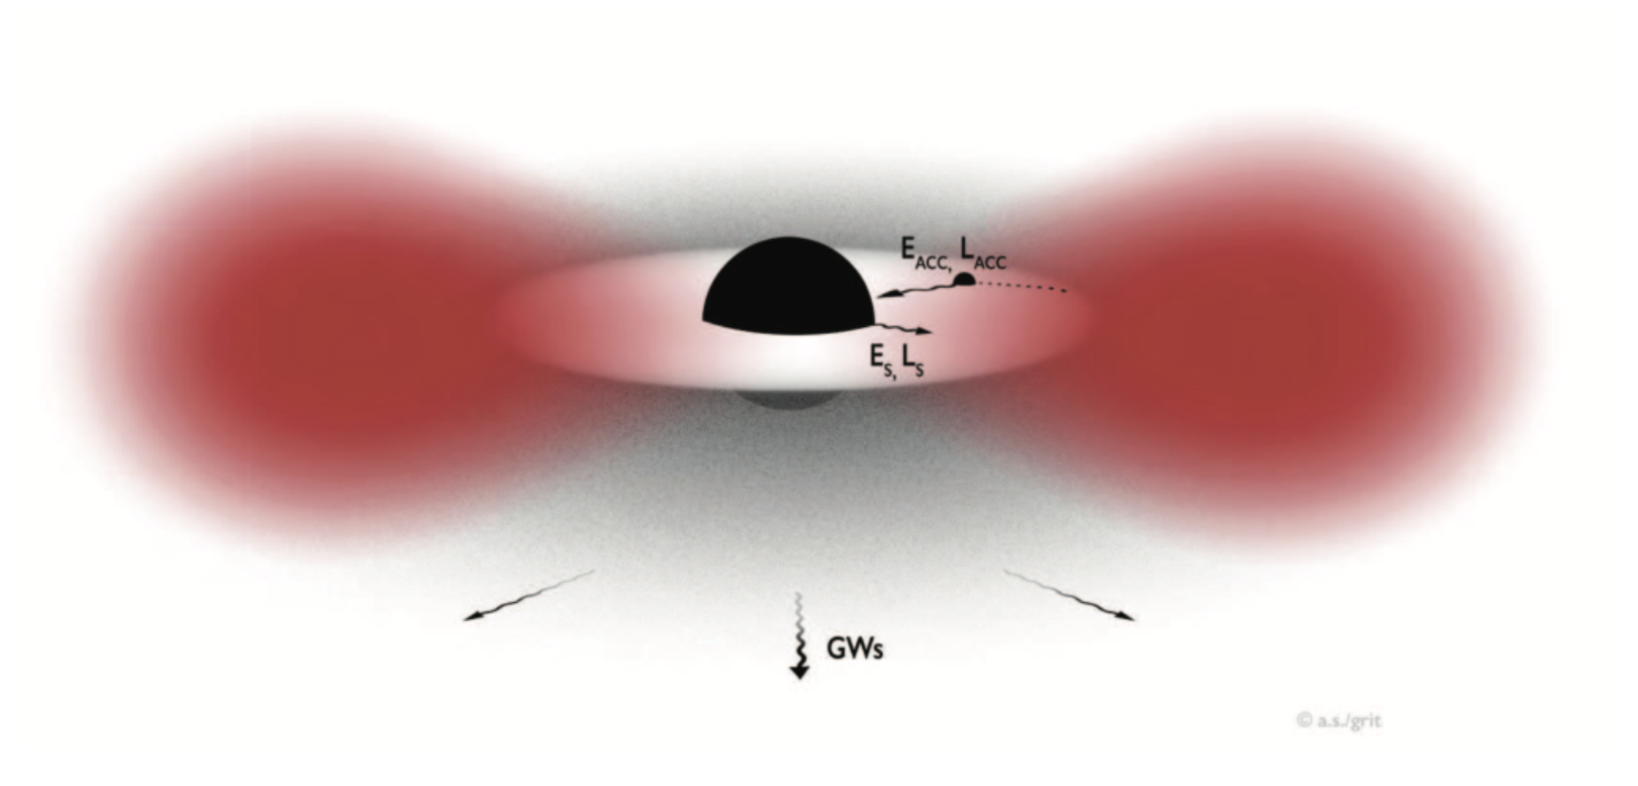
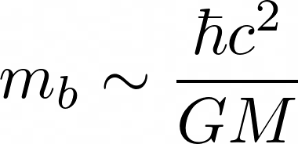
The twins: GW241011 and GW241110
ApJL, 993:L21 (45pp), 2025
S. Mastrogiovanni - ISCRA 2026

Slide 38


The guest star: GW250114
S. Mastrogiovanni - ISCRA 2026
PRL 135, 111403 (2025)

Slide 39



The guest star: GW250114
Kerr Black hole area
Hawking Area theorem: “The Black Hole horizon area can not decrease in time”
S. Mastrogiovanni - ISCRA 2026
PRL 135, 111403 (2025)

Slide 40


The guest star: GW250114
S. Mastrogiovanni - ISCRA 2026
PRL 135, 111403 (2025)

Slide 41

Tuning the detectors: GW240925 and GW250207
S. Mastrogiovanni - ISCRA 2026
Phys. Rev. Lett. - Accepted 30 April, 2026

Slide 42


Tuning the detectors: GW240925 and GW250207
An interferometer is like a electrical system closed in a box…you can characterize it with a transfer function
S. Mastrogiovanni - ISCRA 2026
Phys. Rev. Lett. - Accepted 30 April, 2026

Slide 43

Tuning the detectors: GW240925 and GW250207
GW240925
GW250207
S. Mastrogiovanni - ISCRA 2026
Phys. Rev. Lett. - Accepted 30 April, 2026

Slide 44
Part 2 - end

