Slide 1




Gravitational Waves III
GW cosmology
Simone Mastrogiovanni
INFN Rome
ISCRA - Erice, Italy 2026

Slide 2

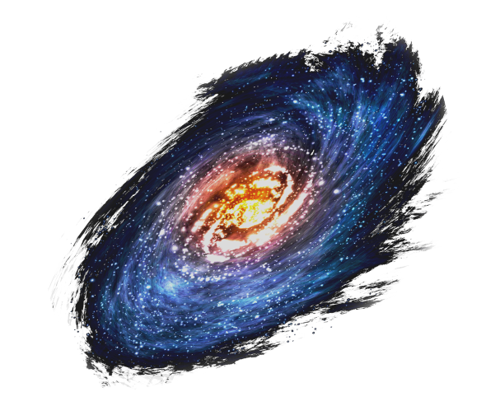



The cosmic expansion
The universe expansion can be using a scale factor. Galaxies are placed on an expanding carpet. If we measure the distance between galaxies as a function of time, we find that it increases
Expansion

Slide 3

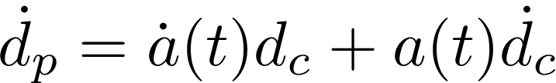
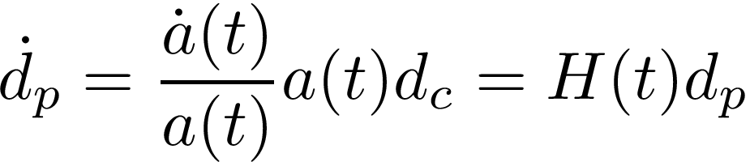
The cosmic expansion
For an expanding universe, we need to define a physical distance and and comoving distance.
Physical distance
Scale factor
Comoving distance
Hubble’s parameter
Expansion
Hubble’s Law
In an expanding Universe, objects naturally run-away from each other with a velocity proportional to their distance.

Slide 4
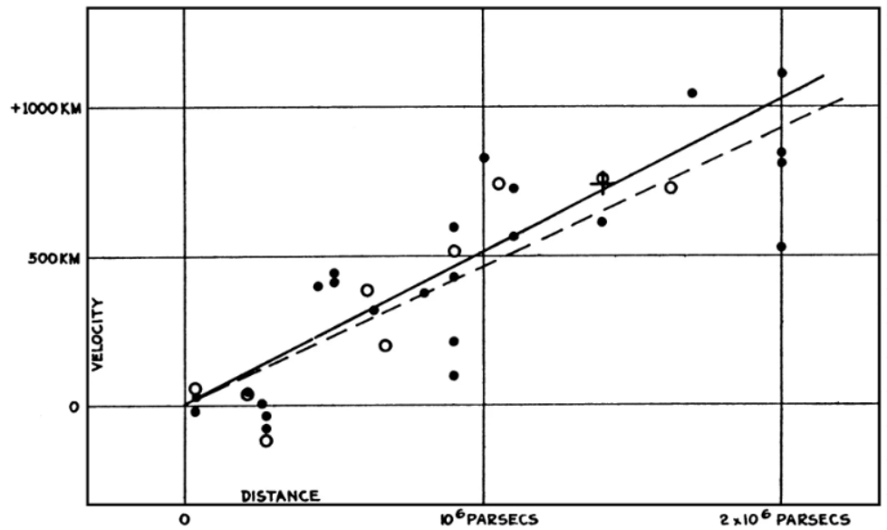
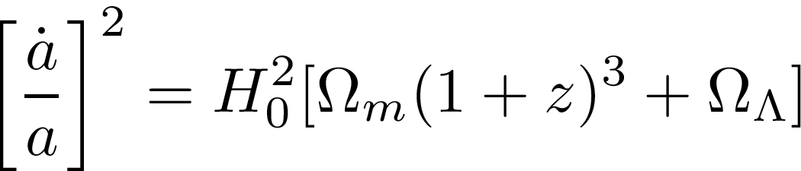
The cosmic expansion
First observations by Hubble have shown that further galaxies display an higher recessional velocity.
Velocity [km/s]
At low distances, the Hubble parameter is constant = > Hubble constant
At high distances, the Hubble parameter is not constant anymore (depends on other cosmological parameters)
Distance [Mpc]
From Friedman’s Equations

Slide 5
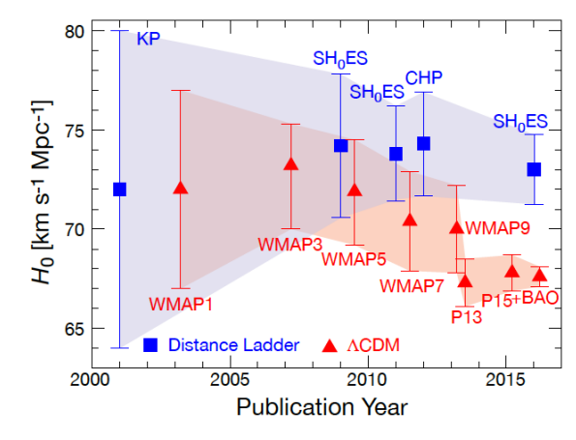
The cosmic expansion
There is a tension between direct and indirect measurements of the Hubble constant
Measurements of the cosmic microwave background points toward a value of ~67 km/s/Mpc.
Measurements from supernovae a value of ~74 km/s/Mpc.
New physics? Systematics?
[W. Freedman, Nature Astronomy, 1, 0169 (2017)]

Slide 6
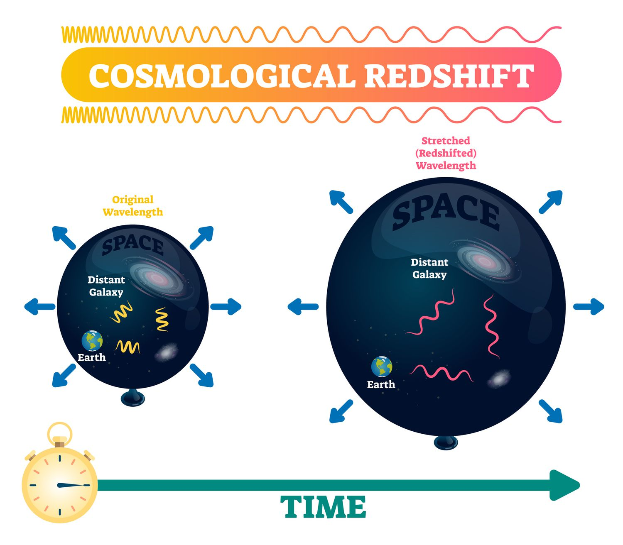
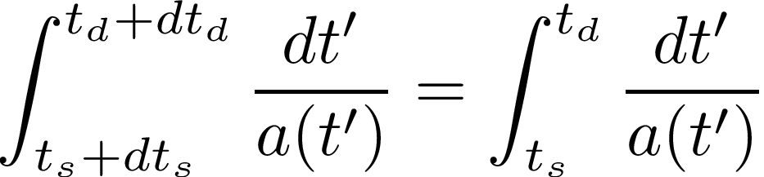
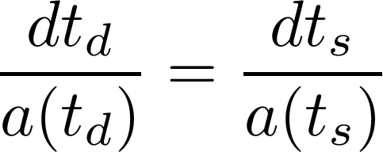
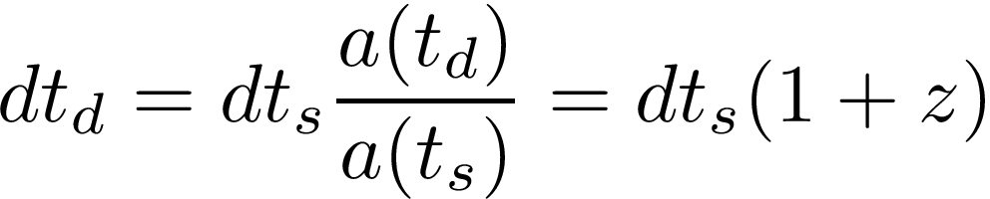
The cosmic expansion
Waves travelling in an expanding universe are redshifted. This can be demonstrated from the definition of comoving distance.
Comoving distance pulse 1
Comoving distance pulse 2

Slide 7
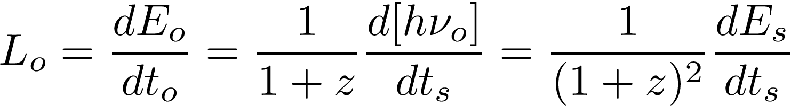
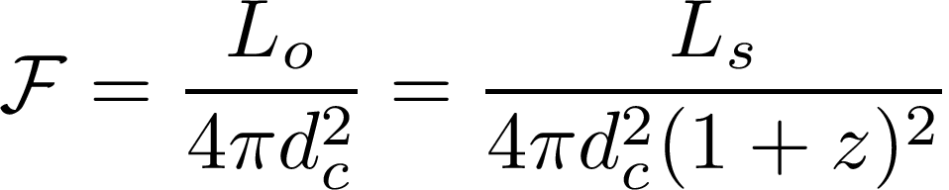
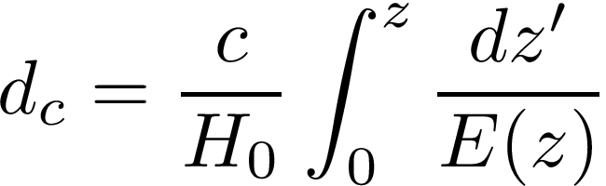

The cosmic expansion
In cosmology exists several definitions of distances. The last definition we will see in the luminosity distance.
Luminosity at observer
Luminosity at source
Flux
If we know the intrinsic luminosity of a source we can measure its luminosity distance

Slide 8
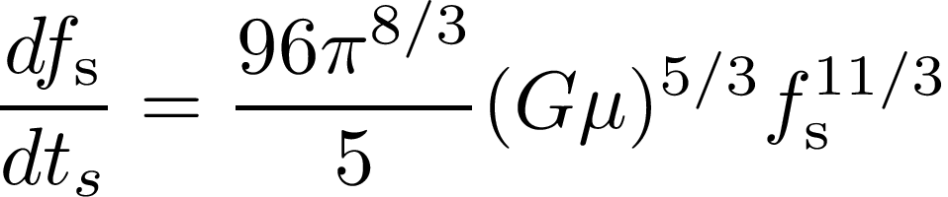
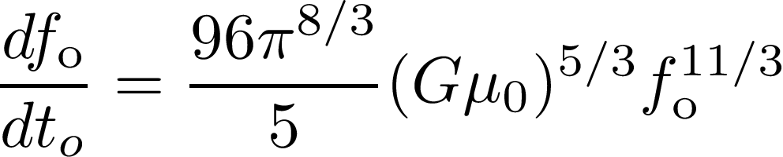
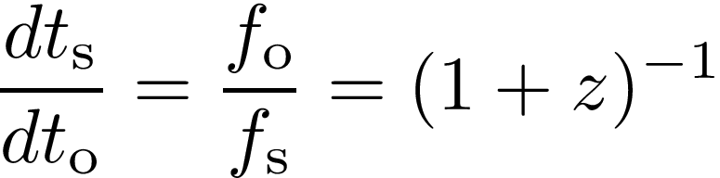

The cosmic expansion
Gravitational Waves at cosmological distances have special properties
GW frequency evolution at source
GW frequency evolution at source
Cosmological redshift
Detector’s chirp mass
The frequency evolution of a GW is the same at the source anad at the detector, we just need to define a detector frame mass.

Slide 9
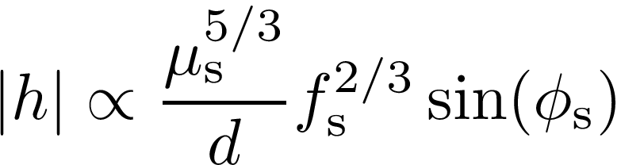
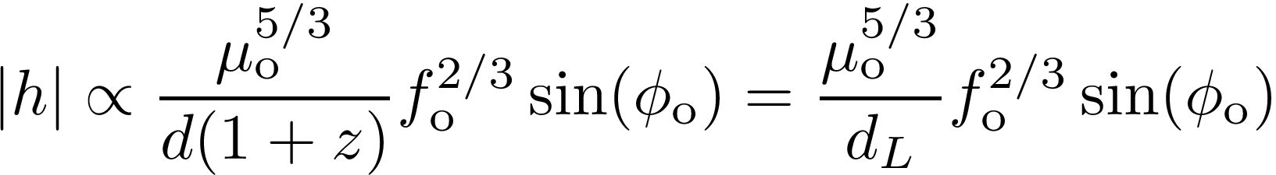
The cosmic expansion
What about the amplitude of a GW?
Amplitude at the source
We need to replace all the source quantities with detector quantities and we will note that
From the GW it is possible to directly measure the luminosity distance of the source

Slide 10
The cosmic expansion
Let’s and summarize what we have learnt
From the GW sourced by a CBC at cosmological distance, we can measure the detector masses and the luminosity distance.
GWs are the only source for which we can measure directly a distance.
If provided with a redshift (recessional velocity), GWs can be used to probe cosmology.
How do we get a redshift?
Let’s take a step back for a second

Slide 11
Standard sirens
In recent years, we used several methods to assign a redshift to GW sources
Bright sirens: An associated Electromagnetic (EM) counterpart (GRB, Kilonova etc…) can provide the identification of the host galaxy.
Dark sirens: Galaxy surveys can be used to identify possible hosts in the GW localization volume.
Spectral sirens: Knowledge of the source-frame mass distribution can be used to assign a redshift to GW sources.

Slide 12
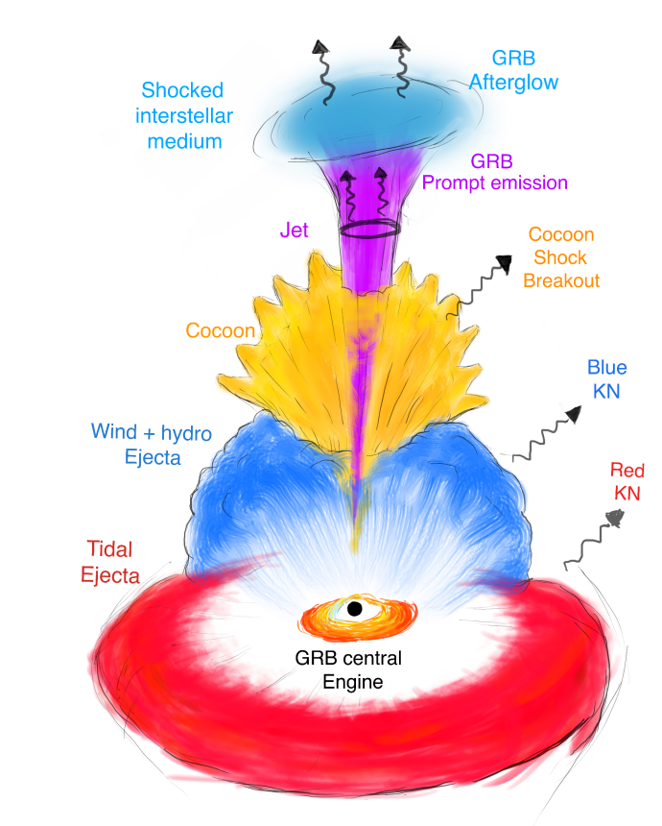
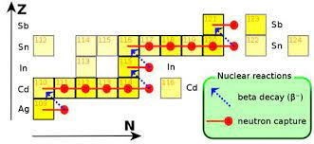
Standard sirens
Ascenzi+, Journal of Plasma Physics, 87, 1 2021

Slide 13
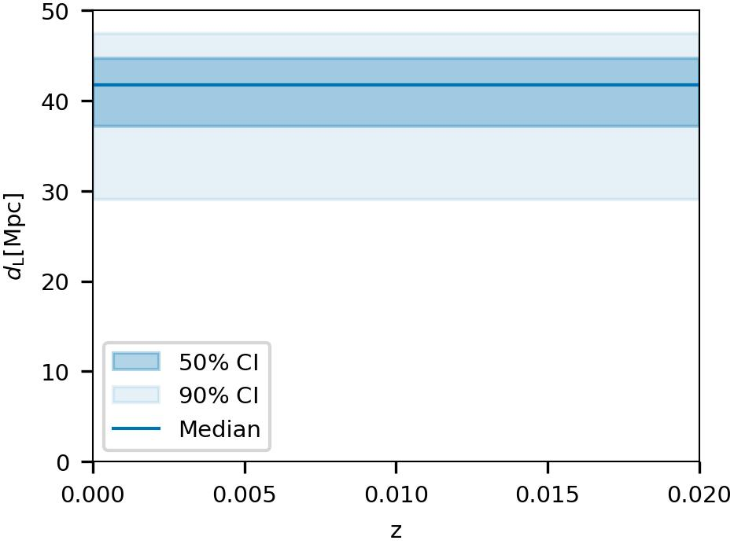
GW170817
GW170817: A binary neutron star merger detected by LIGO and Virgo. From the GW, source distance ~ 40 Mpc [LVK+, ApJL, 848 (2017)].

Slide 14
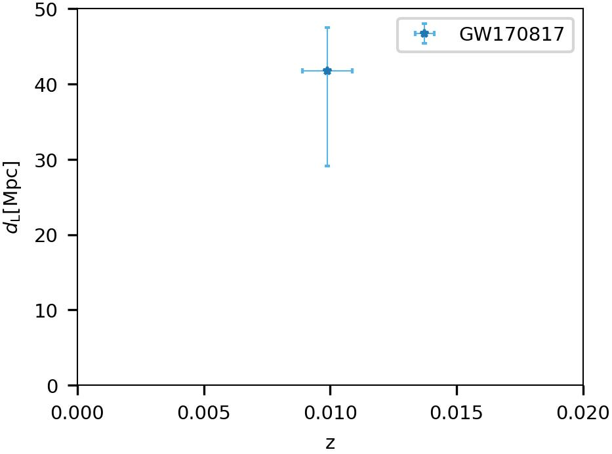
GW170817
GW170817: A binary neutron star merger detected by LIGO and Virgo. From the GW, source distance ~ 40 Mpc [LVK+, ApJL, 848 (2017)].
Short Gamma-ray burst and Kilonova: Two associated EM counterparts allowed the identification of the source host galaxy NGC4993.

Slide 15
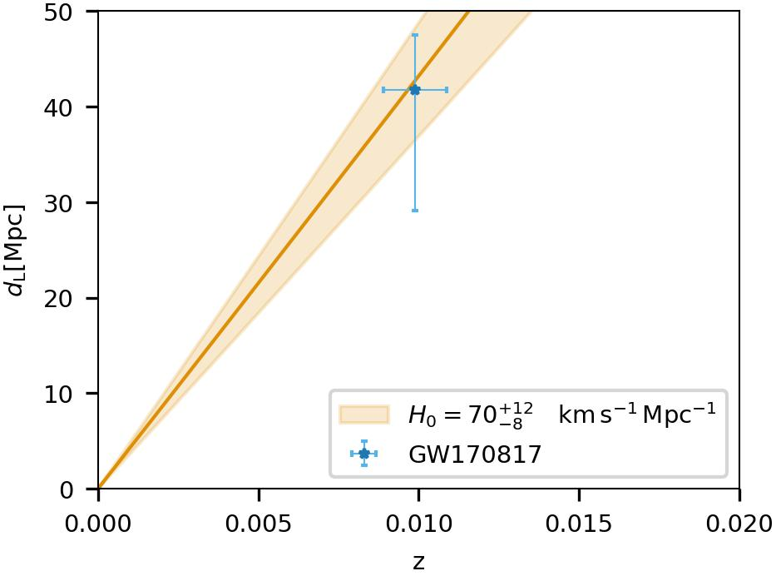
GW170817
GW170817: A binary neutron star merger detected by LIGO and Virgo. From the GW, source distance ~ 40 Mpc [LVK+, ApJL, 848 (2017)].
Short Gamma-ray burst and Kilonova: Two associated EM counterparts allowed the identification of the source host galaxy NGC4993.
This type of events will difficult to detect, we might expect to have 0-10 others in the next two observing runs [SM+ A&A (2017), Patricelli+, MNRAS (2022)]

Slide 16
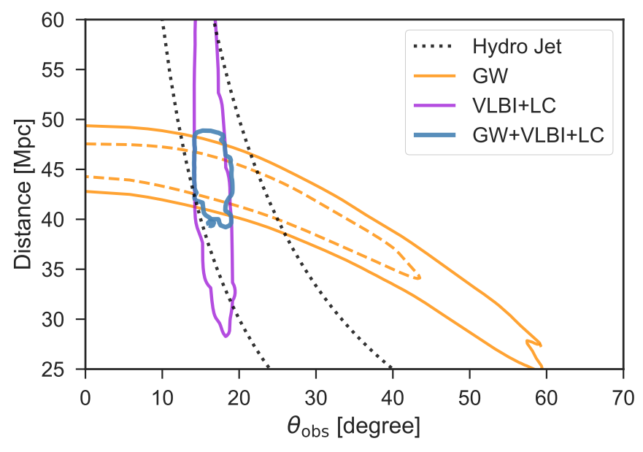
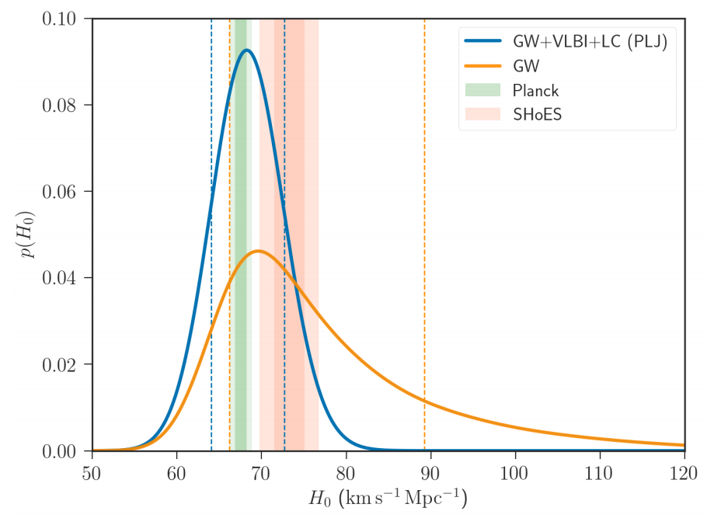
GW170817
Credit: S. Ascenzi
Afterglow informed cosmology
[K. Hotokezaka, Nature Astronomy, 3(2019)]

Slide 17
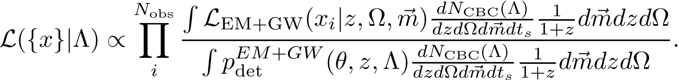
Dark sirens
In the case of an EM counterpart, we need to modify the hierarchical likelihood to take into account the fact that we also measure redshift and sky position from the EM counterpart
Overall likelihood
Rate of CBC with EM counterparts
Detection probability
We make two assumptions:
The detection probability is dominated by the GW.
The EM and GW likelihoods can be separated in two independent terms.

Slide 18
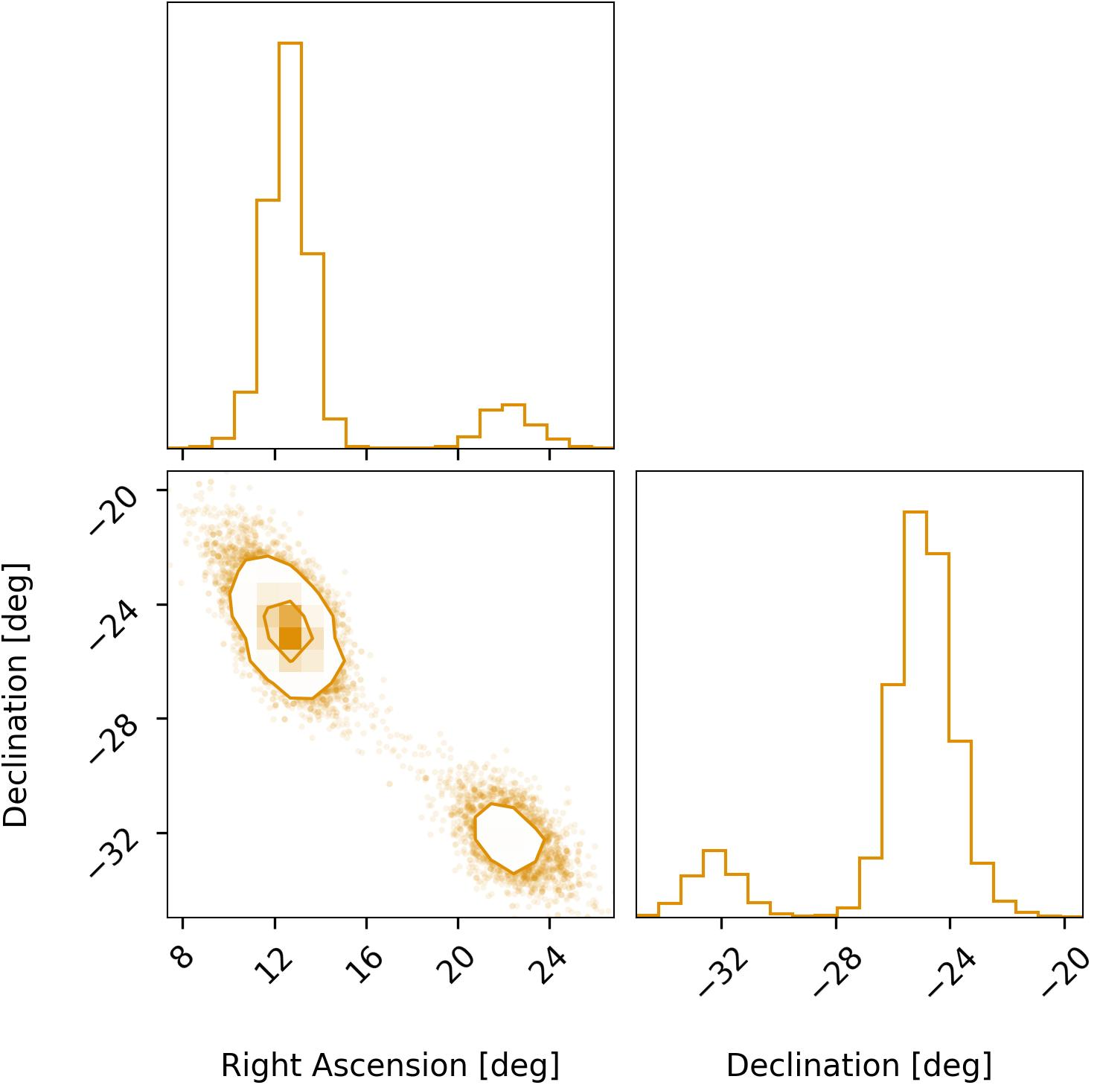
Dark sirens
GW190814
Localization volume 88,000 Mpc³
In the case that the GW is not observed with EM counterpart, we can use galaxy catalogs to identify possible galaxy hosts [Schutz, Nature 1986].
Galaxy surveys will provide possible redshifts.
GW will provide luminosity distance.
Best localized events provide better constraints for cosmology.
[LVK, ApJL 896 (2020)]

Slide 19
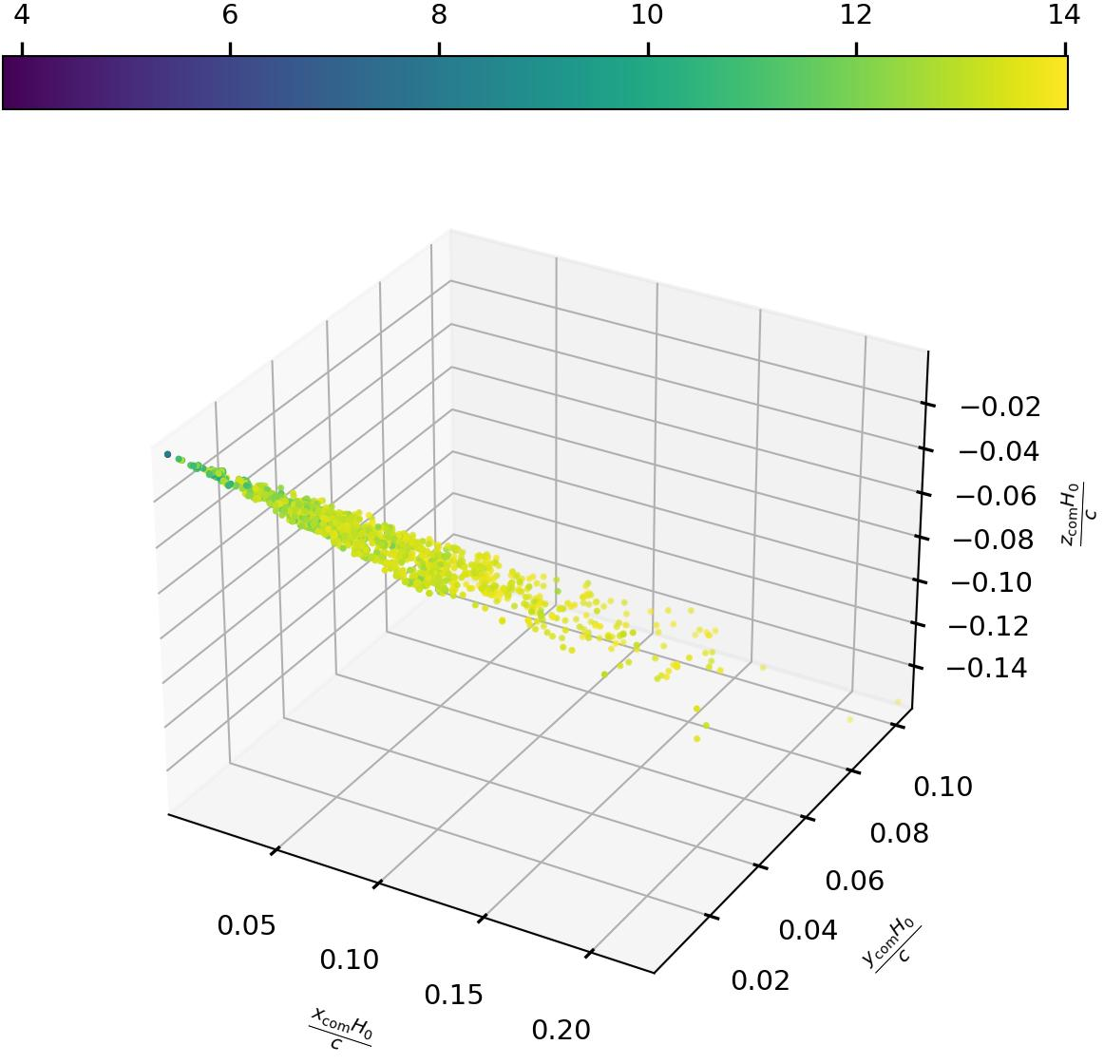
Dark sirens
Apparent magnitude
A cosmological model has statistical support when the GW localization matched an overdensity of galaxies.
Galaxy catalogs are not complete at higher redshifts, we need to apply corrections in order to now bias our analyses [R. Gray+, PRD (2019)]
GW190814
H₀=67.7 km/s/Mpc
GW190814
H₀=120 km/s/Mpc
Fainter galaxies

Slide 20
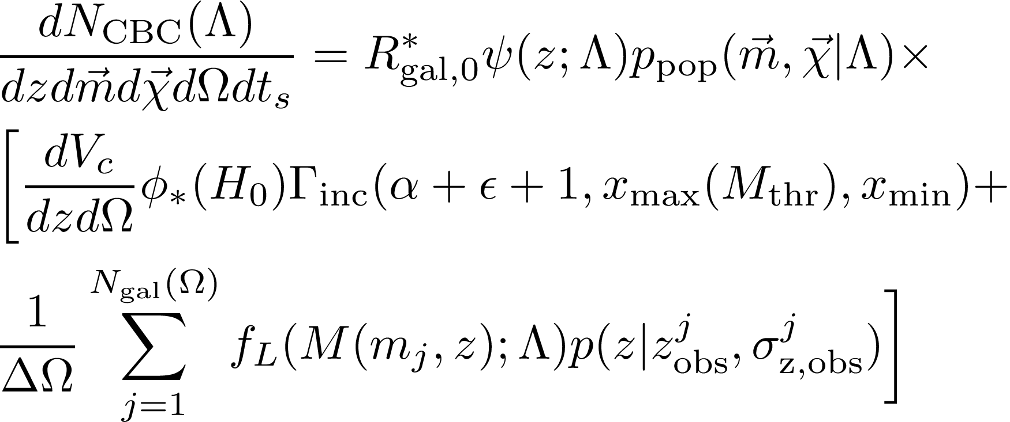
Dark sirens
The CBC likelihood is often parametrized in terms of redshift and source-frame time
CBC per galaxy per year
Term similar to the vanilla rate
Number density of galaxies per steradian (completeness correction)
Integral of Schecter function
Number density of galaxies per steradian (catalog)
Luminosity weight
Galaxy localization in redshift
Sky pixel area

Slide 21
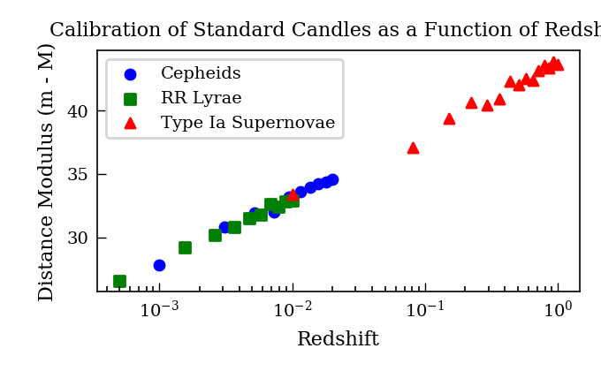

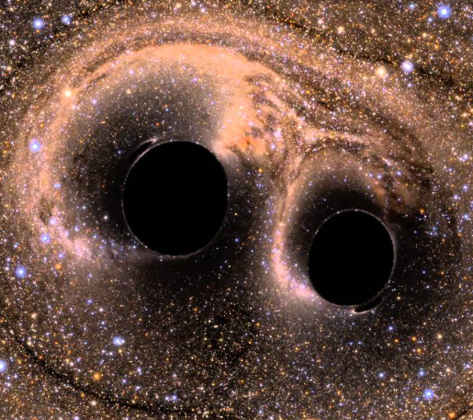
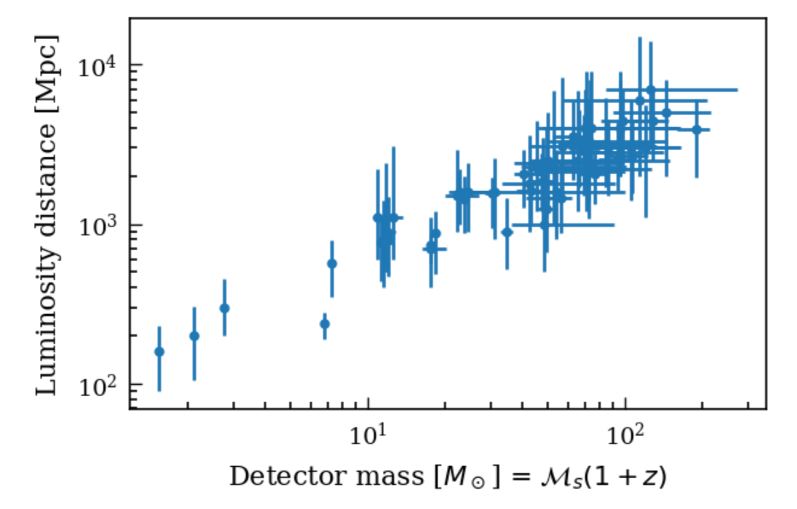

Spectral sirens
Compact binaries

Slide 22
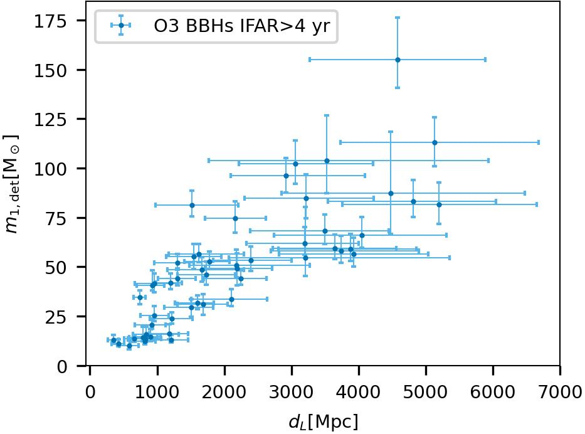

Spectral sirens
Many GW are detected with large sky localizations and are very far (galaxy catalogs highly incomplete).
If BBHs are preferentially produced at a given mass, we can exploit the mass-redshift relation to assign a redshift to the GW source [SM+, PRD 104 (2021)].
Excess of BBHs

Slide 23
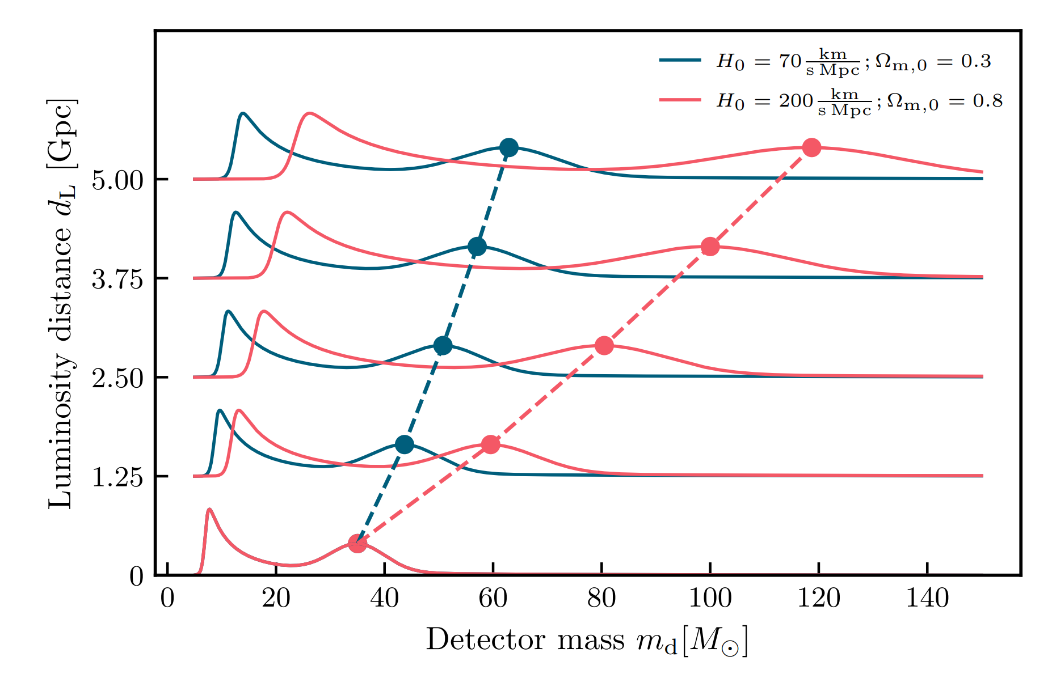
Spectral sirens

Slide 24
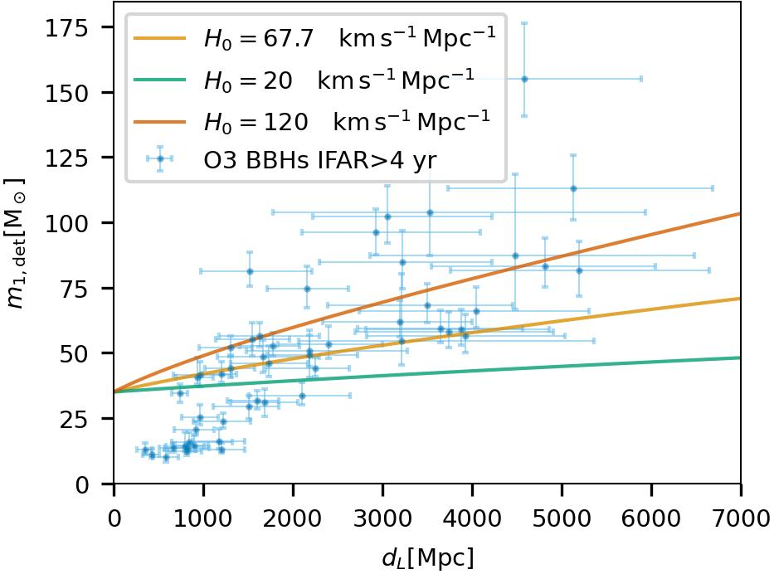
Spectral sirens
If we assume an overdensity of BBHs produced at 35 solar masses, some “extreme” cosmologies can not fit the overdensity of BBHs.
35 solar mass feature

Slide 25
Spectral sirens
Detector frame
Source frame
Detector Frame
Source Frame
Population:
64 events.
PISN.
Planck cosmology
Cosmology
Selection biases
Cosmology
+
Selection bias
+
Astrophysics
Simulation
Simone Mastrogiovanni - Vulcano Workshop 2022 - Sept 26th Elba Island
Notes:
Messages:
* Results, we constrained the NS Eos and my codes have contributed to many scientific results and are employed in many works.
* The common thread here is DA.

Slide 26
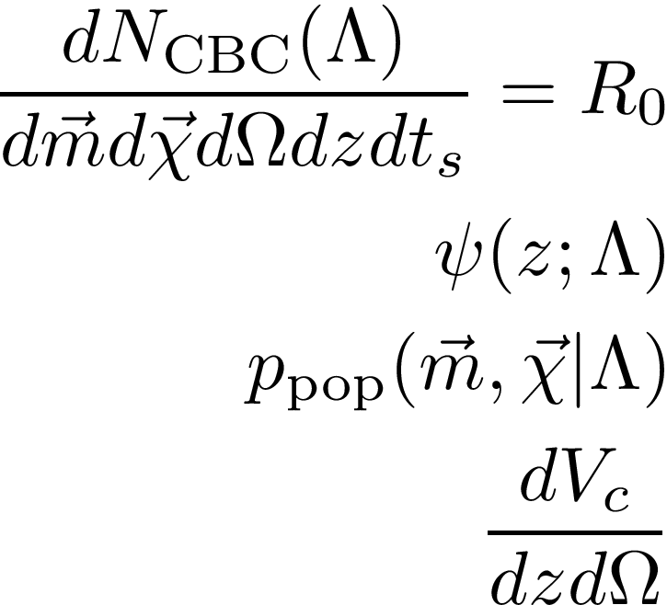
Spectral sirens
The CBC likelihood is often parametrized in terms of redshift and source-frame time
Rate of CBC [#mergers Gpc^-3 yr^-1]
Rate evolution function, e.g. (1+z)^gamma. Two models available
Probabilities for source-frame masses and spins, 8 models for masses, 2 for spins
Comoving volume (depends on cosmology)

Slide 27
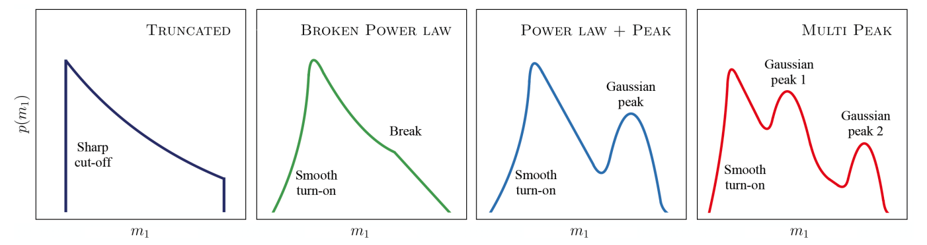
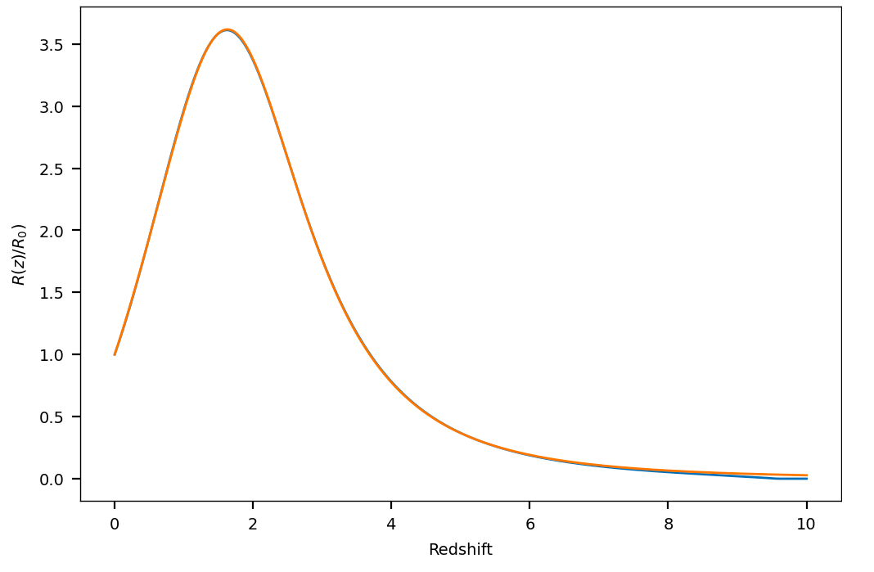
Spectral sirens
Several mass models include various scales to describe stellar processes [LVK+ 2021 ApJL 913 L7].
As a consequence, the masses of GW observations are redshifted by the expansion of the Universe [Ye+ PRD 104 2021].
Peak of SFR?
Notes:
Messages:
* Results, we constrained the NS Eos and my codes have contributed to many scientific results and are employed in many works.
* The common thread here is DA.

Slide 28
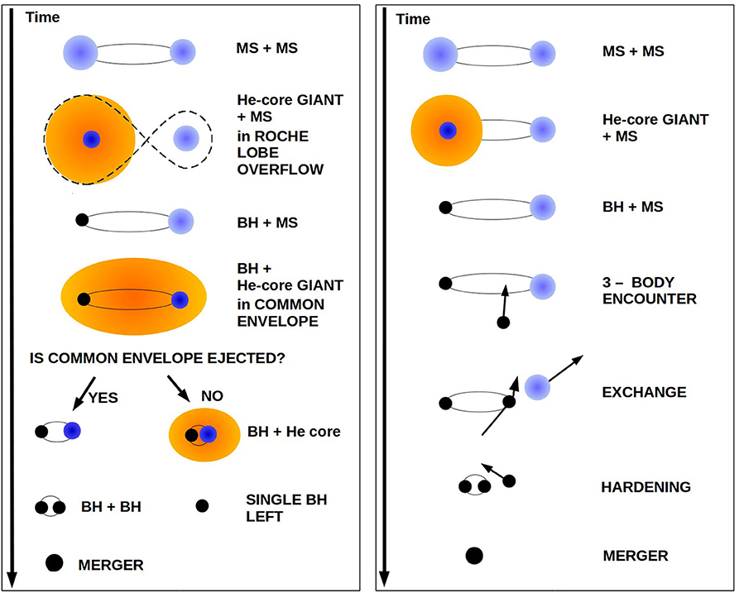
Spectral sirens
Two main formation channels:
Isolated stellar binary evolution: First generation black holes with spins aligned with the orbital angular momentum.
Hierarchical mergers: Possibly n-th generation black holes (spin~0.7) with isotropic spins.
Peak of SFR?
[Mapelli M. Handbook of Gravitational Wave Astronomy]
Notes:
Messages:
* Results, we constrained the NS Eos and my codes have contributed to many scientific results and are employed in many works.
* The common thread here is DA.

Slide 29
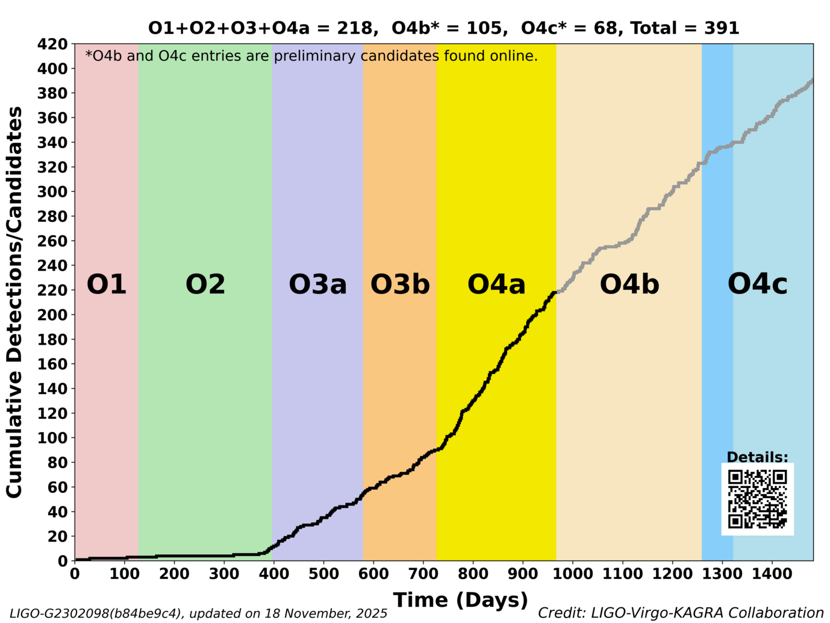
Latest results

Slide 30
Latest results

Slide 31
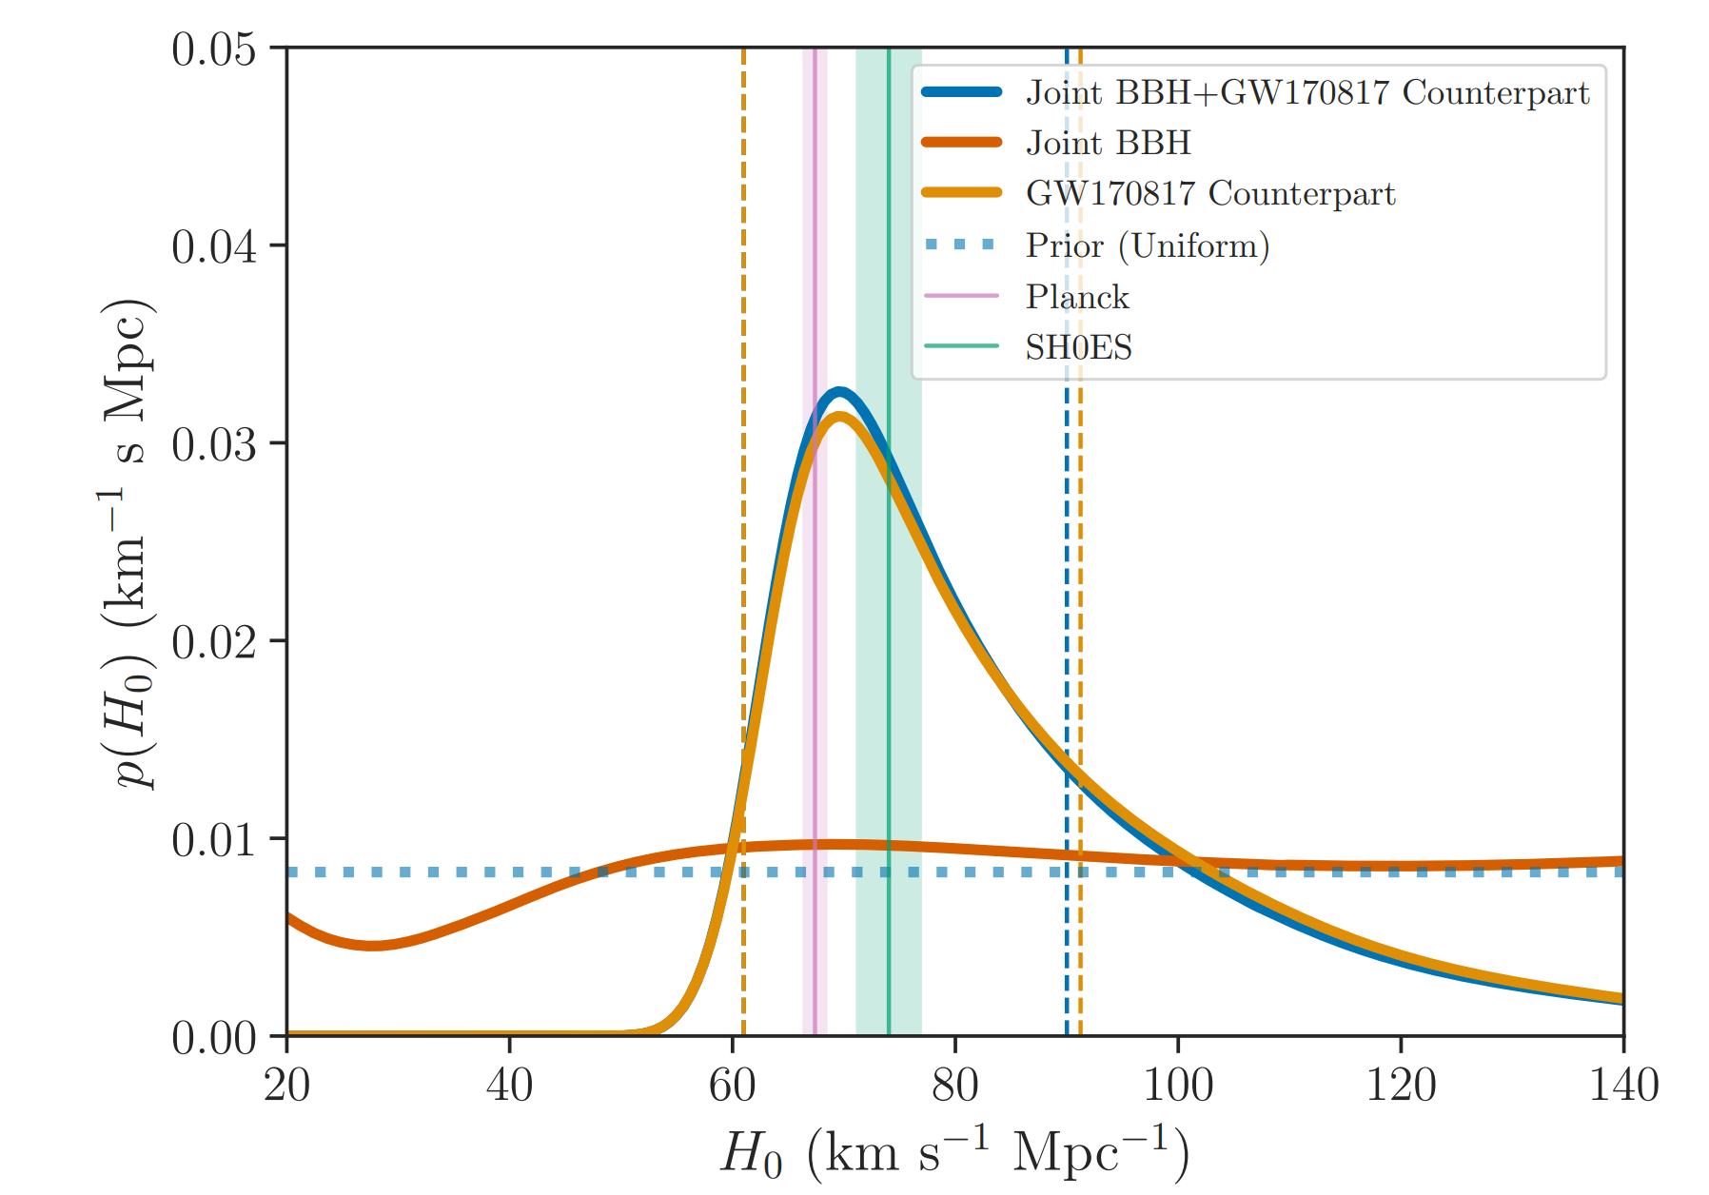
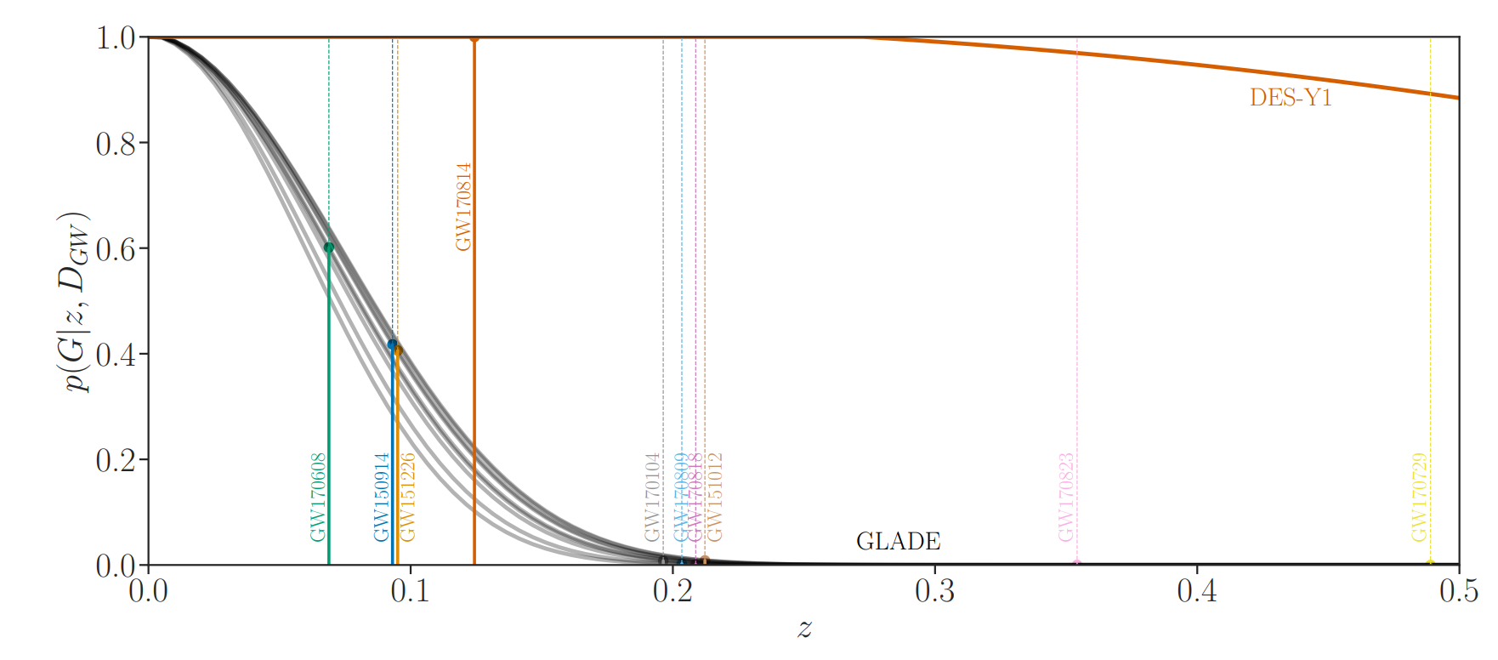
Latest results
At the end of O2 (2017) we had ~10 dark sirens and 1 bright siren, we used the galaxy catalog GLADE (fixing the BBH mass distribution) and we obtained a “measure” of H0. Results were pretty insensitive to the BBH mass distribution
We also added the completeness correction to the galaxy catalog
LVK Astrophys J 909 Number 2 218 (2021)
Completeness correction

Slide 32
Latest results

Slide 33
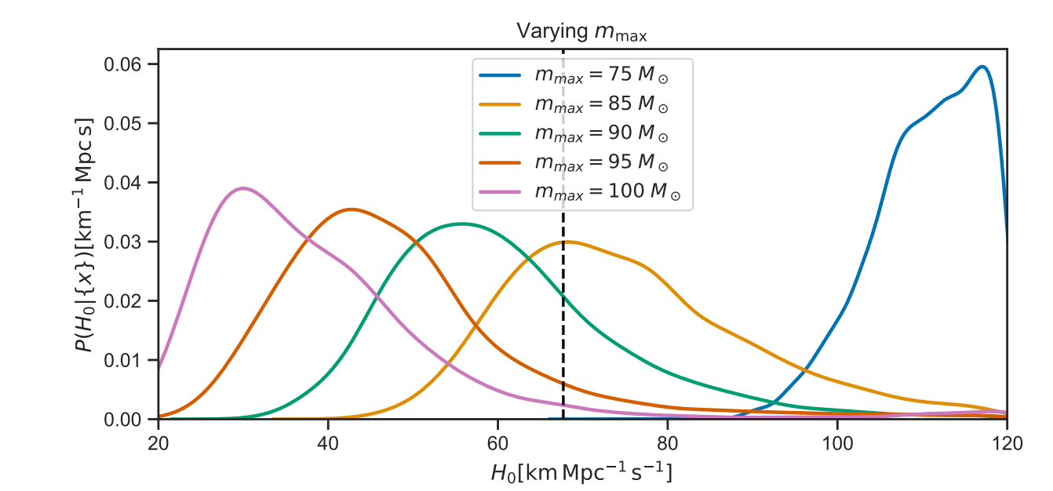
Latest results
At the end of O3 (2019), we were having ~50 significant dark sirens available for GW cosmology and still 1 bright siren…
But we were having problems, posteriors on H0 for dark sirens were extremely sensitive to the upper end of the BBH mass spectrum

Slide 34
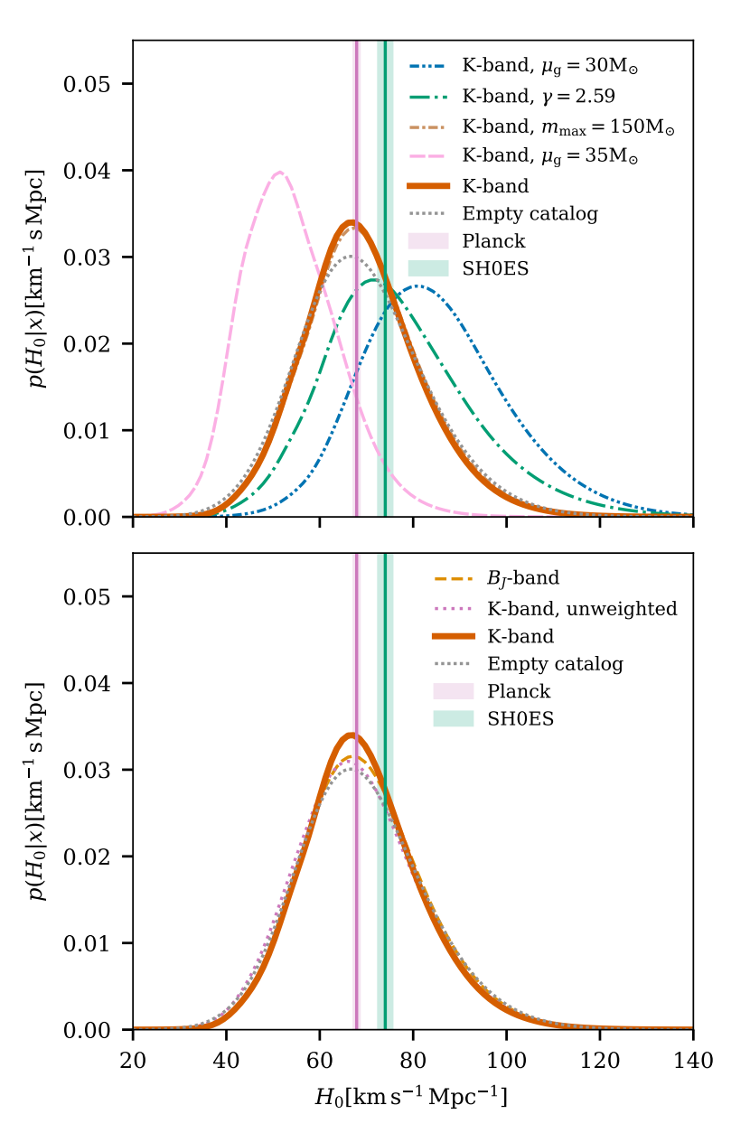
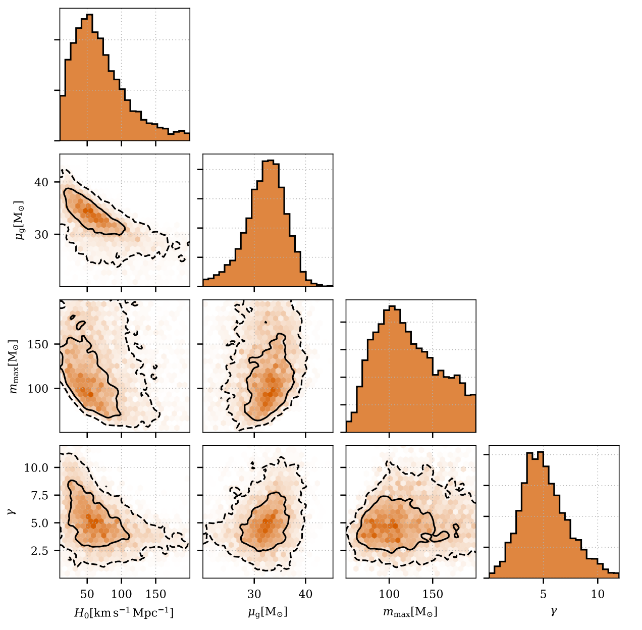
Latest results
We realized that we were dealing with what was described by Chernoff and Finn in 1993 with a difference:
The BBH mass spectrum can provide statistical redshift estimation, but it is also a major issue for a bias!
R. Abbott et al 2023 ApJ 949 76

Slide 35
Latest results

Slide 36
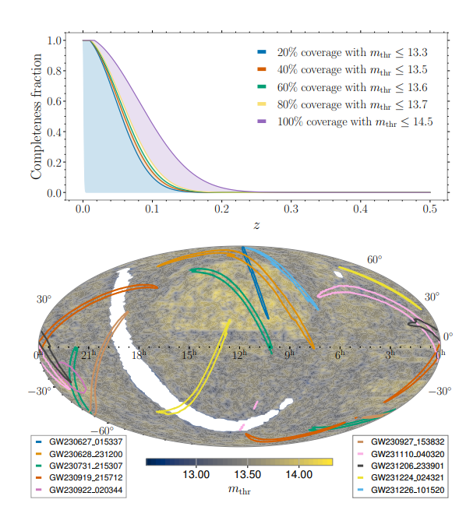
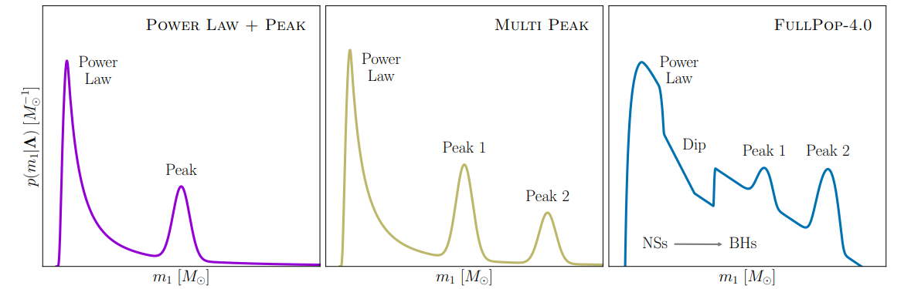
Latest results
We used the most significant GW sources (142/218) from GWTC-4 to estimate the cosmic expansion [LVK+, 2509.04348, accepted on ApJ]
We employed three different mass models and an all-sky galaxy catalog (GLADE+).
We merged the galaxy catalog and mass calibration into a single global fit.

Slide 37
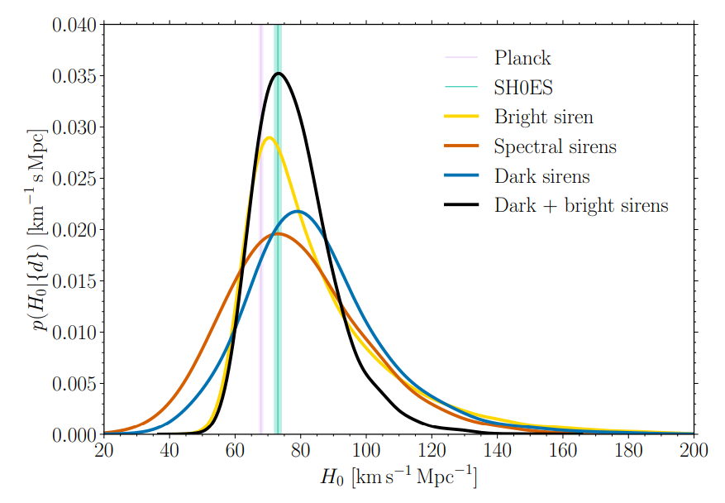
Latest results
Dark Standard sirens are not yet competitive with the precision offered by a single bright siren.
The cosmological information is mostly coming from the BBH mass calibration and not from the galaxy catalog.
For a FlatLCDM universe, the Hubble constant is the parameter that we can measure the best.
[LVK+, 2509.04348]

Slide 38
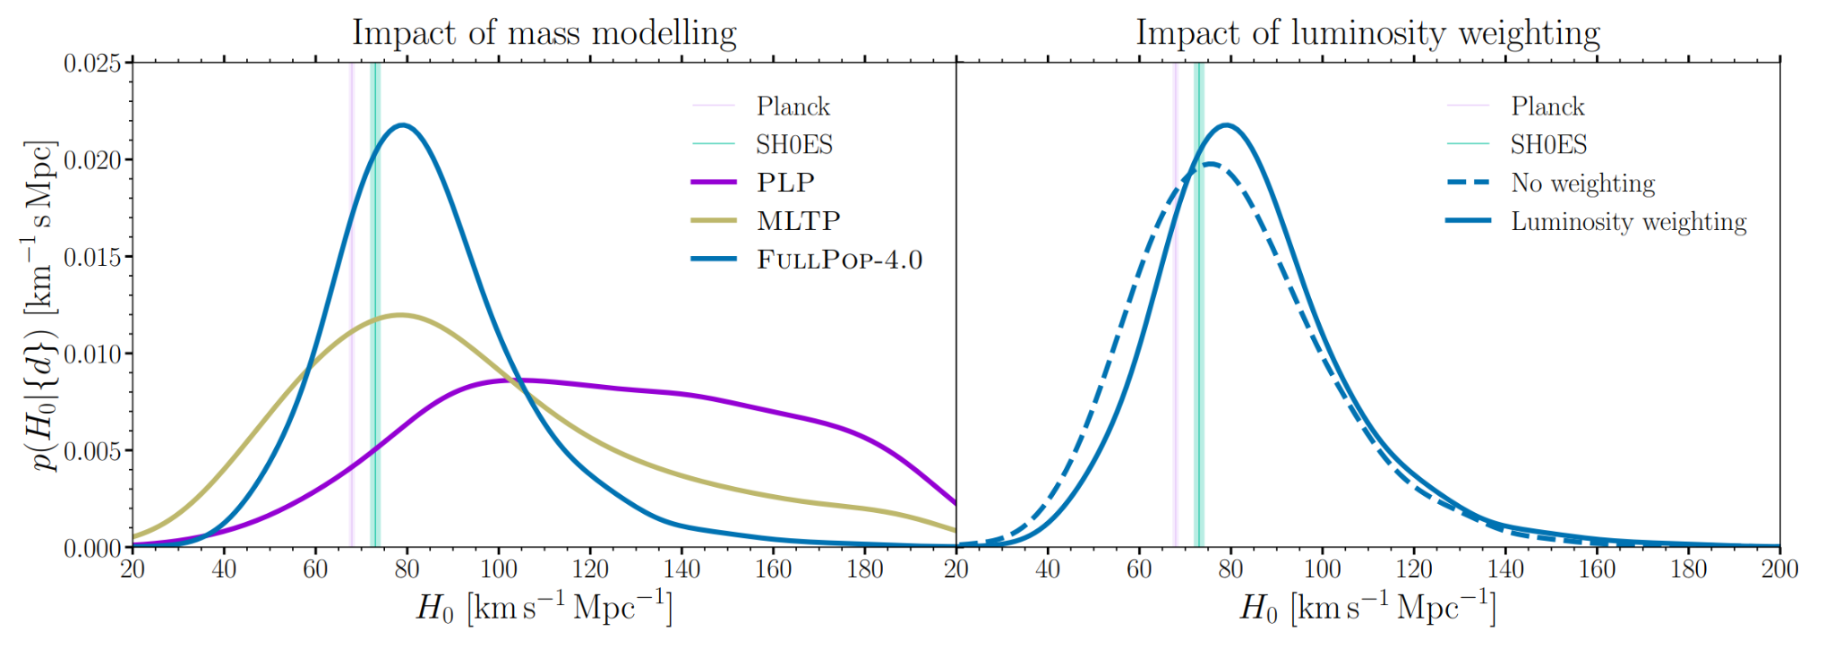
Latest results
[LVK+, 2509.04348]

Slide 39
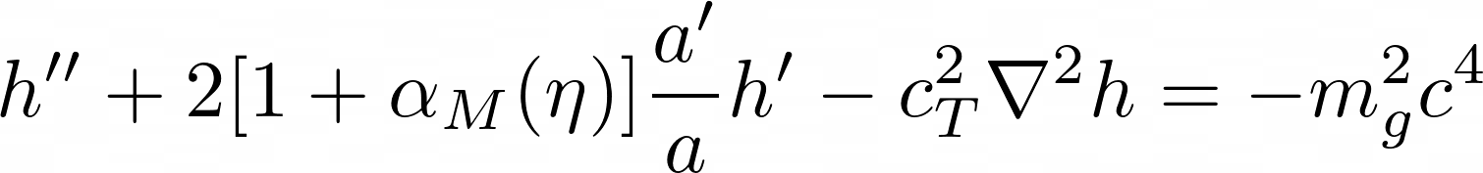
Latest results
GW friction
Propagation
Massive graviton
Dispersion relation:
GWs group velocity depends on the frequency.
GWs modes arrive off-phased at the detector.
GWs modes show a time delay w.r.t EM counterparts.
Horava gravity, massive gravity, scalar tensor theories with field derivative couplings
GW friction:
GWs show an additional energy leakage as they travel.
extra energy dissipation terms, e.g. a running Planck mass, 4+n dimensional gravity, scalar-tensor theories

Slide 40



Latest results
Phenomenological approach
Running Planck mass
Binary black holes allows us to set tight constraints on modified gravity (more effective at high redshifts).
Roughly speaking, we are providing a measure on G(source)/G(today).
These constraints are becoming comparable with the ones obtained from LSSs [Ishak+, 2024] and CMB [Seraille+, 2024]
[LVK+, 2509.04348]

Slide 41
Latest results

Slide 42

Latest results
We used the most significant 235 GW sources from GWTC-4 to estimate the cosmic expansion [LVK+, 2605.27227]
We employed three different mass models and an all-sky galaxy catalog (GLADE+) as well as the Dark Energy Spectroscopic Survey Y6 (DES-Y6).

Slide 43

Latest results

Slide 44

Latest results
Dark and Spectral sirens are now becoming as precise as the only bright siren that we have.
Again, most of the cosmological information is coming from the calibration of the BBH mass spectrum.
[LVK+, 2509.04348]

Slide 45

Latest results

Slide 46

Latest results
Phenomenological approach
Running Planck mass

Slide 47

Concluding…
Gravitational-wave cosmology is at its beginning like supernova cosmology 20 years ago.
With the upcoming runs, we expect to have hundreds of GW sources that can be used to improve the precision and check for the measurement robustness
[W. Freedman, Nature Astronomy, 1, 0169 (2017)]

Slide 48


Concluding…
2035+
Einstein Telescope
LVK observing plans

Slide 49
Part 3 - end

