Slide 1

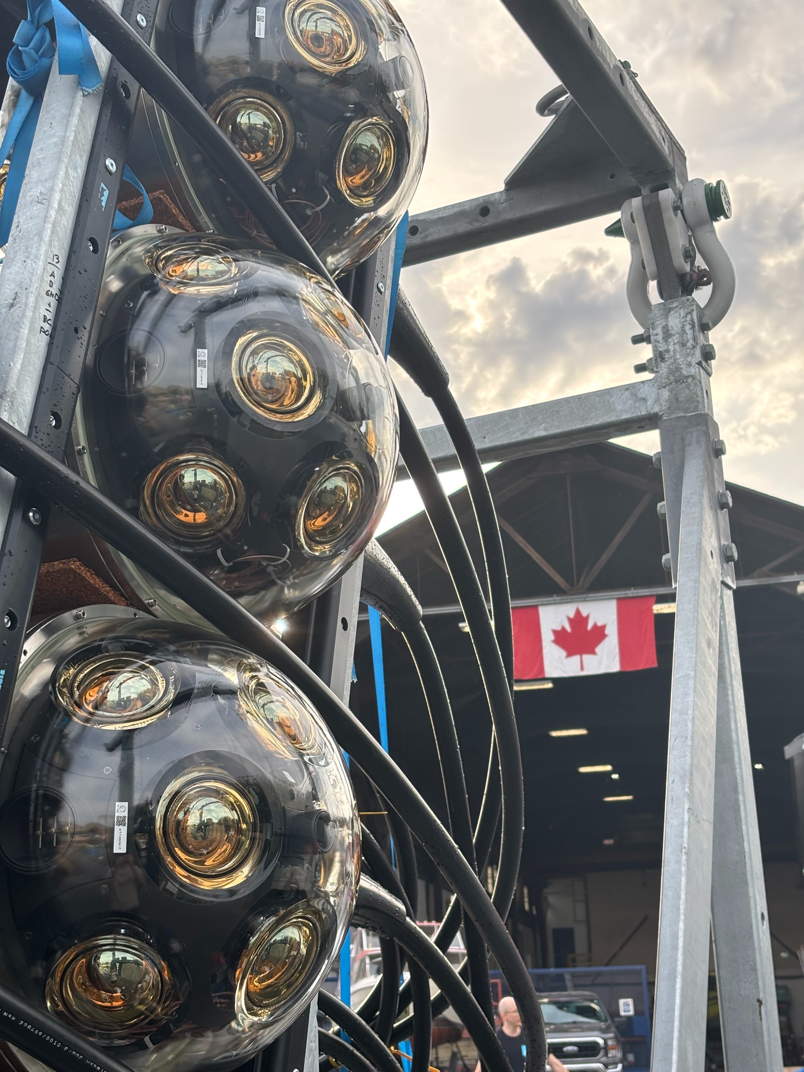

Pacific Ocean Neutrino Experiment
ANNABELLE GRIMES
P-ONE Collaboration • August 2026
Photo Credit:
Jakub Stacho
Notes:
My name is Annabelle Grimes, and today I’ll be introducing the Pacific Ocean Neutrino Experiment, or P-ONE.
P-ONE is a planned cubic-kilometre-scale neutrino telescope that will be installed deep in the Pacific Ocean off the west coast of Canada.

Slide 2



ANNABELLE GRIMES
SFU Masters Student
High Energy Particle Physics
Notes:
I’m a master’s student at Simon Fraser University in Vancouver, working in high-energy particle physics as part of the P-ONE collaboration.
My own research focuses on the acoustic positioning of the detector, which I’ll discuss later in the presentation.

Slide 3
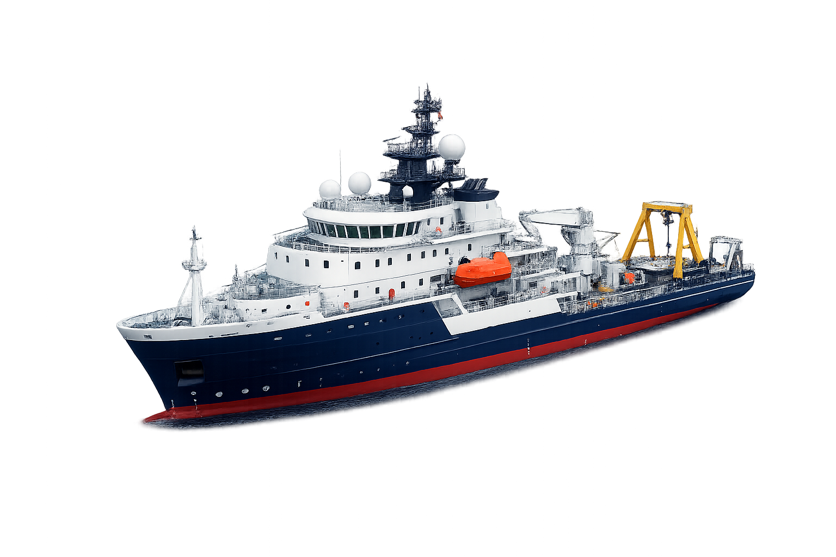
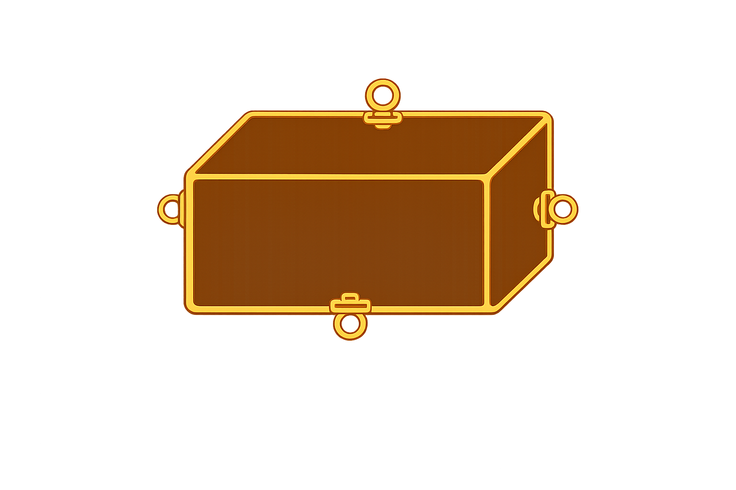
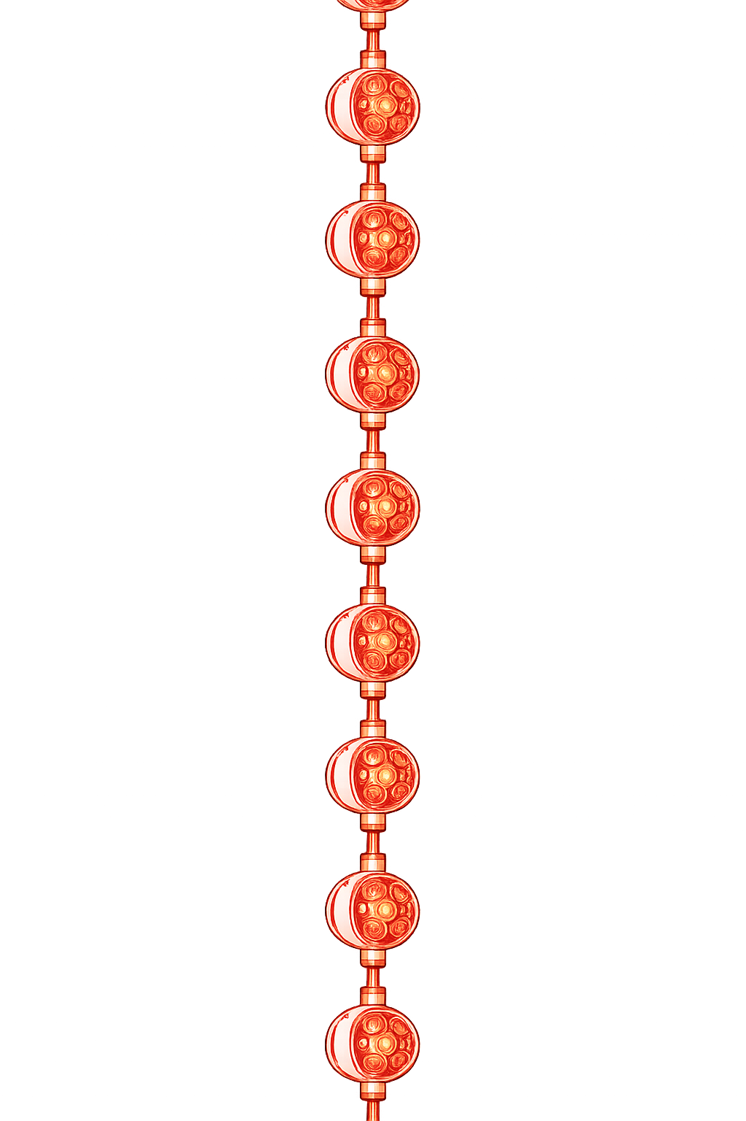
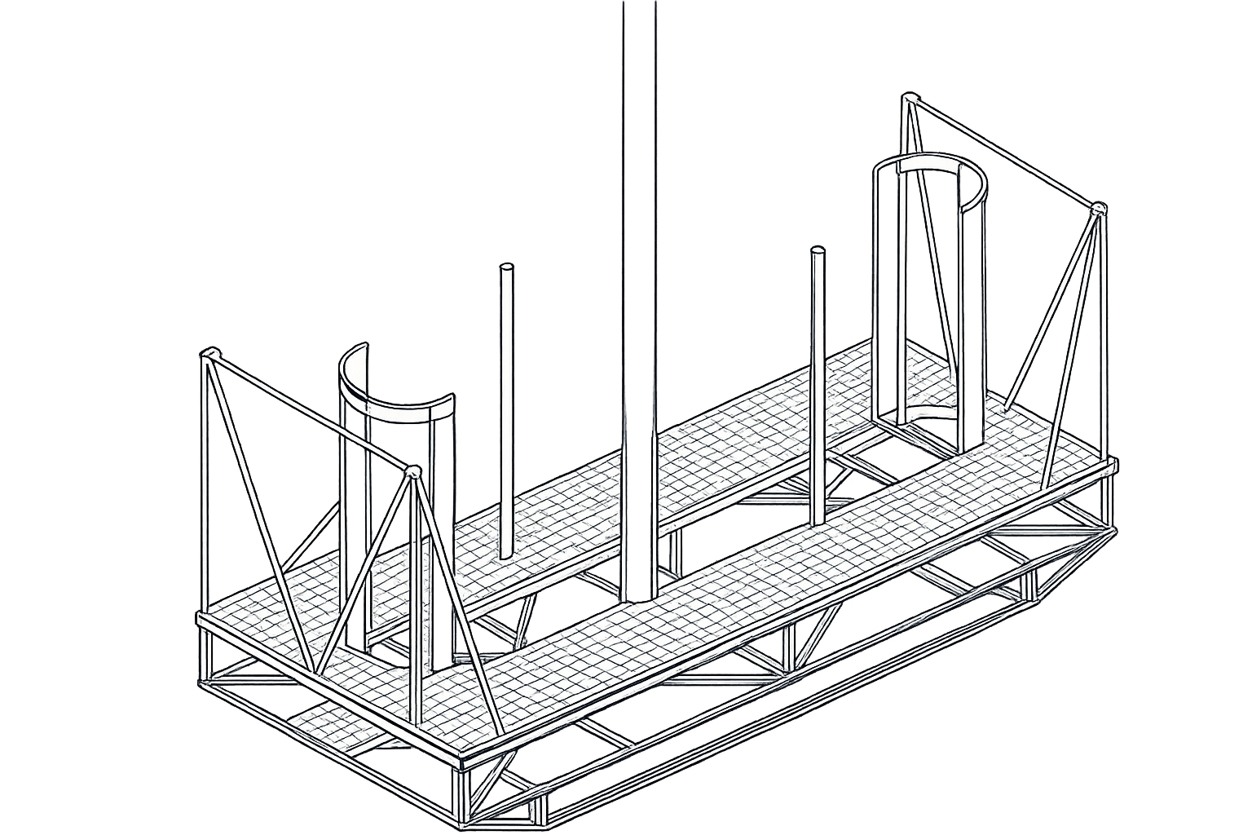
Introduction
P-ONE Overview
1000 m
0 m
Ocean Surface
See publication: Agostini, M. et al., “The Pacific Ocean Neutrino Experiment,” Nature Astronomy 4, 913–915 (2020).
Neutrino Telescope
Cubic-kilometer scale
70 instrumented strings
Deep Pacific Ocean
PRELIMINARY
-1660 m
-2600 m
Ocean Floor
ANNABELLE GRIMES
P-ONE Collaboration • ISCRA 2026
Notes:
At full scale, P-ONE will consist of 70 one-kilometre-long strings anchored about 2,600 metres below the ocean surface, each carrying 20 optical modules.
Together, they will instrument roughly a cubic kilometre of seawater, which serves as both the detection medium and shielding from particles above.
The layout shown here is preliminary, and the string spacing is still being optimized for detector performance.

Slide 4
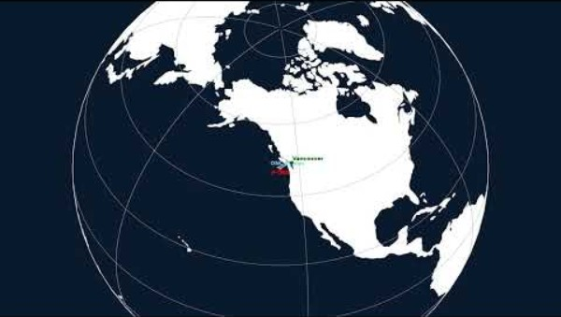
Map generated using PLEnuM software tools (Schumacher, Huber, Bustamante et al.), adapted by Annabelle Grimes. Source: https://github.com/PLEnuM-group/Plenum. License: BSD 2-Clause.
ANNABELLE GRIMES
P-ONE Collaboration • July 2026
Notes:
P-ONE will be located about 200 kilometres west of Vancouver Island, where existing Ocean Networks Canada infrastructure will provide continuous power, communication, and data transfer to shore.

Slide 5
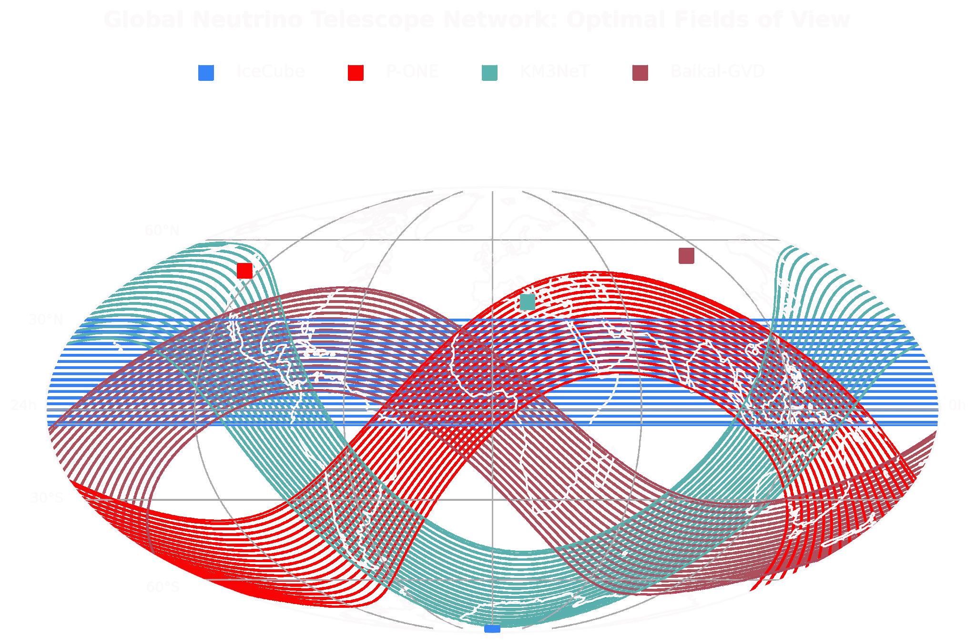
Motivation
Global Neutrino Telescope Network: Optimal Fields of View
Map generated using PLEnuM software tools (Schumacher, Huber, Bustamante et al.), adapted by Annabelle Grimes. Source: https://github.com/PLEnuM-group/Plenum. License: BSD 2-Clause.
ANNABELLE GRIMES
P-ONE Collaboration • ISCRA 2026
Notes:
P-ONE will join IceCube, KM3NeT, and Baikal-GVD in a global network of neutrino telescopes.
Because these detectors often use the Earth to filter atmospheric muons, their latitude determines which regions of the sky they observe best.
Together, they provide complementary coverage and independent cross-checks.

Slide 6
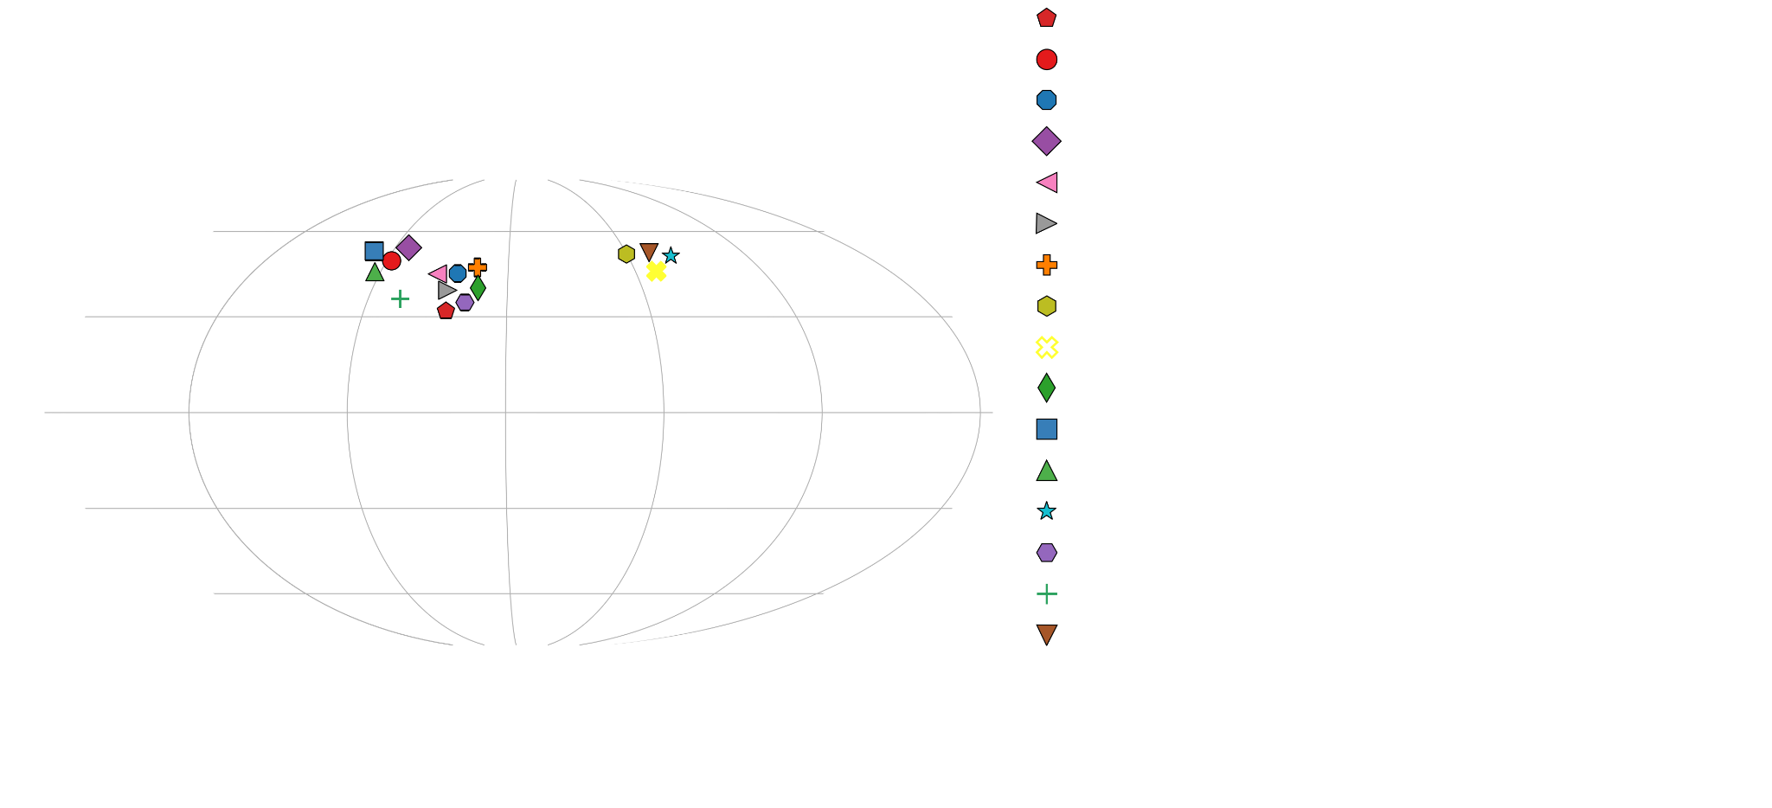
Member Institutes
Map generated using PLEnuM software tools (Schumacher, Huber, Bustamante et al.), adapted by Annabelle Grimes. Source: https://github.com/PLEnuM-group/Plenum. License: BSD 2-Clause.
ANNABELLE GRIMES
P-ONE Collaboration • ISCRA 2026
Notes:
P-ONE brings together institutions across Canada, Europe, and the United States, combining expertise in particle physics, ocean engineering, instrumentation, and data analysis.
Ocean Networks Canada, not shown here, provides essential deep-ocean infrastructure and expertise.

Slide 7

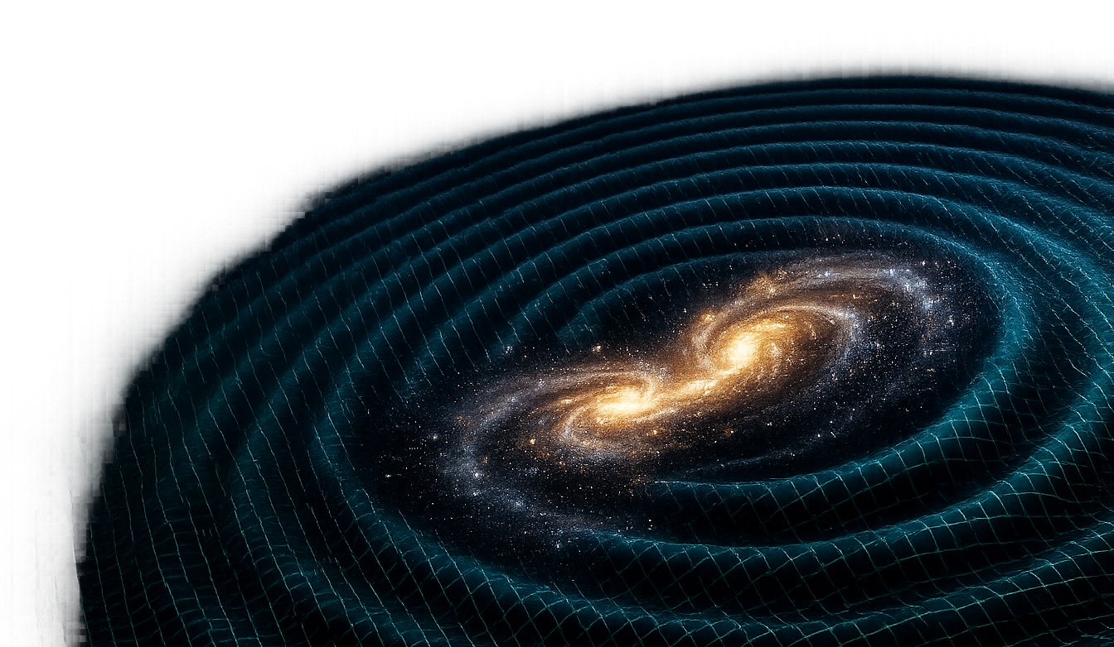
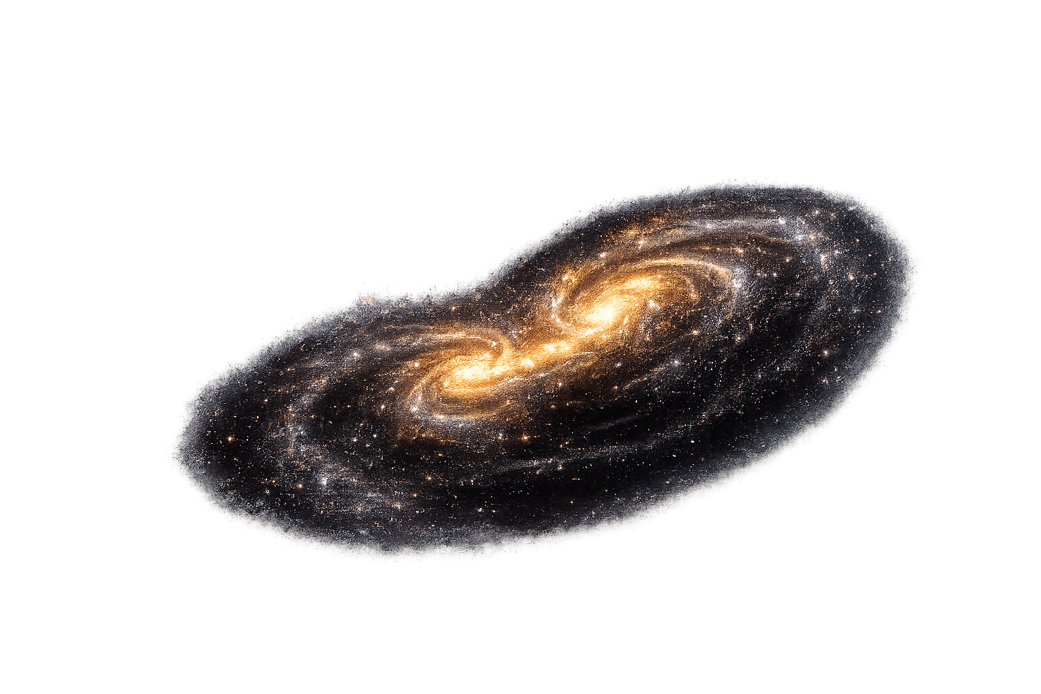
𝛄
p
p
Gamma Rays
Cosmic Rays
readily absorbed
ν
deflect magnetically
Neutrinos
Multi-messenger Source
weaken over distance
Gravitational Waves
ANNABELLE GRIMES
P-ONE Collaboration • ISCRA 2026
Notes:
High-energy neutrinos are valuable cosmic messengers because they travel nearly undeflected and escape environments opaque to light.
They can therefore trace energetic particles back to their astrophysical sources.

Slide 8
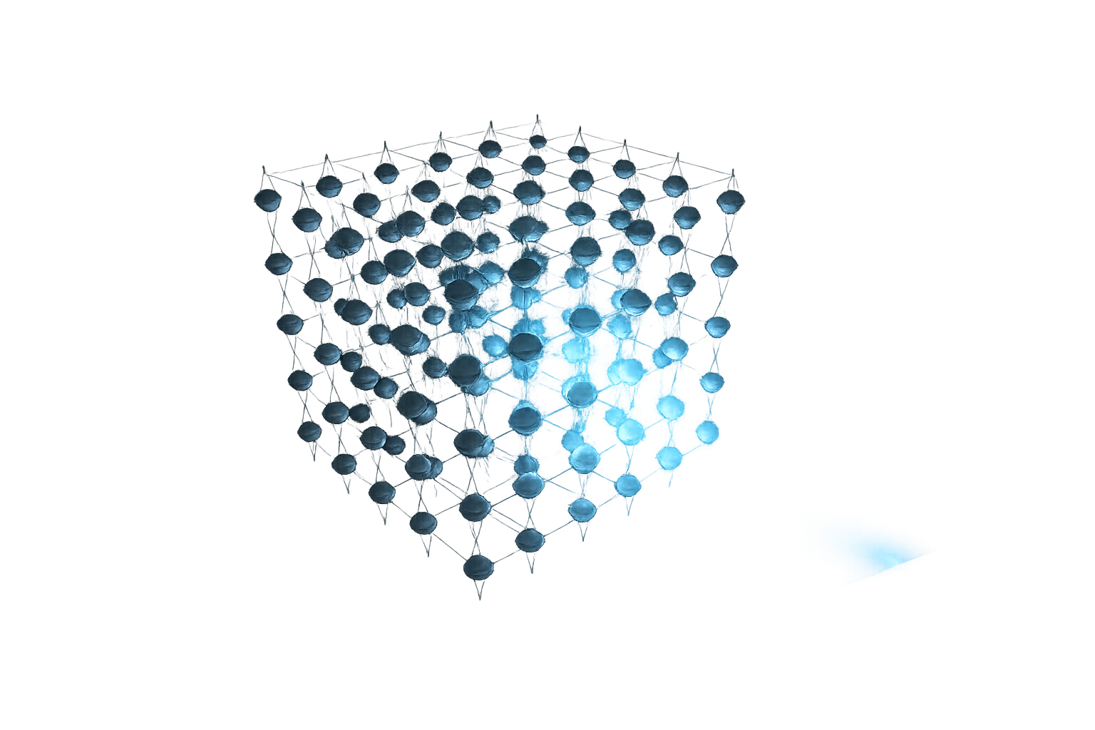
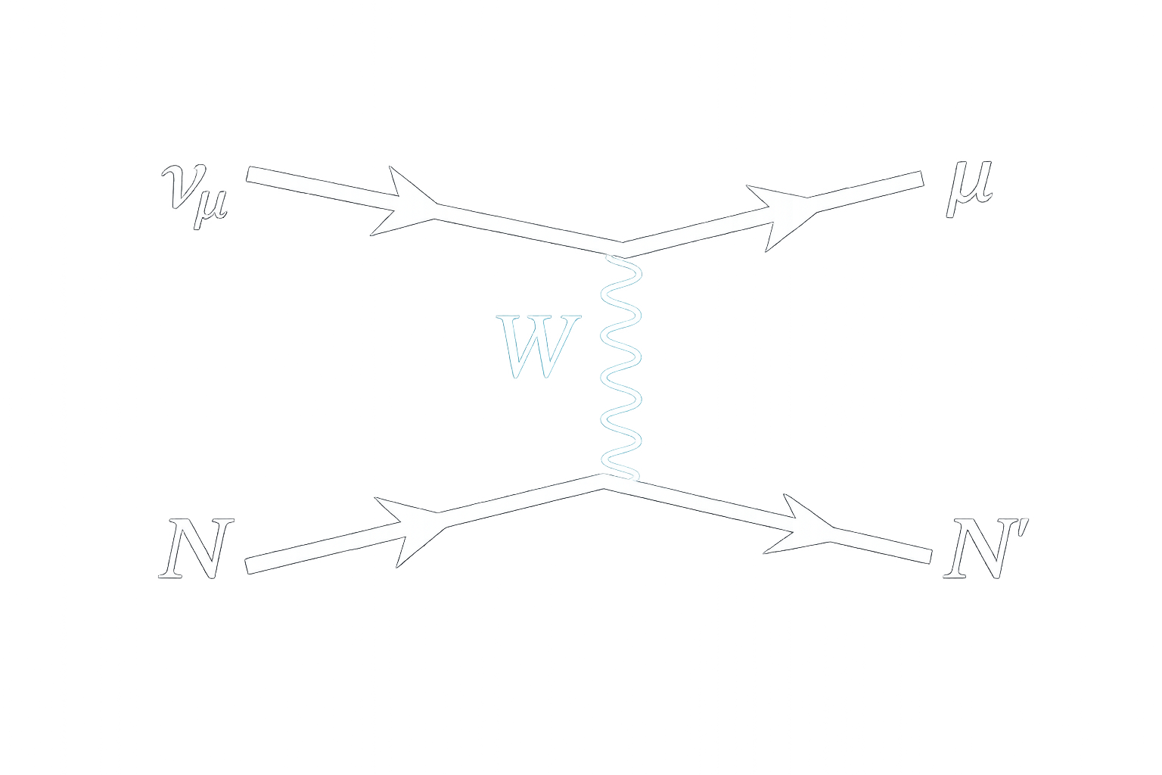




Method
From Neutrinos to Light
Muon
Detector Array
Neutrino
Cherenkov Light
Water Nucleus
ANNABELLE GRIMES
P-ONE Collaboration • ISCRA 2026
Notes:
Neutrino interactions produce charged particles that emit Cherenkov light. Its timing and pattern reveal the neutrino’s direction and energy.
P-ONE will detect all three flavours across the TeV–PeV range; here, a muon neutrino produces a track-like muon signal.

Slide 9

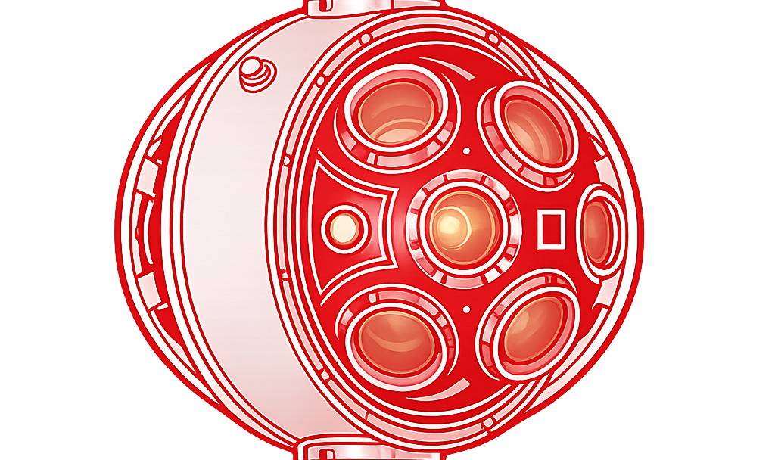
float
50 m
Detector Module
String junction box
Deployment frame
1000 m
-2600 m
Ocean Floor
ANNABELLE GRIMES
P-ONE Collaboration • ISCRA 2026
Notes:
Here we have one complete P-ONE string.
It is anchored to a deployment frame on the ocean floor and held vertically by a float at the top.
Twenty optical modules are distributed along approximately one kilometre of cable, with about 50 metres between neighbouring modules.
Each module detects the Cherenkov light arriving from near the detector.

Slide 10
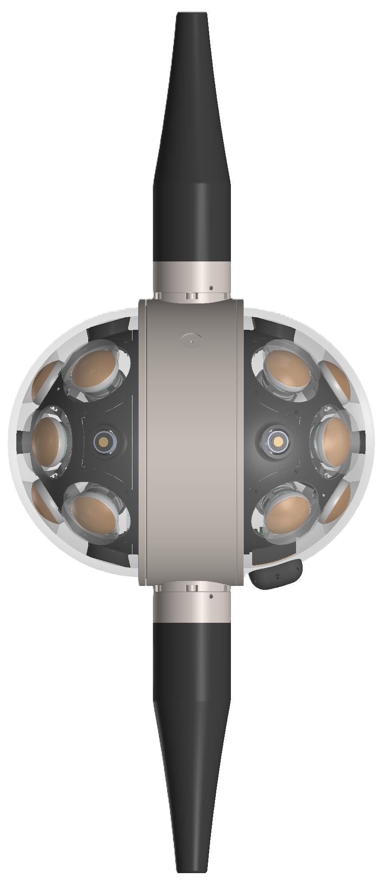
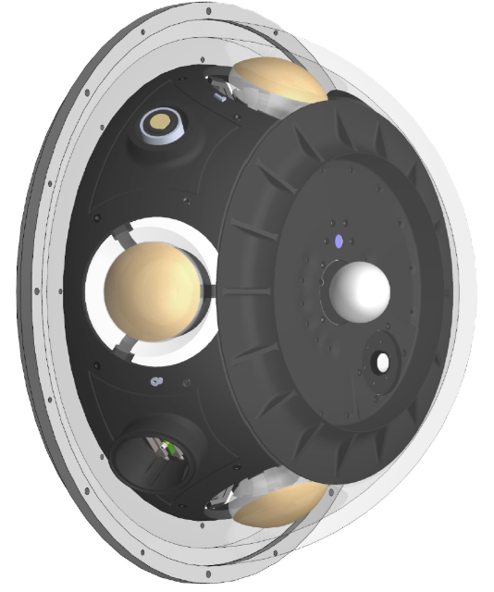
P-OM: Optical Module
P-CAL: Calibration Modules
Publication in preparation
See publication: M. Agostini et al. (P-ONE Collaboration), JINST 21 (2026) P07029.
Detects Cherenkov detectors
16 three-inch PMTS
2 acoustic receivers
18 modules per line
Produce controlled flashes of light
8 three-inch PMTs
Calibrates detector timing & response
2 modules per line
2 hemispheres per module
ANNABELLE GRIMES
P-ONE Collaboration • ISCRA 2026
Notes:
Each module consists of two left–right hemispheres.
The P-OM contains sixteen individually gel-coupled PMTs and uses a titanium ring to route the cable without a connector through the glass.
The related P-CAL design provides controlled light flashes for timing and response calibration.

Slide 11

Context
P-ONE in Perspective
1.8 m
Detector Module
0.42 m
ANNABELLE GRIMES
P-ONE Collaboration • ISCRA 2026
Notes:
Each optical module is about 42 centimetres across—compact compared with a person,
despite housing multiple photomultiplier tubes, electronics, calibration systems, and acoustic instrumentation.

Slide 12
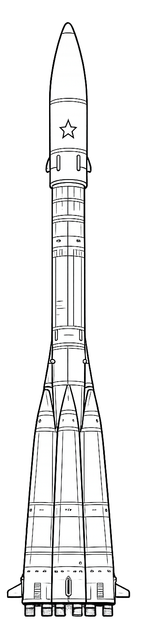
50 m
Detector Module
Context
P- ONE in Perspective
String Segment
Detector Module
1.8 m
ANNABELLE GRIMES
P-ONE Collaboration • ISCRA 2026
Notes:
Neighbouring modules are separated by about 50 metres—roughly the height of a Soyuz launch vehicle.
This wide spacing allows P-ONE to monitor an enormous volume of water without densely instrumenting it.

Slide 13


Context
P-ONE in Perspective
1000+ m
828 m
1 km string
20 detector modules / string
70 strings
330 m
50 m
Notes:
A complete string extends over one kilometre—about three times the height of the Eiffel Tower and taller than the Burj Khalifa.
With 70 strings and roughly 1,400 optical modules, P-ONE achieves the enormous target volume needed to detect rarely interacting neutrinos.

Slide 14
float
50 m
Detector Module
String junction box
Deployment frame
1000 m
-2600 m
Ocean Floor
ANNABELLE GRIMES
P-ONE Collaboration • ISCRA 2026
Notes:
So far, I have shown the string as straight and fixed.

Slide 15
float
Detector Module
String junction box
Deployment frame
Variable Currents
(mean 3 cm/s)
ANNABELLE GRIMES
P-ONE Collaboration • ISCRA 2026
Notes:
In the ocean, however, currents will bend the string, causing each detector module to move over time.
Accurate event reconstruction therefore requires knowing each module’s location when its light signal was recorded.

Slide 16
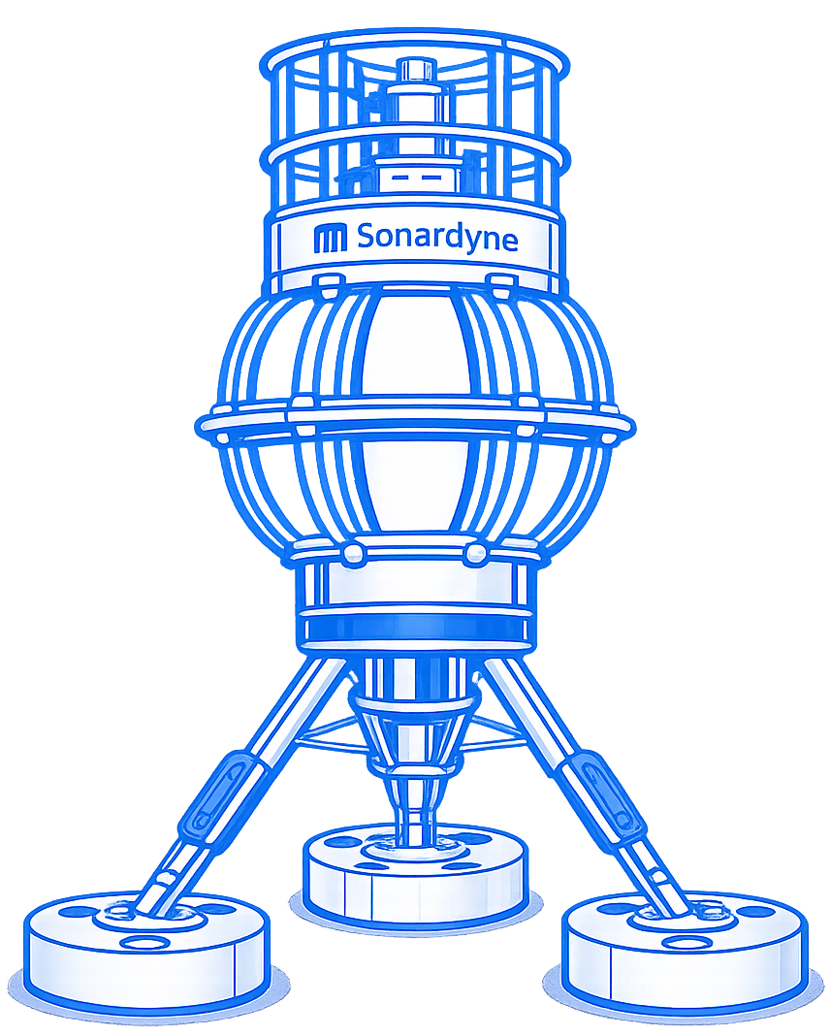
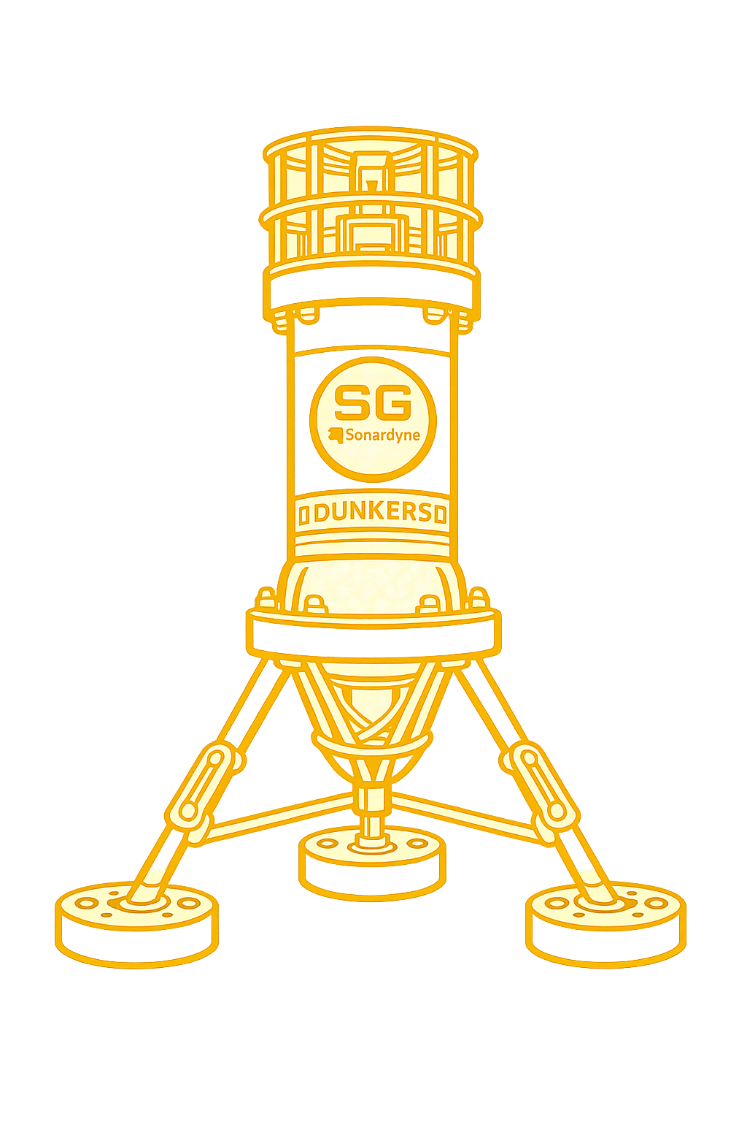
float
Detector Module
String junction box
Deployment frame
Variable Currents
(mean 3 cm/s)
“FETCH” modulec
“Dunker” module
(x,y,z)
Comms/Power Cable
See Publication: The P-ONE Collaboration, JINST 20 (2025) P07003.doi:10.1088/1748-0221/20/07/P07003
200 m
ANNABELLE GRIMES
P-ONE Collaboration
Notes:
This motivates P-ONE’s acoustic positioning system and my master’s research: developing a framework that reconstructs the detector’s changing geometry from acoustic measurements.
These reconstructed positions must feed directly into the physics analysis so that Cherenkov-light timing is interpreted using the correct detector geometry.
The major components of this positioning system are the FETCH transponders,
And the cabled Dunker interrogator, which I’ll describe in more detail on the next slide.

Slide 17
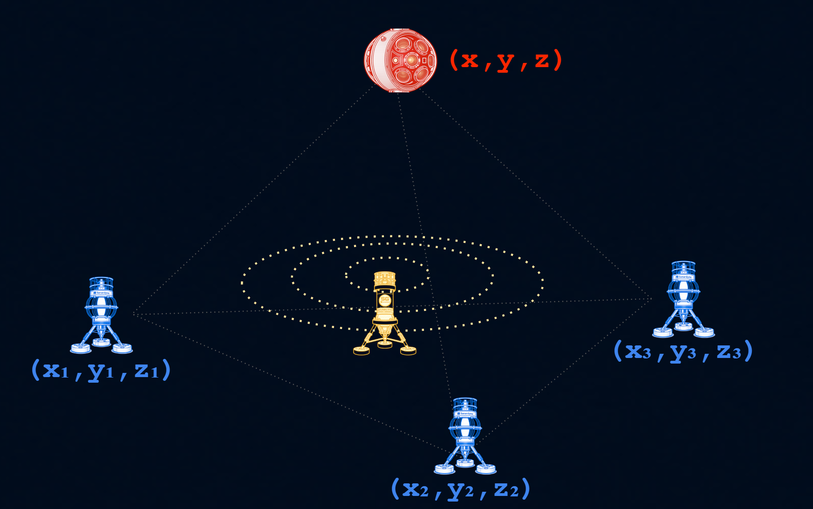
Preliminary Validation
Prototype Acoustic Positioning Test
Detector module
Ocean-tested in Saanich Inlet
3D receiver motion reconstructed from acoustic time-of-flight
24-30 cm estimated relative positioning precision
Absolute accuracy limited by “FETCH” module location uncertainty
“Dunker” module
“FETCH” module
See publication: The P-ONE Collaboration, JINST 20 (2025) P07003.doi:10.1088/1748-0221/20/07/P07003
ANNABELLE GRIMES
P-ONE Collaboration • ISCRA 2026
Notes:
The cabled Dunker interrogator pings the FETCH transponders positioned around the string base, while acoustic receivers inside the detector modules record the signals.
The measured travel times are converted into distances and combined through multilateration to reconstruct each module’s 3D position.
A prototype test in Saanich Inlet successfully tracked the detector’s drift, even when it was several hundred metres from the FETCH transponders, achieving an estimated relative precision of 24–30 centimetres per measurement.
Absolute accuracy was mainly limited by uncertainty in the pinger locations, with further improvements expected from better calibration and signal processing.

Slide 18
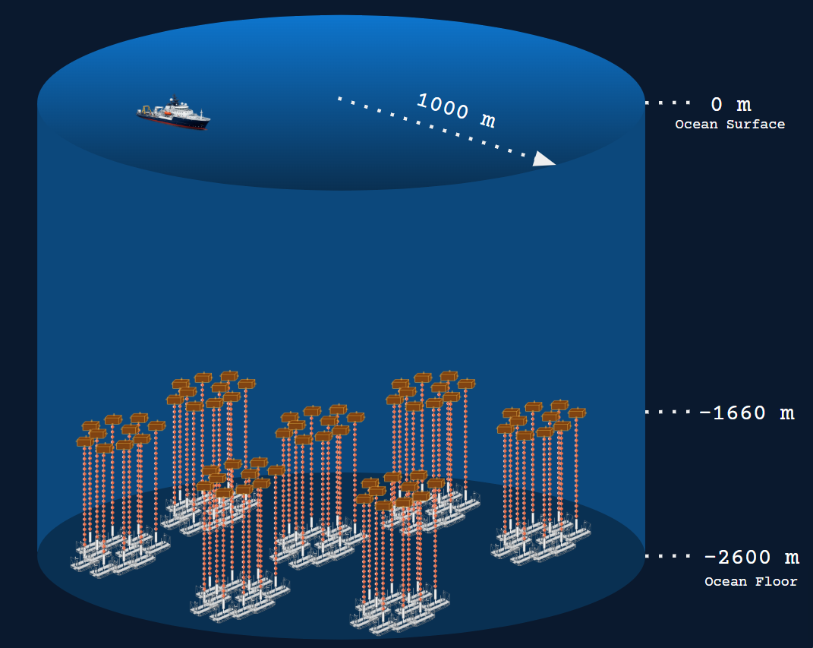
Motivation
P-ONE Engineering Goals
Neutrino energy range: TeV–PeV
Targeted median pointing resolution: 0.4°–0.05°,
depending on energy and event topology
Relative module-position accuracy: ≤20 cm
Inter-module timing synchronization: ≈0.1 ns
Detector scale: approximately 1,400 optical modules instrumenting more than 1 km³
PRELIMINARY
See publication: Agostini, M. et al., “The Pacific Ocean Neutrino Experiment,” Nature Astronomy 4, 913–915 (2020).
ANNABELLE GRIMES
P-ONE Collaboration • July 2026
Notes:
This brings us back to the large-scale performance goals of P-ONE.
The detector will use roughly 1,400 optical modules to instrument more than a cubic kilometre of ocean and target neutrinos in the TeV–PeV range.
To achieve its targeted pointing resolution of about 0.4° to 0.05°, depending on energy and event topology, P-ONE needs both inter-module timing synchronization of roughly 0.1 nanoseconds and relative module positions known to within about 20 centimetres.
Otherwise, an error in the detector geometry could be mistaken for a feature of the particle track.
The acoustic positioning system is therefore directly connected to the detector’s overall physics performance.

Slide 19
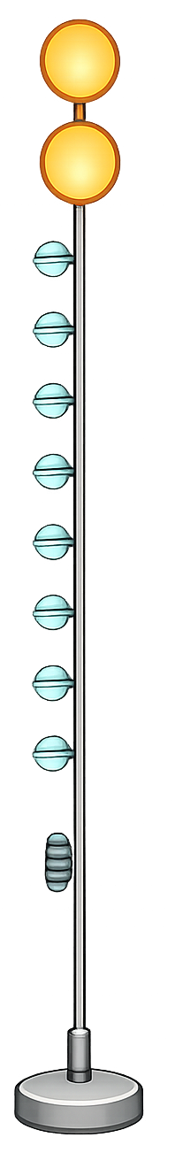
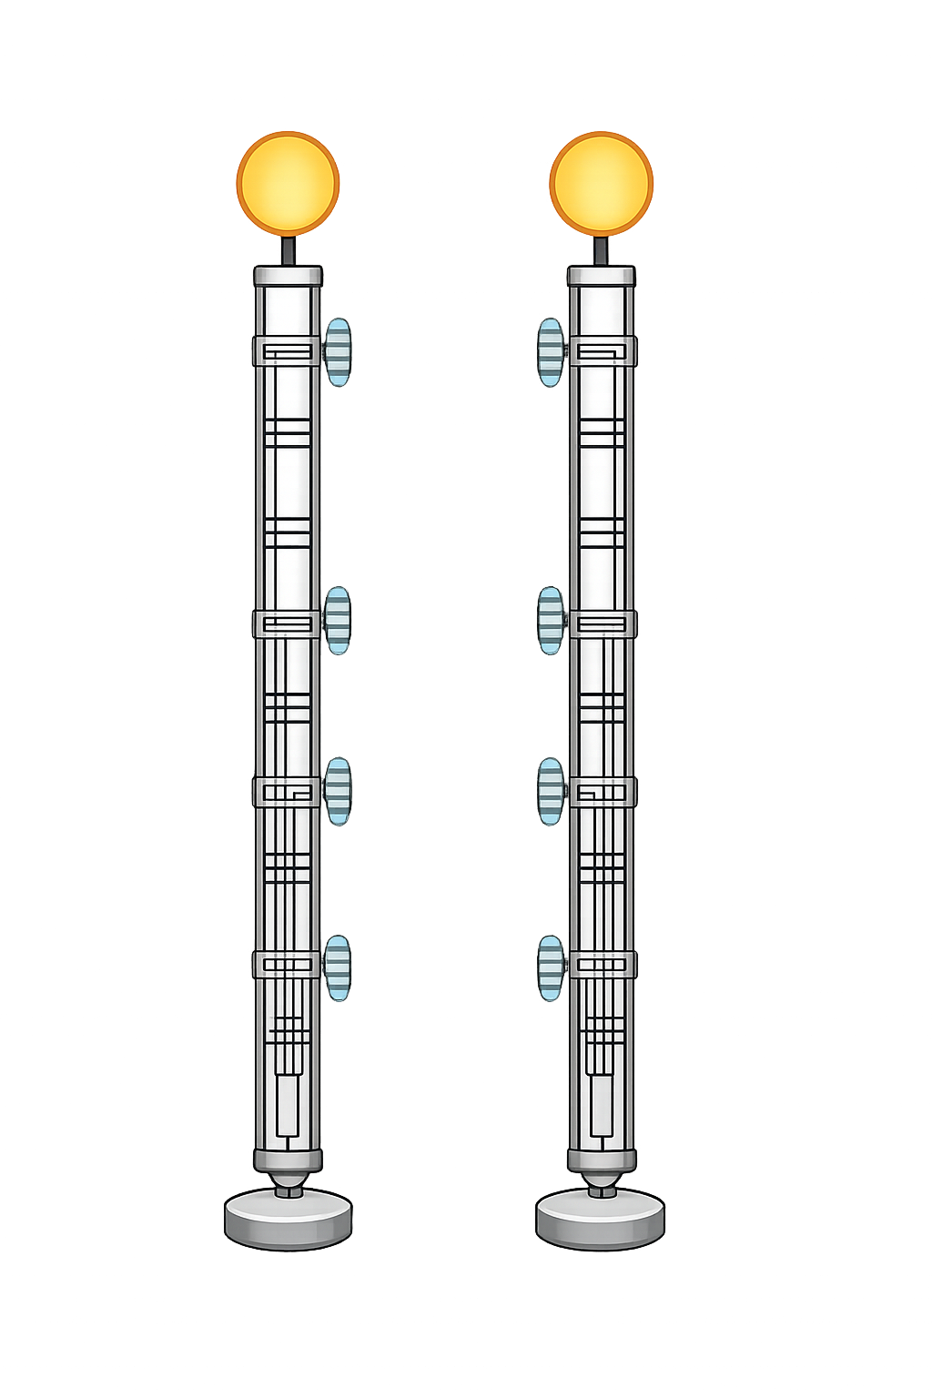
Status
P-ONE Timeline
2018
2020
2026
2028
STRAW
First pathfinder
Strings: 2
Modules: 8
Height: 150 m
STRAW-b
Second pathfinder
Strings: 1
Modules: 10
Height: 450 m
P-ONE-1
First P-ONE string
Strings: 1
Modules: 20
Height: 1 km
P-ONE-D
Small P-ONE cluster
Strings: 4
Modules: 80
Height: 1 km
Publication: M. Boehmer et al., JINST 14 (2019) P02013. doi:10.1088/1748-0221/14/02/P02013
Publication: K. Holzapfel et al., JINST 19 (2024) P05072. doi:10.1088/1748-0221/19/05/P05072
Notes:
But first P-ONE is being developed in stages.
The first pathfinder, STRAW, was deployed in 2018 to characterize the optical properties and background conditions at the site.
STRAW-b followed in 2020 with additional instrumentation and a larger vertical structure.
The next major step is P-ONE-1 in 2026: the first complete, one-kilometre P-ONE string carrying 20 detector modules.
The planned P-ONE-D phase will expand this to a small four-string cluster, providing the first opportunity to reconstruct events using a genuinely three-dimensional P-ONE array.

Slide 20

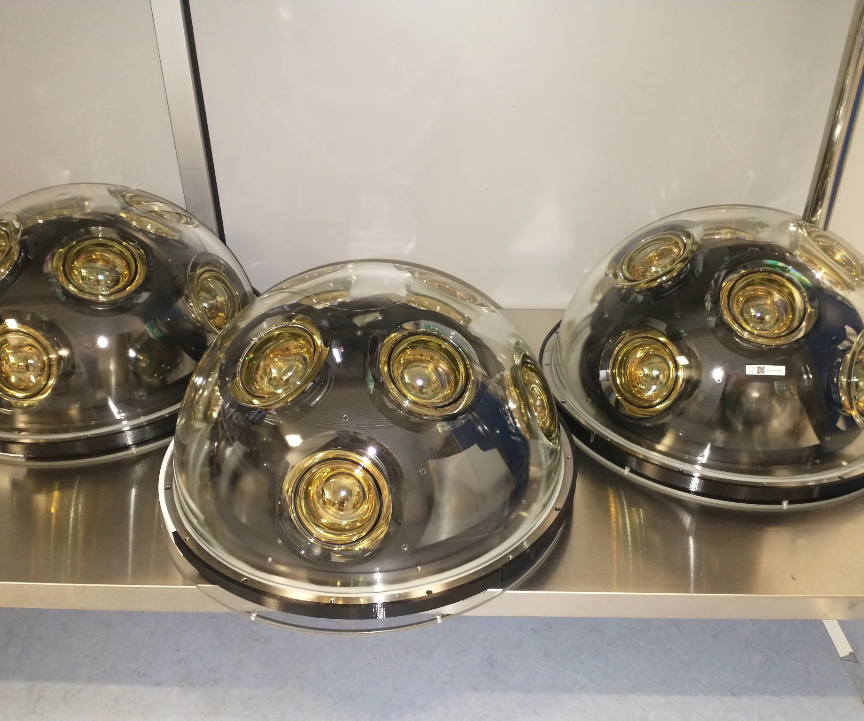
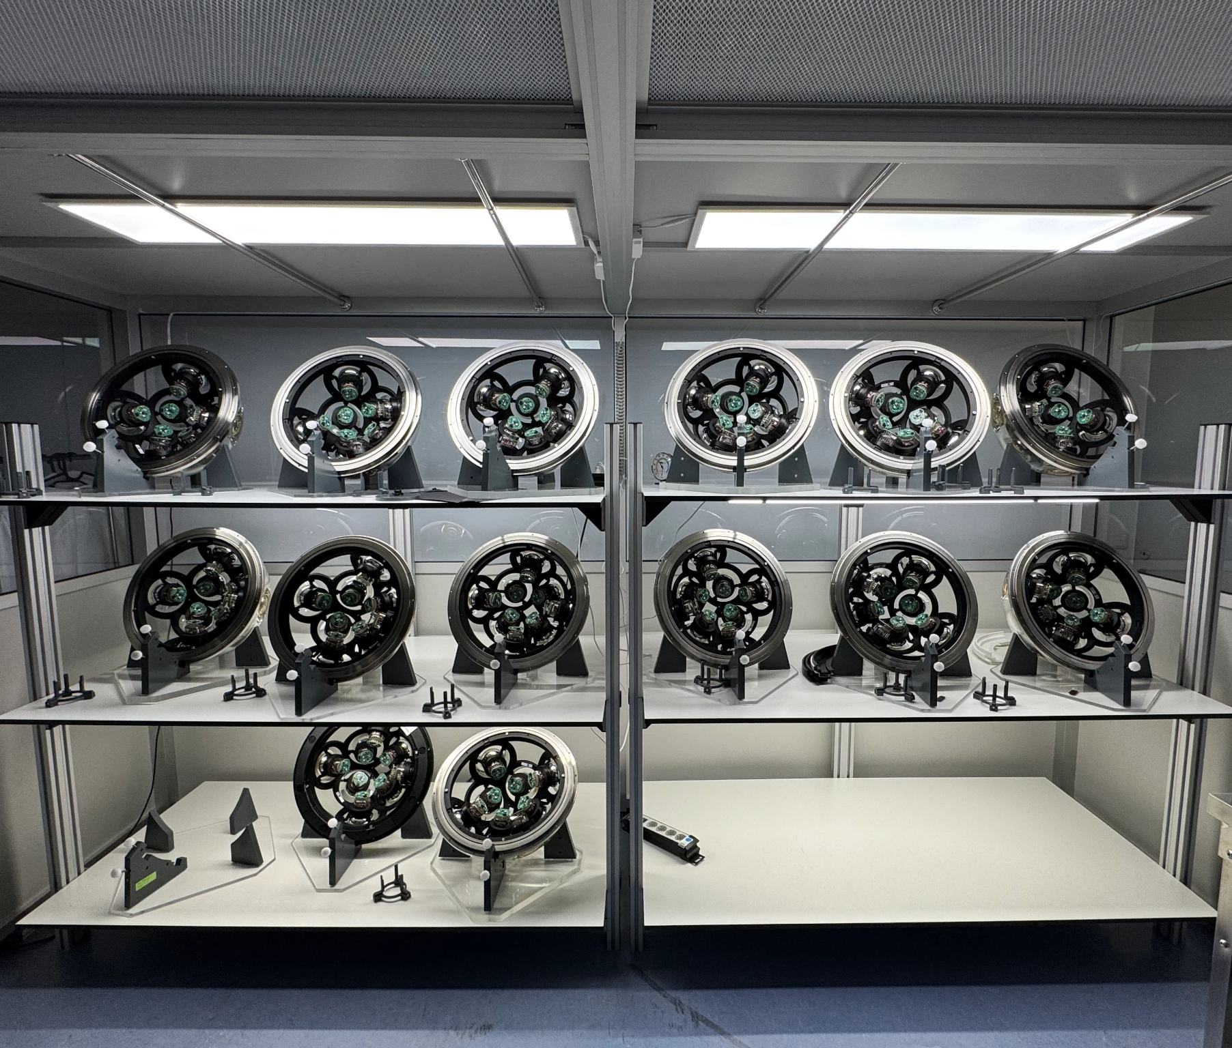
Status
P-ONE-1: P-OM Production
Photo Credits
Left: Lea Ginzkey
Right: Laura Winter
Completed P-OM optical hemispheres
P-OMs assembled for testing and line integration
ANNABELLE GRIMES
P-ONE Collaboration • ISCRA 2026
Notes:
P-ONE-1 has moved well beyond the conceptual stage.
Its optical modules have been produced and assembled at TUM through the work of Laura Winter and colleagues.
These photographs show the pressure-resistant hemispheres and several modules during assembly and testing.

Slide 21

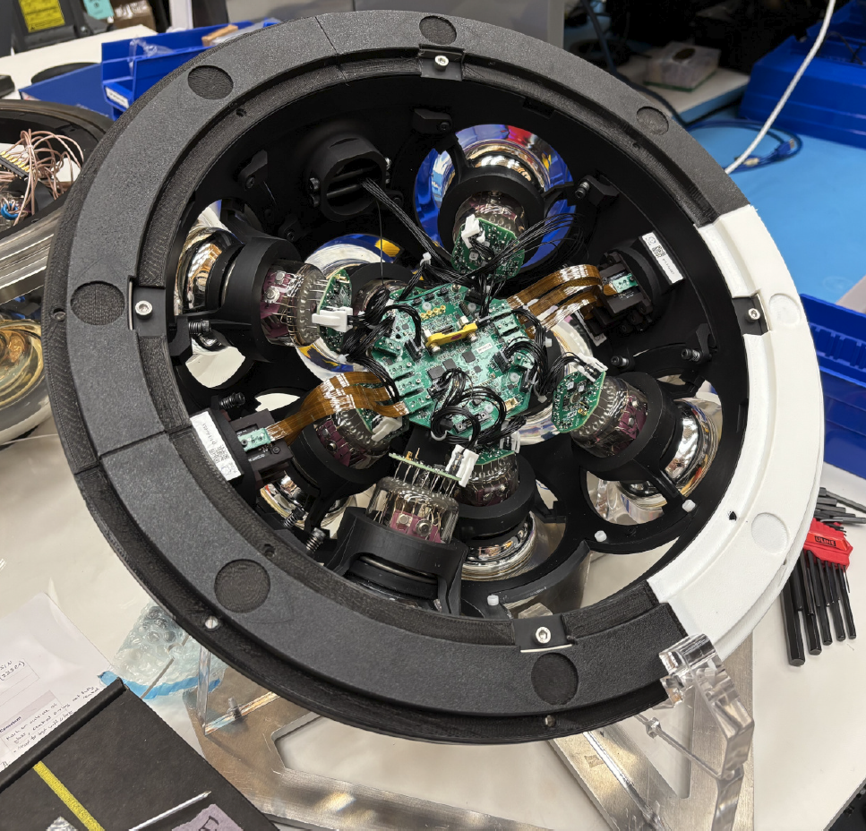
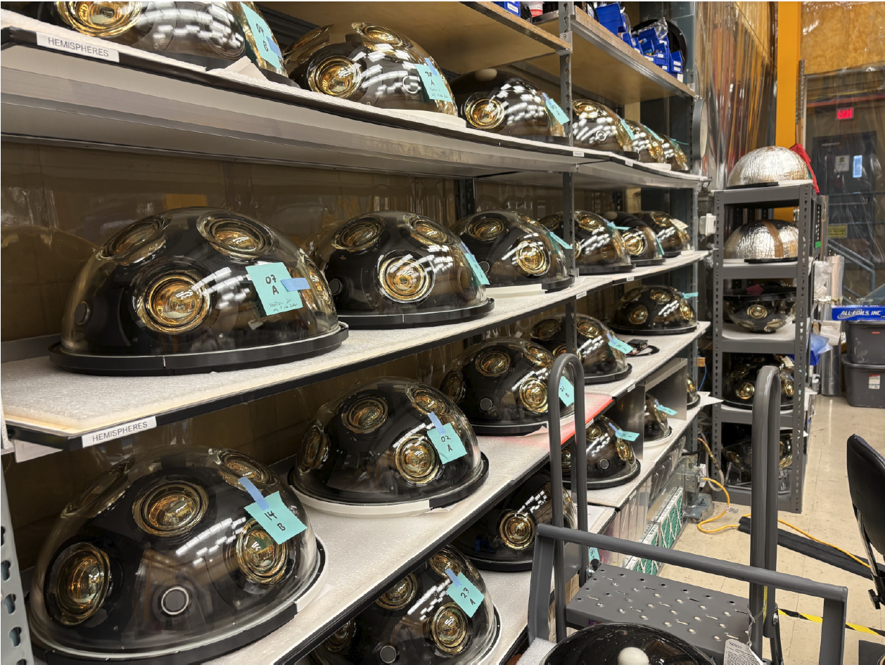
Status
P-ONE-1: Hemisphere Integration
Inside a P-OM
P-OMs awaiting integration
ANNABELLE GRIMES
P-ONE Collaboration • ISCRA 2026
Notes:
This slide shows the fully integrated P-OM hemispheres, completed at TRIUMF in Vancouver.
On the left, you can see the internal arrangement of the PMTs, electronics, and support structure.
On the right are multiple completed hemispheres awaiting final module integration, highlighting the scale of the production effort.

Slide 22
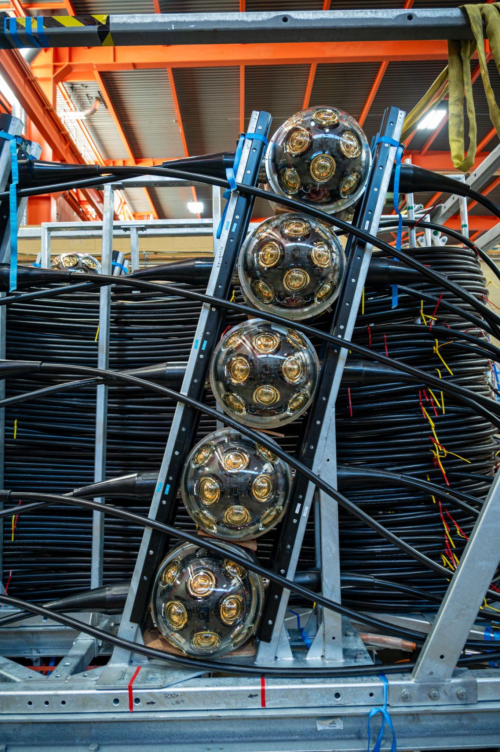
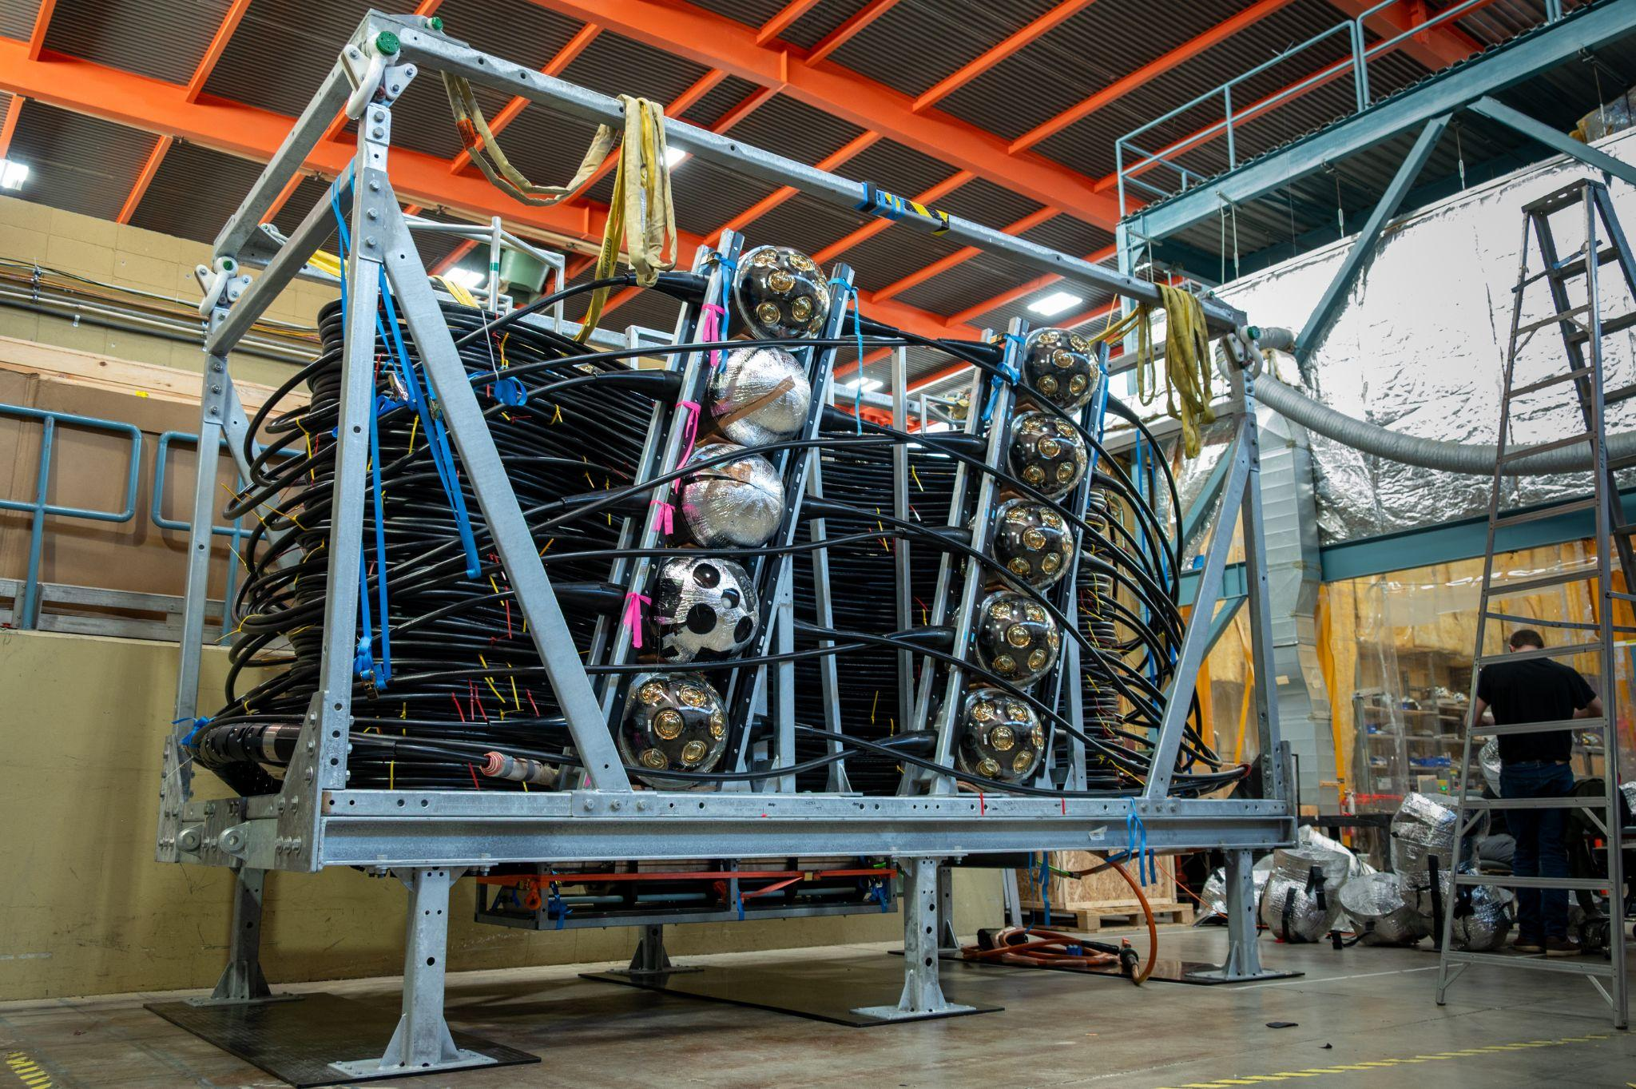
Photo Credit
Ben Nührenbörger
Status
P-ONE-1: Line Integration
Integrated P-OMs and cable
P-ONE-1 Deployment package
ANNABELLE GRIMES
P-ONE Collaboration • ISCRA 2026
Notes:
Following module production, the complete P-ONE-1 line was integrated onto its deployment frame.
The kilometre of cable is carefully arranged within the structure, while the optical modules are secured around the outside.
This frame must transport and protect the detector during handling, and then allow the string to be released in a controlled sequence during deployment on the ocean floor.

Slide 23
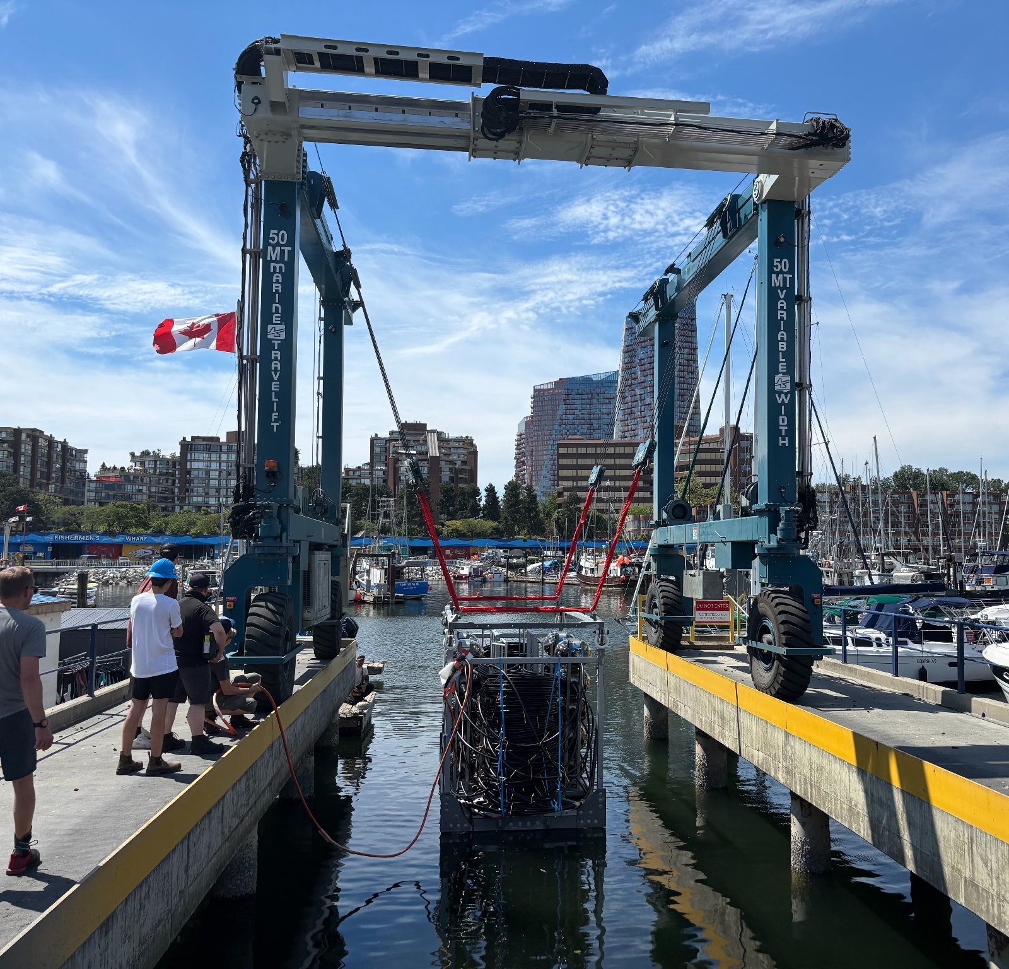
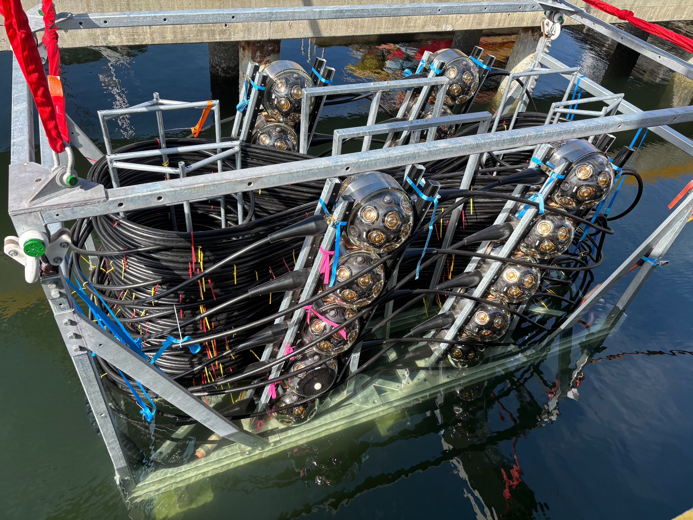
Photo Credit
Ben Nührenbörger
Status
P-ONE-1: Boatyard Wet Test
Boatyard wet-test deployment
P-ONE-1 during immersion testing
ANNABELLE GRIMES
P-ONE Collaboration • ISCRA 2026
Notes:
The integrated system was then lowered into the water for a boatyard wet test last month.
This was not the final deep-ocean deployment.
It was an opportunity to test the integrated structure in water, practise the handling procedures and identify problems while the system was still accessible.
For a detector that will ultimately operate 2.6 kilometres below the surface, this kind of staged testing is essential. Once it is deployed, physical access becomes extremely difficult and expensive.
That said, this test was a great success, and it’s all systems go.

Slide 24
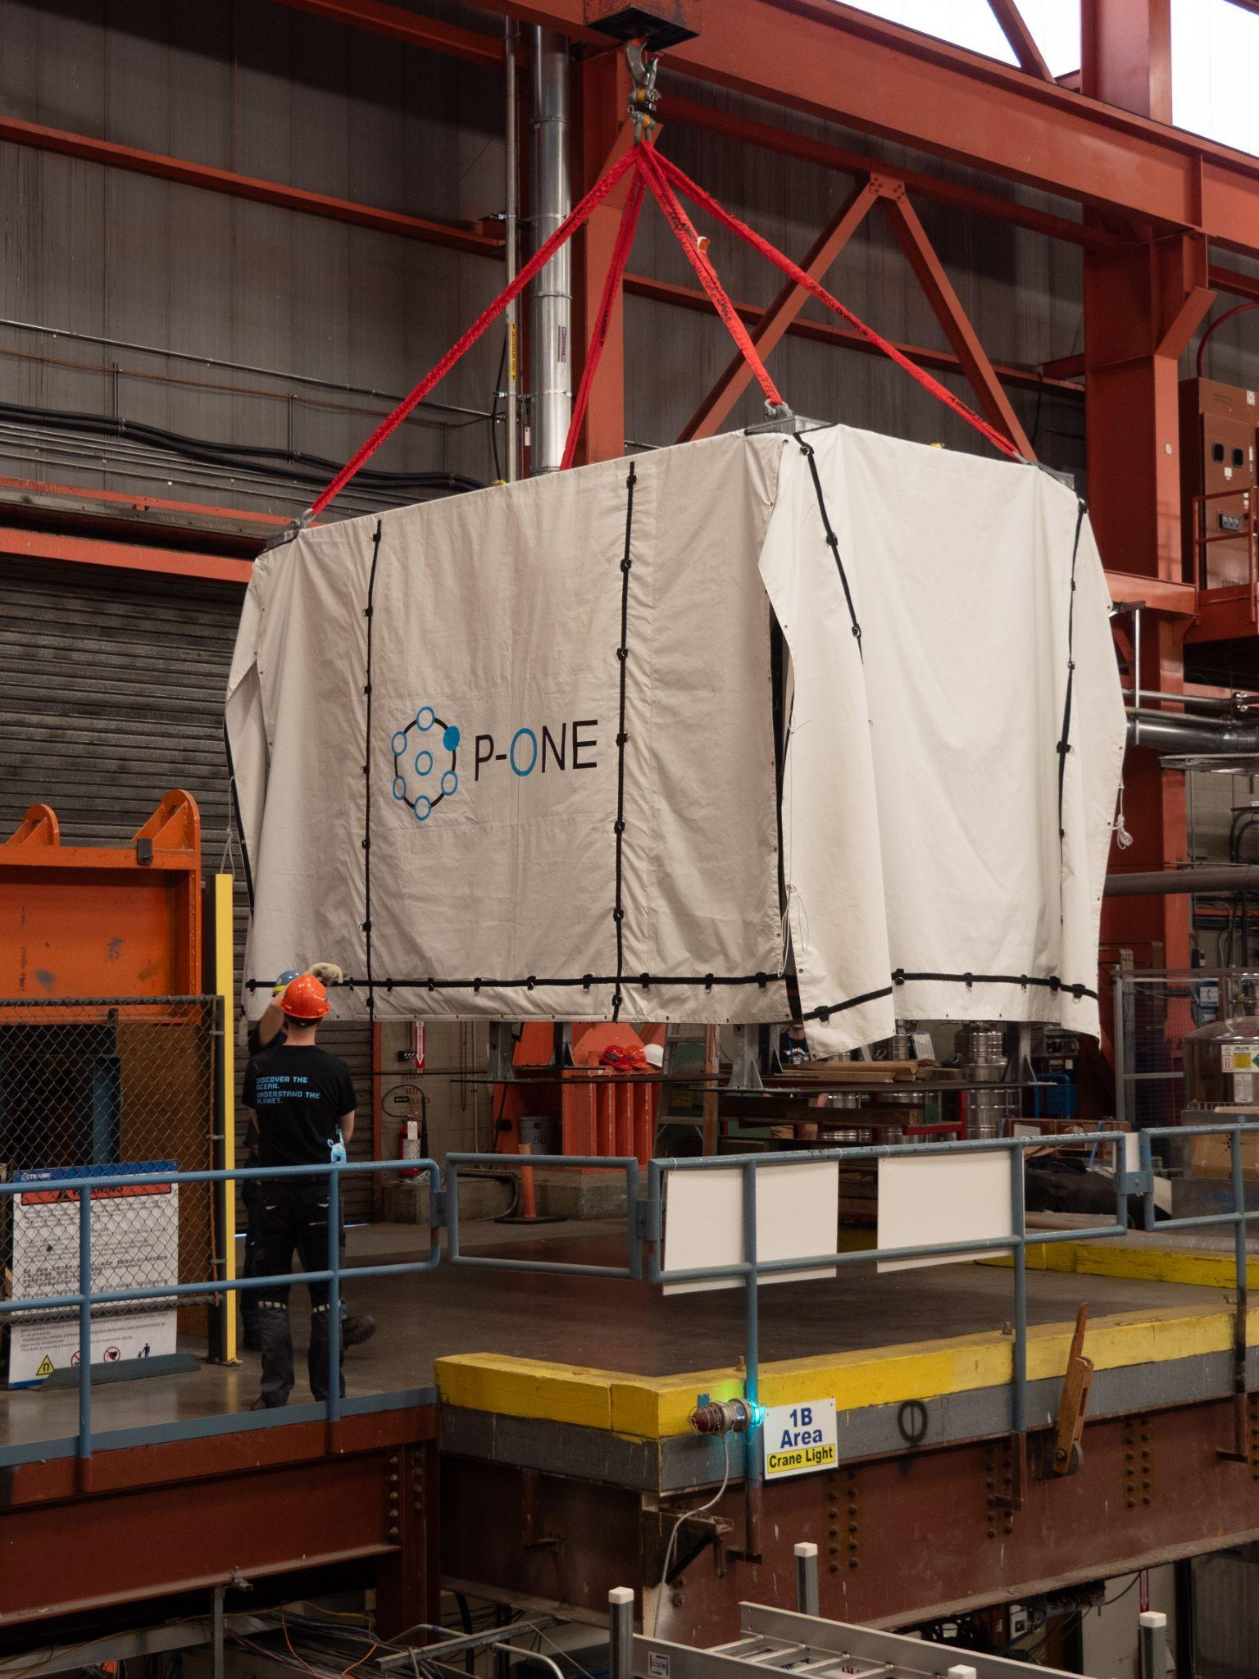
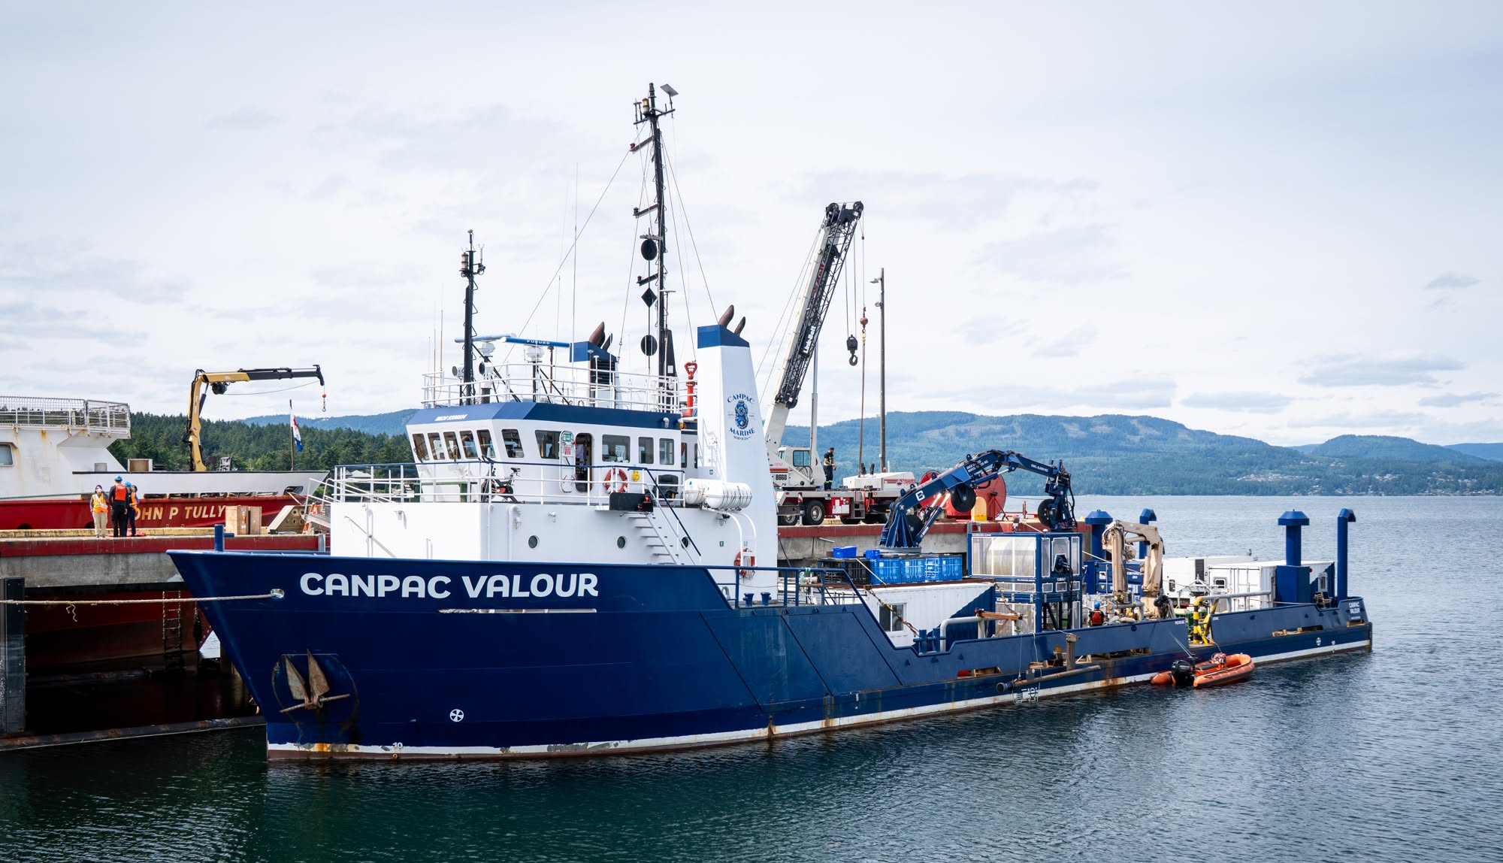

Status
P-ONE-1: Awaiting Deployment September 2026
Photo Credit:
Ben Nührenbörger
P-ONE shrouded
Deployment vessel for P-ONE-1: Canpac Valour
ANNABELLE GRIMES
P-ONE Collaboration • ISCRA 2026
Notes:
The next major milestone is the deployment of P-ONE-1, currently planned for September 2026 in partnership with Ocean Networks Canada.
P-ONE-1 will provide the first full-scale test of the string design,
the optical system,
the acoustic positioning system
and the connection to the existing subsea infrastructure.

Slide 25
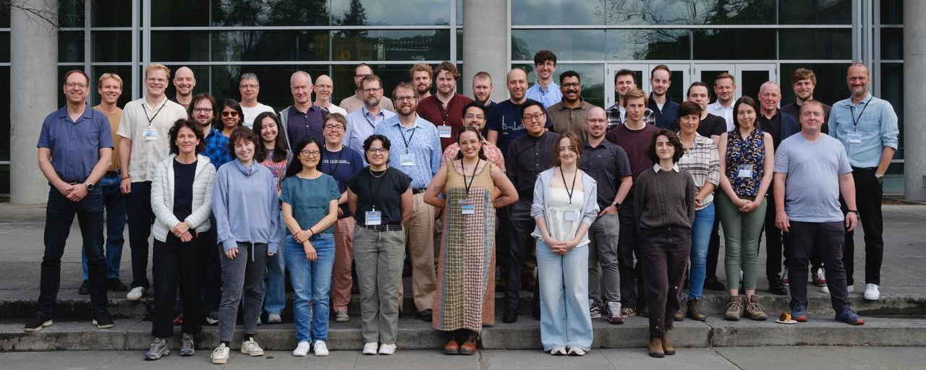

Thank You!
Notes:
To summarize:
P-ONE will add a major Pacific component to the global neutrino-telescope network;
its enormous flexible geometry makes acoustic positioning essential;
and the first full P-ONE string is now approaching deployment.
Thank you, and I’m happy to take any questions.

